Slide 1
Recitation 1.3
Atharva Kirkole
Thursday, Sep 17, 2026

Slide 2

Attendance!
Attendance for recitations is mandatory!

Slide 3
Important!
HW2 Checkoff was due 2 days ago.
Homework 2 is due 21st September
Apologies….
We figured out the problem and confusions will not repeat…
Project 1 beta: September 24
Project 1 final: October 1

Slide 4
Coding warm up & QA time
Notes:
Give them some time to work on their code, revise or keep going, ask me if you have question, make sure everyone’s on the same page before we move on
about 20 minutes on this: start at around 9am

Slide 5
Bit hacks
Notes:
not only a review, but also some hint on the optimization we’ll talk about later

Slide 6
Tips for Bit Manipulation
Use the appropriate literals
  A plain 1 is a 32-bit integer. 1 << 63 can give unexpected results.
  1ULL means 1 unsigned long long which is uint64_t
    00000000 00000000 00000000 00000000
    00000000 00000000 00000000 00000001
Never shift by more than the number of bits in the number
  ((uint64_t) i) >> 64 is undefined behavior (UB)
Never shift by a negative amount
  Also UB
Notes:
make sure the manipulation you’re doing and the data type you’re using matches each other

Slide 7
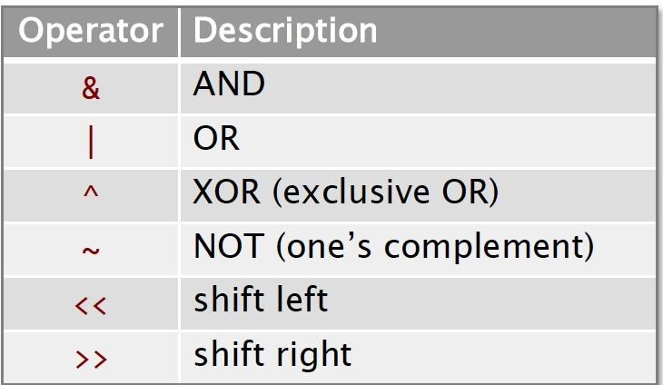
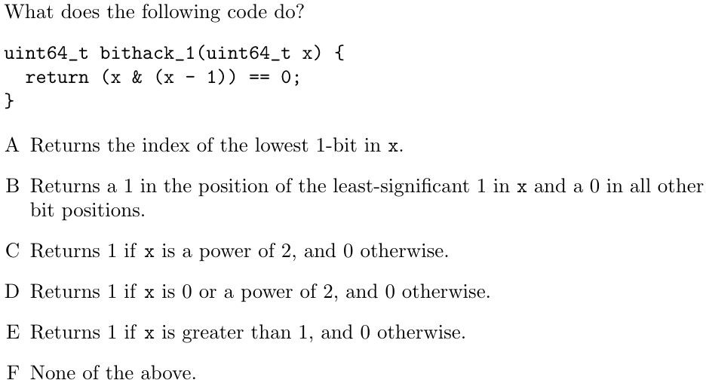
Practice Question
Notes:
answer is D

Slide 8
Why?
We know x -1 will find the first set bit on x, when scanning from the least significant bit and invert all bits till the found bit.
Ex: 11001000 – 1 = 11000111
Now, let the number be x= abcd100…
x – 1 = abcd011….
x & x -1 = abcd000…
The above number will be 0 if abcd are all 0.
Which means x must be of the form 00..010… (only 1 set bit)
Which represents all and only powers of 2 or 0

Slide 9
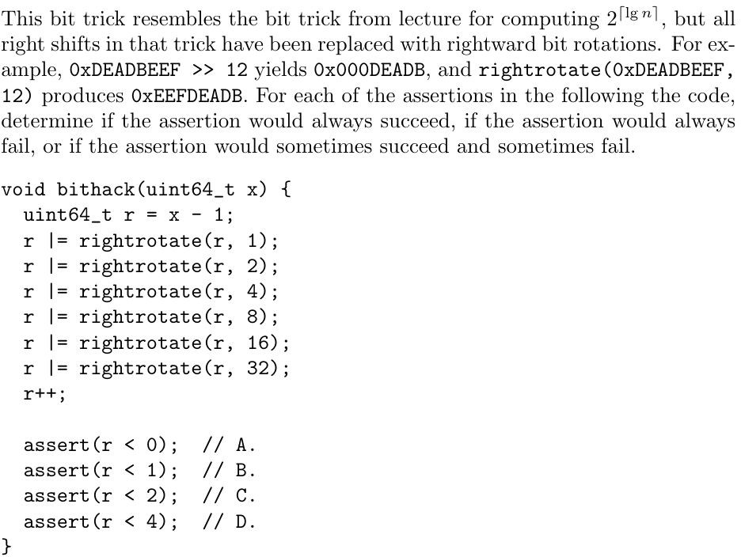
Practice Question

Slide 10
Practice Question
Trace: Take x = 2 => r =1
r = 100…01
r = 11100….01
r = 111111…001
.
.
r = 1111….1
r++ will result in 0
We can easily see that if any bit in x-1 is 1, then the final r will be 0.
Otherwise, the final r is 1.
So, it tests if x-1 is 0, that is if x is 1.
Notes:
if x = 1, x - 1 = 0, r = 0, r++ = 1
if x > 1 or x = 0, x - 1 includes 1 bits, r = 1, r++ = 0
so r will only be 1 or 0, never < 0, always < 2 and < 4

Slide 11
Practice Question
Trace: Take x = 2 => r =1
r = 100…01
r = 11100….01
r = 111111…001
.
.
r = 1111….1
r++ will result in 0
We can easily see that if any bit in x-1 is 1, then r is 0.
Otherwise, r is 1
So, it tests if x-1 is 0, that is if x is 1.
A – Never
B – Sometimes
C – True
D - True
Notes:
A. Never
B. Sometimes
C. True
D. Always pass
Checks if x == 1
X = 0: return 0
X = 1: return 1
X >= 2 return 0

Slide 12
Project 1: continue

Slide 13
Row-column-row algorithm
An algorithm for rotating block of bits
Basic idea:
  rotate row r left by r + 1
  rotate column c down by c + 1
  rotate row r left by r

Slide 14
Row-column-row algorithm
An algorithm for rotating block of bits
Basic idea:
  rotate row r left by r + 1
  rotate column c down by c + 1
  rotate row r left by r
 | 0 | 1 | 2 | 3
0 | M | I | E | A
1 | N | J | F | B
2 | O | K | G | C
3 | P | L | H | D
 | 0 | 1 | 2 | 3
0 | A | B | C | D
1 | E | F | G | H
2 | I | J | K | L
3 | M | N | O | P
Notes:
what do you think of this algorithm? better? worse? why?
faster, as we’re not doing by bits, but working with rows and columns, which is many bits at a time

Slide 15
How to implement row rotation?

Slide 16
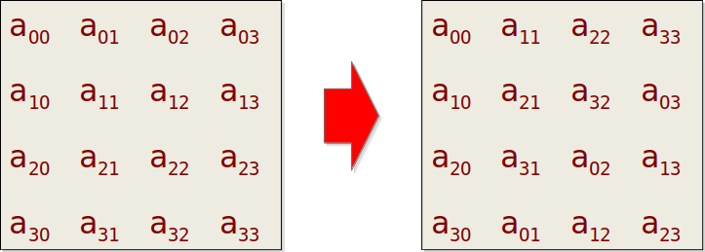
How to implement column rotation?
Input: N × N matrix of bits, stored in row-major order.
Goal: Circularly rotate ith column of bits up i rows.
In the example that follows, we have N = 32. Each row is stored in a 32-bit word, with column 0 in the most-significant bit.
Notes:
endianess! most significant bit first!

Slide 17
Naive approach
const uint32_t N = 32;
const uint32_t mask = 1 << (N-1);
uint32_t A[N];
for (int i = O; i < N; i++){
uint32_t col = O;
// gather bits in column i
for (int j = O; j < N; j++)
col = col | (((A[j] << i) & mask) >> j);
// rotate bits in column i
col = (col << i) | (col >> (N - i));
// put column i back
for (int j = O; j < N; j++)
A[j] = (A[j] & ~(mask >> i)) |
(((col << j) >> i) & (mask >> i));
}

Slide 18
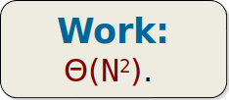
Naive approach
const uint32_t N = 32;
const uint32_t mask = 1 << (N-1);
uint32_t A[N];
for (int i = O; i < N; i++){
uint32_t col = O;
// gather bits in column i
for (int j = O; j < N; j++)
col = col | (((A[j] << i) & mask) >> j);
// rotate bits in column i
col = (col << i) | (col >> (N - i));
// put column i back
for (int j = O; j < N; j++)
A[j] = (A[j] & ~(mask >> i)) |
(((col << j) >> i) & (mask >> i));
}
Notes:
for column rotation, we need N^2 time using the naive approach
apparently this is quite slow, if the matrix goes very large, then the time cost goes super expensive
how can we do better? (hint: we just review bit hacks, we can use bit mask to extract part of the row/column)

Slide 19
Divide-and-Conquer approach
 | 0 | 1 | 2 | 3
0 | A | B | C | D
1 | E | F | G | H
2 | I | J | K | L
3 | M | N | O | P

Slide 20
Divide-and-Conquer approach for STEP 2
Example matrix we will demostrate
Actual matrix we have AFTER step 1(rotating row r by r+1)
 | 0 | 1 | 2 | 3
0 | A | B | C | D
1 | E | F | G | H
2 | I | J | K | L
3 | M | N | O | P
 | 0 | 1 | 2 | 3
0 | B | C | D | A
1 | G | H | E | F
2 | L | I | J | K
3 | M | N | O | P
Rotate columns 2 & 3 down by 2, same as rotate up by 2

Slide 21
Divide-and-Conquer approach
 | 0 | 1 | 2 | 3
0 | A | B | K | L
1 | E | F | O | P
2 | I | J | C | D
3 | M | N | G | H
Rotate columns 2 & 3 down by 2, same as rotate up by 2

Slide 22
Divide-and-Conquer approach
 | 0 | 1 | 2 | 3
0 | A | B | K | L
1 | E | F | O | P
2 | I | J | C | D
3 | M | N | G | H
Rotate columns 1 & 3 down by 1, same as rotate up by 3

Slide 23
Divide-and-Conquer approach
 | 0 | 1 | 2 | 3
0 | A | N | K | H
1 | E | B | O | L
2 | I | F | C | P
3 | M | J | G | D
Rotate columns 1 & 3 down by 1, same as rotate up by 3

Slide 24
Divide-and-Conquer approach
 | 0 | 1 | 2 | 3
0 | A | N | K | H
1 | E | B | O | L
2 | I | F | C | P
3 | M | J | G | D
Rotate all columns down by 1, same as rotate up by 3

Slide 25
Divide-and-Conquer approach
 | 0 | 1 | 2 | 3
0 | M | J | G | D
1 | A | N | K | H
2 | E | B | O | L
3 | I | F | C | P
Rotate all columns down by 1, same as rotate up by 3

Slide 26
Divide-and-Conquer approach
 | 0 | 1 | 2 | 3
0 | A | B | C | D
1 | E | F | G | H
2 | I | J | K | L
3 | M | N | O | P
 | 0 | 1 | 2 | 3
0 | M | J | G | D
1 | A | N | K | H
2 | E | B | O | L
3 | I | F | C | P
Result: rotate all columns c down by c + 1, same as rotate up by N - (c + 1)

Slide 27
Full steps
32-bit matrix example

Slide 28
Divide-and-conquer approach
uint32_t A[32], B[32]; // use B as scratch space
// rotate columns 16...31 down 16 positions
uint32_t stay_mask = 0xFFFF0000; // columns that don't move
for (int j = 0; j < 32; j++)
B[j] = (A[j] & stay_mask) | (A[(j-16+32) % 32] & ~stay_mask);
// rotate columns 8..15 and 24...31 down 8 positions
stay_mask = 0xFF00FF00;
for (int j = 0; j < 32; j++)
A[j] = (B[j] & stay_mask) | (B[(j-8+32) % 32] & ~stay_mask);
Notes:
remember, you can do rotate up or down as long as the index is handled carefully
there’re a lot of things you can optimize in the above example
How much work is this one?

Slide 29

Divide-and-conquer approach
uint32_t A[32], B[32]; // A and B are 2 row buffers for a Ping Pong system
// rotate columns 16...31 down 16 positions
uint32_t stay_mask = 0xFFFF0000; // columns that don't move
for (int j = 0; j < 32; j++)
B[j] = (A[j] & stay_mask) | (A[(j-16+32) % 32] & ~stay_mask);
// | acts as the joining of 2 halves
// A[(j-16+32) % 32 is the second half we need filled
// rotate columns 8..15 and 24...31 down 8 positions
stay_mask = 0xFF00FF00;
for (int j = 0; j < 32; j++)
A[j] = (B[j] & stay_mask) | (B[(j-8+32) % 32] & ~stay_mask);
Notes:
But sometimes the asymptotically best algorithms don’t perform well in practice. You must decide for yourself.

Slide 30
Coding time!

Slide 31
6 recitations for project 1
4-way rotation
introduction to rcr, image walkthrough, naive col rotation
bit hacks review, divide-and-conquer using bit masks (find the excel table)
vectorization, built-in intrinsics (after beta submission)
the queen’s problem using bit hacks (homework 4)
tiling, prefetching, performance gap table: technique, tier, engineering time estimation

