Slide 1
Recitation 2.3
Atharva Kirkole
Tuesday, November 4, 2025

Slide 2

Attendance!
Be prepared to work with your teammate!

Slide 3
Some due dates
HW 4 due 19th Oct
QUIZ 1 22nd Oct
Notes:
Today: cover some memory management technique, this may or may not be helpful to your implementation, but feel free to apply them when you see fit in any of the project.

Slide 4
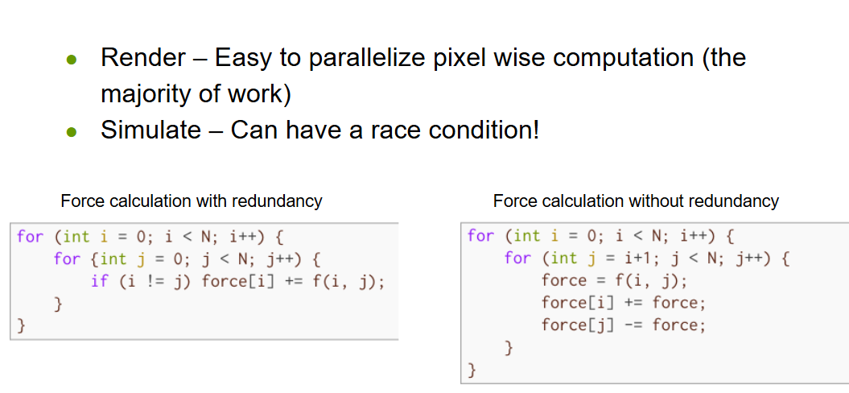
Parallelization

Slide 5
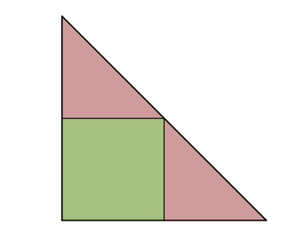
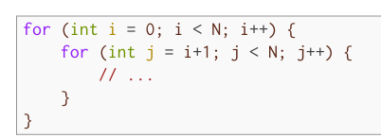
Iteration space of
:
Triangles can be run in parallel. Rectangle should be run before/after the triangles.

Slide 6
Guidelines
Tier for Guaranteed B in Beta : 47
Your code must match the behavior of the original code exactly!
  Beware of the lack of floating point associativity!
  No -ffast-math
No determinacy races (including benign races)
  Cilksan should report no races
Intrinsics for atomic operations and locks are not allowed
  Ex. the compare-and-swap intrinsic

Slide 7
Malloc and Free

Slide 8
Malloc, Free, and Realloc
void* addr = malloc(size_t size)
Allocates a chunk of memory of size size
void free(void* addr)
Frees the allocated chunk of memory starting at addr
Notes:
When you allocate memory dynamically (new or malloc), the system gives you a chunk from the heap.
When you free it (delete or free), that memory is returned to the heap allocator.
However, in performance-critical programs (e.g., games, embedded systems, or allocators), constantly allocating and freeing small objects is slow.
To solve this, we maintain our own "free list" — a linked list of previously freed memory blocks that can be quickly reused.

Slide 9
Free Lists

Slide 10
Free Lists
Can implement as a singly linked list
Keeps track of deallocated memory
Allows us to reuse memory
Most memory allocators use a freelist of some sort
Notes:
A free list is typically a singly linked list of memory blocks:
When you free an object, you don’t return it to the system — you add it to the free list.
When you allocate, you first check if the free list has a node available.
If yes → reuse that memory.
If not → allocate a new block from the heap.

Slide 11
Allocating Memory w/ Free Lists (fixed size blocks)

Slide 12
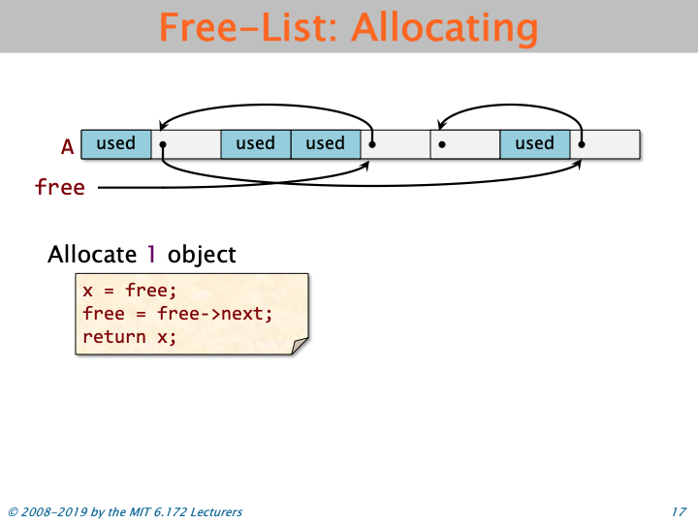
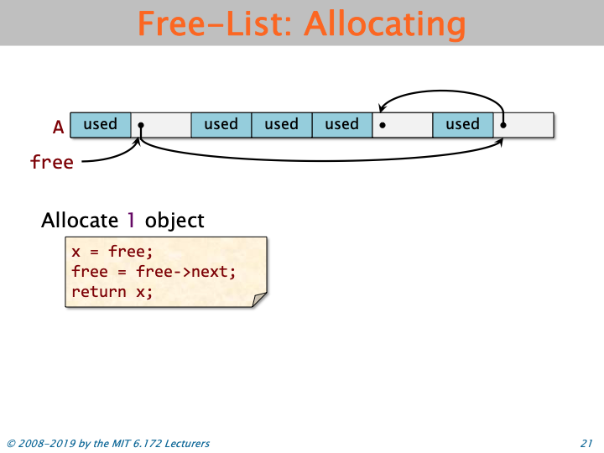
Before:
After:
Notes:
Free points to the next block we want to allocate

Slide 13
Notes:
Free points to the next block we want to allocate

Slide 14
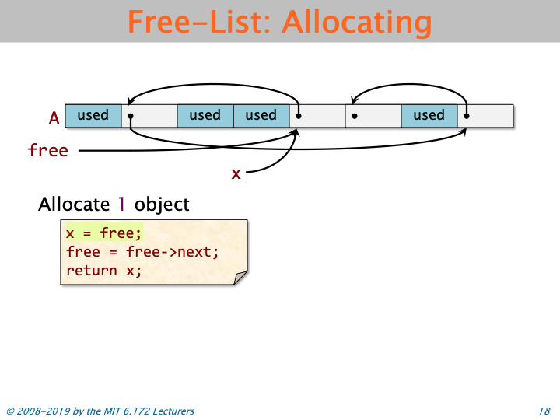

Slide 15
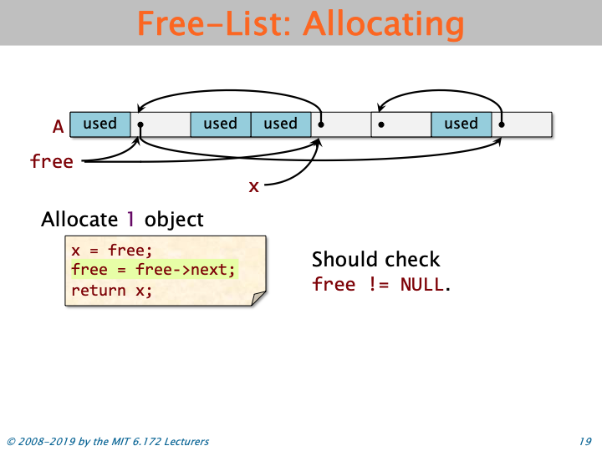

Slide 18
Freeing Memory w/ Free Lists (fixed size blocks)

Slide 19
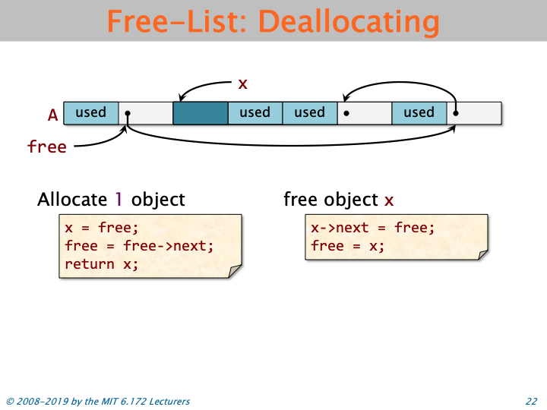
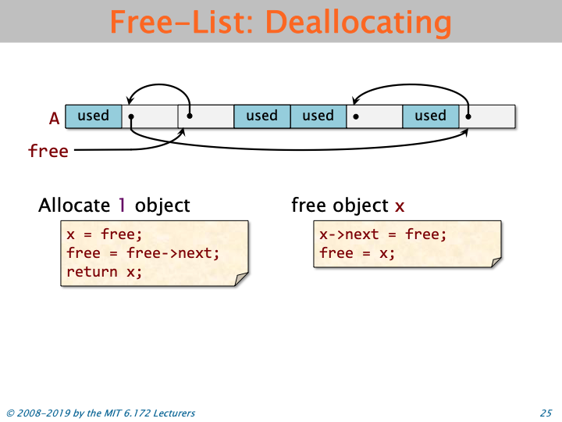
Before:
After:

Slide 21
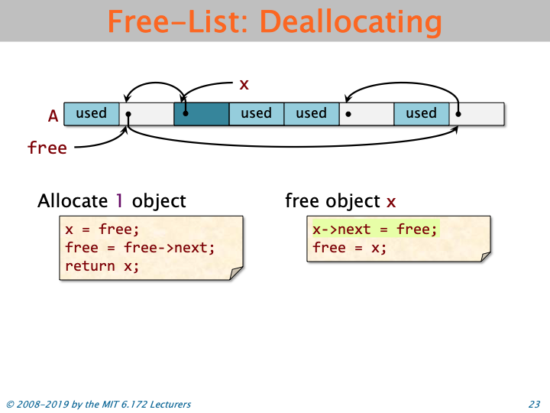

Slide 22
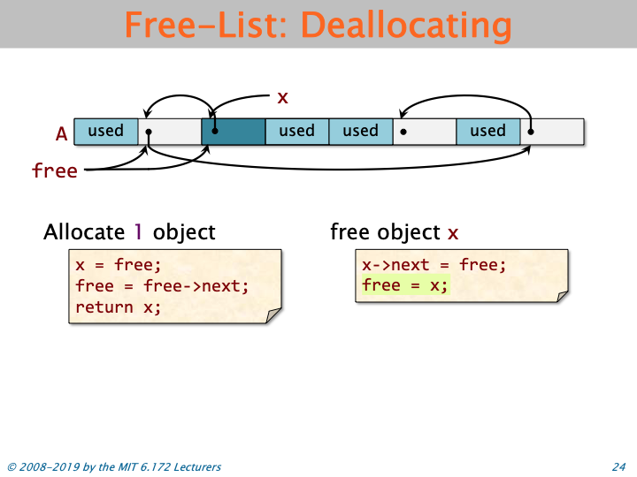

Slide 24
What does a freed block look like?
addr
ptr to next
Unused data
Freelist node struct
*Need to make sure Freelist node struct is smaller than the size of the block
Notes:
example: allocate a 100 bytes block, then deallocate it, now we need to add it to the free list
the first part of the block will be updated to be a free list node, eg: a ptr to the next node in the free list
free list node struct < total block size, otherwise we can’t fit the free list node struct into the block, and can’t add it to the free list
if node struct > block size: risk of memory corrupt as we might write the node out of the block space

Slide 25
Binned Free Lists

Slide 26
Binned Free Lists
Allocate chunks of memory at specific sizes
(i.e. round up user’s requested size to the next power of 2)
Maintain free lists for these different sizes
Need to keep track of chunk sizes
The user will only give us the pointer, not the size!
Store this information in headers.
addr
size
size
header
actual memory the user receives
Notes:
A binned free list is a memory allocator design that organizes free memory blocks into multiple “bins” (or “buckets”), each dedicated to a specific block size range.
Instead of having one global free list for all freed blocks (which would mix sizes),
we maintain separate free lists, one for each block size class.
So you can think of it like this:
Bin[0] → free list for 16-byte blocks
Bin[1] → free list for 32-byte blocks
Bin[2] → free list for 64-byte blocks
Bin[3] → free list for 128-byte blocks
...

Slide 27
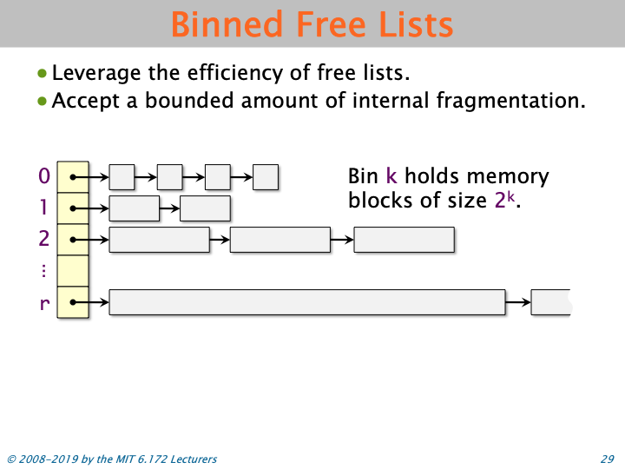
Notes:
🚀 Benefits
✅ Fast allocation/deallocation
O(1) for most operations — just push/pop from a linked list.
✅ Reduced fragmentation
Blocks are reused within the same size bin.
✅ Predictable behavior
Each bin size guarantees enough room for future allocations of that size.
⚠️ Trade-offs
❌ Wasted space (internal fragmentation)
A 33-byte request uses a 64-byte block.
❌ More metadata
You need to track multiple free lists and bin sizes.
❌ Complexity
Bin size selection and memory coalescing (for larger blocks) can get tricky.

Slide 28
Fragmentation

Slide 29
What is fragmentation?
Memory is broken apart into many pieces
Even if you have X amount of memory available, if it’s not contiguous, you can’t allocate it as a chunk of memory of size X.
vs
Notes:
Fragmentation happens when free memory is split into small, non-contiguous pieces, making it hard to reuse efficiently, even if the total free memory is large.

Slide 30
Types of Fragmentation
External fragmentation:
Blocks are scattered across virtual memory, making remaining memory non-contiguous (previous slide)
Internal fragmentation:
The difference in how much memory the user requested and how much we actually allocated (i.e. due to headers)
addr
user requested
unused

Slide 31
Strategies for Mitigating Fragmentation
Splitting : dividing a large free block into smaller pieces, depending on how much memory the user requested
(allows you to “fill in” large gaps of free memory in your heap)
Coalescing : merging together adjacent free blocks into a single, large free block
Notes:
two ways to handle fragmentation during using free list

Slide 32
Coding time!

