Slide 1
Welcome Everyone
Hope all of you enjoy our project

Slide 2
FORUM FOR
OUR
SPECIAL CHILD

Slide 3
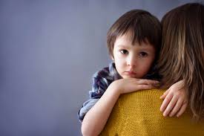
Who use this application
Special Child and their parents
Doctors, Physiatrist, Therapist.
Donor Team, NGOs.
Autism Schools
Volunteers

Slide 4
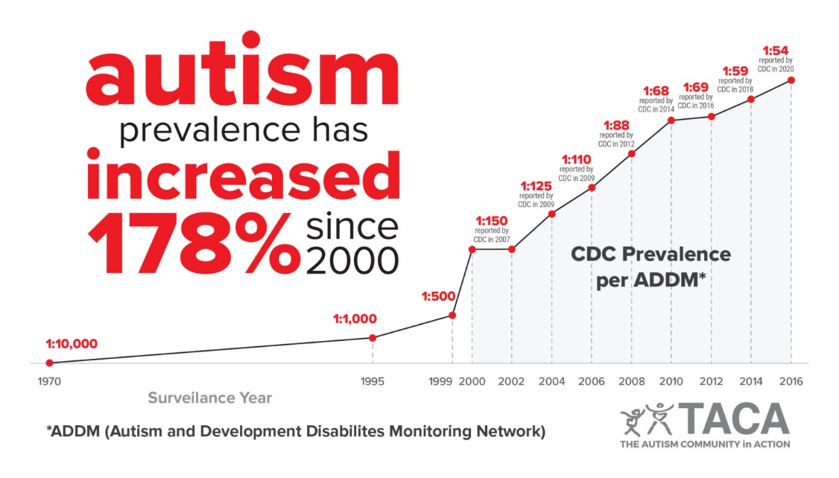
Why people use this application
1% in 1.5 lakh peoples are autistic and Male female ratio is 4:1
‘ Finding Doctor, School,
Donation Problem’

Slide 5

Features of This Application
Special child list
School list
Doctor List
Donor team, NGO name
Volunteer list
Achievement of special child details
Share their skills with others
Child can change his account privacy

Slide 6
Using Process of This Application
After entering this application people can create his account as a special child( if parents wants to hide their profile from other parents they can also do it), ministrant, donor, volunteer. And creating account people enter the home page and they can choose their desire option like finding school, finding doctor. Volunteer can create an event with all special child, arrange a picnic. Sometimes many NGOs foreign donor team cannot find the special child. They can find special child easily using this

Slide 7
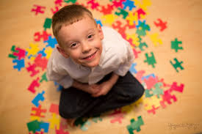
Advantages of this application
Special child can create their community.
They can arrange a picnic about them.
Parents can find easily doctor and school.
Donor can easily Donte their donation among the special child, special child school, special child club.
Volunteer can arrange many event so that the special child can communicate with one another and its help to overcome their communication problems.

Slide 8
Thank You Everyone
Presented by (Group 8) :
1. Saha, Shobhan Kuman(19-40911-2)
2. Paul, Durlov(19-39950-1)
3. Hossain, Abir(19-40907-2)
4. Esha, Nura Solahin(19-39767-1)
Presented to:
Dr Razib Hayat Khan Sir
Assistant Professor , CS
American International University - Bangladesh

