Slide 1
Java Full Stack Development & Mobile Development
- Veeresh Bushetti
- Avinash Chandra

Slide 2
Agenda
Topic Name | Topic Description | Duration (mins)
Introduction | Introduction to Java Full stack development | 30
Java fullstack development | Java fullstack development using Springboot, Angular and Mongodb | 45
Web security | How to develop a secure application | 15
Tea Break |  | 15
Introduction to mobile development | Introduction to mobile development Android, iOS, Hybrid (React Native, Cordova), IBM Mobile First and sample application development | 30
Hands-on session | Lab 1 : Develop application with Android Lab2 : Develop application with iOS Lab 3 : Develop application with React Native | 45
Deployment of mobile application and trends in market | convert the application developed inLab 3 to a mobile application, Deploy the application to PlayStore, AppStore, Which technologies are trending in market. | 60

Slide 3
History of Java
James Gosling, Mike Sheridan, and Patrick Naughton initiated the Java language project in June 1991. The small team of sun engineers called Green Team.
Originally designed for small, embedded systems in electronic appliances like set-top boxes.
Firstly, it was called "Greentalk" by James Gosling, and file extension was .gt. After that, it was called Oak and was developed as a part of the Green project.
Why Oak? Oak is a symbol of strength and chosen as a national tree of many countries like U.S.A., France, Germany, Romania, etc.
In 1995, Oak was renamed as "Java" because it was already a trademark by Oak Technologies.
Why had they chosen java name for java language? The team gathered to choose a new name. The suggested words were "dynamic", "revolutionary", "Silk", "jolt", "DNA", etc. They wanted something that reflected the essence of the technology: revolutionary, dynamic, lively, cool, unique, and easy to spell and fun to say.
According to James Gosling, "Java was one of the top choices along with Silk". Since Java was so unique, most of the team members preferred Java than other names.
Java is an island of Indonesia where first coffee was produced (called java coffee).
Java is just a name, not an acronym.

Slide 4
JDK Versions
JDK Alpha and Beta (1995)
JDK 1.0 (January 23, 1996)
JDK 1.1 (February 19, 1997)
J2SE 1.2 (December 8, 1998)
J2SE 1.3 (May 8, 2000)
J2SE 1.4 (February 6, 2002)
J2SE 5.0 (September 30, 2004)
Java SE 6 (December 11, 2006)
Java SE 7 (July 28, 2011)
Java SE 8 (March 18, 2014)
Java SE 9 (September 21, 2017)
Java SE 10 (March, 20, 2018)
Java SE 11 - Open for Bug fix

Slide 5
JDK Editions
Java Standard Edition (J2SE)
Also known as Core Java, this is the most basic and standard version of Java.It’s the purest form of Java, a basic foundation for all other editions.
It consists of a wide variety of general purpose API’s (like java.lang, java.util) as well as many special purpose APIs
J2SE is mainly used to create applications for Desktop environment.
Java Enterprise Edition (J2EE)
The Enterprise version of Java has a much larger usage of Java, like development of web services, networking, server side scripting and other various web based applications.
J2EE is a community driven edition, i.e. there is a lot of continuous contributions from industry experts, Java developers and other open source organizations.
J2EE uses many components of J2SE, as well as, has many new features of it’s own like Servlets, JavaBeans, Java Message Services, adding a whole new functionalities to the language.
J2EE uses HTML, CSS, JavaScript etc., so as to create web pages and web services. It’s also one of the most widely accepted web development standard.
Java Micro Edition (J2ME).
This version of Java is mainly concentrated for the applications running on embedded systems, mobiles and small devices.(which was a constraint before it’s development)
Also, the J2ME apps help in using web compression technologies, which in turn, reduce network usage, and hence cheap internet accessibility.

Slide 6
Characteristics of Java
Java is simple - The Java programming language is easy to learn. Java code is easy to read and write.
Java is object-oriented - Java is a fully object-oriented programming language. It has all OOP features such as abstraction, encapsulation, inheritance and polymorphism.
Java is robust - With automatic garbage collection and simple memory management model (no pointers like C/C++), plus language features like generics, try-with-resources,… Java guides programmer toward reliable programming habits for creating highly reliable applications.
Java is secure - The Java platform is designed with security features built into the language and runtime system such as static type-checking at compile time and runtime checking (security manager), which let you creating applications that can’t be invaded from outside.
Java is architecture-neutral - Java is architecture neutral because there are no implementation dependent features, for example, the size of primitive types is fixed. In C programming, int data type occupies 2 bytes of memory for 32-bit architecture and 4 bytes of memory for 64-bit architecture. However, it occupies 4 bytes of memory for both 32 and 64-bit architectures in Java.
Java is portable - Java is portable because it facilitates you to carry the Java bytecode to any platform. It doesn't require any implementation.
Java’s performance - Java code is compiled into bytecode which is highly optimized by the Java compiler, so that the Java virtual machine (JVM) can execute Java applications at full speed. In addition, compute-intensive code can be re-written in native code and interfaced with Java platform via Java Native Interface (JNI) thus improve the performance.
Java is multithreaded - The Java platform is designed with multithreading capabilities built into the language. That means you can build applications with many concurrent threads of activity, resulting in highly interactive and responsive applications.
Java is dynamic - Java is a dynamic language. It supports dynamic loading of classes. It means classes are loaded on demand. It also supports functions from its native languages, i.e., C and C++.

Slide 7
OOP Concepts in Java
Abstraction. Abstraction means using simple things to represent complexity. We all know how to turn the TV on, but we don’t need to know how it works in order to enjoy it. In Java, abstraction means simple things like objects, classes, and variables represent more complex underlying code and data. This is important because it lets avoid repeating the same work multiple times.
Encapsulation. This is the practice of keeping fields within a class private, then providing access to them via public methods. It’s a protective barrier that keeps the data and code safe within the class itself. This way, we can re-use objects like code components or variables without allowing open access to the data system-wide.
Inheritance. This is a special feature of Object Oriented Programming in Java. It lets programmers create new classes that share some of the attributes of existing classes. This lets us build on previous work without reinventing the wheel.
Polymorphism. This Java OOP concept lets programmers use the same word to mean different things in different contexts. One form of polymorphism in Java is method overloading. That’s when different meanings are implied by the code itself. The other form is method overriding. That’s when the different meanings are implied by the values of the supplied variables. See more on this below.

Slide 8
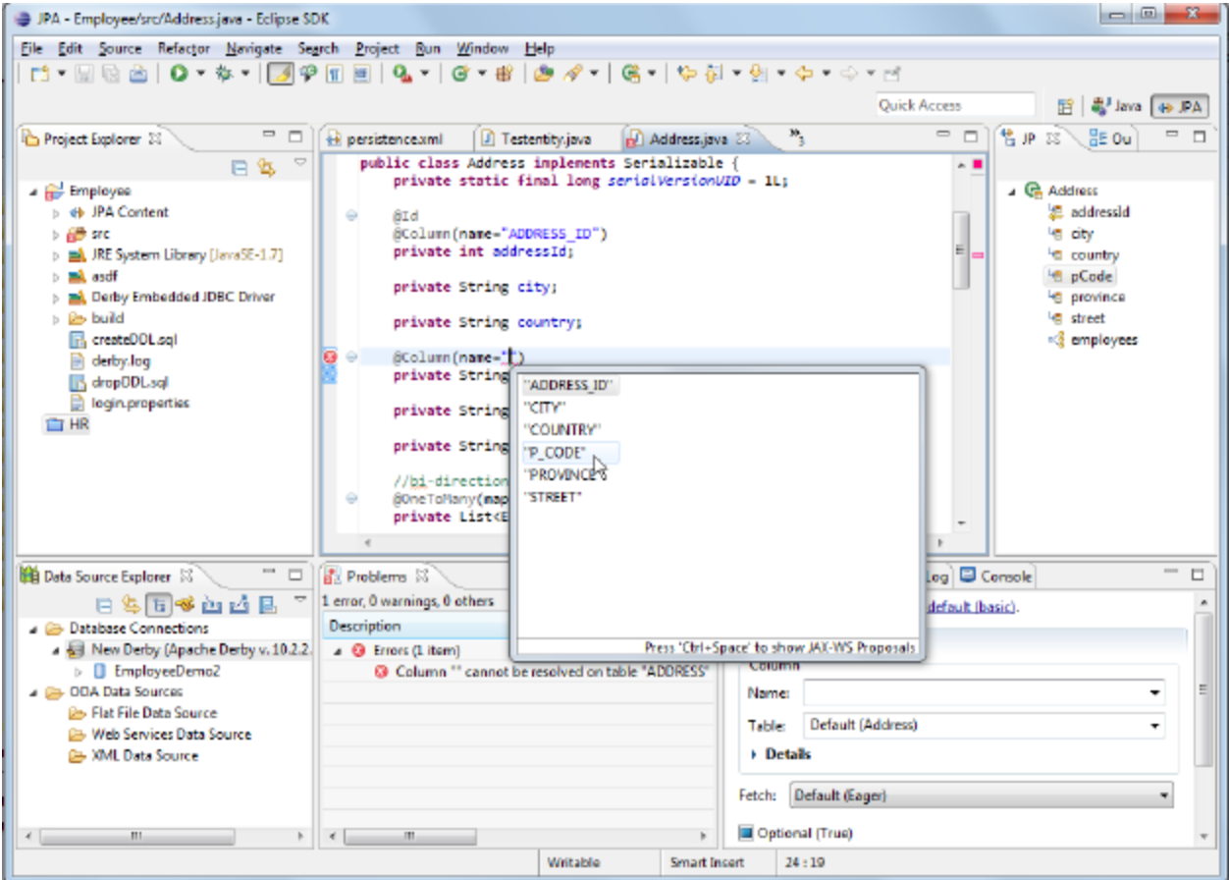
Java IDE Tools
Eclipse
Netbeans
IntellJ

Slide 9
Getting Started with Java Programming
A Simple Java Application
Compiling Programs
Executing Applications

Slide 10
A Simple Application
// Your First Program
class HelloWorld {
public static void main(String[] args) {
System.out.println("Hello, World!");
}
}
Output:
Hello, World!

Slide 11
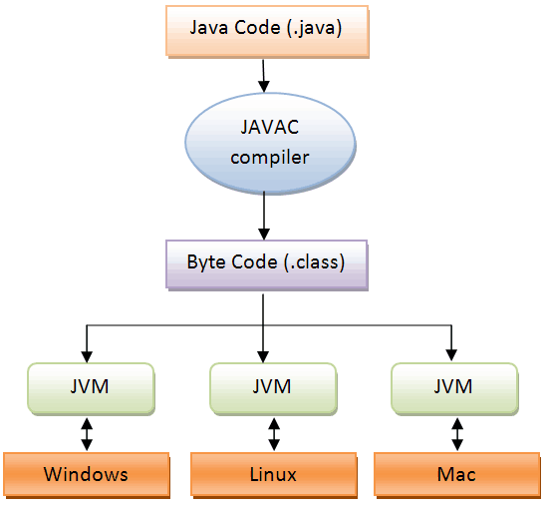
Compilation and Execution of a Java Program

Slide 12
JVM
JVM (Java Virtual Machine) is an abstract machine. It is called a virtual machine because it doesn't physically exist. It is a specification that provides a runtime environment in which Java bytecode can be executed.
JVMs are available for many hardware and software platforms. JVM, JRE, and JDK are platform dependent because the configuration of each Operating System is different from each other. However, Java is platform independent.
The JVM performs the following main tasks:
Loads code
Verifies code
Executes code
Provides runtime environment

Slide 13
JRE
JRE is an acronym for Java Runtime Environment. It is also written as Java RTE. The Java Runtime Environment is a set of software tools which are used for developing Java applications.
It is used to provide the runtime environment. It is the implementation of JVM. It physically exists. It contains a set of libraries + other files that JVM uses at runtime.

Slide 14
JDK
JDK is an acronym for Java Development Kit. The Java Development Kit (JDK) is a software development environment which is used to develop Java applications. It physically exists. It contains JRE + development tools.
The JDK contains a private Java Virtual Machine (JVM) and a few other resources such as an interpreter/loader (java), a compiler (javac), an archiver (jar), a documentation generator (Javadoc), etc. to complete the development of a Java Application.

Slide 15
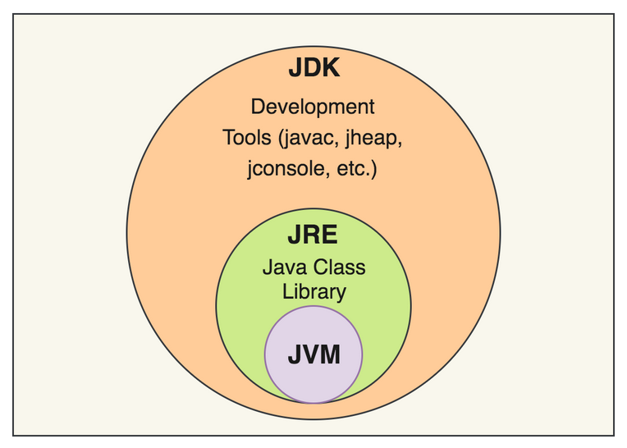
JVM, JRE & JDK

Slide 16
Classes and Objects
The class is the unit of programming
A Java program is a collection of classes
Each class definition (usually) in its own .java file
The file name must match the class name
A class describes objects (instances)
Describes their common characteristics: is a blueprint
Thus all the instances have these same characteristics
These characteristics are:
Data fields for each object
Methods (operations) that do work on the objects

Slide 17
Primitive Data Types
Data type | Range of values
byte | -128 .. 127 (8 bits)
short | -32,768 .. 32,767 (16 bits)
int | -2,147,483,648 .. 2,147,483,647 (32 bits)
long | -9,223,372,036,854,775,808 .. ... (64 bits)
float | +/-10⁻³⁸ to +/-10⁺³⁸ and 0, about 6 digits precision
double | +/-10⁻³⁰⁸ to +/-10⁺³⁰⁸ and 0, about 15 digits precision
char | Unicode characters (generally 16 bits per char)
boolean | True or false

Slide 18
Operators
subscript [ ], call ( ), member access .
pre/post-increment ++ --, boolean complement !, bitwise complement ~, unary + -, type cast (type), object creation new
* / %
binary + - (+ also concatenates strings)
equality comparison == !=
bitwise and &
bitwise or |
logical (sequential) and &&
logical (sequential) or ||
conditional cond ? true-expr : false-expr
assignment =, compound assignment += -= *= /= <= >= &= |=

Slide 19
Declaring and Setting Variables
int square;
square = n * n;
double cube = n * (double)square;
Can generally declare local variables where they are initialized
All variables get a safe initial value anyway (zero/null)

Slide 20
Control Statements
if Statements
switch Statements
Conditional Operators

Slide 21
if Statements
if (booleanExpression) {
statement(s);
}
Example:
if ((i > 0) && (i < 10)) {
System.out.println("i is an " +
"integer between 0 and 10");
}

Slide 22
The if...else Statement
if (booleanExpression) {
statement(s)-for-the-true-case;
}
else {
statement(s)-for-the-false-case;
}

Slide 23
if...else Example
if (radius >= 0) {
area = radius*radius*PI;
System.out.println("The area for the “
+ “circle of radius " + radius +
" is " + area);
}
else {
System.out.println("Negative input");
}

Slide 24
Multiple Alternative if Statements
if (score >= 90)
grade = ‘A’;
else
if (score >= 80)
grade = ‘B’;
else
if (score >= 70)
grade = ‘C’;
else
if (score >= 60)
grade = ‘D’;
else
grade = ‘F’;
if (score >= 90)
grade = ‘A’;
else if (score >= 80)
grade = ‘B’;
else if (score >= 70)
grade = ‘C’;
else if (score >= 60)
grade = ‘D’;
else
grade = ‘F’;

Slide 25
switch Statements
switch (year) {
case 7: annualInterestRate = 7.25;
break;
case 15: annualInterestRate = 8.50;
break;
case 30: annualInterestRate = 9.0;
break;
default: System.out.println(
"Wrong number of years, enter 7, 15, or 30");
}

Slide 26
Conditional Operator
if (num % 2 == 0)
System.out.println(num + “is even”);
else
System.out.println(num + “is odd”);
System.out.println(
(num % 2 == 0)? num + “is even” :
num + “is odd”);

Slide 27
while Loop Flow Chart
while (continuation-condition) {
// loop-body;
}

Slide 28
while Loop Flow Chart, cont.
int i = 0;
while (i < 100) {
System.out.println(
"Welcome to Java!");
i++;
}

Slide 29
do-while Loop
do {
// Loop body;
} while (continue-condition);

Slide 30
for Loops
for (initial-action; loop-continuation-condition; action-after-each-iteration) {
//loop body;
}
int i = 0;
while (i < 100) {
System.out.println("Welcome to Java! ” + i);
i++;
}
Example:
int i;
for (i = 0; i < 100; i++) {
System.out.println("Welcome to Java! ” + i);
}

Slide 31
The break Keyword

Slide 32
The continue Keyword

Slide 33
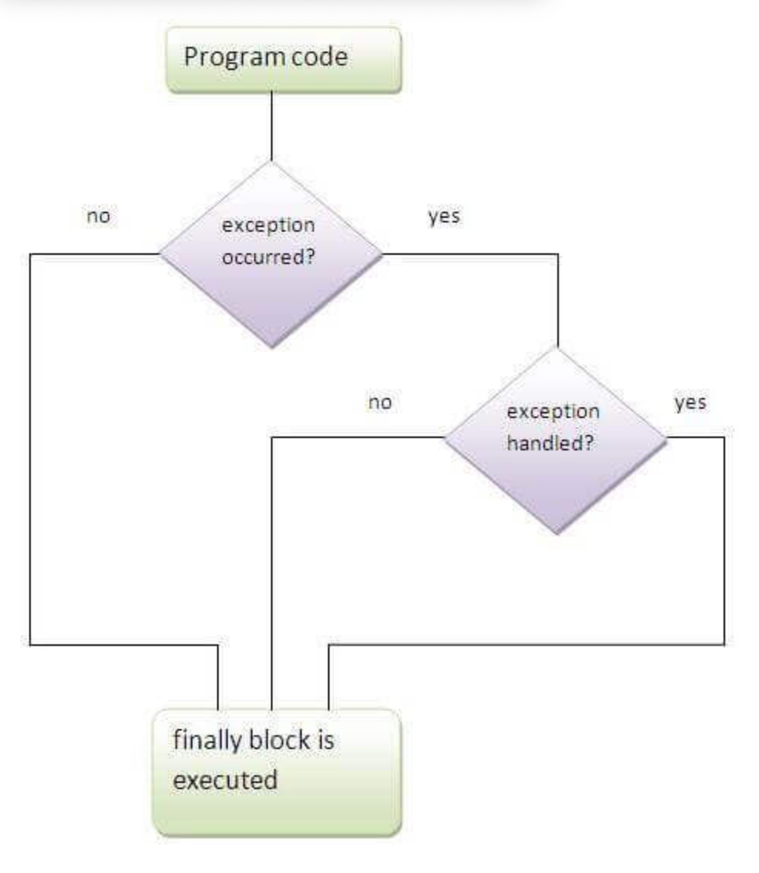
Exception Handling
try {
//open file
//read file
}
catch(Exception e) {
//handle exception while reading the file
}
finally {
//close the file
}

Slide 34
REST API
REST stands for REpresentational State Transfer. REST is web standards based architecture and uses HTTP Protocol. It revolves around resource where every component is a resource and a resource is accessed by a common interface using HTTP standard methods. REST was first introduced by Roy Fielding in 2000.
In REST architecture, a REST Server simply provides access to resources and REST client accesses and modifies the resources. Here each resource is identified by URIs/ global IDs. REST uses various representation to represent a resource like text, JSON, XML. JSON is the most popular one.
HTTP methods
Following four HTTP methods are commonly used in REST based architecture.
GET − Provides a read only access to a resource.
POST − Used to create a new resource.
DELETE − Used to remove a resource.
PUT − Used to update a existing resource or create a new resource.

Slide 35
Spring Boot - Introduction
Spring Boot is an open source Java-based framework used to create a micro Service. It is developed by Pivotal Team and is used to build stand-alone and production ready spring applications.
What is Micro Service?
Micro Service is an architecture that allows the developers to develop and deploy services independently. Each service running has its own process and this achieves the lightweight model to support business applications.
Advantages
Micro services offers the following advantages to its developers −
Easy deployment
Simple scalability
Compatible with Containers
Minimum configuration
Lesser production time

Slide 36
What is Spring Boot?
Spring Boot provides a good platform for Java developers to develop a stand-alone and production-grade spring application that you can just run. You can get started with minimum configurations without the need for an entire Spring configuration setup.
Advantages
Spring Boot offers the following advantages to its developers −
Easy to understand and develop spring applications
Increases productivity
Reduces the development time
Goals
Spring Boot is designed with the following goals −
To avoid complex XML configuration in Spring
To develop a production ready Spring applications in an easier way
To reduce the development time and run the application independently
Offer an easier way of getting started with the application

Slide 37
How does it work?
Spring Boot automatically configures your application based on the dependencies you have added to the project by using @EnableAutoConfiguration annotation. For example, if MySQL database is on your classpath, but you have not configured any database connection, then Spring Boot auto-configures an in-memory database.
The entry point of the spring boot application is the class contains @SpringBootApplication annotation and the main method.
Spring Boot automatically scans all the components included in the project by using @ComponentScan annotation.

Slide 38
Spring Boot Starters
Handling dependency management is a difficult task for big projects. Spring Boot resolves this problem by providing a set of dependencies for developers convenience.
For example, if you want to use Spring and JPA for database access, it is sufficient if you include spring-boot-starter-data-jpa dependency in your project.
Note that all Spring Boot starters follow the same naming pattern spring-boot-starter- *, where * indicates that it is a type of the application.
Examples
Look at the following Spring Boot starters explained below for a better understanding −
Spring Boot Starter Actuator dependency is used to monitor and manage your application. Its code is shown below −
<dependency>
<groupId>org.springframework.boot</groupId>
<artifactId>spring-boot-starter-actuator</artifactId>
</dependency>

Slide 39
Spring Boot Application
The entry point of the Spring Boot Application is the class contains @SpringBootApplication annotation. This class should have the main method to run the Spring Boot application. @SpringBootApplication annotation includes Auto- Configuration, Component Scan, and Spring Boot Configuration.
If you added @SpringBootApplication annotation to the class, you do not need to add the @EnableAutoConfiguration, @ComponentScan and @SpringBootConfiguration annotation. The @SpringBootApplication annotation includes all other annotations.
Observe the following code for a better understanding −
import org.springframework.boot.SpringApplication;
import org.springframework.boot.autoconfigure.SpringBootApplication;
@SpringBootApplication
public class DemoApplication {
public static void main(String[] args) {
SpringApplication.run(DemoApplication.class, args);
}
}

Slide 40
Component Scan
Spring Boot application scans all the beans and package declarations when the application initializes. You need to add the @ComponentScan annotation for your class file to scan your components added in your project.
Observe the following code for a better understanding −
import org.springframework.boot.SpringApplication;
import org.springframework.context.annotation.ComponentScan;
@ComponentScan
public class DemoApplication {
public static void main(String[] args) {
SpringApplication.run(DemoApplication.class, args);
}
}

Slide 41
Spring Boot CLI
The Spring Boot CLI is a command line tool and it allows us to run the Groovy scripts. This is the easiest way to create a Spring Boot application by using the Spring Boot Command Line Interface. You can create, run and test the application in command prompt itself.
This section explains you the steps involved in manual installation of Spring Boot CLI. For further help, you can use the following link: https://docs.spring.io/springboot/ docs/current-SNAPSHOT/reference/htmlsingle/#getting-started-installing-springboot
You can also download the Spring CLI distribution from the Spring Software repository at: https://docs.spring.io/spring-boot/docs/current-SNAPSHOT/reference/htmlsingle/#getting-started-manual-cli-installation

Slide 42
Angular JS
What is Angular ?
Angular is a Javascript framework to build more interactive web apps. It is designed for both Web, Desktop and Mobile platforms. While, we create apps using HTML, CSS and Javascript, Angular requires us to know Typescript (a typed superset of Javascript that scales), kind of stricter version of Javascript provided with OOPS features. Although, other alternative could be Dart, typescript is the most widely used language for Angular apps.
Angular 1 vs Angular 2 vs Angular 4:
Angular JS or Angular 1 was released by Google early in 2010. It was used for building client-side web apps. Initially different versions of it were created to add extra feature sets.
However, Google has completely rewritten the framework to meet the new needs of web apps and released what is called the Angular or Angular 2 in 2016. In fact Angular 2 itself is written in Typescript.
Later, angular 4 and then Angular 5 are released with some more features, developer productivity and small payload size.

Slide 43
ngIf
Angular2 supported only the if condition. However, Angular 4 supports the if else condition as well. Let us see how it works using the ng-template.
<span *ngIf="isavailable; else condition1">Condition is valid.</span> <ng-template #condition1>Condition is invalid</ng-template> as keyword in for loop
With the help of as keyword you can store the value as shown below −
<div *ngFor="let i of months | slice:0:5 as total"> Months: {{i}} Total: {{total.length}} </div> The variable total stores the output of the slice using the as keyword.

Slide 44
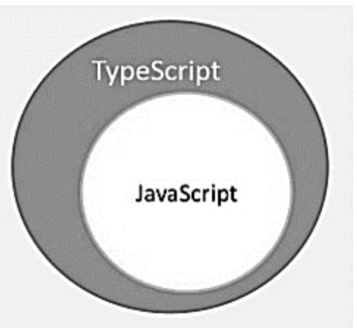
What is TypeScript?
By definition, “TypeScript is JavaScript for application-scale development.”
TypeScript is a strongly typed, object oriented, compiled language. It was designed by Anders Hejlsberg (designer of C#) at Microsoft. TypeScript is both a language and a set of tools. TypeScript is a typed superset of JavaScript compiled to JavaScript. In other words, TypeScript is JavaScript plus some additional features.

Slide 45
Mongo DB
MongoDB is a cross-platform, document oriented database that provides, high performance, high availability, and easy scalability. MongoDB works on concept of collection and document
Database
Database is a physical container for collections. Each database gets its own set of files on the file system. A single MongoDB server typically has multiple databases.
Collection
Collection is a group of MongoDB documents. It is the equivalent of an RDBMS table. A collection exists within a single database. Collections do not enforce a schema. Documents within a collection can have different fields. Typically, all documents in a collection are of similar or related purpose.
Document
A document is a set of key-value pairs. Documents have dynamic schema. Dynamic schema means that documents in the same collection do not need to have the same set of fields or structure, and common fields in a collection's documents may hold different types of data.

Slide 46
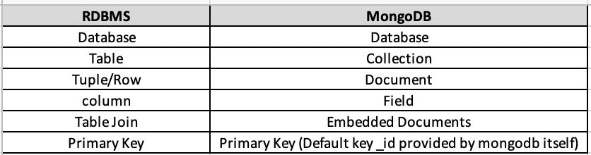
Relationship of RDBMS terminology with MongoDB.

Slide 47
Sample Document
{
_id: ObjectId(7 df78ad8902c)
title: 'MongoDB Overview',
description: 'MongoDB is no sql database',
tags: ['mongodb', 'database', 'NoSQL'],
likes: 100,
comments: [
{
user: 'user1',
message: 'My first comment',
dateCreated: new Date(2011, 1, 20, 2, 15),
like: 0
},
{
user: 'user2',
message: 'My second comments',
dateCreated: new Date(2011, 1, 25, 7, 45),
like: 5
}
]
}

Slide 48
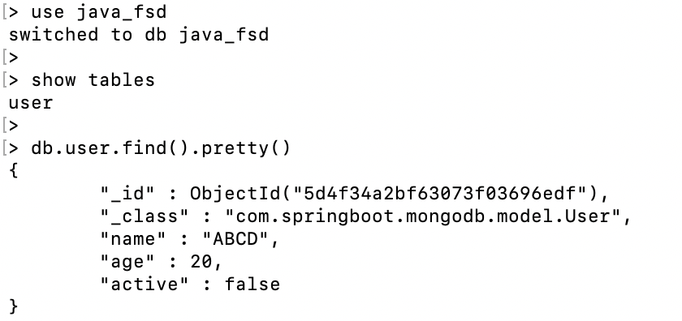

Slide 49
Demo

Slide 50
Web Security

Slide 51
SQL Injection
SQL injection is a code injection technique, used to attack data-driven applications, in which malicious SQL statements are inserted into an entry field like text box, hidden box or get parameter etc.

Slide 52
Session hijacking
Session Hijacking or Cookie Hijacking is the exploitation of a valid computer session to gain unauthorized access to information or services in a computer system. In particular, it is used to refer to the theft of a magic cookie used to authenticate a user to a remote server.

Slide 53
XSS(Cross Site Scripting)
Cross-site scripting (XSS) is a type of computer security vulnerability typically found in web applications. XSS enables attackers to inject client-side scripts into web pages viewed by other users. A cross-site scripting vulnerability may be used by attackers to bypass access controls such as the same-origin policy.

Slide 54
CSRF(Cross Site Request Forgery)
Cross-site request forgery, also known as one-click attack or session riding and abbreviated as CSRF or XSRF, is a type of malicious exploit of a website where unauthorized commands are transmitted from a user that the web application trusts. There are many ways in which a malicious website can transmit such commands; specially-crafted image tags, hidden forms, and JavaScript XMLHttpRequests.

Slide 55
Mobile Apps Development
A process by
Which a
Mobile App is
developed for
Mobile Devices.

Slide 56
Milestones of Mobile Operating Systems
Pre-1993
1973–1993 – Mobile phones use embedded systems to control operation.
1993–1999
1993 – Apple launch Newton OS running on their Newton series of PDAs.
1994 – The first smartphone, the IBM Simon, has a touchscreen, email, and PDA features.
1996 – Palm Pilot 1000 PDA is introduced with the Palm OS
1998 – Symbian Ltd. developed Symbian OS. Symbian was used by NOKIA.
2000s
2002Microsoft's first Windows CE (Pocket PC)smartphones.
BlackBerry releases its first smartphone.
2007 Apple iPhone with iOS is introduced as an iPod, "mobile phone.
Open Handset Alliance (OHA) formed by Google, HTC, Sony etc.
2008 – OHA releases Android (based on Linux kernel) 1.0 with the HTC Dream (T-Mobile G1) as the first Android phone.

Slide 57
Mobile Development?
Some trendy mobile development platforms are :
Android
iOS
Hybrid Apps development
React Native
Phonegap/Cordova

Slide 58
Mobile Development
Some trendy mobile development platforms are :
Android
iOS
Hybrid Apps development
React Native
Phonegap/Cordova

Slide 59
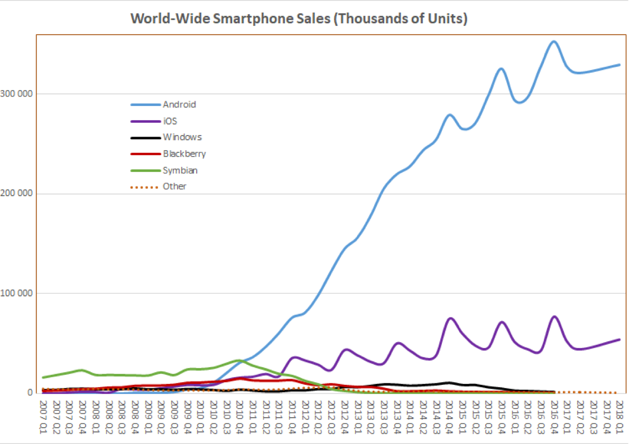
Market Share

Slide 60

Android
In October 2003 by Andy Rubin, Rich Miner, Nick Sears, and Chris White.[
In July 2005, Google acquired Android Inc. for at least $50 million
Written in Java(UI),C & C++
Latest Release : Android 9.0, Pie
Latest Beta Release : Android Q
Package Manager : APK
License : Apache 2.0

Slide 61

iOS
In 2005 by Scott Forstall, named as iPhone OS.
In June 2007 iPhone OS 1.0 was launched
Written in C, C++, Objective C, Swift
Latest Release : 12.4
Latest Beta Release : 13.0
Package Manager : iPA
License : Proprietary software except for open-source components

Slide 62

React-Native
In March 2015 Inside Facebook, Jordan Walke found a way to generate UI elements for iOS from a background Javascript Thread.
Written in JavaScript, Java, C, C++, Objective C, Python
Latest Release : 0.60
License : MIT

Slide 63

Cordova(formerly PhoneGap)
PhoneGap went on to win the People's Choice Award at O'Reilly Media's 2009 Web 2.0 Conference.
Written in JavaScript, Java, C, C++, Objective C, HTML
Latest Release : 9.0.0
License : Apache 2.0

Slide 64
Other Platforms
IBM MobileFirst
Xamarin
Ionic
Windows 10

Slide 65
Dive in
Android Development

Slide 66
Android Development prerequisite
Android Studio
Android SDK
Gradle
Java JDK

Slide 67
Android App Components
Activities :
An activity is the entry point for interacting with the user. It represents a single screen with a user interface.
AndroidManifest.xml:
This XML files holds all configuration of project and permission on device like App name, Icon, Theme, Internet sharing, Read/Write permission on Device etc.
Resources :
It contains all resolutions images, String, layout, Menu etc.

Slide 68
Android App Components
Services :
A service is a general-purpose entry point for keeping an app running in the background for all kinds of reasons. It is a component that runs in the background to perform long-running operations or to perform work for remote processes. A service does not provide a user interface.
Example : play music in the background while the user is in a different app

Slide 69
Android App Components
Broadcast Receiver :
A broadcast receiver is a component that enables the system to deliver events to the app outside of a regular user flow, allowing the app to respond to system-wide broadcast announcements. More commonly, though, a broadcast receiver is just a gateway to other components and is intended to do a very minimal amount of work.
Example : a broadcast announcing that the screen has turned off, the battery is low, or a picture was captured.

Slide 70
Android App Components
Content Provider :
A content provider manages a shared set of app data that you can store in the file system, in a SQLite database, on the web, or on any other persistent storage location that your app can access.
Through the content provider, other apps can query or modify the data if the content provider allows it.
Example : Android system provides a content provider that manages the user's contact information such as ContactsContract.Data, to read and write information about a particular person

Slide 71
Android Development using Kotlin
Kotlin has been Google’s preferred language for development since 7 May 2019
Kotlin is a cross-platform, general-purpose programming language with type inference. Kotlin is designed to interoperate fully with Java, and the JVM version of its standard library depends on the Java Class Library, but type inference allows its syntax to be more concise. Kotlin mainly targets the JVM, but also compiles to JavaScript or native code.
Link : https://developer.android.com/kotlin/learn

Slide 72
Dive in
iOS Development

Slide 73
iOS Development prerequisite
Mac OS
XCode 10

Slide 74
Dive in
Reactive Development

Slide 75
React-Native Development prerequisite
NodeJS 10 +
React Native CLI or EXPO CLI
Temporary Alternate of #1 & #2: https://snack.expo.io/
To compile and run on Android same tools as Android development
To compile and run on iOS same tools as iPhone development

Slide 76
React-Native CLIs
Expo CLI
React Native CLI
npm install -g expo-cli
expo init HelloMIT
cd HelloMIT
npm start or expo start
npm install -g react-native-cli
react-native init HelloMIT
react-native run-android
react-native run-ios

Slide 77
Hello MIT Program
import React, { Component } from 'react';
import { Text, View } from 'react-native';
export default class HelloMITApp extends Component {
render() {
return (
<View style={{ flex: 1, justifyContent: "center", alignItems: "center" }}>
<Text>Hello, MIT!</Text>
</View>
);
}
}

Slide 78
Props & State Most components can be customized when they are created, with different parameters. These creation parameters are called props.
import React, { Component } from 'react';
import { AppRegistry, Image } from 'react-native';
export default class Bananas extends Component {
render() {
let pic = {
uri: 'https://upload.wikimedia.org/wikipedia/commons/d/de/Bananavarieties.jpg'
};
return (
<Image source={pic} style={{width: 193, height: 110}}/>
);
}
}
// skip this line if using Create React Native App
AppRegistry.registerComponent('AwesomeProject', () => Bananas);

Slide 79
Style
import React, { Component } from 'react';
import { StyleSheet, Text, View } from 'react-native';
const styles = StyleSheet.create({
bigBlue: {
color: 'blue',
fontWeight: 'bold',
fontSize: 30,
},
red: {color: 'red',},
});
export default class LotsOfStyles extends Component {
render() {
return (
<View>
<Text style={[styles.bigBlue, styles.red]}>bigBlue, then red</Text>
<Text style={[styles.red, styles.bigBlue]}>red, then bigBlue</Text>
</View>
);
}
}

Slide 80
Animation
import React from 'react';
import { Animated, Text, View } from 'react-native';
class FadeInView extends React.Component {
state = {
fadeAnim: new Animated.Value(0), // Initial value for opacity: 0
}
componentDidMount() {
Animated.timing( // Animate over time
this.state.fadeAnim, // The animated value to drive
{
toValue: 1, // Animate to opacity: 1 (opaque)
duration: 10000, // Make it take a while
}
).start(); // Starts the animation
}
render() {
let { fadeAnim } = this.state;
return (
<Animated.View // Special animatable View
style={{
...this.props.style,
opacity: fadeAnim, // Bind opacity to animated value
}}
>
{this.props.children}
</Animated.View>
);
}
}
// You can then use your `FadeInView` in place of a `View` in your components:
export default class App extends React.Component {
render() {
return (
<View style={{flex: 1, alignItems: 'center', justifyContent: 'center'}}>
<FadeInView style={{width: 250, height: 50, backgroundColor: 'powderblue'}}>
<Text style={{fontSize: 28, textAlign: 'center', margin: 10}}>Fading in</Text>
</FadeInView>
</View>
)
}
}

Slide 81
Publishing to Google Play Store
https://facebook.github.io/react-native/docs/signed-apk-android

Slide 82
Q & A

