Slide 1
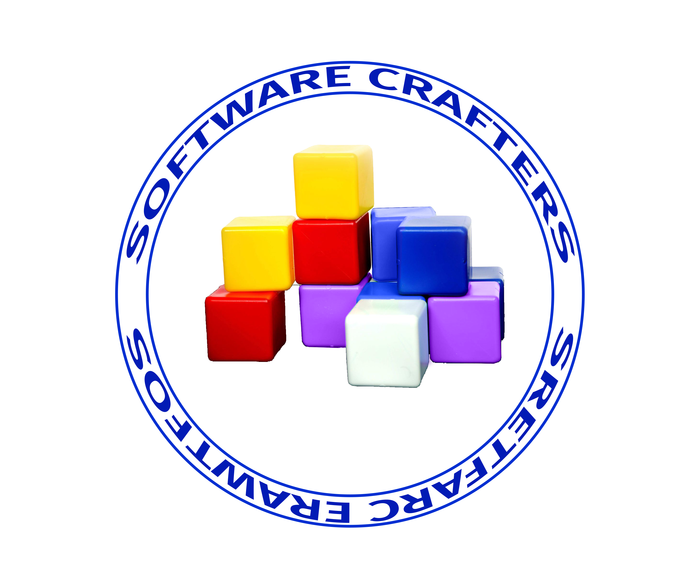
Software Crafters Bucharest
Part of the Global Software Crafters (https://softwarecrafters.org) network of other local Software Craftsmanship Communities.
Software Craftsmanship is more than coding.
Building a community of professionals to solve things that are bothering us.
Practice and writing well-crafted software.
Therefore, we will practice TDD and work on a coding katas with constraints.
https://github.com/softwarecraftersdev
https://www.meetup.com/softwarecrafters

Slide 2
Coderetreat 2023
CodeRetreat is a coding practice event where developers of all experience levels meet and hone their craft by repeatedly implementing the same small coding exercise via test-driven design and pair or ensemble programming. It can be used any programming language.
What are the learning goals of CodeRetreat?
- Use deliberate practice to explore new techniques
- Learn from other software developers by writing readable and well-designed code together
- Take risks and experiment
- Have fun!

Slide 3
Agenda
17:00 - 17:30 Welcome
17:30 - 18:15 First rounds of coding, sessions of 45 min pair programming
18:15 - 18:30 Retrospective
18:30 - 19:15 Further coding. Session of 45 min
19:15 - 20:00 Retrospective, networking, closing

Slide 4
Prereq
Setup IDE
Clone repo https://github.com/softwarecraftersdev/kata-bootstraps
Use unit tests to validate the problem

Slide 5
Coding challenge
https://github.com/softwarecraftersdev/coderetreat2023
The objective is to develop a simple application to implement the logic for Game of Life
Conway's Game of Life – Wikipedia
The universe of the Game of Life is an infinite, two-dimensional orthogonal grid of square cells, each of which is in one of two possible states, live or dead (or populated and unpopulated, respectively). Every cell interacts with its eight neighbours, which are the cells that are horizontally, vertically, or diagonally adjacent. At each step in time, the following transitions occur:
Any live cell with fewer than two live neighbours dies, as if by underpopulation.
Any live cell with two or three live neighbours lives on to the next generation.
Any live cell with more than three live neighbours dies, as if by overpopulation.
Any dead cell with exactly three live neighbours becomes a live cell, as if by reproduction.

Slide 6
Session #1
https://github.com/softwarecraftersdev/coderetreat2023
Constraints:
Small Methods (<5 lines)
Test driven development
Unit tests coverage

Slide 7
Session #2
https://github.com/softwarecraftersdev/coderetreat2023
Constraints:
no if statements
git commits every 5 min

Slide 8

Local Sponsor
Sponsor
Finastra.com

