Slide 1
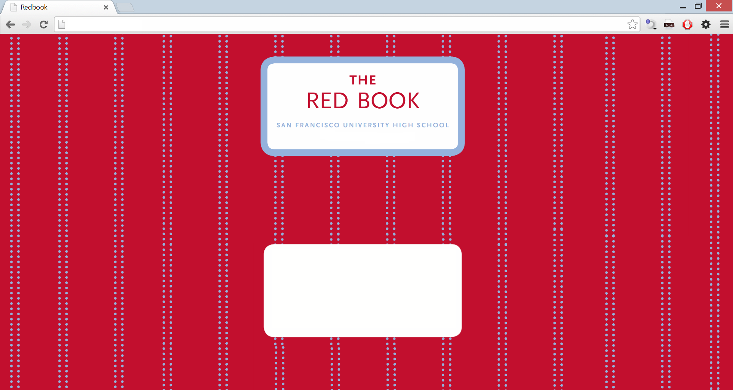

Sign in
username:
password:
See this week

Slide 2
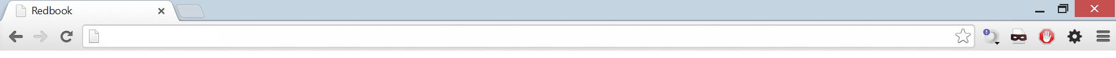
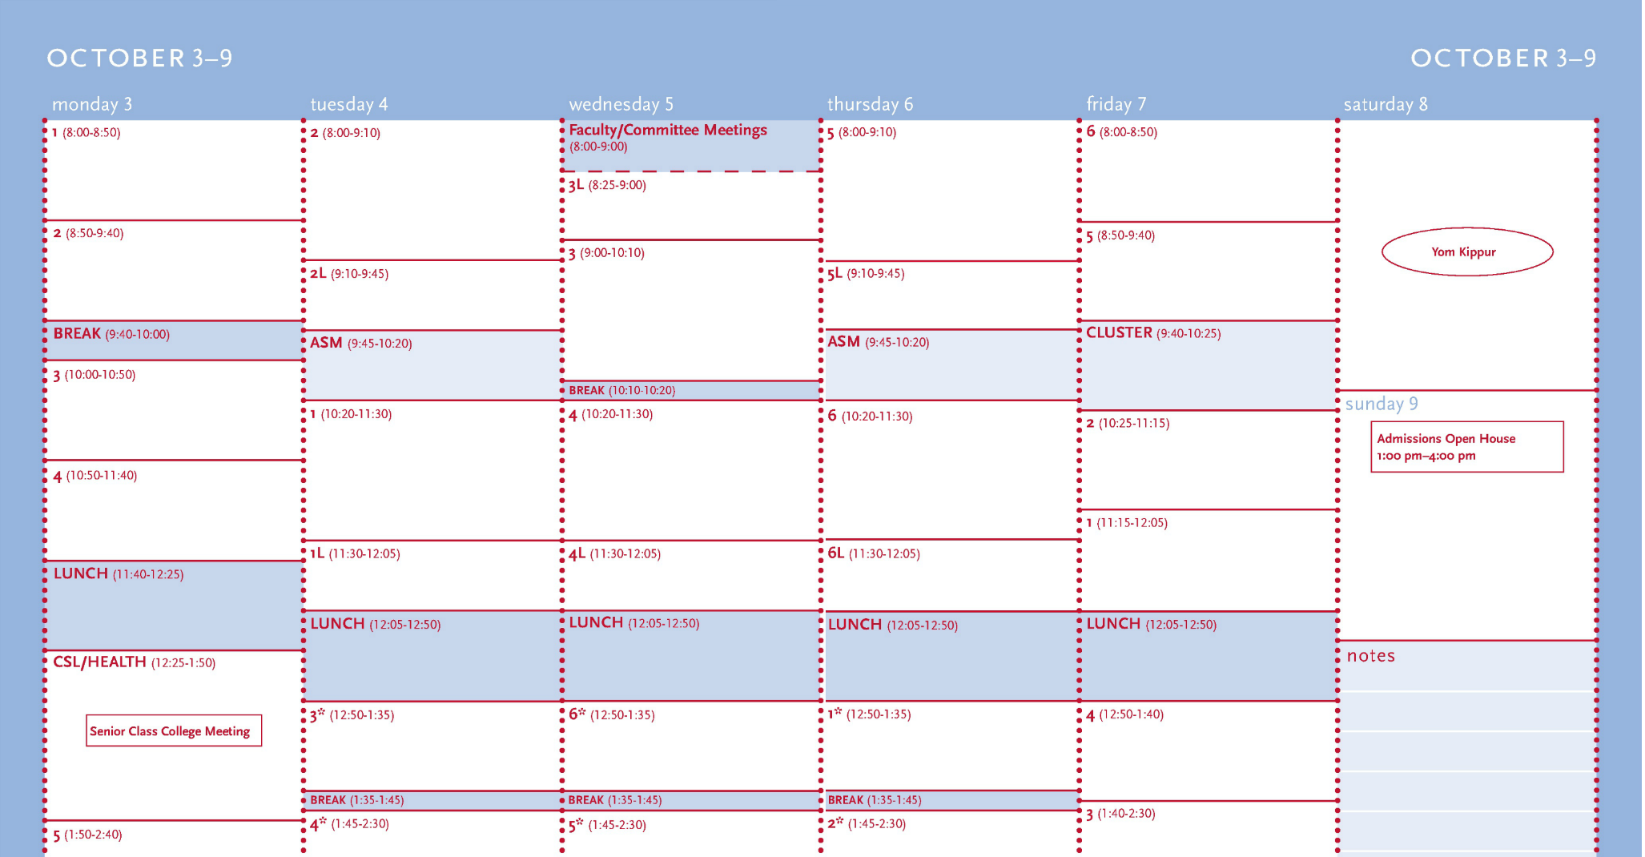
Back to login

Slide 3

October 3–7
Month
Logout
Vocab Quiz #1-25
Lab 1A Due
Marquez Reading
Worksheet 1.2 Due
Read short story
HW pp. 103-105
Unit 2 Test
Quiz 1.2
Finish workbook problems
Carnegie Mellon College
Visit
Finish handout
Software Development
Club in L-105
Debate club meeting
Finalize college list this week
Chapter 3 Test
WB pages 78-80

Slide 4
October 3–7
Month
Logout

Slide 5


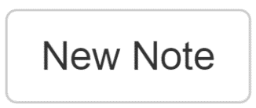
October 3–7
Month
Logout
AP Microeconomics (Sally Jones)
Unit 2 Test
Finish workbook problems
Back

Slide 6
October 3–7
Month
Logout
AP Microeconomics (Sally Jones)
Unit 2 Test
Finish workbook problems
Back

Slide 7

October 3–7
Month
Logout
AP Microeconomics (Sally Jones)
Unit 2 Test
Finish workbook problems
Back

Slide 8
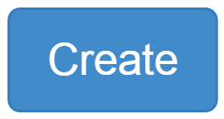
October 3–7
Month
Logout
AP Microeconomics (Sally Jones)
Unit 2 Test
Finish workbook problems

Slide 9
October 3–7
Month
Logout
AP Microeconomics (Sally Jones)
Unit 2 Test
Finish workbook problems
Meet with Sally after class

