Slide 1

FEBBY KAUMBA 2200154
CYBER SECURITY

Slide 2
WHAT IS NORMALISATION
Is a method of structuring relational data that leads to a more efficient database.
The efficiency comes from both minimizing redundancy and ensuring consistency of data.

Slide 3
IMPORTANCE OF NORMALISATION
It makes the data easy to analyze during analysis.
It reduces the amout of data stored on the drive.

Slide 4
WHERE NORMALISATION IS USED
Polices stations - To manage criminal records well.
Clinics - Managing patient data.
Online shops - Ebay.

Slide 5
HOW NORMALISATION WORKS
Normalisation works by removing repeating data in individual tables and Identifying related data using the primary key of a given set, in order to make uniqueness in the database.

Slide 6
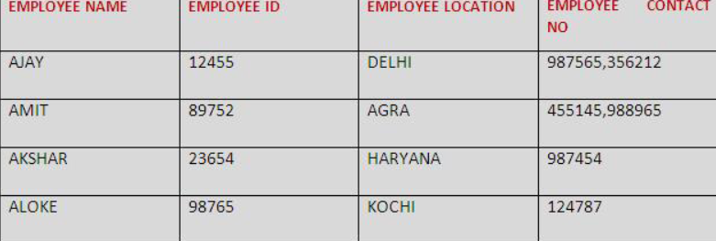
EXAMPLE
Consider a table containing the details of a company. Employees AJAY and AMIT have multiple contact numbers which cannot be accepted in the first normal form.
The next slide will show normalised table to 1NF.

Slide 7
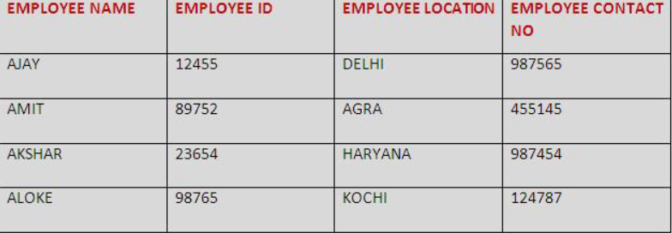
1 NORMAL FORM
First normal form says each table cell should contain only one atomic value.
Multiple value columns have been separated, so that there is only one value in each column per row
In order to bring it to the 1 normal form,the employee cells which has multiple values from the field of employee contact no should be separeted.

Slide 8
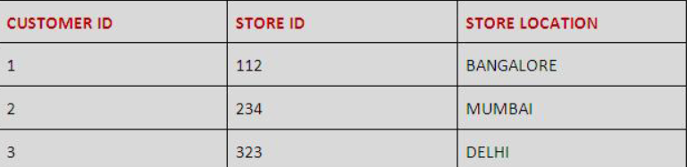
2 NORMAL FORM
An entity is said to be in the second normal form when it is already in 1NF.
All non-key attributes should dependent on the primary key.
EXAMPLE.
The non-key attribute is STORE LOCATION and STORE LOCATION only depends on the STORE ID, which is the sole part of the primary key.

Slide 9
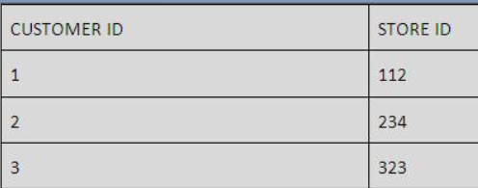
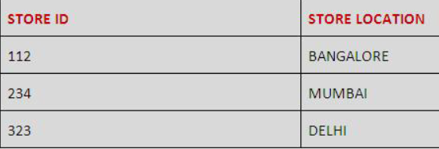
2 NORMAL FORM
SOLUTION.
To resolve this issue and to convert the entity into the 2NF, the table is split into two separate tables.
Now the column STORE LOCATION is completely dependent on the primary key, the STORE ID thereby achieving 2NF

Slide 10
3 NORMAL FORM
An entity is said to be in the third normal form when,
It satisfies the criteria to be in the second normal form.
It has no transitive functional dependency.
Transitive functional dependency is situation where A is functionally
dependent on B, and B is functionally dependent on C then C is transitively dependent on A and B.
In the below table BOOK ID determines the GENRE ID and the GENRE ID determines the BOOK GENRE. Which mean BOOK GENRE has transitive dependence on BOOK ID through GENRE ID.

Slide 11
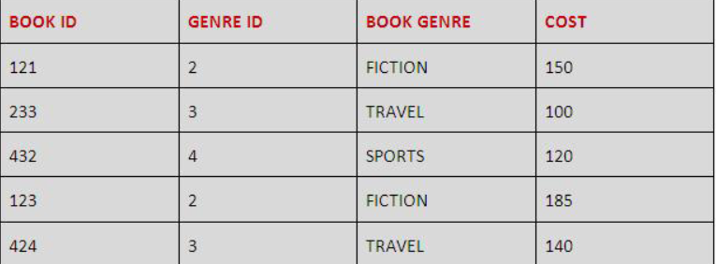
3 NORMAL FORM
1

Slide 12
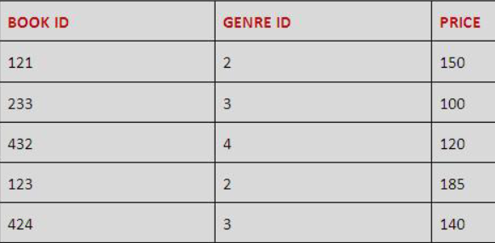
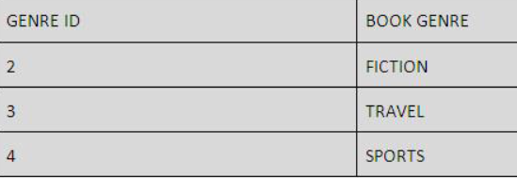
3 NORMAL FORM
SOLUTION

Slide 13
PROBLEMS OF NORMALISATION
Database becomes difficult to understand the tables.
Requires more storage as the tables becomes many.
Normalisation can be difficult to understand for non technical people.

