Slide 1

What do developers like best: Coffee, Beer or Free Software?
By
Jon “maddog” Hall
Board Chair: Linux Professional Institute
President: Linux® International®

Slide 2
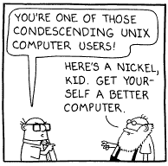
Who Is maddog?
Half Electrical Engineer, Half Business, Half Computer Science
“Open Source” since 1969
Mainframes 5 years
Unix since 1980
Linux since 1994
Latin America since 1994
Companies (mostly large): Aetna Life and Casualty, Bell Labs, Digital Equipment Corporation, SGI, IBM, Linaro, Caninos Loucos
Programmer, Systems Administrator, Systems Engineer, Product Manager, Technical Marketing Manager, University Educator, Author, Businessperson, Consultant
Taught OS design and compiler design and database design among other courses
Extremely large systems to extremely small ones
Vendor and a customer
Pragmatic

Slide 3
What Do Programmers Value? https://dev.to/lynnetye/what-developers-want-in-a-job-7hg
Dev.to
Work/Life Balance
High Quality Code Base
Flexible Work Arrangements
Good for Junior Devs
Promotes From Within
Open Source Contributor
Team is Diverse
Ideal for Parents
Hacker News
Work/Life Balance
High Quality Code Base
Flexible Work Arrangements
Impressive Team Members
Team is Diverse
Eats Lunch Together
High Employee Retention
Promotes From Within

Slide 4
What Things Do Open Source Developers Like?
Visibility of Creativity
  Not necessarily on “competitive” features
Talking to customers/users
  Some developers
  Some customers

Slide 5
How Can Open Source Improve Programmer's Skills?
Able to look at well-written code
Code can be seen by other coders (and users)
  Push for better coding
  Few or no bad comments in source code
Open testing (e.g. Linux Kernel)

Slide 6
Case studies about how FOSSH changed businesses
Move from “Product” to “Service”
Move from “Product” to “Solution”
  IBM
    Sold Laptop and Small Server (3-5% profit margin)
    Bought Price Waterhouse Cooper - Doubled Service Department – 19% profit margin
    Advertises “Business Solutions”

Slide 7
Case studies: FOSSH changing businesses
Nashua Large System Porting
Project.net
Blender

Slide 8
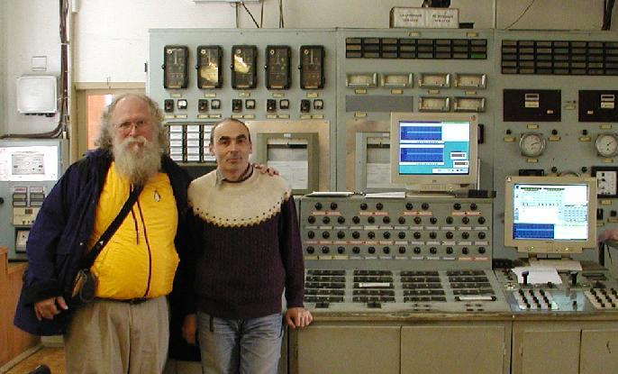
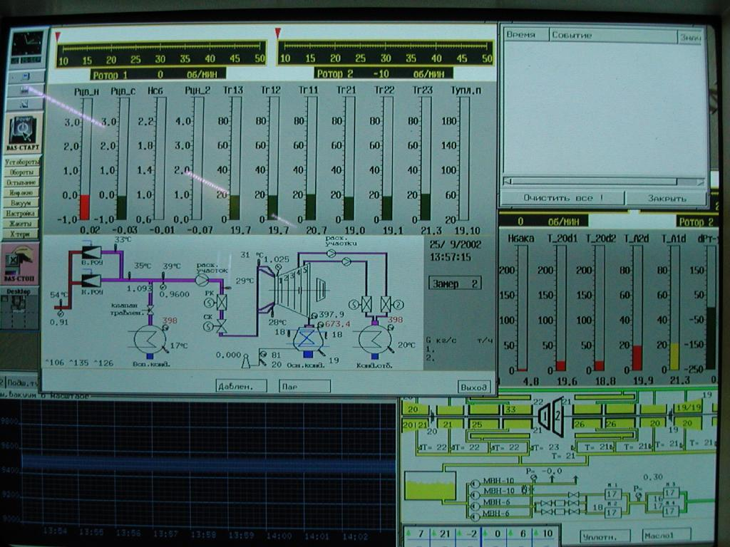
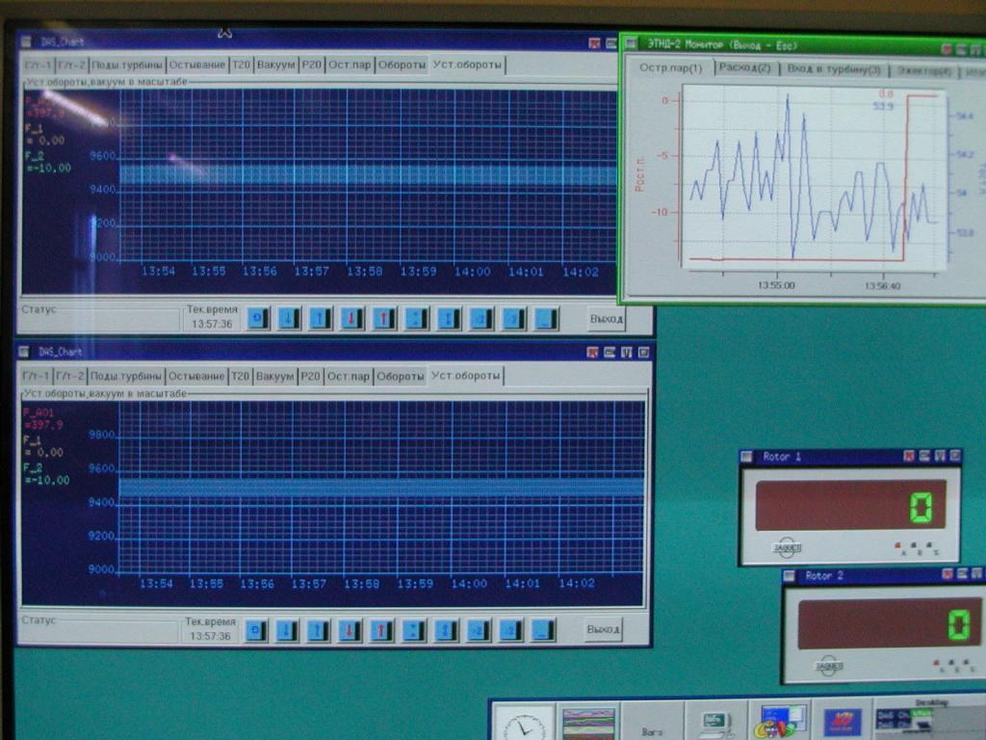
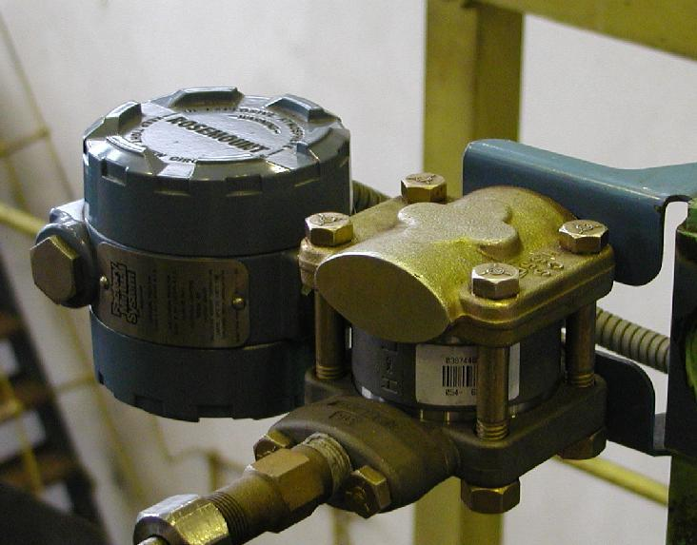
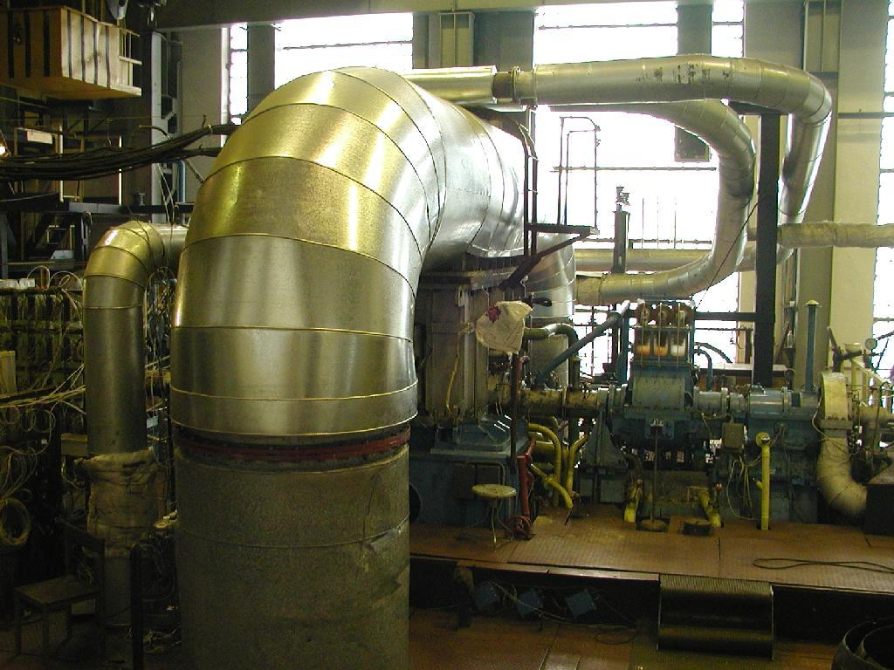
Case Study: St. Petersburg
Turbine Test Bed
Proprietary vs Software Libre
10 months vs three days

Slide 9
My Own Observations:
Fifty Years
Western Electric – Hawthorn Studies
  Electric Bulbs
  How much light?
Bell Labs Time Clock
Twenty Years without confirmation
Better tools for programmers
How is your management style?

Slide 10

Questions?

