Slide 1

AVM INTELLIGENCE
The metadata
question became
a factory
12 May – 12 October 2026
A timeline of the architecture, the problems it solved, and the destination it was built for.
01

Slide 2
THE QUESTION
One question stayed constant
How can a platform team judge a fleet of Terraform modules without maintaining each repository by hand?
“How good are the modules, actually?”
CURRENCY
Which source revision is current?
The catalog was not enough. Each module lived in its own repository, with its own release cadence and evidence.
QUALITY
What can be checked from source?
VISIBILITY
Can a team review the fleet as a whole?
ORIGIN / THE EVALUATION QUESTION
02

Slide 3
FOUR ITERATIONS
Four iterations, one evolving runtime
The commits mark when work entered each repository; they do not prove every workflow succeeded.
01
02
03
04
12–19 MAY
JUN–SEP
27–30 SEP
28 SEP–12 OCT
The Proof
The Real World
The Sidequest
The Factory
AVM modules evaluation
Private fleet on Azure DevOps
Go parser with Jev classifier
Go factory with durable state
From a person-run workspace to a durable, staged factory.
TIMELINE / FOUR ITERATIONS
03

Slide 4

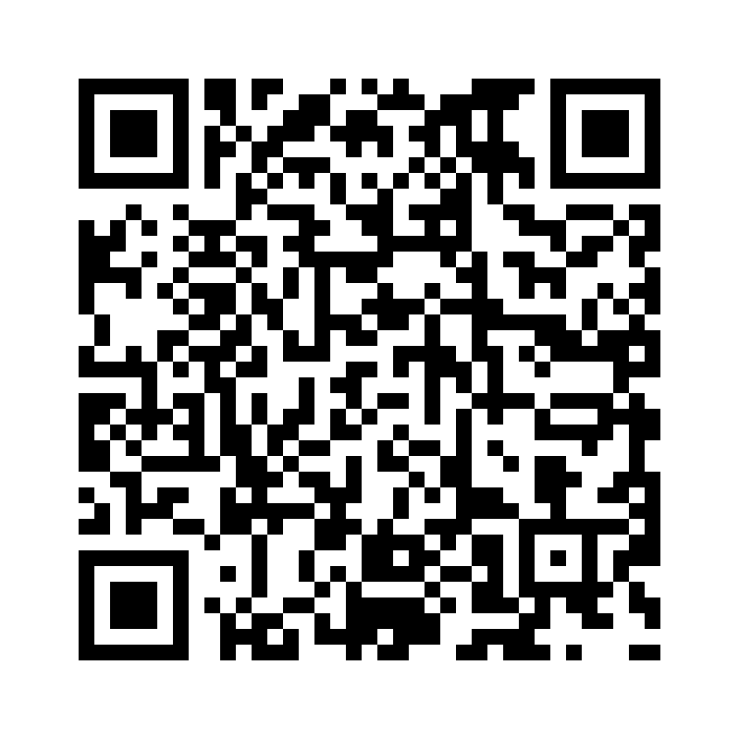
THE PROOF / PHASE 01
SCAN TO OPEN REPOSITORY
The Proof
avm-metadata
12–19 May 2026
The first workspace turned separate AVM repositories into a catalog that could be synced, analyzed, and reviewed.
PUBLIC ARCHIVE
Crayon-HU/avm-metadata
THE PROOF / AVM-METADATA
04

Slide 5
ITERATION 1 · MAY 2026
First: make the fleet visible
avm-metadata · 12–19 May 2026 · public archive
148
FIRST MOVE
WHAT SHIPPED
A local catalog
Seven analysis dimensions
repositories in the platform-team framing
Sync AVM CSVs, store module metadata, and clone repositories into one workspace.
Coverage, documentation, required interface, provider pins and more; a static portal surfaced findings.
The limit
Useful for a person at a laptop. Scraping and analysis were local, with no durable queue.
THE PROOF / FIRST CATALOG
05

Slide 6
ITERATION 1 · MAY 2026
Turn separate repositories into one working set
The first improvement was operational: make the AVM fleet consistent enough to inspect and compare.
01 · SYNC
02 · WORKSPACE
03 · ANALYZE
A catalog you can refresh
Operate the fleet together
Reuse the same checks
Read the official AVM index CSVs. Keep Available modules by default; opt into Proposed when needed. Store one YAML record per module.
Clone and fetch repositories, inspect status and branches, stash work, and clean up from one multi-root workspace instead of repeating it by hand.
Seven analysis dimensions assessed the modules. Provider currency could be checked without cloning; /avm-sync and /avm-check called the same scripts.
THE DESIGN CHOICE
Copilot skills were an interface to deterministic scripts, not a model-only analysis path.
THE PROOF / SYNC AND ANALYSIS
06

Slide 7
ITERATION 1 · MAY 2026
Make the evidence useful to a platform team
A static portal brought the catalog, quality signals, and recent movement into one place.
BROWSE
COMPARE
FOLLOW
Know what is in the fleet
See quality signals
Track change over time
A searchable catalog and resource treemap made separate module repositories easier to navigate.
A quality scoreboard brought together coverage, documentation, required interface, provider pins, and other analysis findings.
Provider-currency findings, known issues, and a 90-day activity feed gave reviewers context beyond a single score.
NEXT PRODUCT IDEA
Sync findings to GitHub Issues and a Project board
PROPOSED · NOT SHIPPED HERE
The portal made findings visible; collection and analysis were still local, with no durable queue.
THE PROOF / PORTAL AND NEXT STEP
07

Slide 8
THE REAL WORLD / PHASE 02
The Real World
Private fleet on Azure DevOps
147
3 June – 15 September 2026
MANAGED MODULES
The same idea moved into a client environment and expanded across a 147-module Azure, AWS, and GCP fleet.
Azure · AWS · GCP
THE REAL WORLD / PRIVATE FLEET
08

Slide 9
ITERATION 2 · JUN–SEP 2026
Then: prove the workflow on a real fleet
private-modules-metadata · private Azure DevOps repository
147
59%
19%
18%
5%
modules
Azure
AWS
GCP
other
Rounded shares; one module is counted in more than one platform, so categories overlap.
CAPABILITY
OPERATING LOOP
CONSTRAINT
More than a scrape
Work had an owner
Still host-bound
Ten analysis runners, provider status, a resource index, and an upgrade graph.
Reports could be prioritized, linked to tickets, and presented through a portal.
The private fleet required its client network and authenticated CLI session.
THE REAL WORLD / FLEET COVERAGE
09

Slide 10
ITERATION 2 · JUN–SEP 2026
A repository was not always a module
The AVM starting point assumed one repository maps to one module. The private fleet broke that assumption.
ONE ANCHOR · NO INTERNALS
MULTIPLE PUBLIC ANCHORS
Single block
Multi-block
One public module at the root: the original AVM shape.
Several callable modules can live side by side in one repository.
ONE PUBLIC · INTERNAL MODULES
PUBLIC AND INTERNAL TOGETHER
Parent with submodules
Mixed
Keep internal implementation modules attached to the public parent; do not score them as standalone products.
Score each public module independently and leave internal modules with the repository.
SOLUTION
Discover anchor.module files; if none exists, keep a visible catalog fallback instead of dropping the repository.
THE REAL WORLD / REPOSITORY SHAPES
10

Slide 11
SIX COLLECTORS · THREE SCOPES
Collect host and source facts once
Six collectors in three scopes record metadata and status; analysis consumes them to judge.
BUILDING BLOCK
REPOSITORY
REPOSITORY
Terraform metadata
Block inventory
Repository status
Versions, providers, resources, calls, variables, and outputs.
Find anchors and classify public blocks versus internals.
Git state plus Azure DevOps policies, builds, reviewers, and security.
REPOSITORY
WORKSPACE
WORKSPACE
Pipeline inventory
Project status
Provider status
Classify execute, test, release, tag, and security pipeline files.
Collect inherited branch policy and build definitions once.
Enrich resource stubs with provider releases, issues, and optional probe results.
DATA FLOW
Scoped scrape records → registered checks → evidence-backed result
THE REAL WORLD / EVIDENCE COLLECTION
11

Slide 12
ANALYSIS SYSTEM · WEIGHTED SCORES
Ten dimensions, 56 checks
Encode the team’s standard once, then apply it consistently across the fleet.
MODULE CONTRACT
DELIVERY PRACTICE
Layout · interface · examples
Pipelines · docs · governance
Is the repository usable, are inputs and outputs documented, and do examples have executable test coverage?
Does the team’s build, test, release, branch, and review process meet its own standards?
RISK AND CLASSIFICATION
PROVIDER SIGNALS
Security · taxonomy
Health · concurrency
Check secret-shaped values and security automation; keep each module classifiable by platform, domain, and role.
Check minimum/current pins and known breaking changes or critical issues since a person last reviewed a symbol.
TRUTHFUL SCORE
Unavailable network evidence stays unchecked, not failed; provider concurrency remains visible but outside the weighted score.
THE REAL WORLD / ANALYSIS MODEL
12

Slide 13
CLIENT NETWORK · AZURE DEVOPS
The client environment shaped the checks
Network and permissions determined which facts were available and when a check could be trusted.
ONE WORKFLOW ON MAC AND WINDOWS
HOST FACTS NEED AUTHENTICATED ACCESS
Bash + PowerShell
Azure DevOps scrape
Both entry points expose the same commands and flags; users do not need to know which Python runner implements a step.
Branch policies, build validation, status checks, reviewers, and repository security come from the host, not the clone.
INHERITED FACTS ARE WORKSPACE-SCOPED
UPSTREAM HEALTH NEEDS FRESH DATA
Project status
Provider status
Read default-branch policy and build definitions once instead of copying project-wide settings into every module record.
Fetch releases and open issues from declared providers. Missing probes or stale collection leave dependent checks unchecked.
THE REAL WORLD / PRIVATE ENVIRONMENT
13

Slide 14
FROM SIGNALS TO WORK
Turn fleet facts into prioritized work
The catalog, dependency graph, and provider evidence could organize cross-fleet upgrade work.
01 · MODEL
02 · PRIORITIZE
03 · TRACK
Build an upgrade graph
Create a per-module plan
Link work in Azure DevOps
Relate modules to resources and provider versions; identify dependencies that affect upgrade order.
Produce upgrade reports and spread work across five priority levels instead of treating the fleet as one ticket.
Inventory the parent ticket; create or update one child per module; resolve link types from the tracker.
SAFETY RAIL
Dry run by default · create, update, and link phases covered · link types resolved from Azure DevOps
Timeline records when features landed in git; it does not claim every live pipeline run succeeded.
THE REAL WORLD / FROM SIGNALS TO WORK
14

Slide 15

THE SIDEQUEST / PHASE 03
SCAN TO OPEN REPOSITORY
The Sidequest
iaclens
27–30 September 2026
A short Go-based experiment separated repository structure from module intent, using Jev only when code could not decide.
PUBLIC REPOSITORY
Ledermayer/iaclens
THE SIDEQUEST / IACLENS
15

Slide 16
DECISION POINT · 15 SEP 2026
A narrow question for Jev
System One offered a choice with probabilities, not an open-ended paragraph.
0.8
UNRESOLVED DIRECTORY
module
deployment
unknown
Only when Go rules could not decide.
default probability and confidence thresholds
Below threshold → stay unknown; dependent checks stay unchecked.
The experiment made uncertainty explicit. It also introduced a model call into the analysis path.
THE SIDEQUEST / WHY A CLASSIFIER
16

Slide 17
ITERATION 3 · 27–30 SEP 2026
Go separates repository structure from module intent
iaclens · Go HCL parser · v0.1.0 released 30 September
WHAT GO DECIDED
WHAT NEEDED A RULE
WHAT STAYED UNCERTAIN
Structural role
Intent kind
Jev as fallback
Each .tf or .tf.json directory is a unit. Examples attach to their nearest owning module and do not inflate component counts.
Backend or cloud blocks signal deployment. Conflicting signals stay unknown; configured paths and operator overrides decide first.
Jev is used only when structure, rules, and overrides cannot decide module versus deployment.
BOUNDARY
The summary is derived: mixed means multiple resolved kinds; any unresolved directory keeps classification incomplete.
THE SIDEQUEST / REPOSITORY SHAPE
17

Slide 18
CLASSIFIER CONTRACT · IACLENS
A bounded classifier, with an explicit off switch
Only unresolved directories become model questions; the program decides whether an answer can count.
CLOSED CHOICES
PROGRAM-OWNED THRESHOLD
OPERATOR CONTROL
A strict response contract
The model cannot force a decision
Prepare without calling
Ask one unresolved directory at a time. The answer must be module, deployment, or unknown; probabilities cover every allowed choice and sum to one.
Both confidence and selected-choice probability must meet 0.8. Below either threshold, the result stays unknown and dependent checks stay unchecked.
`--mode prepare` writes the request only. `--mode jev` makes the selected provider call; the report records the ruleset digest and response.
SCOPE
Terraform source is data: no execution, module downloads, tfvars, plans, or state. Pre-1.0; not a certification.
A report with no findings is not, by itself, a plan or a security result.
THE SIDEQUEST / CONFIDENCE GATE
18

Slide 19
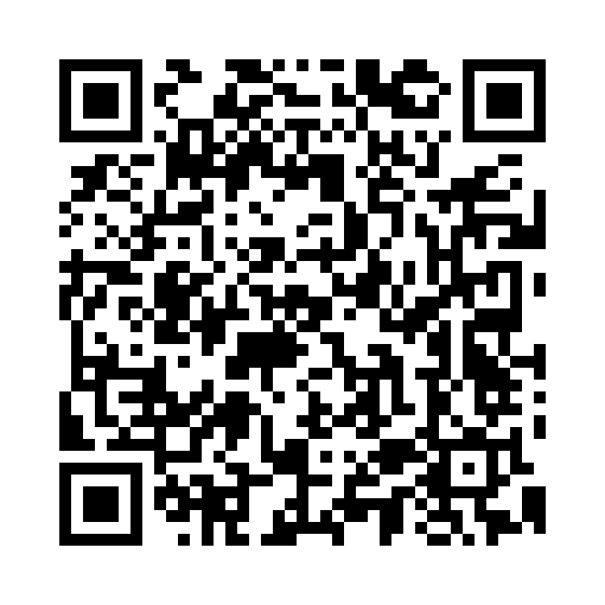
THE FACTORY / PHASE 04
SCAN TO OPEN REPOSITORY
The Factory
avm-intelligence
28 September – 12 October 2026
The work moved from local commands to a durable factory with distinct discovery, evidence, acceptance, and publication stages.
softwareone-public/avm-intelligence
THE FACTORY / AVM-INTELLIGENCE
19

Slide 20
ITERATION 4 · SEP–OCT 2026
The factory begins — and its first design is replaced
AVM Intelligence started in softwareone-public on 28 September.
01 OCT · V1 FLEET
01–02 OCT · V2 APPROVED
A laptop pipeline
inside Actions
One module.
Owned facts.
Review before acceptance.
• Discovery and source pinning
• Workers and accepted cohort data
• Pages portal and Issues / Project board
The factory would own parsing and compiled checks. IaCLens and the model path left the runtime.
THE FACTORY / V1 TO V2
20

Slide 21
ARCHITECTURE DESTINATION
A staged factory with explicit authority
Each stage has one job; durable state coordinates work, while human-facing surfaces report it.
01
02
03
04
05
06
DISCOVER
ACQUIRE
ASSESS
ACCEPT
SELECT
PUBLISH
pin the source
extract native facts
compiled checks
reviewed evidence
reviewed release set
receipt-backed view
STATE AUTHORITY
Projections
JSON-only factory-state · expected-head commits · fencing
Issues / Project
Pages portal
Neither board nor site schedules work or grants acceptance.
THE FACTORY / LIFECYCLE AUTHORITY
21

Slide 22
ARCHITECTURE · PROJECTION AUTHORITY
ARCHITECTURE · PROJECTION AUTHORITY
The board reports state; it does not run the factory
Following slide 21’s staged lifecycle: factory workflows write durable state, then one projector updates the human-facing board.
FACTORY WORKFLOWS
DURABLE AUTHORITY · BRANCH
PROJECTION WORKFLOW
HUMAN-FACING BOARD
Producers and operators
factory-state
factory-projection
GitHub Project + module Issues
factory-discovery / manual-discovery
factory-dispatch / manual-dispatch
manual-worker
factory-worker (reusable)
manual-accept-evidence
manual-site-publish
requests · attempts · fences
lifecycle and projection intents
acceptance + Pages receipts
per-module delivery checkpoints
Reads due state intents
Applies exact Issue / Project updates
Acknowledges delivered effects
status · summary · labels
human notes are preserved
read model for people
Read, claim, seal, accept, publish
JSON under state/ · expected-head Git writes
Sole board writer · currently hard-disabled
Never a queue or approval input
AUTHORITY BOUNDARY Board status never dispatches work or grants acceptance. The projector only reconciles state-backed intents.
Implementation note: the current review branch keeps the factory-projection job hard-disabled pending its rollout gate.
THE FACTORY / AUTHORITY & DATA FLOW
22

Slide 23
ARCHITECTURE · ARTIFACTS & MAIN
Artifacts prove a run; reviewed main records accepted data
The evidence path and the state path meet only at exact, verified receipts.
FACTORY WORKER / EXPORT
UPLOADED ARTIFACT
DATA-ONLY PROPOSAL
HUMAN REVIEW
PROTECTED MAIN
Seals one exact attempt
Immutable run evidence
factory/v2-evidence-*
Pull request
Accepted data/**
and prepares a data-only
proposal when eligible
Exact producer IDs
Not canonical data
proposal.json + data/**
Exact expected base
required checks
review + merge
Trusted code + config
Review is the gate
EXACT MERGED MAIN
EXACT ACCEPTANCE IMPORT
FACTORY-STATE
manual-accept-evidence
Acceptance receipt
Revalidated artifact IDs + exact merged main commit
Lifecycle handoff
NEXT · manual-site-publish reads accepted main; the exact Pages deployment receipt returns to factory-state.
THREE DISTINCT RECORDS Artifact = what ran · main = reviewed data · factory-state = lifecycle and receipts
THE FACTORY / AUTHORITY & DATA FLOW
23

Slide 24
ARCHITECTURE CHANGES · 1
Make each module its own durable unit
The v1 failures were structural; v2 changed the unit of work and the state model.
COHORT REPLACEMENT
Patch one module into the accepted dataset.
Keeps the fleet intact.
One-module acceptance could replace the dataset.
→
FILE QUEUE
Durable compare-and-swap state with fencing.
Stale runners cannot overwrite a newer generation.
Runner-local renames are not a shared lock.
→
FAILURE COUPLING
Independent module requests and lifecycle intents.
One module can stop without replaying the fleet.
One worker failure could block siblings.
→
LOST FACTS
Native typed records; missing stays unknown.
Unknown is not silently converted to zero.
Normalization discarded typed facts.
→
THE FACTORY / DURABLE MODULE UNIT
24

Slide 25
ARCHITECTURE CHANGES · 2
Keep review, acceptance, and publication separate
Workers prepare evidence. They do not accept data or publish a result.
WORKER
REVIEW
ACCEPT
SELECT
PUBLISH
seals evidence
exact-head PR
receipt imports
reviewed export
deployment receipt
ISSUE FOUND IN V1
V2 RESPONSE
“Done” could describe a different commit than the published site.
Bind completion to exact accepted commit, digest, and module membership.
GitHub Issues and Projects reflect lifecycle state; they are not queue or approval inputs.
THE FACTORY / REVIEW AND ACCEPTANCE
25

Slide 26
ARCHITECTURE CHANGES · 3
Real runs refined the machinery
Corrections in 6–10 October addressed measured or repeatable failure modes.
TRANSPORT
LIFECYCLE
EVIDENCE
State reads were too expensive
Discovery was too coupled
Evidence needed a real handoff
REST re-downloaded 1,336 blobs twice, taking about 3.5 minutes each pass. Git transport reads one snapshot and publishes a small expected-head commit.
A batch cursor could replay already committed module work; transaction identity also failed validation. Per-module durable discovery and a separate projector isolate retries.
Prepared worker branches were not accepted evidence. Sealed attempts now pass through exact-head review PRs and receipt import before selection.
A successful workflow is not itself proof of acceptance or publication.
THE FACTORY / OPERATIONAL CORRECTIONS
26

Slide 27
DESTINATION · GUARDRAILS
Autonomous delivery, with evidence boundaries
“Unattended” describes the data pipeline goal; it never removes review.
SAFETY
DETERMINISM
TRUTHFULNESS
Source is data
Checks are replayable
Unknown stays unknown
Go parses approved source revisions. Terraform, providers, and upstream code are not executed.
Reviewed, pinned Go libraries and compiled checks. Mandatory AI and dynamically loaded checks stay out.
Path conventions and exact checks decide role. Missing evidence does not become a pass or zero.
REVIEW IS A GATE
A reviewed PR stands between assessment and accepted data; a deployment receipt stands between accepted data and “Done.”
THE DESTINATION / GUARDRAILS
27

Slide 28
THE DESTINATION
The destination: end-to-end module delivery
The target is an autonomous, staged factory for reviewed data — with every decision tied to evidence.
NIGHTLY DISCOVERY
finds a new stable revision and records it
THE IDEA
STAYED STABLE.
MODULE LIFECYCLE
moves through acquisition, checks, review, and selection
THE RUNTIME
DIDN’T.
RECEIPT-BACKED VIEWS
publish what was actually accepted
From local scrape
to durable factory.
Source: docs/panel/timeline.md · updated 12 October 2026
THE DESTINATION / END-TO-END DELIVERY
28

Slide 29

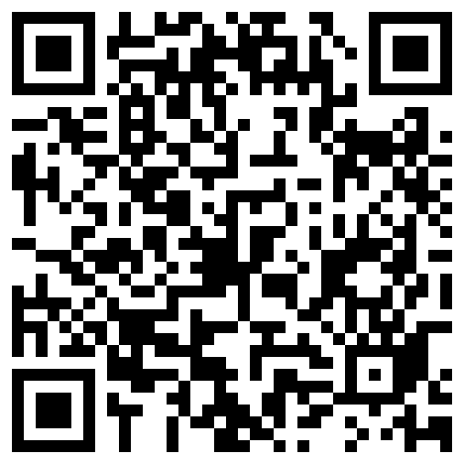
Thank you!
Bence Bánó
bence.bano@softwareone.com
SCAN TO CONNECT

