Slide 1

Software Carpentry
Astronomy & Astrophysics
13th February 2019
Sam Mangham, John Robinson, Adam Hill
@RSGSoton @swcarpentry
Notes:
So, on the technical front, following on from Mark, will give overview of
- The PEDASI IoT demonstrator itself
- Bring together with an overview of current architecture
- Current status

Slide 2
Software Carpentry
Before we start:
Please ensure you’ve installed the prerequisites and downloaded the repository
  https://tinyurl.com/swc-astro-prereq

Slide 3
Software Carpentry
Why are we here?
We’re scientists
Our research involves writing code

Slide 4
We should care about software
100%
92%
69%
50%
56%
0%
Use software
Fundamental to results
Develop own code
Source: Software Sustainability Institute Survey 2014

Slide 5
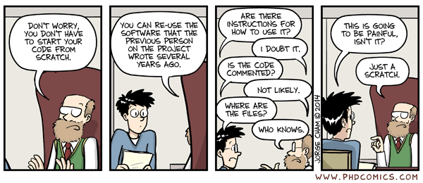
We should care about software
We want to set you on the road to writing Sustainable Software

Slide 6

Software Carpentry
The take-home message is:
This is the Software Sustainability Institute motto
www.software.ac.uk

Slide 7
Software Carpentry
“Teaching researchers the computing skills they need to get more done in less time and with less pain”
27,000 + Researchers taught since 1998 in 35 Countries
Materials are freely reusable (CCA license)

Slide 8
Who are we?
Research Software Group – rsg.soton.ac.uk
Sam Mangham
Steve Crouch
James Graham
John Robinson

Slide 9
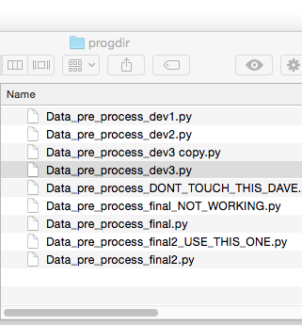
Version Control (Git)
Sam Mangham
How has this code changed?
Who made this change?
Which version of this code was used to generate this result?
Reproducibility

Slide 10
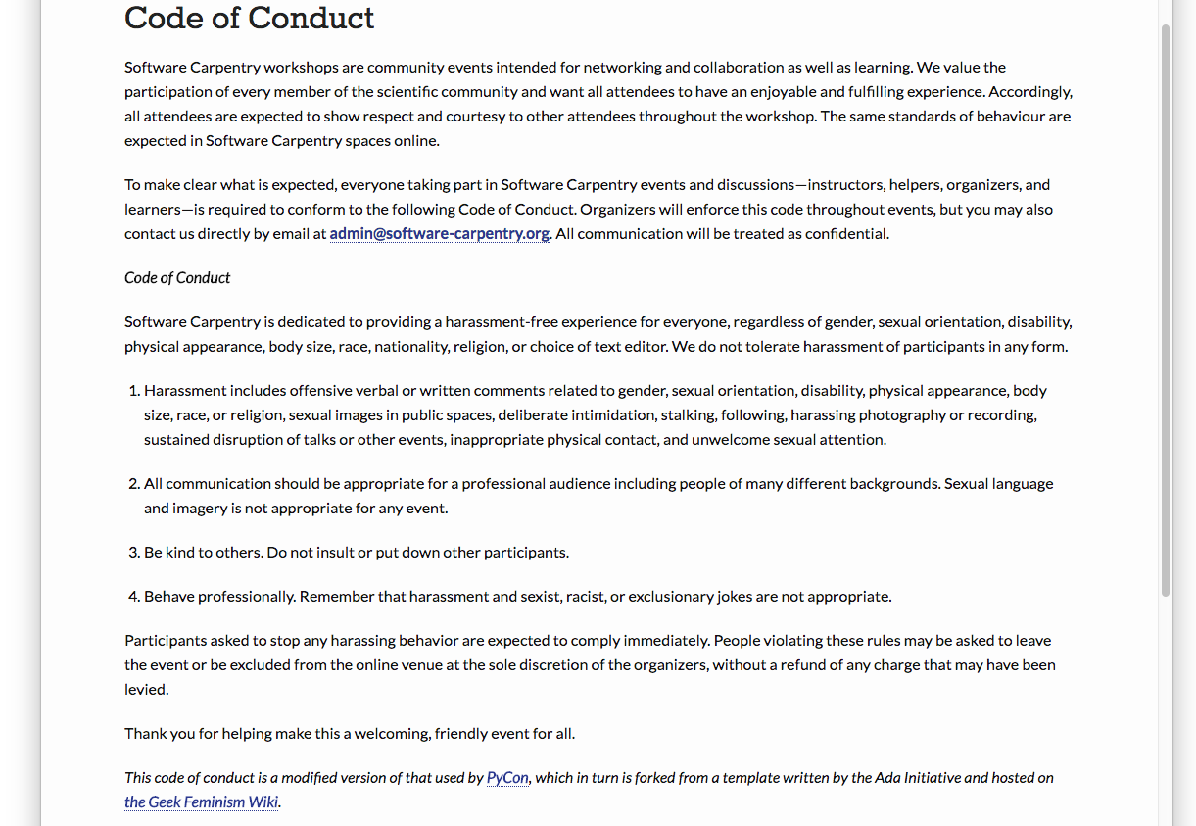
Code of Conduct
http://software-carpentry.org/conduct/

Slide 11
Need help?
Say hi to your neighbours!

Slide 12
Need help?
Sticky notes

Slide 13
Pre-workshop Survey
Help us to help you, by telling us what you know
On GitHub, could you check out a working copy of a project, add a new file and commit the change?
    Yes
    Yes – with documentation
    No

