Slide 1
Version Control with Git
Software Sustainability Institute
http://software.ac.uk/
@SoftwareSaved

Slide 2
What is Version Control?
AKA revision control, source control
Tracks changes to files

Slide 3

A Better Backup

Slide 4
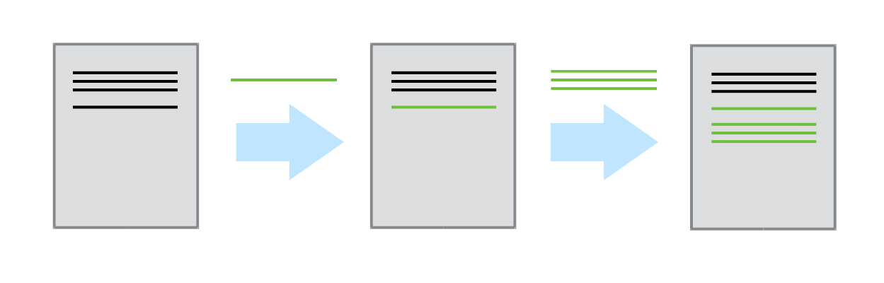
Version Control Tracks Changes
          Changes are tracked sequentially

Slide 5
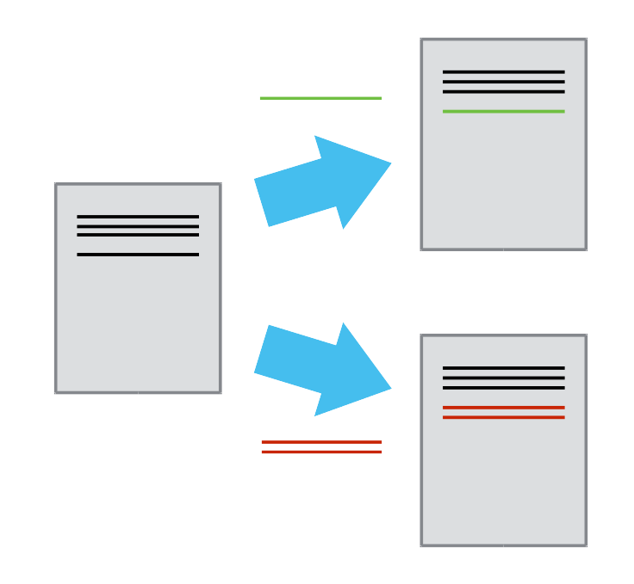
Version Control Tracks Changes
          Different versions can be saved

Slide 6
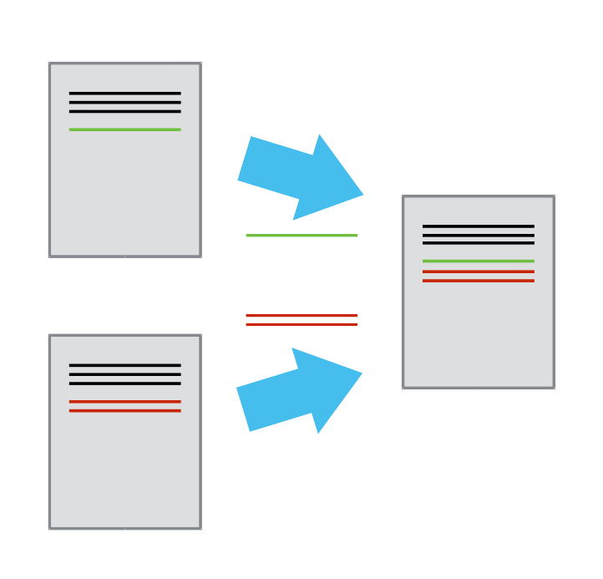
Version Control Tracks Changes
          Multiple versions can be merged

Slide 7
Version Control Alternatives
Subversion (svn)
Mercurial (hg)
Git (git)

Slide 8

Monsters to Mars

Slide 9

Monsters to Mars

Slide 10
Creating a Repository
git init
git status

Slide 11
Tracking Changes to Files
git add
git commit
git status
git log
git diff

Slide 12
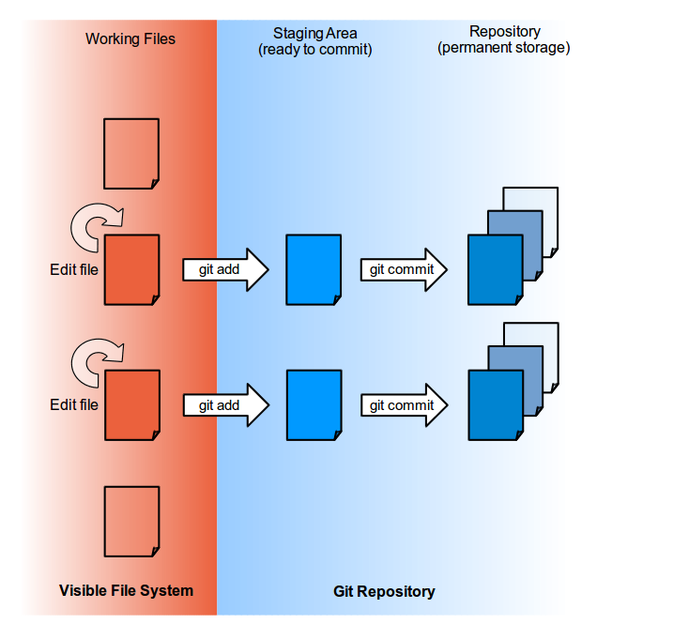
Git Add / Commit

Slide 13
Exploring History
git diff HEAD~1
git diff <hash>

Slide 14
Recovering Old Versions
git reset

Slide 15
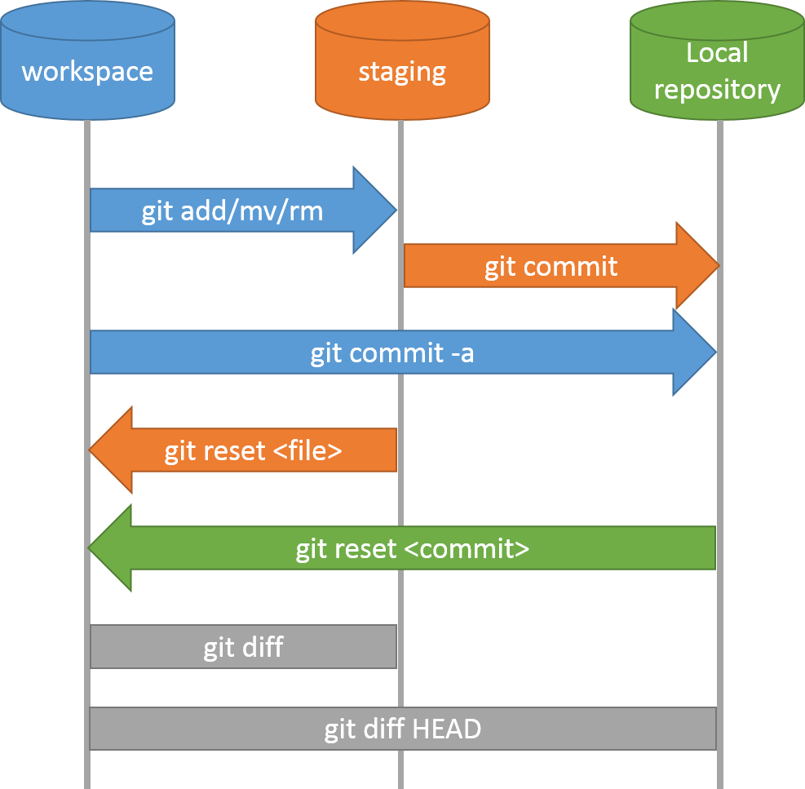
Git Workflow – Local Repo.

Slide 16
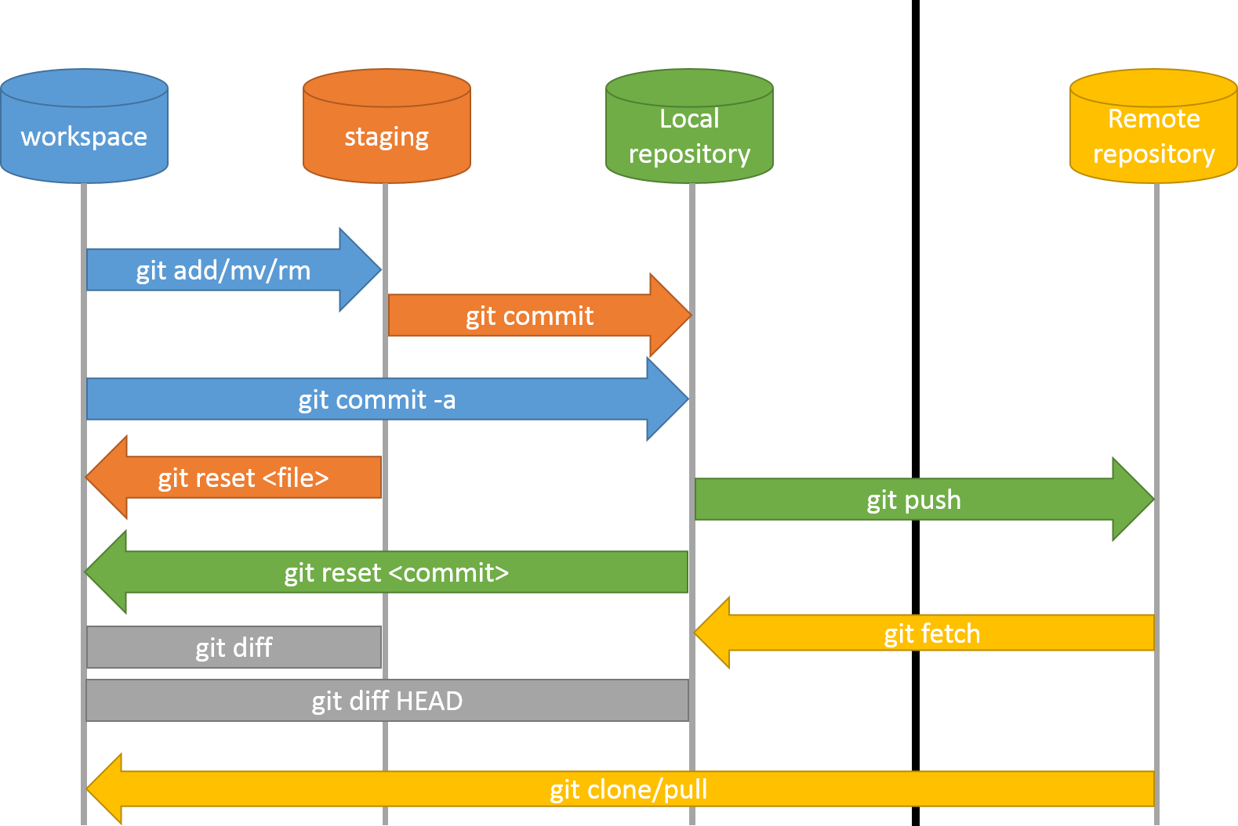
Git Workflow – Remote Repo.

Slide 17
A Collaboration Tool
Let's collaborate with ourselves
Laptop / Desktop

Slide 18
Remote Repositories
GitHub / Bitbucket
Sign up / in https://github.com/
Create a new repository

Slide 19
Connect Repositories
git remote add
git push
git pull

