Slide 1









Introducing the Software Sustainability Institute Date, Meeting, Location Name (@ID), Organisation ORCID: 0000-0000-0000-0000 | email@my.domain
Supported by
Project funding from
Slides licensed under CC-BY where indicated:

Slide 2

Software Sustainability Institute
“A national facility for cultivating better, more sustainable, research software to enable world-class research”
Providing to the wider community:
expertise, services, tools, events, policy, guidance, data, opportunities, …
Supported by EPSRC/ESRC/BBSRC grant EP/N006410/1, with additional project funding from Jisc and NERC.
Collaboration between the universities of Edinburgh, Manchester, Oxford and Southampton.

Slide 3
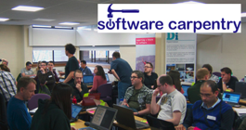


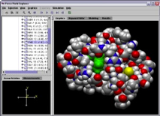
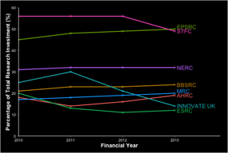
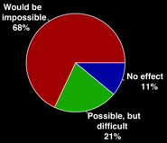

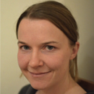



Software
Training
Helping the community to develop software that meets the needs of reliable, reproducible, and reusable research
Delivering essential software skills to researchers via CDTs, institutions & doctoral schools
Outreach
Exploiting our platform to enable engagement, delivery & uptake
Collecting evidence on the community’s software use & sharing with stakeholders
Bringing together the right people to understand and address topical issues
Policy
Community

Slide 4

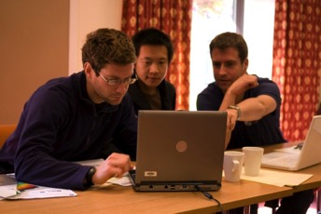
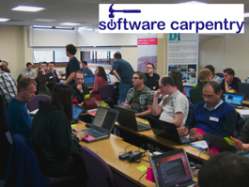



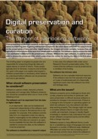









Software
Training
Advice
Courses
100+ UK SWC workshops
2500+ learners
Consultancy
70+ projects
200+ evaluations
4 surgeries
Guides
Outreach
80+ guides
50,000 readers
Website & blog
200+ contributed articles
20,000 unique visitors per month
4,000 Twitter followers
Research
740 researchers 50,000 grants analysed
Campaigns
Workshops
Fellowship
80+ domain ambassadors
500+ RSEs engaged
2100 signatures
13 issues highlighted
Policy
Community
25+ workshops organised

Slide 5
Additional slides

Slide 6
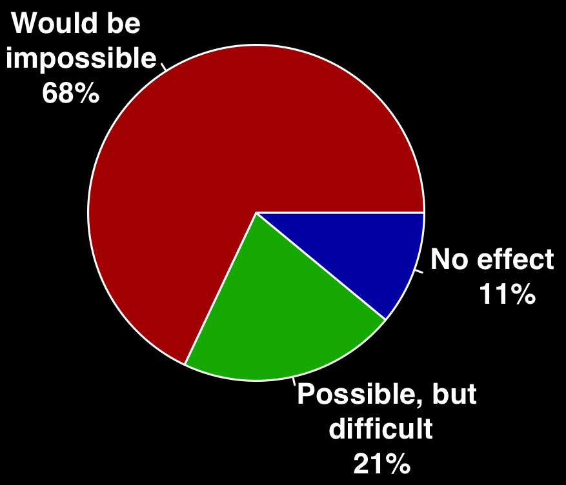
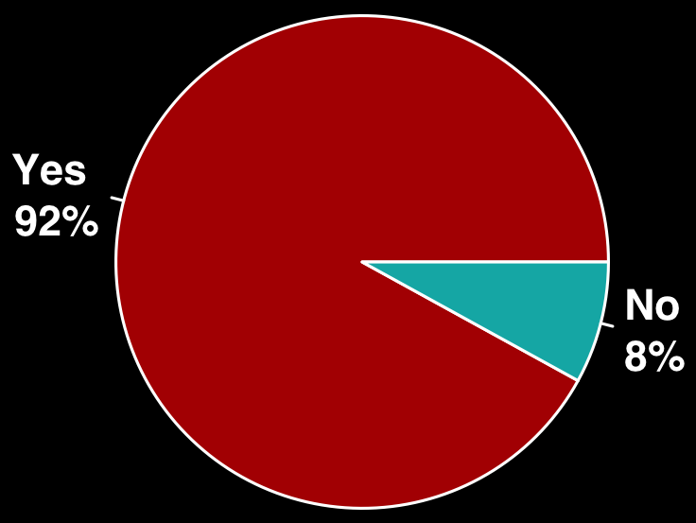
The UK research community relies on software
Do you use research software?
What would happen to your research without software
Survey of researchers from 15 Russell Group universities conducted by SSI between August - October 2014. 406 respondents covering representative range of funders, discipline and seniority.
Notes:
In related study 100% of respondents to survey from Europe said they used research software, 2.5 % No effect, 7.5% Possible but difficult, 90% impossible – this survey has more inherent bias because of the way it was conducted.
Euro survey responses – Develop own software (90%), no formal training (57.5%)
No training = 15%
Formal + Self-Taught/Formal = 42.5%
Self-taught only = 42.5%

Slide 7
The cost of UK research that relies on software
£840m
30%
Investment in 2013-2014 financial year, an amount that has risen by 3% on average over last four years
Of total research investment has been spent on research which relies on software over the last four financial years
Analysis of data from 49,650 grant titles and abstracts published on Gateway to Research covering 2010-2014.
Notes:
What is more, the UK invests a huge amount into research which relies on software – nearly a third of all research funding. This is a lower bound, as many grants will not have directly mentioned software.

Slide 8
The UK research community doesn’t have the skills
56%
71%
Of UK researchers develop their own research software
Of UK researchers have had no formal software development training
140,000
UK researchers are relying on their own coding skills
Survey of researchers from 15 Russell Group universities conducted by SSI between August - October 2014. 406 respondents covering representative range of funders, discipline and seniority.
Notes:
No training 46%
Self-taught + formal = 54%
Self-taught only = 25%
Euro survey responses – Develop own software (90%), no formal training (57.5%)
No training = 15%
Formal + Self-Taught/Formal = 42.5%
Self-taught only = 42.5%

