Slide 1
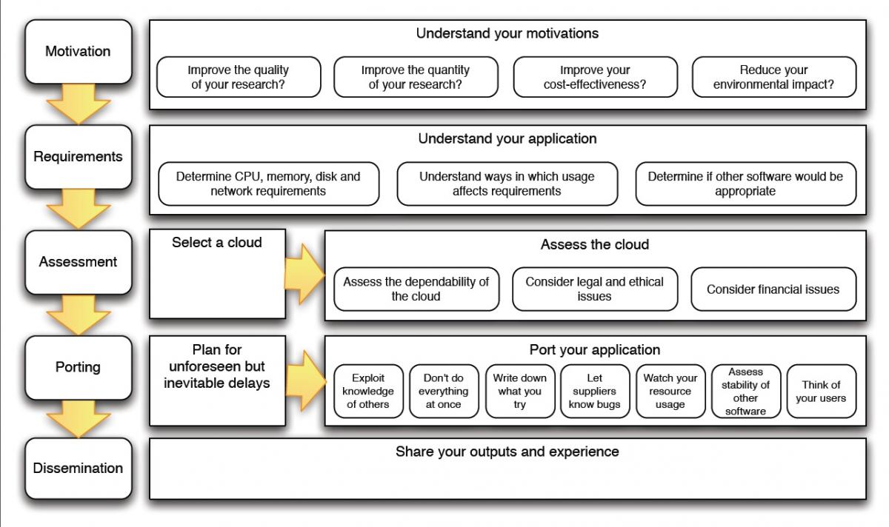
Software Deposit and Preservation Guidance workflows and diagrams
Desired look-and-feel to be similar to https://www.software.ac.uk/resources/guides/cloud-for-research-best-practice

Slide 2
Why deposit software
Personal benefits
Personal motivation
Save time/effort
Repeatability
Reproducibility
Reuse
Delegate storage/distribution responsibility
Research-related benefits
Promote trust
Improve quality
Research-related motivation
Historical record
Store more complete research ecosystem
Peer review
Get credit
Get collaborators
Funder/publisher requirement
Repeatability
Reproducibility
Reuse
Community benefits
Promote trust
Improve quality

Slide 3
When to deposit software
Ask yourself…
Deposit now
Publishing results derived from your software?
Sharing your software?
Project coming to an end?
Project going into a hiatus?
Concerned that others may publish results based on your software before you do?
Apply an embargo to publish later

Slide 4
Where to deposit software
Avoid popular but problematic options
Use to manage software under active development
Laptop
Desktop
USB
Web site
(personal, project, department)
Repository hosting service
(GitHub, BitBucket, GitLab, …)
Choose a digital repository
Identify your options
Institutional
Publisher/funder mandated/recommended
Community recommended
General
(e.g. Zenodo, Figshare, Software Heritage)
Assess your options
Does it issue persistent identifiers?
Is it mandated by a publisher/funder?
Is its longevity acceptable?
If there is a fee, is this a one-off payment and can you afford it?
Can it accommodate the size of your deposit?
Are its policies and service agreements acceptable?
Is it free or is there a fee?
Is it accredited/certified?

Slide 5
How to choose a software licence
Consider constraints
Who owns copyright?
Are copyright owners legal entities?
Does your software includes third-party software which imposes licensing restrictions?
Is there a stakeholder-mandated licence?
(institution, collaborators, funders, …)
Consider your intentions
Encourage reproducibility and reuse
Allow others to withhold source code of changes they make
Encourage commercialisation of your software
Charge for reuse of your software
Allow others to redistribute, modify, and redistribute modifications
Require others to release source code of changes they make
Prevent others from publishing research done using your software or details about your software
Explore licence options
OSI-approved open source licences
Permissive licences
(Apache 2, 3-clause BSD, MIT, …)
Free licences
(GPL 3, Mozilla Public Licence, …)
Dual licencing
Proprietary licences
Assess potential licence
Is licence acceptable to copyright owners and other stakeholders?
Are licence terms valid under national laws?
Do you know if any terms are not valid and implications of this?

Slide 6
How to deposit software
Read digital repository documentation
Review intended deposit content
Review yourself
Discuss with colleague
Colleague reviews content
Colleague reviews quality, utility, usability
Decide how to deposit
Deposit
Make manual deposit
Make tool-assisted deposit (if available)
Create deposit archive file
Check deposit archive file
Submit deposit archive file
Enter metadata
Make deposit
Check, correct, add metadata
Configure embargo
(optional)
Check uploaded deposit archive file

Slide 7
What to deposit
Minimal deposit
README
Name
Description
Contact
Link to project website/source code repository
Copyright and licence
(LICENCE)
Source code
Authors and other contributors
(CONTRIBUTORS)
includes
Runnable deposit
README
Version number
Copyright statement
Licence name
User documentation (if short)
Summary of other contents
Documentation
Metadata
Sample input and output data
User
Metadata
(codeMeta.json)
Recommended citation
(Citation.cff)
Dependencies
includes
Comprehensive deposit
Documentation
Additional sample and test data
Test code
Developer
What the code does and how it does it
Software ecosystem

Slide 8
What not to deposit
Sensitive personal information
Inappropriate content
Unused source code
Internal information
Temporary directories/files
Unnecessary data files
Software/data not licensed for sharing/redistribution
Source code repository configuration files
Unintended binary files/executables

Slide 9
How to describe a software deposit
Capture metadata
Minimal
Link to related research outputs
Get credit
Encourage discovery
Name
Version number
Description
Authors
Licence
Link to live software e.g. source code repository
Type
Version
Relationship
Contributors
Funders
Organisations
Keywords
Programming languages
Operating systems
Dependencies
Standards and specifications
etc.
Record metadata
Add plain-text (e.g. codeMeta.json and CONTRIBUTORS) files to deposit
Enter into digital repository web forms
Submit via digital repository application-programming interface

Slide 10
How to review a software deposit
Review content
Quick
but
superficial
Check deposit is in popular open archive format
Unpack deposit archive file
Check for minimal content
Check for content that should not be deposited
Check for runnable content
(optional)
Check for comprehensive content
(optional)
Review consistency
Compare
In case of inconsistencies, consult depositor
Deposit content
README
LICENCE
CONTRIBUTORS
Citation.cff
codeMeta.json
Digital repository metadata
Review quality, utility, usability
Comprehensive
but
time-consuming
Engage services of a research software engineer
(optional)
Build, deploy, run
Review readability, accuracy, comprehensibility, usability

