Slide 1
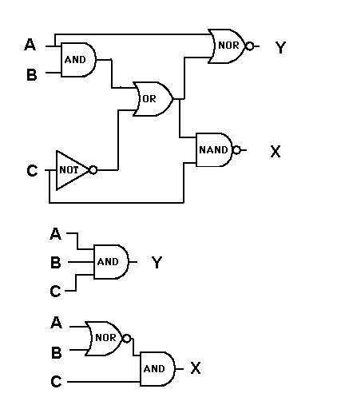
Logic Minimization

Slide 2
------------------------------------------------------------------------
The Espresso-II Algorithm, page 56 of /Logic Minimization
Algorithms for VLSI Synthesis/, by Brayton et. al.,
Kluwer Academic Publishers, 1984.
Procedure ESPRESSO-II (F, D)
/* Given F, a cover of {f,d,r} = (on-set, don't-care, off-set)
/* and D a cover of d, minimizes Phi(F)=(NPT,NLI,NLO)
/* where NPT is the number of cubes, NLI is the number of
/* input literals and NLO is the number of output literals.
/* Returns a minimized cover F and its cost Phi.
Begin
F <= UNWRAP(F)
R <= COMPLEMENT(F, D)
Phi1 <= Phi2 <= Phi3 <= Phi4 <= COST(F) /* Initialize Cost
LOOP1: (Phi,F) <= EXPAND(F,R) /* F is prime and SCC-minimal
if (First-Pass) /* Move essential primes
(Phi,F,D,E) <= ESSENTIAL_PRIMES(F,D)/* into don't care set
if (Phi == Phi1) goto OUT /* Check termination criterion
Phi1 <= Phi$
(Phi, F) <= IRREDUNDANT_COVER(F,D) /* F is minimal cover
if(Phi == Phi2) goto OUT /* of prime implicants
Phi2 <= Phi
LOOP2: (Phi,F) <= REDUCE(F,D) /* Each cube of F replaced by
if (Phi == Phi3) goto OUT /* smallest cube containing
Phi3 <= Phi /* its ``essential'' vertices.
goto LOOP1
OUT: if (Phi == Phi4) goto QUIT
(Phi', F) <= LAST_GASP(F, D, R) /* If no further improvement
if (Phi == Phi') goto QUIT /* terminate
Phi1 <= Phi2 <= Phi3 <= Phi4 <= Phi'
goto LOOP2
QUIT: F <= union(F,E) /* Put essential primes E back
D <= D - E /* into cover and out of D
(Phi, F) <= MAKE_SPARSE(F,D,R) /* Concentrate on literals
return(Phi, F)
End

Slide 3
Espresso-II in Prolog
lexpress --> unwrap,
complement,
expand,
essential_primes,
iterate(init_cost),
add_to_care,
sub_from_dont_care,
make_sparse.
iterate(done) --> [].
iterate(Step) -->
call(Step),
cost_value(Step, Previous, Current, PLA),
{ sum_costs(PLA, cost(0, 0, 0), Current),
Previous = Current -> next(Step, Next, _)
; next(Step, _, Next)
},
iterate(Next).
next(init_cost, reduce, reduce ).
next(irredundant, reduce2, reduce ).
next(reduce, reduce2, expand ).
next(expand, reduce2, irredundant ).
next(reduce2, done, init_cost ).

Slide 4
Cost Computations
% cost_value(+Step, -Previous, -New, -PLA, +DataIn, -DataOut)
cost_value(reduce, I, N, P, costs(I,R,E,G)-P,costs(N,R,E,G)-P).
cost_value(expand, R, N, P, costs(I,R,E,G)-P,costs(I,N,E,G)-P).
cost_value(irredundant,E, N, P, costs(I,R,E,G)-P,costs(I,R,N,G)-P).
cost_value(iterate, G, N, P, costs(I,R,E,G)-P,costs(I,R,E,N)-P).
cost_value(reduce2, G, N, P, costs(I,R,E,G)-P,costs(I,R,E,N)-P).
cost_value(init_cost, 2, 1, P, costs(I,R,E,G)-P,costs(I,R,E,G)-P).
sum_costs([], Cost, Cost).
sum_costs([c(Input,Output)|Cs], cost(P0,In0,Out0), Cost).
length(Input, LI),
length(Output,LO),
P1 is P0 + 1,
In1 is LI + In0,
Out1 is LO + 0ut0,
sum_costs(Cs, cost(P1,In1,Out1), Cost).
init_cost(_-PLA,costs(C,C,C,C)-PLA) :-
sum_costs(PLA,cost(0,0,0),C).

Slide 5
Definite Clause Grammar
You write:
f(A) → foo, bar(A), bean.
And this becomes:
f(A, Vin, Vout) :-
  foo(Vin, V2),
  bar(A, V2, V3),
  bean(V3, Vout).

Slide 6
L'express
The Program
runtime_entry(start) :-
unix(argv(CmdLine)),
options(CmdLine, File, fd, InType),
multplex_input(File, PLA0),
compute_other(InType, PLA0, PLA1),
lexpress(_-PLA1, costs(_,_,_,Cost)-PLAMin),
format(user_error,"Final PLA cost:~q~n",[Cost]),
change_suffix(File, '.po', OutFile),
multiplex_output(OutFile, PLAMin).
options([], _) --> [].
options([Op|Ops], File) -->
option(Op, Ops, Rest),
!,
option(Rest, File).
options([File|Ops], File) -->
option(Ops, File).
option('-Decho', R, R) --> {assert(echo)}.
option('-eness', R, R) --> {assert(ness)}.
option('-t', [Type|R],R, _, Type).

Slide 7
A Programmer's Bookshelf
K&R, The Camel Book (obviously)
The Perl Cookbook, The Craft of Prolog
I Robot (Azimov)
Software Tools (Kernighan and Plauger)
The UNIX Timesharing System (Lyons)
The Elements of Style (Strunk and White)
Modern English Usage (Fowler)
The Structure and Interpretation of Computer Programs (Ableson and Sussman²)

Slide 8
A Programmer's Bookshelf
K&R, The Camel Book (obviously)
The Perl Cookbook, The Craft of Prolog
I Robot (Azimov)
Software Tools (Kernighan and Plauger)
The UNIX Timesharing System (Lyons)
The Elements of Style (Strunk and White)
Modern English Usage (Fowler)
The Structure and Interpretation of Computer Programs (Ableson and Sussman²)

Slide 9
Get the right 'Fowler'
The Kings English (1906)
  Fowler and Fowler
Modern English Usage (1930)
  This is the one you want
A Dictionary of Modern English Usage
  Edited by Sir Gowers (1965)
The New Fowlers Modern English Usage
  (1996) Edited by R.W. Burchfeld
  Humorless drudgery

