Slide 1

Definite Clause Grammars
Input: List of tokens
Output: Data structure (sentence diagram)
Must be able to Backtrack
Every Rule has:
  Input List
  Output List
  May have other arguments

Slide 2
A Grammar
sentence --> noun_phrase,verb_phrase.
noun_phrase --> proper_noun.
noun_phrase --> article,adjective,noun.
noun_phrase --> article,noun.
verb_phrase --> intransitive_verb.
verb_phrase --> transitive_verb,noun_phrase.
article --> [the].
adjective --> [lazy].
adjective --> [rapid].
proper_noun --> [achilles].
noun --> [turtle].
intransitive_verb --> [sleeps].
transitive_verb --> [beats].

Slide 3
Data Structure
(sentence diagram)
sentence
noun_phrase
verb_phrase
article
adjective
noun
transitive_verb
noun_phrase
proper_noun
the
rapid
turtle
beats
achilles

Slide 4
Definite Clause Grammar
You write:
sentence(s(N,V)) →
np(N),
  vp(V).
And it becomes:
sentence(s(N,V), T0, T2) :-
      np(N, T0, T1 ),
      vp(V, T1, T2 ).
(The first is sentence//1 the second sentence/3)

Slide 5
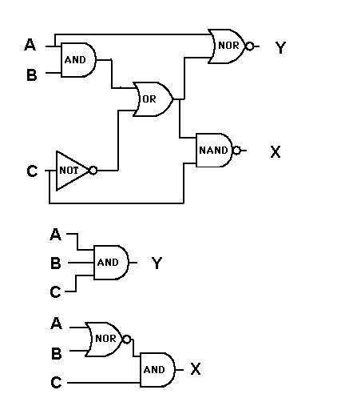
Logic Minimization

Slide 6
Logic Minimization
A B C X Y
0 0 0 0 0
0 0 1 0 0
0 1 0 0 0
0 1 1 0 0
1 0 0 0 0
1 0 1 1 0
1 1 0 0 0
1 1 1 1 0
1 1 1 0 1
0 1 0 1 0
1 0 0 1 0

Slide 7
------------------------------------------------------------------------
The Espresso-II Algorithm, page 56 of /Logic Minimization
Algorithms for VLSI Synthesis/, by Brayton et. al.,
Kluwer Academic Publishers, 1984.
Procedure ESPRESSO-II (F, D)
/* Given F, a cover of {f,d,r} = (on-set, don't-care, off-set)
/* and D a cover of d, minimizes Phi(F)=(NPT,NLI,NLO)
/* where NPT is the number of cubes, NLI is the number of
/* input literals and NLO is the number of output literals.
/* Returns a minimized cover F and its cost Phi.
Begin
F <= UNWRAP(F)
R <= COMPLEMENT(F, D)
Phi1 <= Phi2 <= Phi3 <= Phi4 <= COST(F) /* Initialize Cost
LOOP1: (Phi,F) <= EXPAND(F,R) /* F is prime and SCC-minimal
if (First-Pass) /* Move essential primes
(Phi,F,D,E) <= ESSENTIAL_PRIMES(F,D)/* into don't care set
if (Phi == Phi1) goto OUT /* Check termination criterion
Phi1 <= Phi$
(Phi, F) <= IRREDUNDANT_COVER(F,D) /* F is minimal cover
if(Phi == Phi2) goto OUT /* of prime implicants
Phi2 <= Phi
LOOP2: (Phi,F) <= REDUCE(F,D) /* Each cube of F replaced by
if (Phi == Phi3) goto OUT /* smallest cube containing
Phi3 <= Phi /* its ``essential'' vertices.
goto LOOP1
OUT: if (Phi == Phi4) goto QUIT
(Phi', F) <= LAST_GASP(F, D, R) /* If no further improvement
if (Phi == Phi') goto QUIT /* terminate
Phi1 <= Phi2 <= Phi3 <= Phi4 <= Phi'
goto LOOP2
QUIT: F <= union(F,E) /* Put essential primes E back
D <= D - E /* into cover and out of D
(Phi, F) <= MAKE_SPARSE(F,D,R) /* Concentrate on literals
return(Phi, F)
End

Slide 8
Espresso-II in Prolog
% Each step consumes/produces a COST-PLA structure
lexpress --> unwrap,
complement,
expand,
essential_primes,
iterate(init_cost),
add_to_care,
sub_from_dont_care,
make_sparse.
iterate(done) --> [].
iterate(Step) -->
call(Step),
cost_value(Step, Previous, Current, PLA),
{ sum_costs(PLA, cost(0, 0, 0), Current),
Previous = Current -> next(Step, Next, _)
; next(Step, _, Next)
},
iterate(Next).
next(init_cost, reduce, reduce ).
next(irredundant, reduce2, reduce ).
next(reduce, reduce2, expand ).
next(expand, reduce2, irredundant ).
next(reduce2, done, init_cost ).

Slide 9
Cost Computations
% cost_value(+Step, -Previous, -New, -PLA, +DataIn, -DataOut)
cost_value(reduce, I, N, P, costs(I,R,E,G)-P,costs(N,R,E,G)-P).
cost_value(expand, R, N, P, costs(I,R,E,G)-P,costs(I,N,E,G)-P).
cost_value(irredundant,E, N, P, costs(I,R,E,G)-P,costs(I,R,N,G)-P).
cost_value(iterate, G, N, P, costs(I,R,E,G)-P,costs(I,R,E,N)-P).
cost_value(reduce2, G, N, P, costs(I,R,E,G)-P,costs(I,R,E,N)-P).
cost_value(init_cost, 2, 1, P, costs(I,R,E,G)-P,costs(I,R,E,G)-P).
init_cost(_-PLA,costs(C,C,C,C)-PLA) :-
sum_costs(PLA,cost(0,0,0),C).
sum_costs([], Cost, Cost).
sum_costs([c(Input,Output)|Cs], cost(P0,In0,Out0), Cost) :-
length(Input, LI),
length(Output,LO),
P1 is P0 + 1,
In1 is LI + In0,
Out1 is LO + 0ut0,
sum_costs(Cs, cost(P1,In1,Out1), Cost).
cost(Irr,Red,Exp,Global) PLA

Slide 10
L'express
The Program
runtime_entry(start) :-
unix(argv(CmdLine)),
options(File, CmdLine, []),
multplex_input(File, PLA0),
compute_other(PLA0, PLA1),
lexpress(_-PLA1, costs(_,_,_,Cost)-PLAMin),
format(user_error,"Final PLA cost:~q~n",[Cost]),
change_suffix(File, '.po', OutFile),
multiplex_output(OutFile, PLAMin).
options(_) --> [].
options(File) --> option(Op), !, options(File).
options(File) --> [File], options(_).
option --> ['-Decho'], { assert(echo) }.
option --> ['-eness'], { assert(ness) }.
option --> ['-t', Type], { assert(type(Type)) }.
option --> ['--help'], { usage, exit }.

Slide 11
Result
600 lines of Prolog
vs.
11,000 lines of C
Actual program smaller and clearer
than the original psuedo-code?
Prolog is somewhat slower
(but then, nothing is cheaper than computer power).

Slide 12
Source Code
%</style>
%</head>
%<body>
%<h3>lexpress//0</h3>
%<p>
%The <b>L'express</b> procedure uses the Definite Clause Grammar
%notation to pass a <b>cost</b> vector and <b>PLA</b> structure to
%each of the goals in the body of this predicate.
%<center><b>costs(Irr,Red,Exp,Global)-PLA</b></center>
%Each step in the algorithm can create a new PLA structure
%which will produce a new cost evaluation for the new PLA.
%<code>
lexpress --> unwrap,
complement,
expand,
essential_primes,
iterate(init_cost),
add_to_care,
sub_from_dont_care,
make_sparse.
%</code>
%<h3>iterate//1</h3>

Slide 13
Prolog → HTML
#!/bin/perl
my $outfile = $ARGV[0];
$outfile =~ s/\.pl$/.html/;
open IN,"<$ARGV[0]";
open OUT,">$outfile";
while(<IN>)
{
s/^%//g;
s/<code>/<b><pre>/g;
s/<\/code>/<\/pre><\/b>/g;
print OUT $_;
}
close IN;
close OUT;

Slide 14
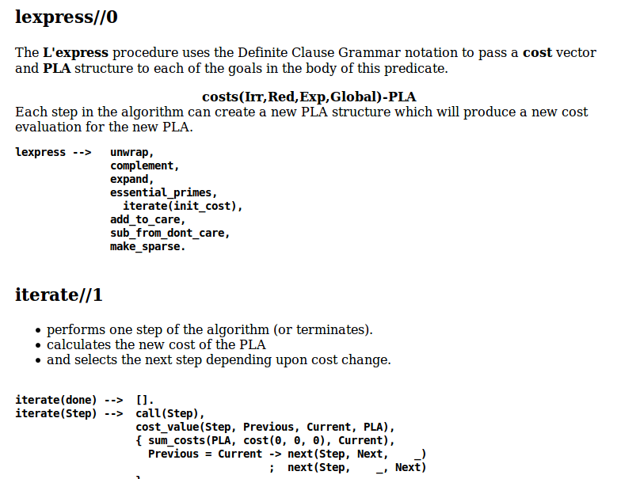
Documentation

