Slide 1
Great projects

Slide 2
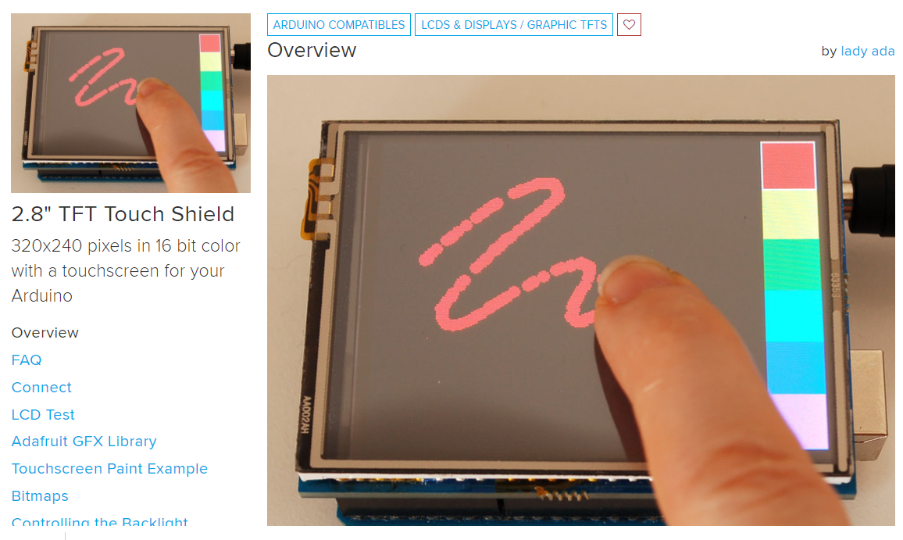
https://learn.adafruit.com/2-8-tft-touch-shield

Slide 3
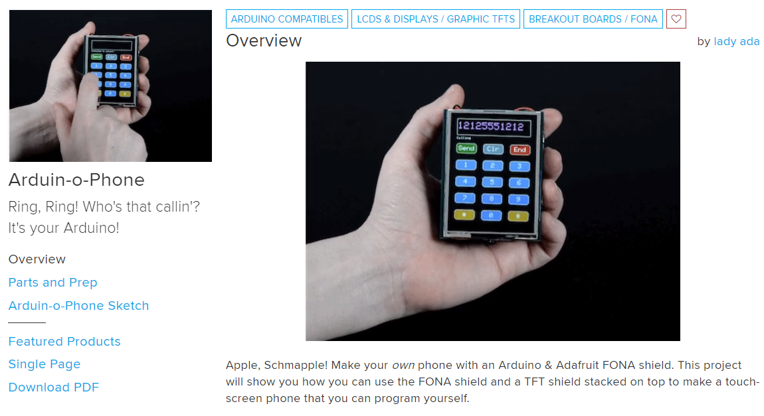
https://learn.adafruit.com/arduin-o-phone-arduino-powered-diy-cellphone

Slide 4
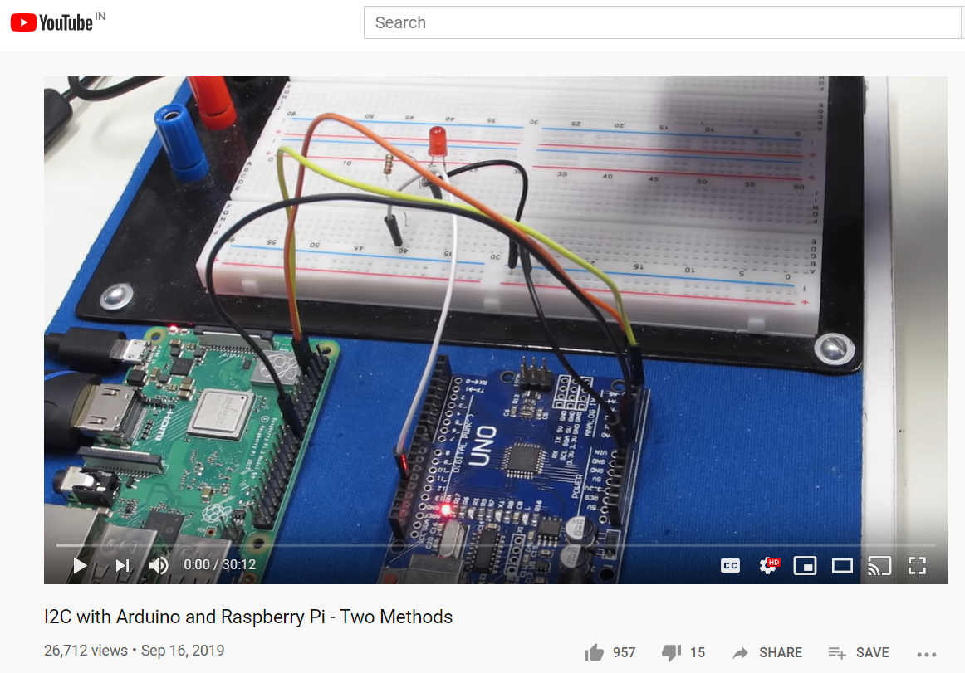
https://www.youtube.com/watch?v=me7mhrRbspk&feature=youtu.be

Slide 5
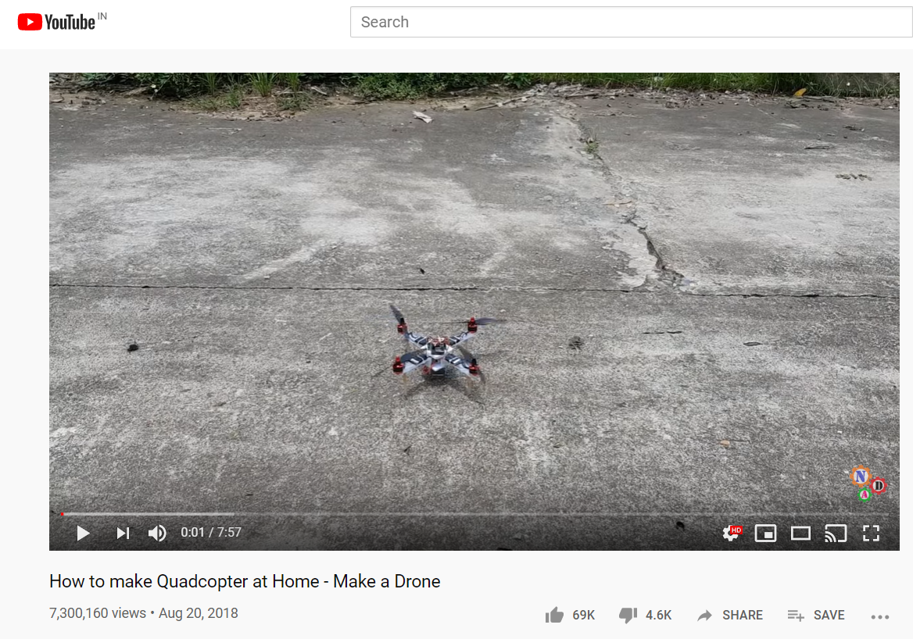
https://www.youtube.com/watch?v=XvMdL1PncEQ&feature=youtu.be

Slide 6
Bluetooth control car using ps3 Bluetooth controller
Option 0 – Build a robot car
https://dronebotworkshop.com/robot-car-with-speed-sensors/
Option 1 - Bluetooth
Control a remote control car using Bluetooth, using PS3 Bluetooth joystick
Option 2 – NRF24l01 / Use Hitanshu’s Drone RF Remote
https://dronebotworkshop.com/nrf24l01-wireless-joystick/

Slide 7
LiDAR Based project - Light Detection and Ranging
https://robu.in/product/tf-mini-lidar-laser-range-finder-security-li-dar-sensor-drones-uav-uas-robots/?gclid=Cj0KCQiA2ITuBRDkARIsAMK9Q7NiOrcN8jMZ9AV40g91kkpYognMGE3v_HN1abeSv8pkvGBVEx8ys2kaAj1jEALw_wcB
Measurement range : 12 m
The TFMini micro LiDAR distance sensor for drones UAV UAS robots (12m) Laser Range Finder sensor has its unique optical, structural, and electronic designs, the product possesses 3 major advantages, low cost, tiny volume and low power consumption. It has built-in algorithm adapted to indoor and outdoor environments can guarantee an excellent ranging performance at a low cost and in a tiny volume, which highly expands the application fields and scenarios of LiDAR and lays a solid foundation for future “eyes” in the smart era.
TF Mini is a single-point micro ranging module and could be widely used in the integrated application of various drones, UAVs, Robots and industrial types of equipment. Main Characteristics of TFMini micro LiDAR distance sensor for drones UAV UAS robots (12m) are, this product is based on TOF (Time of Flight) principle and integrated with unique optical and electrical designs, so as to achieve stable, precise, high sensitivity and high-speed distance detection.
Applications :
Unidirectional ranging LiDAR.
Obstacle avoidance.
Assisted landing.
Terrain following.
Robots outdoor obstacle avoidance.
Intelligent parking. Crane operations.
Vehicle position sensing.
Vehicle detection for barrier gate control.
High-precision & High-speed measurement.
Eye-safe infrared LED light.
Compact size, lightweight.
Good performance for height fixing and terrain following drones

