Slide 1
Great projects

Slide 2
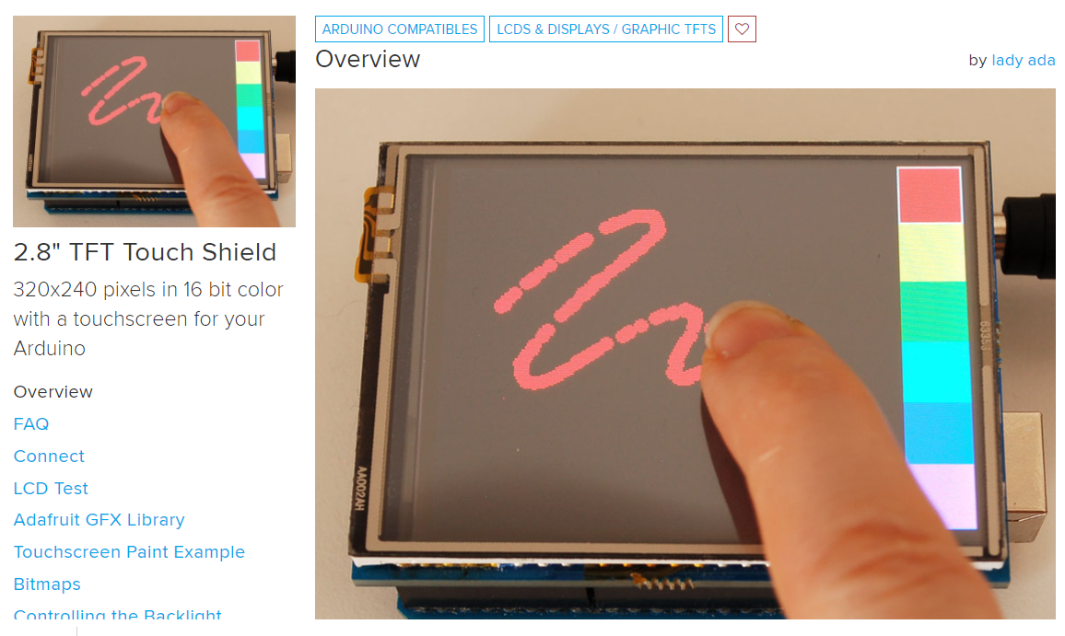
https://learn.adafruit.com/2-8-tft-touch-shield

Slide 3
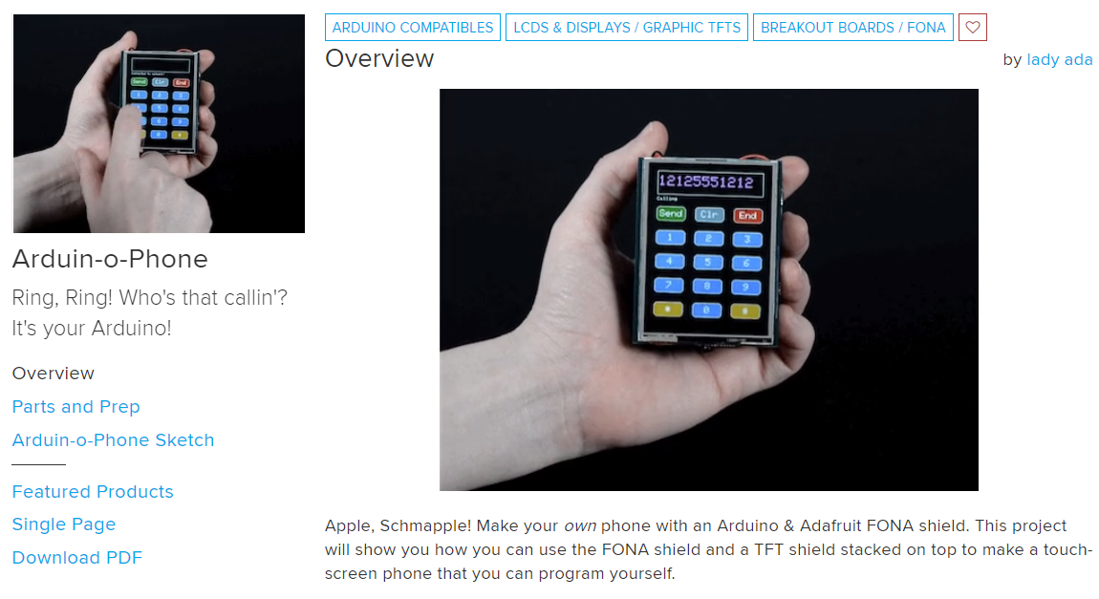
https://learn.adafruit.com/arduin-o-phone-arduino-powered-diy-cellphone

Slide 4
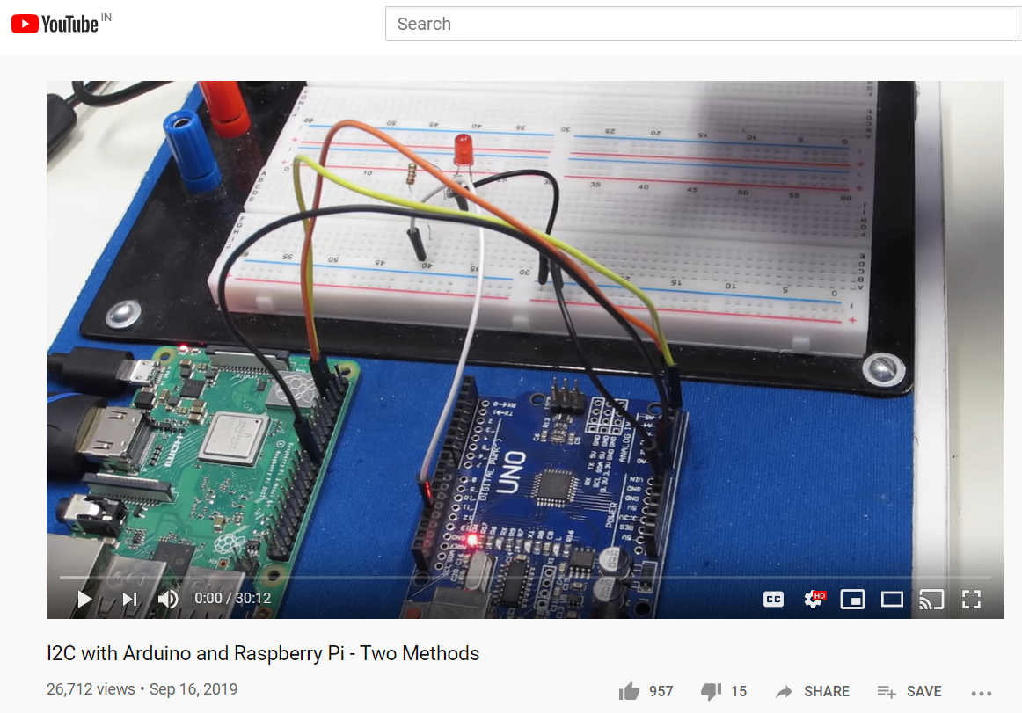
https://www.youtube.com/watch?v=me7mhrRbspk&feature=youtu.be

Slide 5
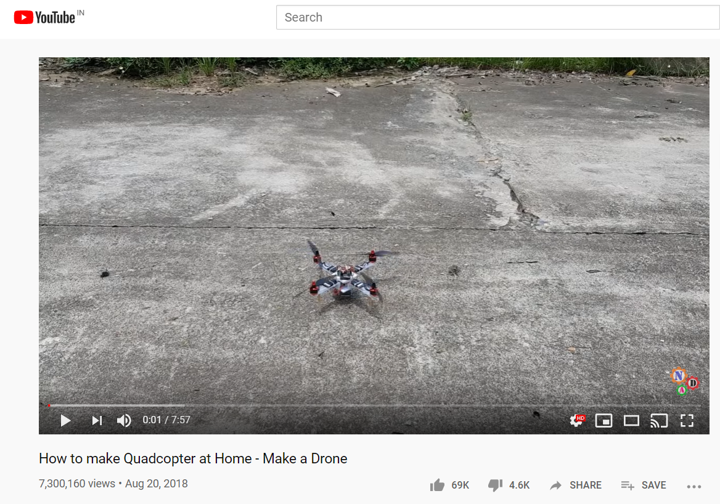
https://www.youtube.com/watch?v=XvMdL1PncEQ&feature=youtu.be

Slide 6
Bluetooth control car using ps3 Bluetooth controller
Control a remote control car using Bluetooth, using PS3 Bluetooth joystick

