Slide 1
MMC Card interfacing

Slide 2
MMC Card interfacing

Slide 3
Hardware Required
Arduino Board
USB Cable type A to B
MMC shield (Arduino, Adafruit based) – we used Arduino based shield
Female to male jumper wire
MMC Card
Hook-up wire
SOFTWARE Required
Sd2Card library class
SdVolume library class
SdFile library class

Slide 4
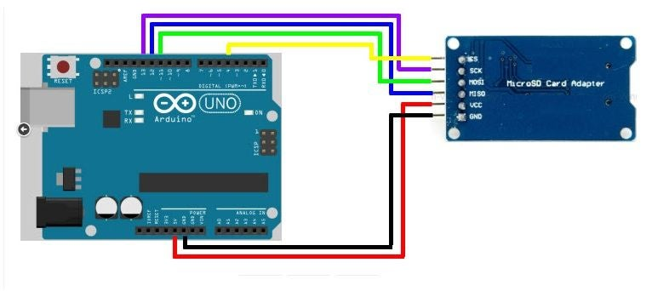
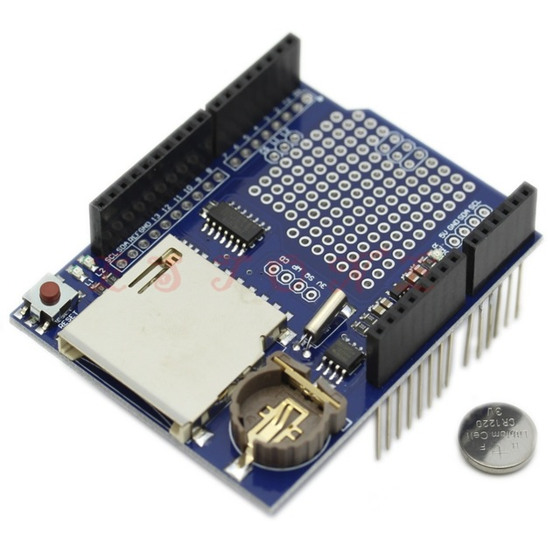
Circuit
Connect VCC with 5V in the Arduino.
Connect the GND of SD card to the ground of Arduino.
Connect CS to pin 10 / 4 / 14 (Depends on shield or adapter used)
Connect SCK to pin 13
MOSI connect to the pin 11
Connect MISO to pin 12
After completing the connection, connect the Arduino to power supply with USB cable.
MMC Adapter
This module uses the standard SPI interface for communication, which involve SPI buses, MISO, MOSI, SCK, and a CS signal pin. through programming, the data can easily be read and wrote into SD Card by using the Arduino or other microcontrollers.
CS (chip select)
SCK (serial clock)
MOSI (master out slave in)
VCC (3.3V or 5V)
GND (ground)
MMC + RTC
Shield

Slide 5
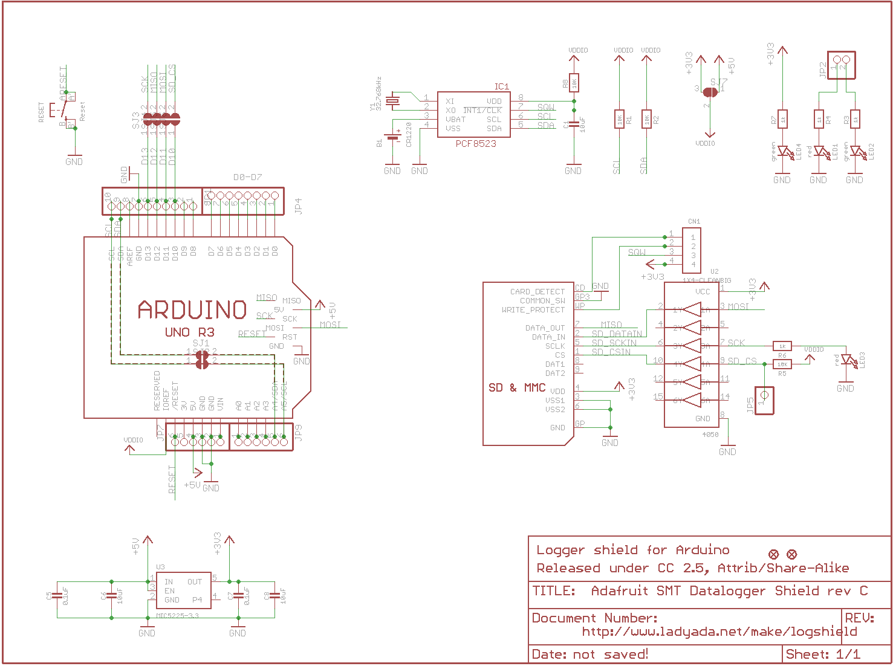
SCHEMATIC

Slide 6
Code – MMC R/W Using Shield

Slide 7
Code – MMC R/W Using Shield

Slide 8
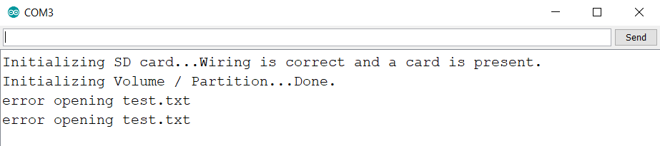
TROUBLESHOOTING
Tried everything, tested everything (wiring, CS pin, 5V power input) …still getting this error ?

Slide 9
Sketch file

Slide 10
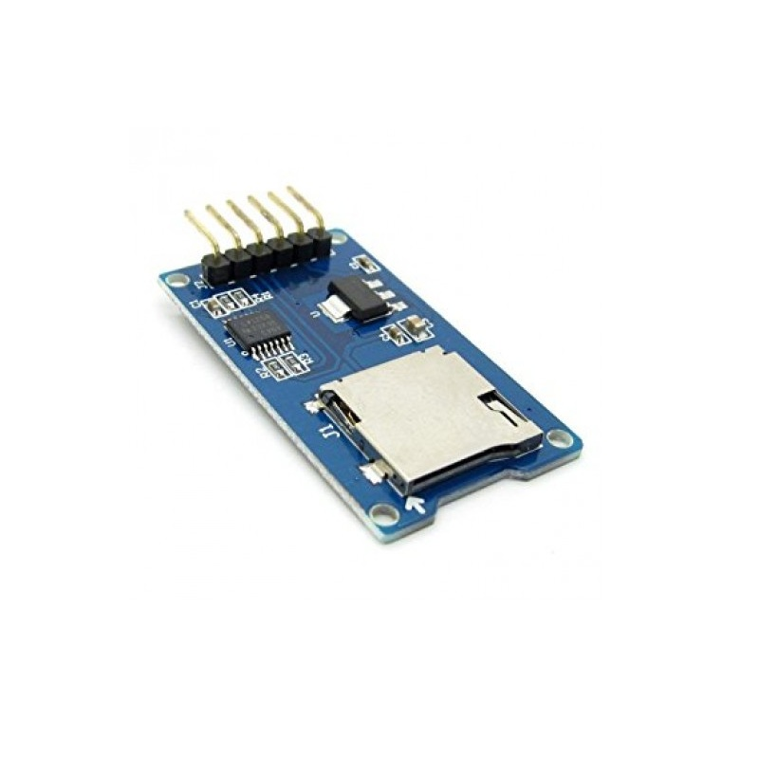
Where to buy
Micro SD Card Reader Module
https://robu.in/product/micro-sd-card-module/
Data Logger module Logging Shield data Recorder Shield (with RTC)
https://robu.in/product/data-logger-module-logging-shield-data-recorder-shield/

Slide 11
Trouble shoot guide
MMC Init Fails
I know this question is relatively old but still, if you wnat to run SD.begin(chipselect); again first call if(root.isOpen()) root.close(); I added this to the library. This way SD.begin(chipselect) will return true if a card is present and false when it's not.

