Slide 1
Software Serial Port
https://www.arduino.cc/en/Tutorial/SoftwareSerialExample

Slide 2
Software Serial Port
Arduino and Genuino boards have built in support for serial communication on pins 0 and 1, but what if you need more serial ports?
The SoftwareSerial Library has been developed to allow serial communication to take place on the other digital pins of your boards, using software to replicate the functionality of the hardwired RX and TX lines.
This can be extremely helpful when the need arises to communicate with two serial enabled devices, or to talk with just one device while leaving the main serial port open for debugging purpose.
In the example below, digital pins 10 and 11 on your Arduino or Genuino boards are used as virtual RX and TX serial lines. The virtual RX pin is set up to listen for anything coming in on via the main serial line, and to then echo that data out the virtual TX line.
Conversely, anything received on the virtual RX is sent out over the hardware TX.

Slide 3
Hardware Required
Arduino Board
Usb to Serial (Silicon Lab’s CP210x module used in this example)
Female to male jumper wire
Hook-up wire
SOFTWARE Required

Slide 4
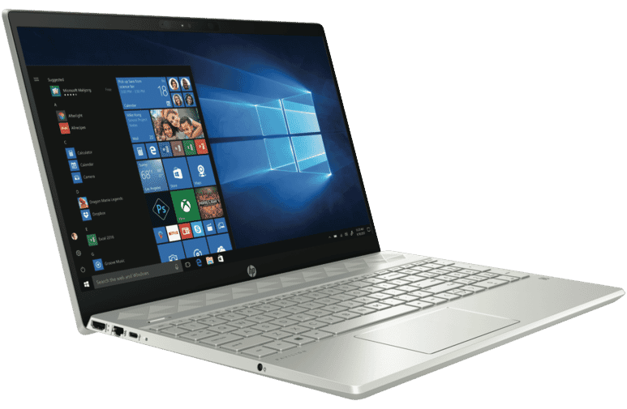
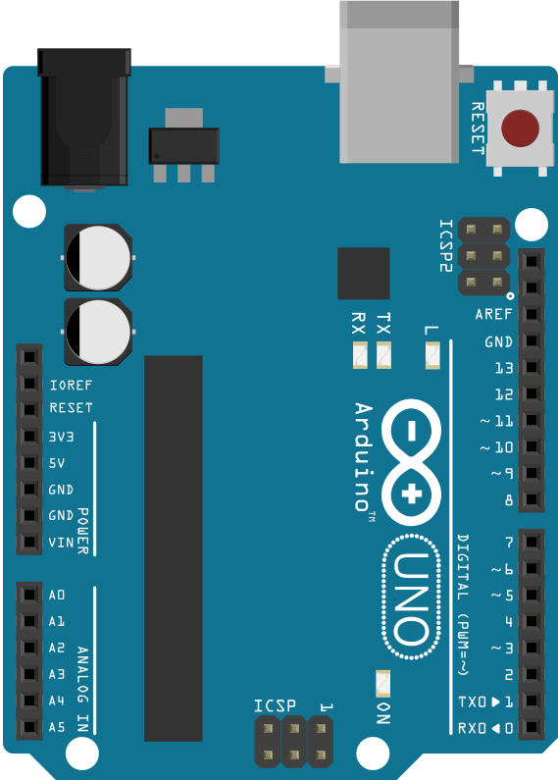
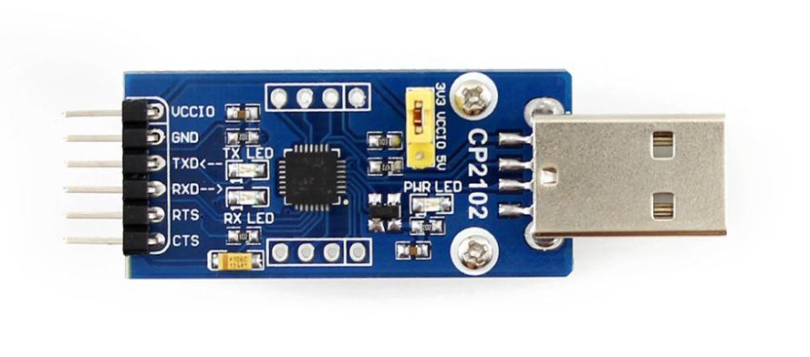
Circuit
Connect Software_RX_Pin_2 (Arduino) with TX of USB-to-Serial Converter.
Similarly, Connect Software_TX_Pin_3 (Arduino) with RX of USB-to-Serial Converter.
Connect both usb (one on Arduino and one on USB-Serial Converter to two different ports on Laptop.
USB Port 1
USB-to-Serial Converter
USB Port 2

Slide 5
Code – MMC R/W
/*
Software serial multple serial test
Receives from the hardware serial, sends to software serial.
Receives from software serial, sends to hardware serial.
The circuit:
* RX is digital pin 2 (connect to TX of other device)
* TX is digital pin 3 (connect to RX of other device)
*/
#include <SoftwareSerial.h>
SoftwareSerial mySerial(2, 3); // RX, TX
void setup()
{
// Open serial communications and wait for port to open:
Serial.begin(115200);
while (!Serial) {
; // wait for serial port to connect. Needed for Native USB only
}
Serial.println("Goodnight moon!");
// set the data rate for the SoftwareSerial port
mySerial.begin(115200);
mySerial.println("Hello, world?");
}
void loop() // run over and over
{
if (mySerial.available())
Serial.write(mySerial.read());
if (Serial.available())
mySerial.write(Serial.read());
}

Slide 6
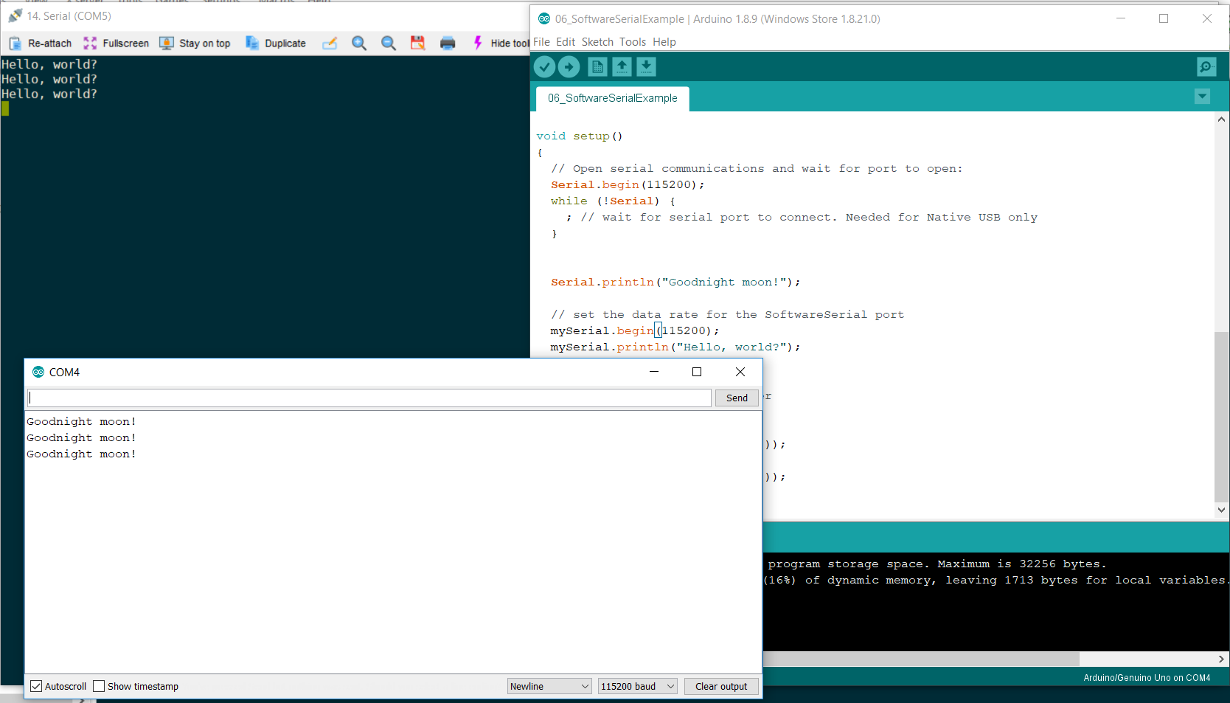
Output
USB Port 2
USB Port 1

Slide 7
TROUBLESHOOT
In case junk characters are observed, ensure that in USB port’s properties, the baud rate is properly configured to the baud rate configured in our sketch (ie. 115200 in our case).
Try to use same baud rate across all interfaces. (Hardware and Software serial ports)

Slide 8
Sketch file

