Slide 1
PCD8544 Nokia Lcd Interfacing
Ex1 – Plain Vanila LCD Interfacing
Ex2 – Temperature Measurement (DS1820) and display on LCD [Thread based]

Slide 2
PCD8544 LCD Interfacing
In this article, we are going to interface the PCD8544 LCD with Arduino.
We will learn interfacing PCD8544 & Arduino with the help of two examples.
First, we will simply show some data on the screen.
In the second example; we will read from the DS1820 temperature and will show the readings on the PCD8544 LCD screen.
The PCD8544 LCD is a great choice when it comes to display data. It is cheaper and very easy to use with the micro-controllers. You just have to connect some wires and you are ready to go.
PCD8544 – Popularly used in Nokia3310 / 5110 mobile phones. Feel proud if you owned one ;-)
This LCD interfacing project is developed using PCD8544 LCD along with Arduino Uno R3 development board

Slide 3
Hardware Required
Arduino Board
USB Cable type A to B
PCD8544 LCD (aka. Nokia Phone LCD)
Hook-up wire(s)
SOFTWARE Required
PCD8544 library by Carlos Rodrigues
Note : There are plenty of other libraries available as well. However, we will be using the library mentioned above for this example

Slide 4
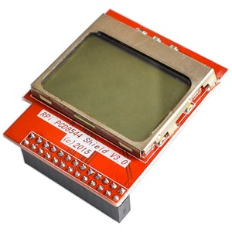
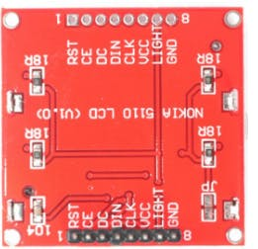
PINOUT
The pin out of the Nokia LCD is as follows :
RST: Reset Pin
SCE / CE: chip select Pin / chip enable
D/C: (Data/Command): This is the mode select pin. Low means command mode and high means Data mode.
DN (Data Pin): Serial Data In
SCLK: Serial Clock
VCC: Input voltage is from 2.7 to 3.3V
LED / LIGHT: This LED is the backlight LED. Input voltage is 3.3V
GND: Ground

Slide 5
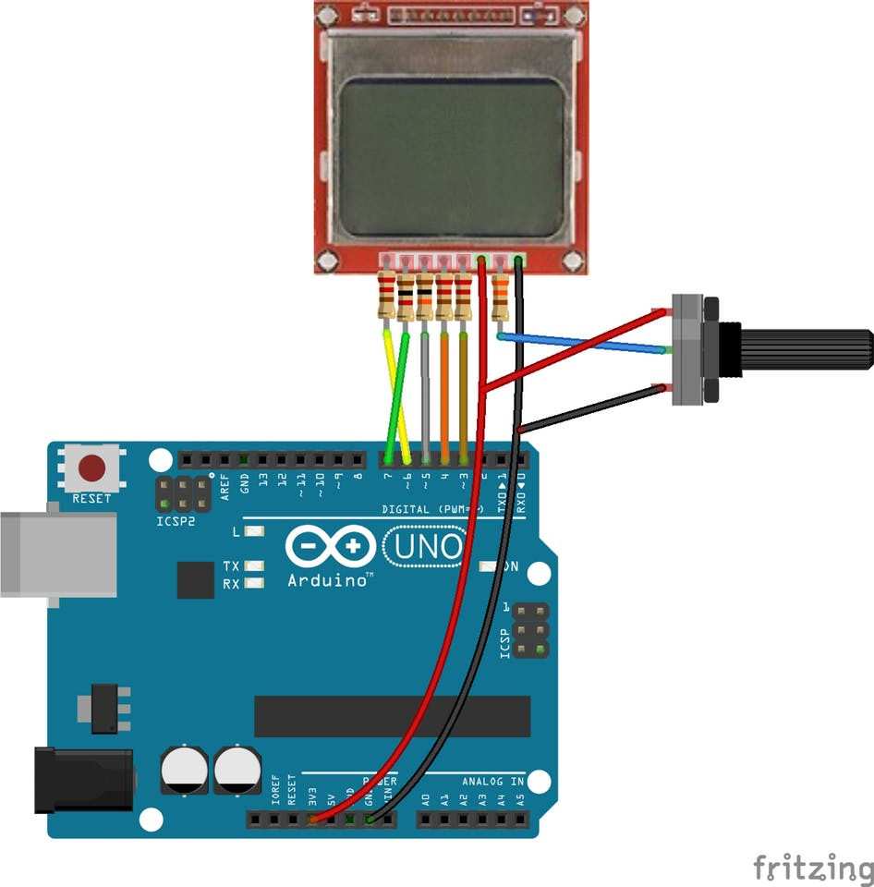
Circuit
Connect Wires as per the table given below :
SIGNAL NAME | PCD8544 LCD Rpi Header PIN # | ARDUINO PIN
VCC | P-01 | 3.3 V
GND | P-06 | GND
CLK | P-11 | 3
DIN | P-12 | 4
D/C | P-13 | 5
CS | P-15 | 7
RST | P-16 | 6
LED / LIGHT | P-01 | 3.3 V
26
1
2

Slide 6
Code – Example1
#include <PCD8544.h>
/* PIN definition on Arduino board */
#define SCLK_PIN 3 // Clock pin
#define DIN_PIN 4 // Data In pin
#define DC_PIN 5 // Data/Command select pin
#define RST_PIN 6 // LCD reset pin
#define SCE_PIN 7 // Select Chip Enable pin
/* Create an object with LCD pins as defined above */
PCD8544 lcd(SCLK_PIN, DIN_PIN, DC_PIN, RST_PIN, SCE_PIN);
#define LCD_WIDTH 84
#define LCD_HEIGHT 48
void setup() {
lcd.begin(LCD_WIDTH, LCD_HEIGHT);
}
void loop() {
lcd.setCursor(0, 0);
lcd.print(" WELCOME ");
lcd.setCursor(0, 1);
lcd.print(" To");
lcd.setCursor(0, 2);
lcd.print(" Softwares");
lcd.setCursor(0, 3);
lcd.print(" Unleashed");
lcd.setCursor(0, 5);
lcd.print("Auth:Sudhanshu");
delay(200);
}

Slide 7
Code – Explaination
First of all, we have included the library (PCD8544 library by Carlos Rodrigues) for the Nokia 5110 LCD. The library will include all the commands that we will require for the Nokia 5110 LCD.
Then, we have declared a variable named ‘lcd’ of type PCD8544, which configures the various signals connected to LCD panel and on other end on Arduino.
/* PIN definition on Arduino board */
#define SCLK_PIN 3 // Clock pin
#define DIN_PIN 4 // Data In pin
#define DC_PIN 5 // Data/Command select pin
#define RST_PIN 6 // LCD reset pin
#define SCE_PIN 7 // Select Chip Enable pin
/* Create an object with LCD pins as defined above */
PCD8544 lcd(SCLK_PIN, DIN_PIN, DC_PIN, RST_PIN, SCE_PIN);
Then in the setup function, we have set the resolution for the Nokia 5110 LCD. The Nokia5110 LCD has 84X48 resolutions, so we have set the 84X48 resolution in the Arduino IDE.
lcd.begin(84, 48);

Slide 8
Code – Explanation
Then in the loop function, first we have set the cursor at first line and printed the ‘Welcome there’. Then we moved to second line and printed ‘To’ there and then on the third line, we printed ‘Softwares Unleashed’. And finally on fifth line we print ‘Auth:Sudhanshu’
void loop() {
lcd.setCursor(0, 0);
lcd.print(" WELCOME ");
lcd.setCursor(0, 1);
lcd.print(" To");
lcd.setCursor(0, 2);
lcd.print(" Softwares");
lcd.setCursor(0, 3);
lcd.print(" Unleashed");
lcd.setCursor(0, 5);
lcd.print("Auth:Sudhanshu");
delay(200);
}

Slide 9
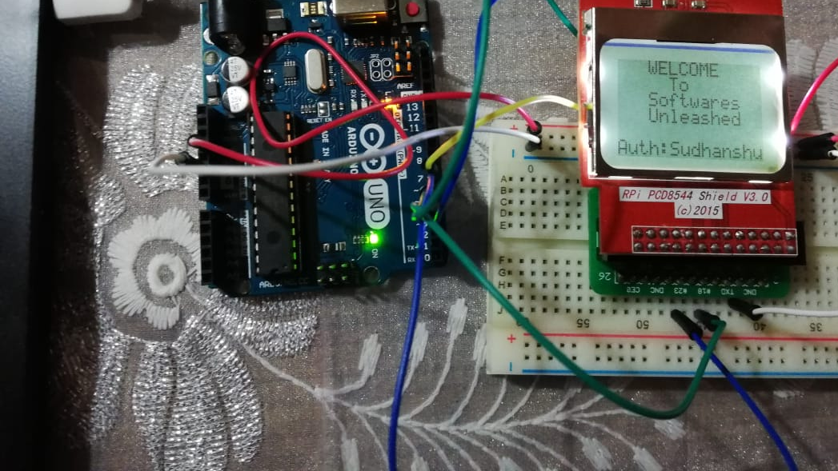



Actual Photographs

Slide 10
Ex2 - PCD8544 LCD TEMPERATURE DISPLAY (Freertos)
In the second example, we will connect the DS1820 temperature with the Arduino and will read the temperature using the temperature IC.
Finally we display these temperature measurements on the Nokia 5110 LCD (PCD8544).
We will use a RTOS (Real Time Operating System), to create two separate threads / tasks (as you may like to call it). One thread reads temperature from DS1820 and store it in a global temperature variable.
Second thread, LCD thread, reads the global variable and displays it on LCD calling the LCD library routines.
Possible Design flaw : There would be preemption while reading / writing to the global variable and this may result in temporary false temperature readings. (TODO : This will be fixed in next project)
Troubleshooting Note : IC DS1820 needs 5V as power supply for its smooth functioning, and ignoring that may result in erratic temperature measurements. (e.g. -127 dec C)

Slide 11
Hardware Required
Arduino Board
USB Cable type A to B
PCD8544 LCD (aka. Nokia Phone LCD)
DS1820 Temp IC breakout board – Caution : This Temp IC needs 5V VCC to operate.
Hook-up wire(s)
SOFTWARE Required
PCD8544 library by Carlos Rodrigues
One Wire Library
DallasTemperature Library

Slide 12
Code – Temperature Display using freertos
/* Include Arduino FreeRTOS library */
#include <Arduino_FreeRTOS.h>
/* LCD Include file */
#include <PCD8544.h>
/* Code for reading from Temperature Sensor */
#include <OneWire.h>
#include <DallasTemperature.h>
#define THREAD_DELAY 5000
/* Wiring Details */
/* PIN definition for LCD on Arduino board */
#define SCLK_PIN 3 // Clock pin
#define DIN_PIN 4 // Data In pin
#define DC_PIN 5 // Data/Command select pin
#define RST_PIN 6 // LCD reset pin
#define SCE_PIN 7 // Select Chip Enable pin
/* Data wire is plugged into pin 8 on Ardiuno */
#define ONE_WIRE_BUS 8
/* Global variables */
float fCurrentTemp = 0;
void setup()
{
/* Create LCD FreeRTOS thread */
xTaskCreate(LCDDisplayTask, "LCD Display Thread", 128, NULL, 1, NULL);
/* Create Temperature FreeRTOS thread */
xTaskCreate(TempReadTask, "Temp Read Task", 128, NULL, 1, NULL);
}
// Loop is empty in case of FreeRTOS, we have our own threads now.
void loop() { }

Slide 13
Code – Temperature Display using freertos
/* ------------------ Temp IC related stuff ---------------------
Setup a oneWire instance to communicate with any OneWire
devices (not just lcMaxim/Dallas temperature ICs)
*/
OneWire oneWire(ONE_WIRE_BUS);
/* Pass our oneWire reference to Dallas Temperature. */
DallasTemperature sensors(&oneWire);
void TempReadTask(void *pvParameters)
{
Serial.begin(115200); // start serial port
Serial.println("Dallas Temperature IC Control Library Demo");
sensors.begin(); // Start up the library
while(1)
{
// Send the command to get temperatures
sensors.requestTemperatures();
// Read temperature from IC
fCurrentTemp = sensors.getTempCByIndex(0);
Serial.print("Temperature for Device 1 is: ");
Serial.print(sensors.getTempCByIndex(0));
delay(THREAD_DELAY);
}
}
/* ------------------ LCD related stuff ---------------------*/
/* Create an object with LCD pins as defined above */
PCD8544 lcd(SCLK_PIN, DIN_PIN, DC_PIN, RST_PIN, SCE_PIN);
#define LCD_WIDTH 84
#define LCD_HEIGHT 48
void LCDDisplayTask(void *pvParameters)
{
lcd.begin(LCD_WIDTH, LCD_HEIGHT);
while(1)
{
lcd.setCursor(0, 0);
lcd.print("Temp : ");
lcd.setCursor(0, 1);
/* Print current temperature that is read in another thread */
lcd.print(fCurrentTemp);
lcd.print(" C");
lcd.setCursor(0, 5);
lcd.print("Auth:Sudhanshu");
delay(THREAD_DELAY);
}
}

Slide 14
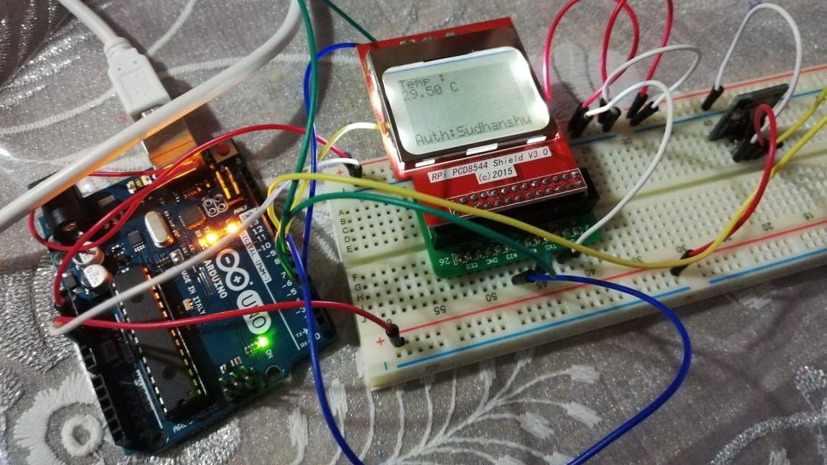
Actual Photographs

Slide 15
Sketch file
Based on FreeRTOS

