Slide 1
M-1 MIFARE Introduction Training:
Introduction MIFARE Classic 1K
Renke Bienert
BLID CAS, 2011

Slide 2

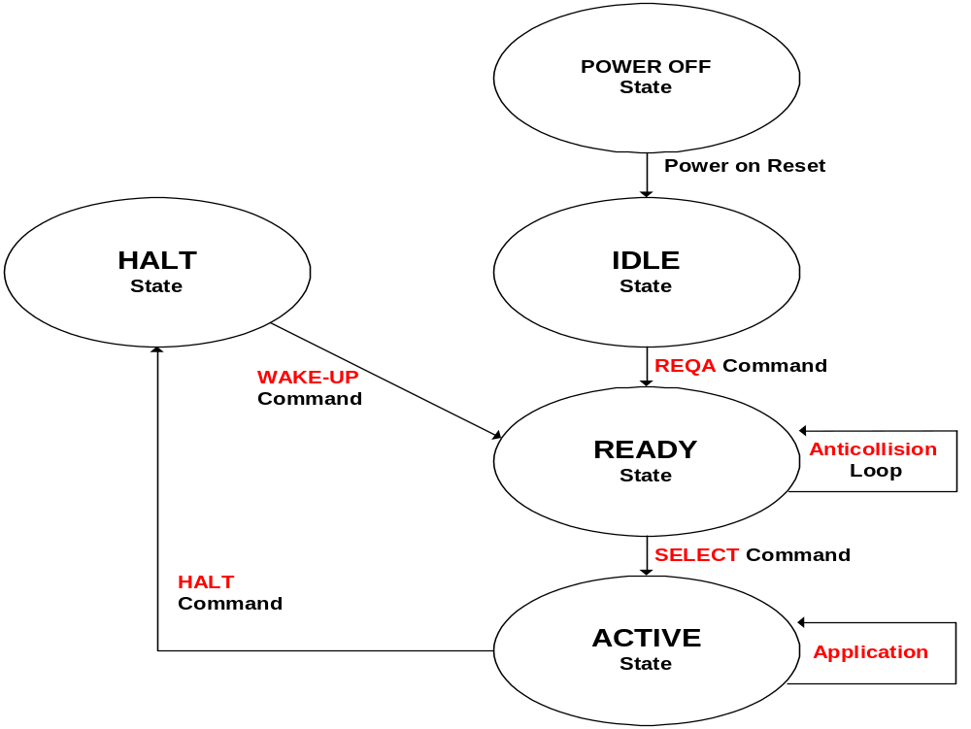
ISO/IEC 14443 Card Activation Sequence
Type A Card
State Diagram
Request
Anti-Collision
Select
MIFARE
Classic extension:
Select Acknowledge = 0x08 (bit 6 = 0)
Authentication
Encryption of
Data Communication
Memory Operations
(R/W & Value Arithmetic)
MIFARE Classic 1K, BUID CAS 2011

Slide 3
Error Response States
Error
Error
Error
Error
Error*
* If the PICC has been in Halt-State before.
MIFARE Classic 1K, BUID CAS 2011

Slide 4
MIFARE Classic Application Instructions
Request Idle
Anticollision
Request All
Power On
RESET
(POR)
Power On
RESET
(POR)
ISO REQA
(ISO WUPA)
ISO WUPA
Identification
& Selection
(ISO 14443 A)
Select Card
Halt
ISO SELECT
ISO HALT
3-Pass Authentication
ISO DIS9798-2
Application
Read
Write
Decrement
Increment
Restore
Memory
Operations
Transfer
MIFARE Classic 1K, BUID CAS 2011

Slide 5
Principle of Bit Frame Anticollision
Manchester Coding
data "1"
"0"
PCD
Synchronous answer
of all PICCs in the field
Anticollision
UID form PICC 1
”1"
”0"
”1"
”0"
1
0
1
0
0
0
PICC 1
UID form PICC 2
”1"
”0"
”0"
”0"
1
0
0
0
0
0
PICC 2
FDT
”1"
”0"
”?"
”0"
PCD
FDT= Frame Delay Time
PCD detects collision
MIFARE Classic 1K, BUID CAS 2011
Notes:
M103-Function

Slide 6
Anticollision (Arbitration)
Unique identifier / serial number (UID) is basis for bitwise arbitration ...
Reader
(R/W) Device
Anticollision command
1xxx….
1011xxx...
Select 1011.....
A)
1011.......
1011.......
1011.......
MIFARE
cards
B)
1010.......
1010.......
C)
0101.......
time
Single remaining (selected) card can be authenticated for R/W operation ...
MIFARE Classic 1K, BUID CAS 2011

Slide 7
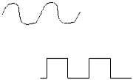

MIFARE CLASSIC – Blockdiagram
MF1 ICS50
RF-Interface
Digital Section
Clock
Data
ATR
Control
&
Arithmetic
Unit
Anti-
collision
Modulator
Demodulator
E²
Memory
Select
Application
E²-Interface
Voltage
Regulator
POR
E²PROM
Authentication &
Access Control
Crypto
Unit
Energy
Crypto Unit for (proprietary) Stream Cipher Encryption
MIFARE Classic 1K, BUID CAS 2011

Slide 8
MIFARE 1K Memory Management
The following slides will cover:
Memory Mapping, Split and Functions
BLOCK Function Cluster
SECTOR Trailer Function and Access Conditions
ACCESS CONDITION Codes for Sector Trailer and Data Instructions
VALUE Blocks, Arithmetic and Operations
Mutual 3-Pass AUTHENTICATION and Data-ENCRYPTION
MIFARE Classic 1K, BUID CAS 2011

Slide 9
MIFARE 1k Classic - Memory Mapping
1024 Byte in 16 SECTORS with 64 addressable BLOCKS @ 16 BYTE each
0
1
2
3
4
5
6
7
8
9
10
11
12
13
14
15
BLOCK 0
0
1
2
3
4
5
6
7
8
9
10
11
12
13
14
15
BLOCK 1
First SECTOR # 0 w. 4 BLOCKS
0
1
2
3
4
5
6
7
8
9
10
11
12
13
14
15
BLOCK 2
EEPROM
0
1
2
3
4
5
6
7
8
9
10
11
12
13
14
15
BLOCK 3
0
1
2
3
4
5
6
7
8
9
10
11
12
13
14
15
BLOCK 0
0
1
2
3
4
5
6
7
8
9
10
11
12
13
14
15
Total amount of 16 SECTORS ( 0…15 )
BLOCK 1
Last SECTOR # 15 w. 4 BLOCKS
0
1
2
3
4
5
6
7
8
9
10
11
12
13
14
15
BLOCK 2
0
1
2
3
4
5
6
7
8
9
10
11
12
13
14
15
BLOCK 3
MIFARE Classic 1K, BUID CAS 2011

Slide 10
MIFARE Memory Split & Function
Every BLOCK has a fixed or alterable functionality ...
0
1
2
3
4
5
6
7
8
9
10
11
12
13
14
15
BLOCK 0 (FIX)
“Manufacturer”
First SECTOR 0 : 4 BLOCKS
BLOCK 1 & 2
(ALT) “Data”
EEPROM
0
1
2
3
4
5
6
7
8
9
10
11
12
13
14
15
BLOCK 3 (FIX)
“Sector Trailer”
0
1
2
3
4
5
6
7
8
9
10
11
12
13
14
15
BLOCK 0 (ALT)
“Data”
Last SECTOR 15 : 4 BLOCKS
Total amount of 16 SECTORS
BLOCK 1 & 2
(ALT) “Data”
0
1
2
3
4
5
6
7
8
9
10
11
12
13
14
15
BLOCK 3 (FIX)
„FIX“: Fixed functionality, but not fixed content!
MIFARE Classic 1K, BUID CAS 2011

Slide 11
BLOCK Function Cluster
SECTOR 0 / BLOCK 0 is always READ-ONLY ...
0
1
2
3
4
5
6
7
8
9
10
11
12
13
14
15
BLOCK 0 (FIX)
“Manufacturer”
Manufacturer Data
EEPROM
Unique IDentifier (4 or 7 Bytes)
Holds KEYs & ACCESS CONDITIONs
0
1
2
3
4
5
6
7
8
9
10
11
12
13
14
15
BLOCK 3 (FIX)
“Sector Trailer”
KEY A
Access Conditions
KEY B
All other = DATA / VALUE BLOCKS ...
0
1
2
3
4
5
6
7
8
9
10
11
12
13
14
15
Other BLOCKs
(ALT) “Data”
„FIX“: Fixed functionality, but not fixed content!
MIFARE Classic 1K, BUID CAS 2011

Slide 12
Sector Trailer Function
SECTOR 1 … 15 ( Remark: Special Function for SECTOR 0 ! )
DATA BLOCK OPERATIONS (enable or disable)
READ
WRITE
DECREMENT
TRANSFER
RESTORE
BLOCK 0, 1, 2
(Data or Value)
INCREMENT
EEPROM
0
1
2
3
4
5
6
7
8
9
10
11
12
13
14
15
BLOCK 3 (FIX)
“Sector Trailer”
KEY A
KEY FUNCTIONALITY
KEY B
Sector Access Conditions (24 Bit)
Byte 9 = GPB = xx (not defined)
Transport Configuration (Pre-defined “Virgin-State”):
  KEY A must be used for authentication ...
  KEY A enables all other configurations ...
„FIX“: Fixed functionality, but not fixed content!
MIFARE Classic 1K, BUID CAS 2011

Slide 13
Sector Access Condition storage
3 Control bits (C1_{n}, C2_{n}, C3_{n}) for each block
(n: block number within a sector)
0
1
2
3
4
5
6
7
8
9
10
11
12
13
14
15
BLOCK 0
0
1
2
3
4
5
6
7
8
9
10
11
12
13
14
15
BLOCK 1
0
1
2
3
4
5
6
7
8
9
10
11
12
13
14
15
BLOCK 2
EEPROM
0
1
2
3
4
5
6
7
8
9
10
11
12
13
14
15
BLOCK 3
KEY A
KEY B
Cx
= INV Cx
BLOCK 3 = Sector Trailer
BIT 0
C1
C3
C2
Control Bits C1 / C2 / C3 - BLOCK 0
0
0
0
BIT 1
C1
C3
C2
Control Bits C1 / C2 / C3 - BLOCK 1
1
1
1
BIT 2
C1
C3
C2
Control Bits C1 / C2 / C3 - BLOCK 2
2
2
2
BIT 3
C1
C3
C2
Control Bits C1 / C2 / C3 - BLOCK 3
3
3
3
BIT 4
C2
C1
C3
Control Bits C1 / C2 / C3 - BLOCK 0
4
4
4
BIT 5
C2
C1
C3
Control Bits C1 / C2 / C3 - BLOCK 1
5
5
5
BIT 6
C2
C1
C3
Control Bits C1 / C2 / C3 - BLOCK 2
6
6
6
BIT 7
C2
C1
C3
Control Bits C1 / C2 / C3 - BLOCK 3
7
7
7
MIFARE Classic 1K, BUID CAS 2011

Slide 14
C1 / C2 / C3- Access Conditions
BLOCK 3 (Sector Trailer)
(WRITE: Access Condition Code for next Authentication)
0
1
2
3
4
5
6
7
8
9
10
11
12
13
14
15
---- = n.a.
READ
KEY A
WRITE
C1
C2
C3
READ
KEY B
WRITE
READ
AC
WRITE
EEPROM
-----
KEY A
0
0
0
KEY A
KEY A
KEY A
-----
-----
-----
0
1
0
KEY A
-----
KEY A
-----
-----
KEY B
1
0
0
-----
KEY B
KEY A or B
-----
-----
-----
1
1
0
-----
-----
KEY A or B
-----
-----
KEY A
0
0
1
KEY A
KEY A
KEY A
KEY A
*
-----
KEY B
0
1
1
-----
KEY B
KEY A or B
KEY B
-----
-----
1
0
1
-----
-----
KEY A or B
KEY B
-----
-----
1
1
1
-----
-----
KEY A or B
-----
Condition Code
Pattern
* Transport Access Condition
MIFARE Classic 1K, BUID CAS 2011

Slide 15
C1 / C2 / C3 - Data Instructions
BLOCK 0, 1, 2 (Data) - Condition Code Pattern fixed in Block 3
0
1
2
3
4
5
6
7
8
9
10
11
12
13
14
15
BLOCK ADDR
Condition Code
Pattern
READ
WRITE
C1
C2
C3
INCR
DECR / TRANSFER / RESTORE
EEPROM
KEY A or B
KEY A or B
0
0
0
KEY A or B
KEY A or B
Transport Access
Condition
KEY A or B
-----
0
1
0
-----
-----
KEY A or B
KEY B
1
0
0
-----
-----
---- = n.a.
KEY A or B
KEY B
1
1
0
KEY B
KEY A or B
KEY A or B
-----
0
0
1
-----
KEY A or B
KEY B
KEY B
0
1
1
-----
-----
KEY B
-----
1
0
1
-----
-----
-----
-----
1
1
1
-----
-----
MIFARE Classic 1K, BUID CAS 2011

Slide 16
VALUE Blocks & Arithmetic
Format of “Value Block” for electronic purse function:
Commands:
READ
WRITE
INCREMENT
DECREMENT
RESTORE
TRANSFER
0
1
2
3
4
5
6
7
8
9
10
11
12
13
14
15
Value
Value
Value
Adr
Adr
Adr
Adr
Fixed block- data format (generation via WRITE)
Automatic value error detection & correction
“Value”: stored 3 times in 32-bit signed 2’s complement
“Adr”: stored 4 times in 8-bit numbers - altered only via WRITE
MIFARE Classic 1K, BUID CAS 2011

Slide 17
VALUE Operations
Operand
0
1
2
3
4
5
6
7
8
9
10
11
12
13
14
15
SOURCE
ADDRESS
Value
Value
Value
Adr
Adr
Adr
Adr
SOURCE Value (3xsigned 4-byte)
ALU
DECREMENT Operand
INCREMENT Operand
Byte 0 … 15 of Block (within same Sector)
RESULT
BUFFER
0
1
2
3
4
5
6
7
8
9
10
11
12
13
14
15
DESTINATION
ADDRESS
Value
Value
Value
Adr
Adr
Adr
Adr
RESULT Value (3xsigned 4-byte)
TRANSFER
0
1
2
3
4
5
6
7
8
9
10
11
12
13
14
15
DESTINATION
ADDRESS
Value
Value
Value
Adr
Adr
Adr
Adr
“COPY” Value (3xsigned 4-byte)
RESTORE
MIFARE Classic 1K, BUID CAS 2011

Slide 18
Mutual 3-Pass Authentication
PCD
PICC
READER
CARD
Anticollision
Send Card-ID / Serial #
SELECT Card
USE KEY &
ACCESS Cond.
Select SECTOR / BLOCK
CALCULATE
Response 2

GENERATE
Random #
for Challenge 1
“Challenge 1” with Random #
Stream Cipher
CRYPTO UNIT
ISO / IEC DIS9798-2
Stream Cipher
CRYPTO UNIT
“Response 2” and Random Challenge
‚
VERIFY Response 2,
CALCULATE own
Response 3 to
Challenge 2
Encrypted RF-Communication
VERIFY Response 3
= Comparison with
Challenge 2
ƒ
Final “Response” to Random Challenge
MIFARE Classic 1K, BUID CAS 2011

Slide 19
RF Data Encryption
PCD
PICC
READER
MF RC5xx
Authenticated
CARD
COMMAND
+
Ciphered COMMAND
+
COMMAND
On-chip,
hardwired
Functionality
Stream Cipher
CRYPTO UNIT
Encrypted
RF-Communication
Stream Cipher
CRYPTO UNIT
On-chip,
hardwired
Functionality
ANSWER
+
Ciphered ANSWER
+
ANSWER
Crypto Operands:
Random # Reader
Random # Card
Card-ID / Serial #
Secret Key
Crypto Operands:
Random # Reader
Random # Card
Card-ID / Serial #
Secret Key
Area of listening-in attack
MIFARE Classic 1K, BUID CAS 2011

Slide 20

New Features of MIFARE Classic
Order options
  MOA4 (SOT 500-2)
  MOA8 (SOT 500-4) new!
  Wafer 120 µm thickness with Gold bumps
  Wafer 75 µm thickness with Gold bumps
For 7 byte UID: UID options,
  configurable during personalization
  7 byte UID (UIDF0)
  7 byte UID with „shortcut“ (UIDF1)
  4 byte RID (UIDF2)
  4 byte NUID (derived from 7 byte UID) (UIDF3)
Either with
4 byte NUID
or
7 byte UID
MIFARE Classic 1K, BUID/CAS 2011

Slide 21
Card Transaction Speed
106 kBaud Transfer Rate 10 µs / Bit
Card Ident-Select & Auth. Time 3 + 2 ms
READ Data Block (16 Byte) 2.5 ms
WRITE Data Block (16 Byte) 6 ms
Typical Ticketing Transaction time* 70 ms
* UPDATE 2 purse values & READ 2 Blocks
MIFARE Classic 1K, BUID CAS 2011

Slide 22
Some CLASSIC Facts – to remember
The very first BLOCK 0 contains UID & Manufacturer Data and is READ ONLY
Mifare Classic 1k / 4k with Double Size UID or Single Size NUID
Ultra Light & DESFire with Double Size UID
Triple Size UID not used yet ...
The SECTOR TRAILER holds the KEYs & ACCESS CONDITION info
Transport configuration: Use KEY A for authentication ...
The Block-NUMBERING convention in MIFAREWND is as follows:
Blocknumbers: 0 ... 63
Sector Trailer Block Designations: 003 ... 0063
MIFARE Classic 1K, BUID CAS 2011

Slide 23
MIFARE 1K Feature Summary
1024 Byte EEPROM (768 Byte available for applications)
Unique serial number (7 byte), RID or 4 Byte NUID
16 separately secured sectors => supporting multi-application
Arithmetic memory operations
2 x 48 bit-keys per sector for key hierarchy
Access conditions free configurable
based on 2 level key hierarchy
Number of single write operations: >100 000
Data retention: >10 years
MIFARE Classic 1K, BUID CAS 2011

Slide 24
MIFARE Classic 1K, BLID CAS 2009

