Slide 1
Connect Arduino n NodeMCU
https://www.electronicwings.com/nodemcu/nodemcu-i2c-with-arduino-ide

Slide 2
Connect Arduino n NodeMCU

Slide 3
Hardware Required
SOFTWARE Required

Slide 4
PINOUT

Slide 5
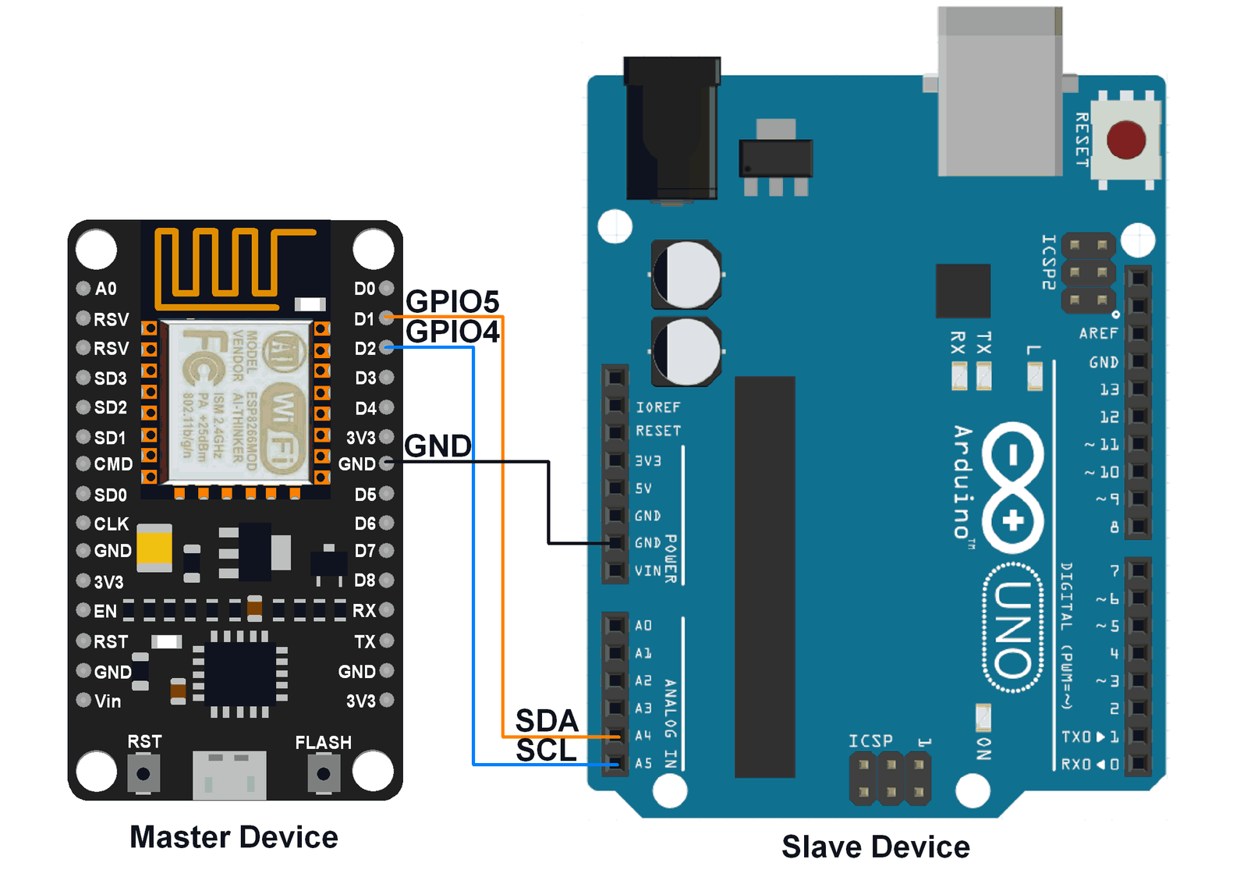
Circuit

Slide 6
Code – Example1

Slide 7
Code – Explaination

Slide 8
Code – Explanation

Slide 9
Sketch file

