Slide 1
Bluetooth With Arduino Using HM10
HM-10 BLE Android App using HM10 & AI2 only. NO ARDUINO
https://www.youtube.com/watch?v=PINCucGRhA8

Slide 2
Reference linkS
Bluetooth Module HM-10 for Arduino (Master Slave)
https://www.robotshop.com/uk/bluetooth-module-hm-10-arduino-master-slave.html
How to Use HM-10 BLE Module with Arduino to Control an LED using Android App
https://circuitdigest.com/microcontroller-projects/how-to-use-arduino-and-hm-10-ble-module-to-control-led-with-android-app
HM-10 Bluetooth 4 BLE Modules (Martyn Curry)
http://www.martyncurrey.com/hm-10-bluetooth-4ble-modules/
Bluetooth 2.0 VS Bluetooth 4.0 (BLE) || Is an Upgrade worth it?
https://www.youtube.com/watch?v=1i-6cz4KHXE
Connecting PS3 Joystick to HM10 (BLE Module)
https://forum.arduino.cc/index.php?topic=137747.0

Slide 3
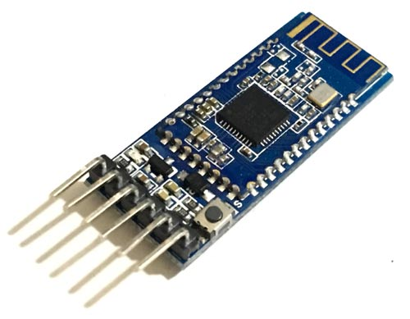
HM-10 Bluetooth Module
The Bluetooth Module HM-10 for Arduino (Master Slave) uses the TI CC2541 chip, configure 256KB space, and support the AT command. Users can change the role (master, slave mode) and the serial port baud rate, equipment name, matching password and other parameters on-demand. It is very flexible to use.
Description
Most complete, most convenient, and most stable Bluetooth data transmission, remote control, and data acquisition module
Master-slave in one, transparent transmission, replacing serial port
Remote control, transparent transmission, MCU is unnecessary
Remote data acquisition, transparent transmission, MCU is unnecessary
Specifications - Product Parameters
Bluetooth Protocol: Bluetooth Specification V4.0 BLE
USB Protocol: USB V2.0
Operating Frequency: 2.4GHz ISM band
Modulation Mode: GFSK (Gaussian Frequency Shift Keying)
Transmitting Power: ≤4dBm
Sensitivity: ≤-84dBm at 0.1% BER
Transmission Rate: Asynchronous: 6 kbps
Synchronous: 6 kbps
Security Feature: Authentication and encryption
Support Service: Central & Peripheral UUID FFE0, FFE1
Power Supply: +3.3VDC 50mA
Operating Temperature: -5 ~ +65 Centigrade
Physical Dimension: 27mm x 13mm x 2.2 mm.

Slide 4


HARDWARE & SOFTWARE requirements

Slide 5

Hardware Required
Arduino (Uno / Mega) x 2 pcs (First as Master, Second as Slave)
BlueTooth Low Energy Module (HM-10)
Usb cables x 1 for power and firmware download
SOFTWARE Required
USB_Host_Shield_Library

Slide 6
HM-10 BT Low Energy Module

Slide 7
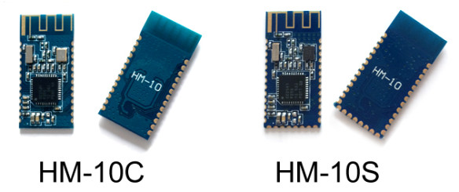
HM-10 Introduction
The HM-10 is a small 3.3v SMD Bluetooth 4.0 BLE module based on the TI CC2540 or CC2541 Bluetooth SOC (System On Chip).
The HM-10 is made by Jinan Huamao and is one of many Bluetooth devices they produce including the HM-11 which is operationally the same as the HM-10 but has a smaller footprint with fewer pins broken out.
The HM-10C does not have the pads along the bottom (the usb connections) and has 26 pads instead of 34 which makes it a little cheaper to produce.
There may be other differences (such as the type of crystal used) due to the date of manufacture.
Operationally the two are the same though.
There are 2 versions of the HM-10; the HM-10C and the HM-10S

Slide 8
HM-10 Basic specs
+2.5v to +3.3v
Requires up to 50mA
Uses around 9mA when in an active state
Use 50-200uA when asleep
RF power: -23dbm, -6dbm, 0dbm, 6dbm
Bluetooth version 4.0 BLE
Default baud rate pre firmware V700 is 9600
Default baud rate firmware V700 and up is 115200
Default PIN is 000000
Default name is HMSoft
Based on the CC2540 or the CC2541 chip
The latest HM-10s all appear to the the CC2541 chip.
This is the same as the CC2540 except it is lower power and has a shorter range. The CC254x is based on the 8051 and runs at 32MHz.
There are 2 versions of the HM-10; the HM-10C and the HM-10S

Slide 9
HM-10 Basic specs
The HM-10 is has become a very popular Bluetooth 4 BLE module for use with the Arduino. In part due to the standard UART serial connection that makes it fairly straight forward to connect to an Arduino.
The UART layer is a good thing and a bad thing, it allows ease of use but it hides the BLE layer so you have no control over the actual BLE side of things.
The HM-10 is Bluetooth version 4.0 only.
This means it cannot connect to Bluetooth 2/2.1 modules such as the HC-06 and HC-05.
The HM-10 is controlled via AT commands which are sent over the serial UART connection.
There are a host of commands, some simple, some more complex, and these are covered later.

Slide 10
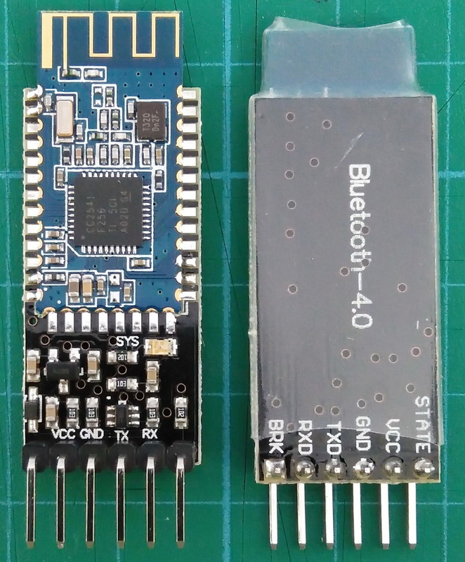
HM-10 on breakout board
The HM-10 is also available mounted to a breakout board that exposes the power and UART connections to breadboard friendly male pins.
The breakout board includes a 3.3v power regulator that makes them 5V compatible. This makes them ideal for hobbyists.
You should note that the RX pin is still 3.3v and when using a 5v Arduino you should covert the Arduino’s 5v TX to 3.3v for the HM-10 RX.

Slide 11
Pinout

Slide 12
pinout
Pin | Description
STATE | Connection status LOW when not connected. HIGH when connected
VCC | Power in. 3.6v to 6v
GND | Common ground
TXD | Serial UART transmit
RXD | Serial UART receive
BRK / EN | Break / Enable pin. When there is an active connection, bringing the BRK pin LOW breaks the connection

Slide 13
ON-Board LED

Slide 14
On-Board LED
The on board LED blinks when waiting for connection. It blinks half a second on, half a second off.
The LED becomes solid on when a connection is made and returns to blinking when the connection is broken.
The LED changes to solid on when pairing. After pairing it returns to flashing. It basically makes a connection to pair and so turns on the LED to show the connection status. After pairing is completed the connection is closed and the LED is turned off.
The behavior of the LED can be changed using the PIO1 command.
“AT+PIO10″ – Default setting. When not connected the LED blinks 500ms on, 500ms off. When connected the LED is solid on.
“AT+PIO11″ – When not connected the LED is off. When connected the LED is solid on.

Slide 15
Status PINs
STATE Pin
The STATE pin is LOW when there is no connection and goes HIGH when a connections is established.
BRK / EN Pin
The BRK / EN pin allows you to cancel a connection.
When there is an active connection, bringing the BRK pin momentarily LOW breaks the connection.
When there is no connection making the BRK HIGH or LOW has no effect.
Although not strictly required, pulling the BRK pin HIGH for normal use will stop the pin floating.

Slide 16
Bluetooth 4.0 ble

Slide 17
Bluetooth 4.0 ble
BLE is not an upgrade to Bluetooth Classic, it is a different system with different intended uses. BLE works in a very different way to the earlier Bluetooth.
BLE is designed for low energy applications and achieves this by using infrequent small packets of data.
It is not really designed for continuous connections and large amounts of data. For this, Bluetooth Classic is a better choice.
In essence, BLE achieves its low power consumption by not being connected very often, unlike Bluetooth Classic which maintains a constant connection.
While you can create a classic style connection using 2 HM-10s, and I give an example below, they were not designed for this and if this is all you need then you would be better suited with Bluetooth Classic modules like the HC-05s or a HC-05 and a HC-06.
There are 2 ways BLE devices can talk to each other :
Broadcaster + Observer
With Broadcaster + Observer there isn’t a standard connection, the Broadcaster, usually some kind of sensor, sends out periodic signals (advertising packets) which the Observer listens for. The Broadcaster does not normally know if anything is listening or not.
Central + Peripheral
The Central + Peripheral scenario is more like (but not exactly the same) as the classic connection. When the Central (master) device finds a Peripheral (slave) device it wants to connect to it initiates a connection and takes on the master role managing the connection and timings.
The HM-10 can use both methods.

Slide 18
HM-10 Services and Characteristics

Slide 19
HM-10 Services and Characteristics
BLE is all about services and characteristics and like all BLE devices, the HM-10 has a set of services and each service has a set of related characteristics. Characteristics are where the values are, some are READ, some are WRITE, and some are READ and WRITE.
All the services on the HM-10 are predefined except one.
This is a custom service that has one custom characteristic.
Predefined services and characteristics are ones where the UUID and the name are set by the Bluetooth governing body.
For example, the characteristic 0x2A00 is the device name and when a device has this characteristic it should always be the device name.
A full list of the predefined services can be found here and a list of the characteristics is here.
HM-10 uses the custom characteristic to send and receive the data it receives over the serial UART interface.

Slide 20
HM-10 custom characteristic
The HM-10 uses the custom characteristic to send and receive the data it receives over the serial UART interface. It works by setting the value of the custom characteristic to the value of the data to be transmitted. It then sends out a notification to the remote device to say there is new data available.
When you tell the the HM-10 to transmit “HELLO”, it first sets the value of the custom characteristic to “HELLO” and then it sends out a notification telling the remote device “Hey, I have new data, come and get it.” The remote device is scanning for the notifications and when it receives one it knows there is a new value, so it reads the data and then sends back a message saying “Thanks, I have it”.
The custom characteristic can hold up to 20 characters, this means to send a string longer than 20 characters the HM-10 splits the data in to 20 character segments and sends each one in turn until none are left.

Slide 21
Getting Started with HM-10

Slide 22
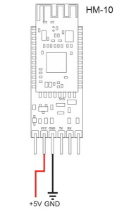
Getting Started with HM-10
First, lets use an Android device to read the services and characteristics from the HM-10. Power on the HM-10, you can use an Arduino for this but all we need is 5V to HM-10 VCC and GND to HM-10 GND.
If done correctly, the LED on the HM-10 should be flashing. When a connection is established the LED will be become solid on.
Checking the HM-10 with an Android Device
Depending on your Android device and the version of Android you are running the HM-10 may or may not show up when searching for Bluetooth devices under the Android Settings.
The Samsung S7 and the Sony Z3 Compact find the HM-10 through Settings but the honor Pro 4 does not. When using a BLE app all phones can find the HM-10 though.
If you device does not find the HM-10 under Bluetooth settings, try using the BLE Scanner app.

Slide 23
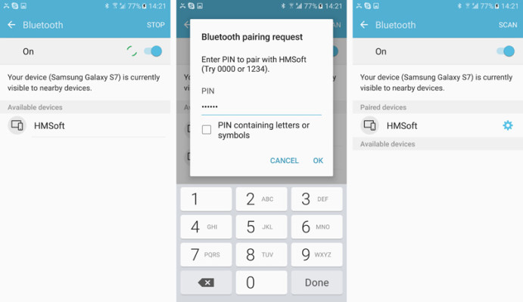
Pairing with HM-10
The modules can be paired using the default pin 000000 (unless you have changed it of course).
To connect to the HM-10 and to read the services and characteristics we need to use a BLE app. Here I am using BLE Scanner. There are many other similar apps available such as B-BLE.

Slide 24
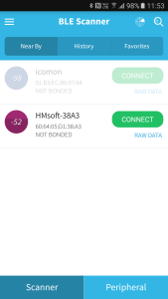
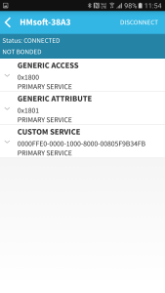
READING CHARACTERISTICS of hm-10
Open the BLE Scanner app and find the HM-10. Tap the CONNECT button to get the app to connect to the HM-10 and start reading its properties.

Slide 25
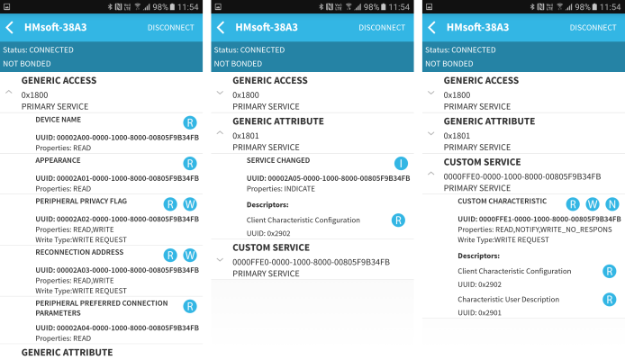
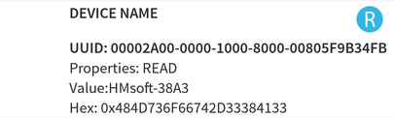
READING CHARACTERISTICS of hm-10
Clicking the small down arrows will expand the services and display the characteristics.
Tapping one of the labels will read the characteristic value.
R = Read value W = Write Value I = Toggle indications on and off N = Toggle notifications on and off

Slide 26
Getting an Arduino talking to the HM-10

Slide 27
Getting an Arduino talking to the HM-10
Next we will connect the HM-10 to an Arduino and try basic serial communication and AT commands.
Note: AT commands only work when the HM-10 is not connected. After a connection is made the commands are treated as data. “AT” is the exception, the “AT” command breaks the connection.

Slide 28
Circuit

Slide 29
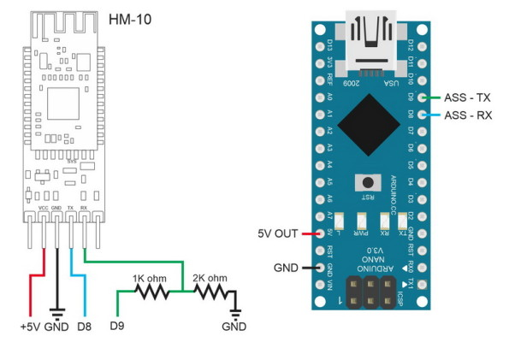
Circuit Hooking Up the HM-10
Connect the modules as per the following: – HM-10 TX pin to Arduino 2 – HM-10 RX pin to a voltage divider and then to Arduino 3* – HM-10 GND to GND – HM-10 VCC to +5V
*The pins on the actual HM-10 (the small daughter board) are 3.3v only. They are not officially 5v tolerant so use a voltage divider or something else to bring the voltage down to 3.3v.
* ENSURE that we use PWM pins on Arduino side.

Slide 30
Actual PICS

Slide 31
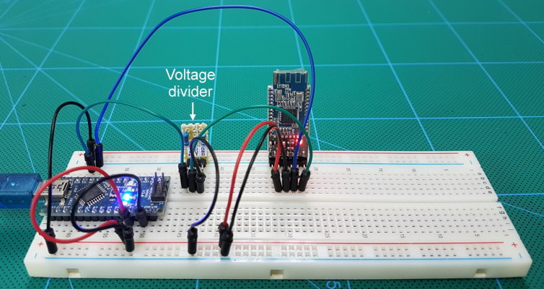
Actual PICS
The HM-10 is a 3.3v device.
The breakout board converts the +5v vcc to 3.3v to power the HM-10 but the RX pin is still 3.3v.
Therefore, we need to bring down the Arduinos 5V TX pin to 3.3V.
A simple way to do this is by using a voltage divider made from 2 resistors.
I use a 1k ohm resistor and a 2k ohm resistor. 1K+2K = 3K. 2K is 2 thirds of 3K and 2 thirds of 5V is 3.3v.
The Arduino will see the 3.3v signal from the HM-10 TX pin as HIGH so we can connect the HM-10 TX pin directly to the Arduino RX pin (D8).

Slide 32

PINOUT

Slide 33
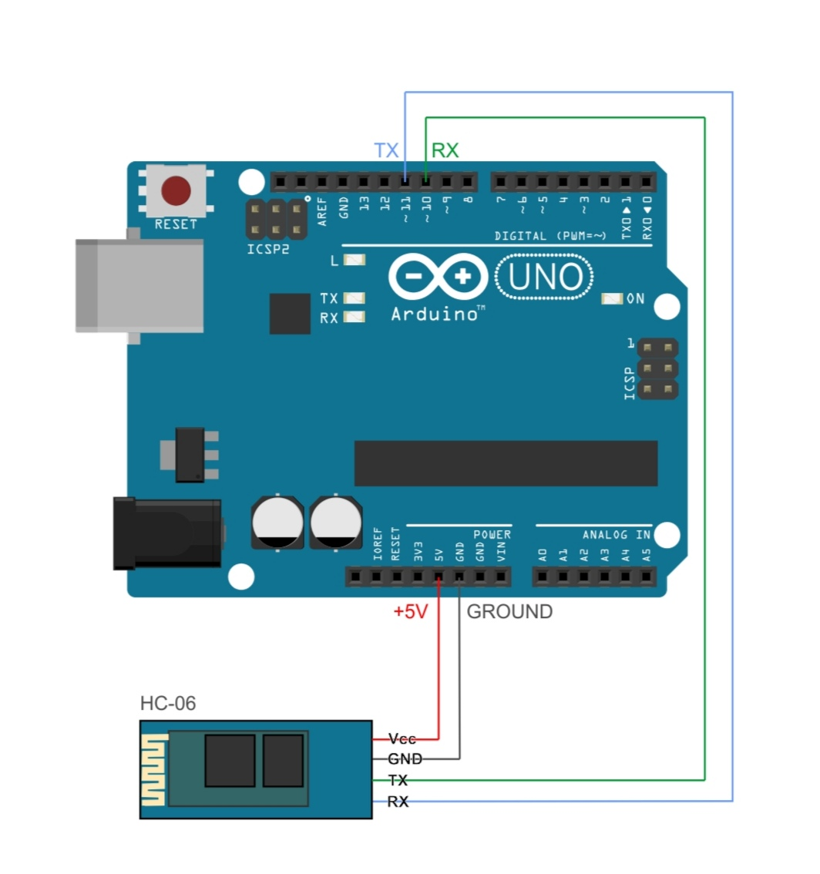
PINOUT
Ensure that we use PWM pin(s) 10 & 11 on Arduino side

Slide 34
AT COMMANDS output

Slide 35
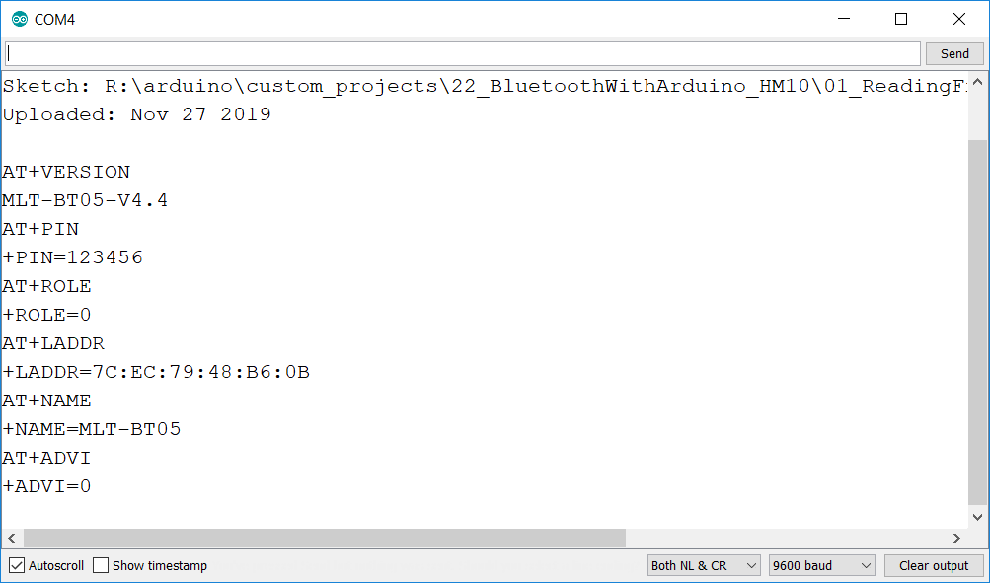
AT COMMANDS output

Slide 36
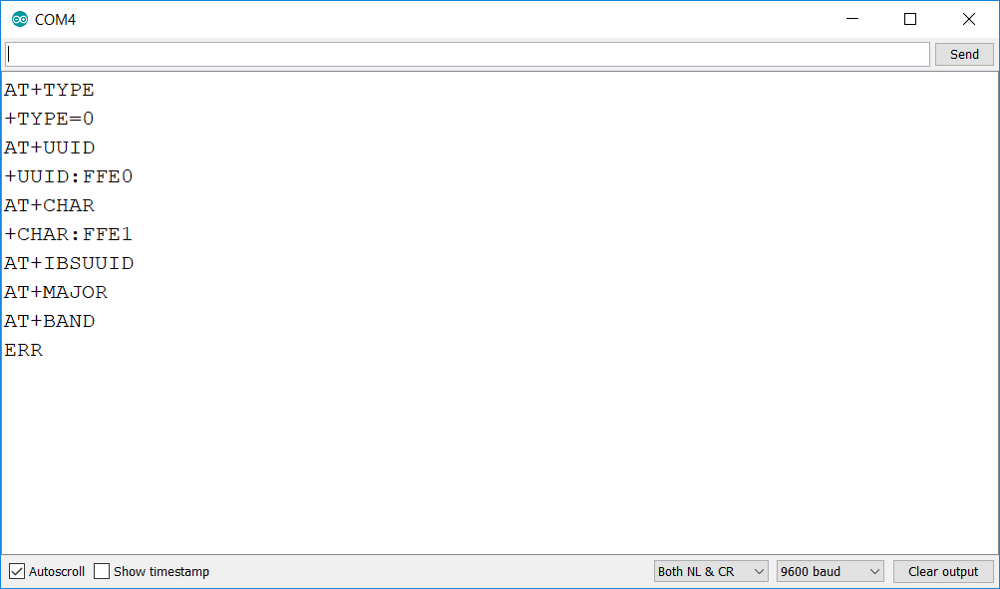
AT COMMANDS output

Slide 37
Connecting ps3 controller

Slide 38
Connecting ps3 controller
For those of you that don't know, the pairing process of a PS3 controller to a host is different than most other Bluetooth devices like mice, keyboards, phones, etc.
The PS3 controller needs to have the MAC of the host sent to it via USB first, then the controller will initiate the connection to the host. There's also a pinhole reset button on the bottom of the controller. That should wipe the address if you ever feel the need to.

Slide 39
SKETCH

Slide 40
SKETCH

Slide 41
TROUBLESHOOT guide

Slide 42
TROUBLESHOOT guide
HM10 BLE module doesn’t read from UART Port
Check if Ports are properly connected to proper pins.
i.e. TX on Arduino <> RX on BLE Module
i.e. RX on Arduino <> TX on BLE Module
2. I checked pins are properly connected, ie. RX to Tx and vice versa , still there is no activity on Rx side of UART.
→ Check if the pins on Arduino are PWM capable.
→ i.e. we used PWM pin 10 & 11 on Arduino side.
3. AT Commands are not being accepted by BLE module
→ AT commands require carriage return and line feed
→ AT commands must be issued before connecting. (ie. when BT module is in non-connected state)
→ Once connected module is in data transmission mode.

