Slide 1
RTC EEPROM Interfacing
DS1307 (RTC) + 24CXX (EEPROM)

Slide 2

What is Real Time Clock?
Real Time Clock or RTC is a system that keeps track of the current time and can be used in any device which needs to keep accurate time.
RTCs have some important advantages.
Low power consumption
Releasing system time from time calculation (this feature is critical because in many cases CPU is operating some delicate tasks like receiving sensors data. and if you don’t use RTC, CPU also has to keep track of the time and it can disrupt processors main tasks.)
High accuracy
RTCs often have an alternate source of power, so that they can continue to keep time while the primary source of power is off or unavailable.
RTCs often use a 32.768 kHz crystal oscillator. But why 32,768?
32768 is equal to 215 and hence can generate 1 second easily.
Also, the crystal must be small with proper width and low power consumption, which can be satisfied with using 32876 Hz. Higher frequencies are larger and fragile crystals, and the lower frequencies have more power consumption that 32, 768KHz.

Slide 3
DS1307 Module Feature & Specifications
DS1307 module is one of the most affordable and common RTCs modules. It can accurately keep track of seconds, minutes, hours, days, months, and years.
Some of the DS1307 important features are:
Ability of Generating Programmable Square-Wave
Low Current Use; under 500nA in Battery Backup mode
The Ability to Set the Date Up to Year 2100
I2C Serial Interface
The DS1307 module has the capability to install a 3-volt CR2023 backup battery. there is also an embedded EEPROM 24c32 memory on this module that can save 32kb of data.

Slide 4
RTC EEPROM Interfacing

Slide 5

Hardware Required
Arduino board (Uno, Mega)
Jumper cables (as per breakout headers)
DS1307 (RTC) + 24Cxx (EEPROM)
USB connection cable
SOFTWARE Required
RTC_DS1307 – You need the RTClib library to use DS1307 with Arduino

Slide 6
PINOUT
PIN on DS1307 board | Operation | Pin on Arduino
Vcc | +5V | 5V
GND | GND | GND
SDA | RTC & EEPROM I2C Data Line | A4 (Analog Input Pin 4)
SCL | RTC & EEPROM I2C Clock Line | A5 (Analog Input Pin 5)

Slide 7
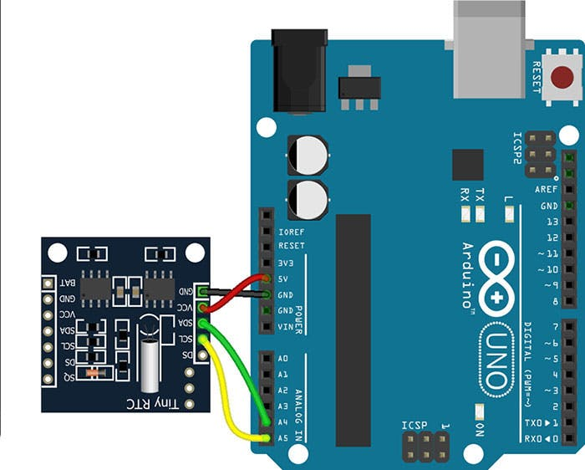
Circuit
RTC part communicates with the microcontroller using I2C protocol.
PIN on DS1307 board | Pin on Arduino
Vcc | 5V
GND | GND
SDA | A4 (Analog Input Pin 4)
SCL | A5 (Analog Input Pin 5)

Slide 8
Code-1 RTC EEPROM Interfacing

Slide 9
Code RTC EEPROM Interfacing
// Date and time functions using a DS1307 RTC connected via I2C and Wire lib
#include <Wire.h>
#include "RTClib.h"
#define SERIAL_BAUDRATE 115200
/* Create an RTC clock instance */
RTC_DS1307 rtc;
char daysOfTheWeek[7][12] = {"Sunday", "Monday", "Tuesday", "Wednesday", "Thursday", "Friday", "Saturday"};
void setup () {
while (!Serial); // for Leonardo/Micro/Zero
Serial.begin( SERIAL_BAUDRATE );
if (! rtc.begin()) {
Serial.println("Couldn't find RTC");
while (1);
}
if (! rtc.isrunning()) {
Serial.println("RTC is NOT running!");
// following line sets the RTC to the date & time this sketch was compiled
rtc.adjust(DateTime(F(__DATE__), F(__TIME__)));
// This line sets the RTC with an explicit date & time, for example to set
// January 21, 2014 at 3am you would call:
// rtc.adjust(DateTime(2014, 1, 21, 3, 0, 0));
}
}

Slide 10
Code RTC EEPROM Interfacing
void loop () {
/* Get current time (read from EEPROM) */
DateTime now = rtc.now();
Serial.print(now.year(), DEC);
Serial.print('/');
Serial.print(now.month(), DEC);
Serial.print('/');
Serial.print(now.day(), DEC);
Serial.print(" (");
Serial.print(daysOfTheWeek[now.dayOfTheWeek()]);
Serial.print(") ");
Serial.print(now.hour(), DEC);
Serial.print(':');
Serial.print(now.minute(), DEC);
Serial.print(':');
Serial.print(now.second(), DEC);
Serial.println();
Serial.print(" since midnight 1/1/1970 = ");
Serial.print(now.unixtime());
Serial.print("s = ");
Serial.print(now.unixtime() / 86400L);
Serial.println("d");
// calculate a date which is 7 days and 30 seconds into the future
DateTime future (now + TimeSpan(7, 12, 30, 6));
Serial.print(" now + 7d + 30s: ");
Serial.print(future.year(), DEC);
Serial.print('/');
Serial.print(future.month(), DEC);
Serial.print('/');
Serial.print(future.day(), DEC);
Serial.print(' ');
Serial.print(future.hour(), DEC);
Serial.print(':');
Serial.print(future.minute(), DEC);
Serial.print(':');
Serial.print(future.second(), DEC);
Serial.println();
Serial.println();
delay(3000);
}

Slide 11

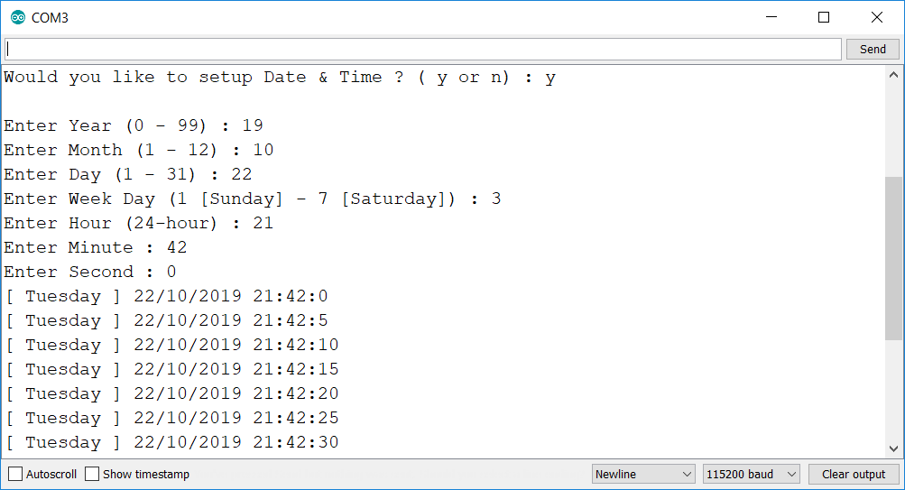

CODE-2 Get SET Time Using serial port

Slide 12
Code Get SET Time Using serial port
#include <Wire.h>
#define SERIAL_BAUDRATE 115200
/* RTC Module I2C address */
#define DS1307_ADDRESS 0x68
byte zero = 0x00;
/* Structure of RTC */
typedef struct DateTime_
{
uint8_t year;
uint8_t month;
uint8_t day;
uint8_t weekday;
uint8_t hour;
uint8_t minute;
uint8_t second;
}DateTime_t;
DateTime_t xDateTime;
byte decToBcd(byte val){
#if 1
// Convert normal decimal numbers to binary coded decimal
// We need to do this, else time is treated as decimal, and seconds and minutes go till 100 :(
return ( (val/10*16) + (val%10) );
#else
return val;
#endif
}
byte bcdToDec(byte val) {
#if 1
// Convert binary coded decimal to normal decimal numbers
// We need to do this, else time is treated as decimal, and seconds and minutes go till 100 :(
return ( (val/16*10) + (val%16) );
#else
return val;
#endif
}

Slide 13
Code Get SET Time Using serial port
char * pcGetWeekDayStr( uint8_t uiWeekDay )
{
char * pcWeekDay = (char *) "INVALID";
switch( uiWeekDay )
{
case 1:
pcWeekDay = (char *) "Sunday";
break;
case 2:
pcWeekDay = (char *) "Monday";
break;
case 3:
pcWeekDay = (char *) "Tuesday";
break;
case 4:
pcWeekDay = (char *) "Wednessday";
break;
case 5:
pcWeekDay = (char *) "Thursday";
break;
case 6:
pcWeekDay = (char *) "Friday";
break;
case 7:
pcWeekDay = (char *) "Saturday";
break;
}
return pcWeekDay;
}

Slide 14
Code Get SET Time Using serial port
void vGetRtcFromUser()
{
/* Get Year */
Serial.print("Enter Year (0 - 99) : ");
while( Serial.available() == 0 ); // Wait for user input
xDateTime.year = strtoul(Serial.readString().c_str(), NULL, 0);
Serial.println(xDateTime.year);
/* Get Month */
Serial.print("Enter Month (1 - 12) : ");
while( Serial.available() == 0 ); // Wait for user input
xDateTime.month = strtoul(Serial.readString().c_str(), NULL, 0);
Serial.println(xDateTime.month);
/* Get Day */
Serial.print("Enter Day (1 - 31) : ");
while( Serial.available() == 0 ); // Wait for user input
xDateTime.day = strtoul(Serial.readString().c_str(), NULL, 0);
Serial.println(xDateTime.day);
/* Get Week Day */
Serial.print("Enter Week Day (1 [Sunday] - 7 [Saturday]) : ");
while( Serial.available() == 0 ); // Wait for user input
xDateTime.weekday = strtoul(Serial.readString().c_str(), NULL, 0);
Serial.println(xDateTime.weekday);
/* Get Hour */
Serial.print("Enter Hour (24-hour) : ");
while( Serial.available() == 0 ); // Wait for user input
xDateTime.hour = strtoul(Serial.readString().c_str(), NULL, 0);
Serial.println(xDateTime.hour);
/* Get Minute */
Serial.print("Enter Minute : ");
while( Serial.available() == 0 ); // Wait for user input
xDateTime.minute = strtoul(Serial.readString().c_str(), NULL, 0);
Serial.println(xDateTime.minute);
/* Get Second */
Serial.print("Enter Second : ");
while( Serial.available() == 0 ); // Wait for user input
xDateTime.second = strtoul(Serial.readString().c_str(), NULL, 0);
Serial.println(xDateTime.second);
}

Slide 15
Code Get SET Time Using serial port
void setDateTime()
{
vGetRtcFromUser();
byte second = xDateTime.second; //0-59
byte minute = xDateTime.minute; //0-59
byte hour = xDateTime.hour; //0-23
byte weekDay = xDateTime.weekday; //1-7
byte monthDay = xDateTime.day; //1-31
byte month = xDateTime.month; //1-12
byte year = xDateTime.year; //0-99
Wire.beginTransmission(DS1307_ADDRESS);
Wire.write(zero); //stop Oscillator
Wire.write(decToBcd(second));
Wire.write(decToBcd(minute));
Wire.write(decToBcd(hour));
Wire.write(decToBcd(weekDay));
Wire.write(decToBcd(monthDay));
Wire.write(decToBcd(month));
Wire.write(decToBcd(year));
Wire.write(zero); //start
Wire.endTransmission();
}
void printDate()
{
// Reset the register pointer
Wire.beginTransmission(DS1307_ADDRESS);
Wire.write(zero);
Wire.endTransmission();
Wire.requestFrom(DS1307_ADDRESS, 7);
int second = bcdToDec(Wire.read());
int minute = bcdToDec(Wire.read());
int hour = bcdToDec(Wire.read() & 0b111111); //24 hour time
int weekDay = bcdToDec(Wire.read()); //0-6 -> Sunday - Saturday
int monthDay = bcdToDec(Wire.read());
int month = bcdToDec(Wire.read());
int year = bcdToDec(Wire.read());
//print the date e.g [Tuesday] 22/10/2019 23:59:59
Serial.print("[ ");
Serial.print(pcGetWeekDayStr(weekDay));
Serial.print(" ] ");
Serial.print(monthDay);
Serial.print("/");
Serial.print(month);
Serial.print("/");
Serial.print(2000 + year);
Serial.print(" ");
Serial.print(hour);
Serial.print(":");
Serial.print(minute);
Serial.print(":");
Serial.println(second);
}

Slide 16
Code Get SET Time Using serial port
void setup ()
{
String cliOption = "";
Wire.begin();
Serial.begin( SERIAL_BAUDRATE );
Serial.print("Would you like to setup Date & Time ? ( y or n) : ");
while( Serial.available() == 0 ); // Wait for user input
cliOption = Serial.readString(); // cliOption = "y + NULL" or "n + NULL"
Serial.println(cliOption);
if( strncmp( cliOption.c_str(),"y", 1) == 0 ) // Compare only first ASCII char
{
setDateTime(); //MUST CONFIGURE IN FUNCTION
}
}
void loop ()
{
/* Get current time (read from EEPROM) */
printDate();
delay(5000);
}

Slide 17
Sketch file

