Slide 1
Sensing Sound Levels
https://circuitdigest.com/microcontroller-projects/arduino-sound-level-measurement
https://www.cdc.gov/nceh/hearing_loss/what_noises_cause_hearing_loss.html

Slide 2
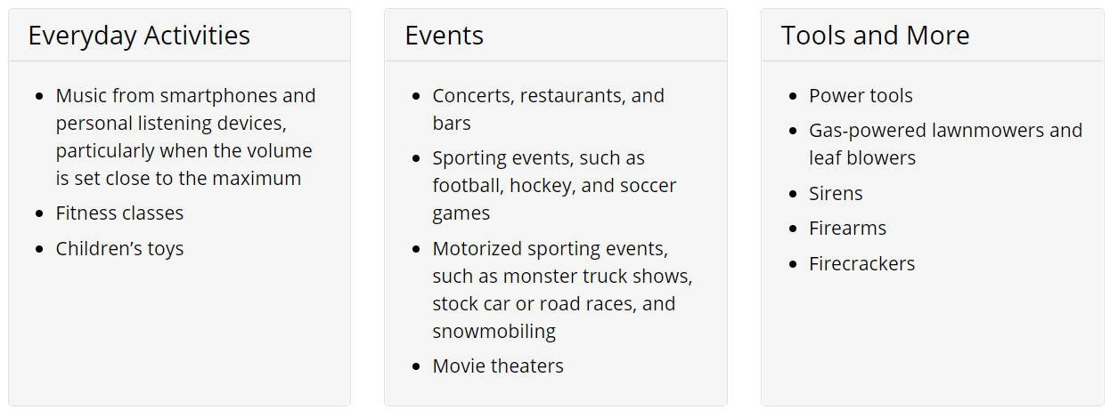
Sensing Sound Levels
Here are some sources of loud noise that you may be exposed to. If you are repeatedly exposed to them over time, they can cause hearing loss.

Slide 3
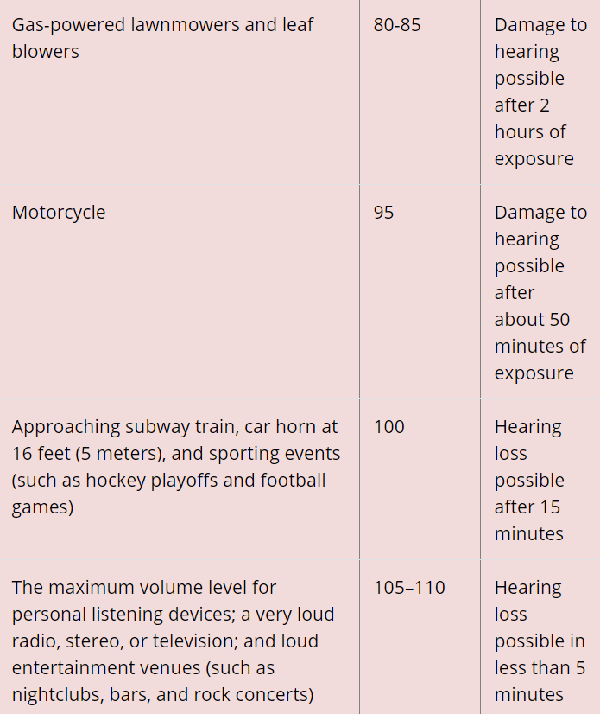
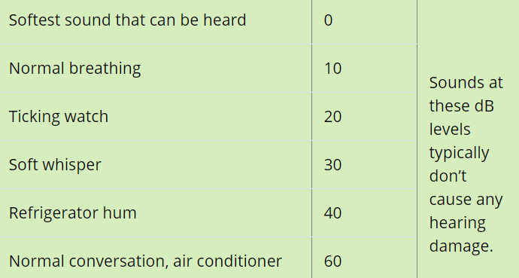
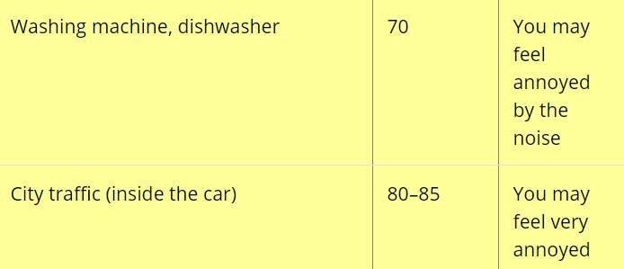
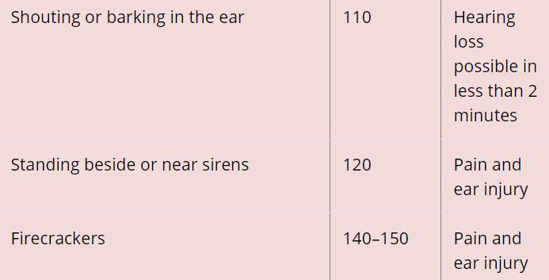
Common Sources of Noise and Decibel Levels
Src: https://www.cdc.gov/nceh/hearing_loss/what_noises_cause_hearing_loss.html
Noise above 70 dB over a prolonged period of time may start to damage your hearing. Loud noise above 120 dB can cause immediate harm to your ears.

Slide 4
Sounds May Be Louder Than What You Hear
Sound intensity is the amount of sound energy in a confined space.
It is measured in decibels (dB).
The decibel scale is logarithmic, which means that loudness is not directly proportional to sound intensity.
Instead, the intensity of a sound grows very fast.
This means that a sound at 20 dB is 10 times more intense than a sound at 10 dB.
Also, the intensity of a sound at 100 dB is one billion times more powerful compared to a sound at 10 dB.
Two sounds that have equal intensity are not necessarily equally loud. Loudness refers to how you perceive audible sounds.
A sound that seems loud in a quiet room might not be noticeable when you are on a street corner with heavy traffic, even though the sound intensity is the same.
In general, to measure loudness, a sound must be increased by 10 dB to be perceived as twice as loud.
For example, ten violins would sound only twice as loud as one violin.

Slide 5


Sound sensor

Slide 6
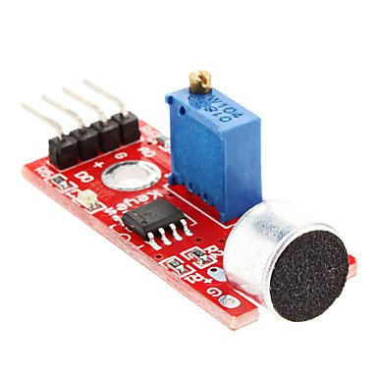
Sound Sensor
https://www.instructables.com/id/Simple-FC-04-Sound-Sensor-Demo/
Sound sensor module, in my opinion, is a very sensitive sound detection module.
Although this sensor does not provide any ability to identify specific sounds or the frequency of a sound it does do what it is supposed to - it detects sound.
The key to this sensor is the on-board potentiometer (POT)
Every reference I saw said that POT was for adjusting the "sensitivity". Well, naturally I assumed the "sensitivity" being adjusted was the microphone pickup, as in a GAIN control. Nope, just to mess with my head, that POT adjusts the "sensitivity" of the voltage trigger point (VTP). Meaning that it adjusts the level of voltage (internally on the pickup) required to trigger OUTPUT.
To successfully use this sensor you need to adjust that POT until you find the sweet spot for the VTP that works best with your project, in your environment. Do note that turning the POT a tiny,tiny,tiny bit to far in either direction will leave the output stuck on HIGH or LOW (not forever, just till you turn the POT back).
Refer to 02_F1YHID5II6E5KS8.ino

Slide 7
HARDWARE & SOFTWARE requirements

Slide 8
Hardware Required
Arduino
Hookup cables
Usb cables x 2 for power and firmware download
Adraxx Sound Sensor Module
SOFTWARE Required

Slide 9
Circuit

Slide 10
Circuit
dfsd
dsfsd

Slide 11
Actual PICS

Slide 12
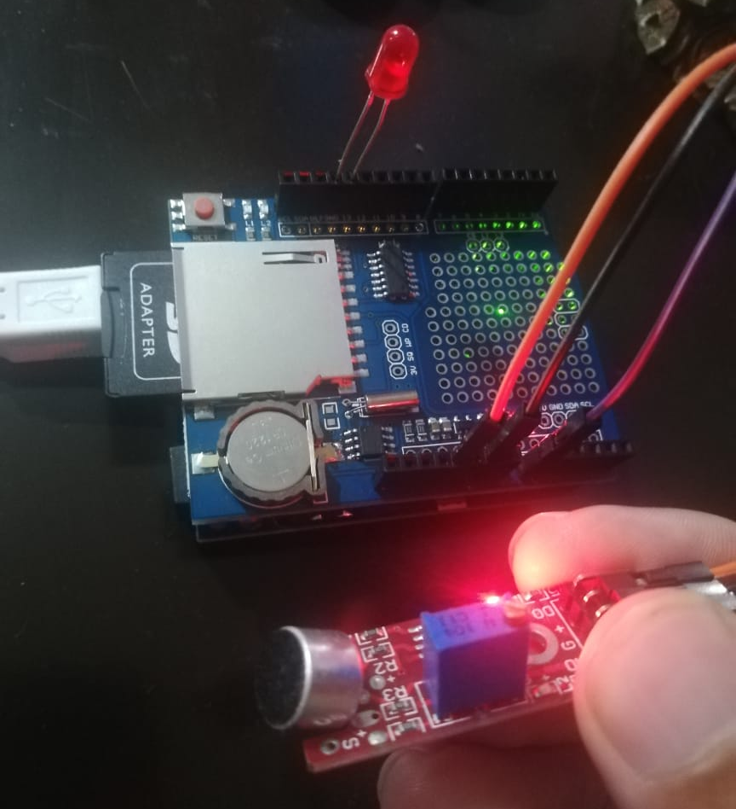
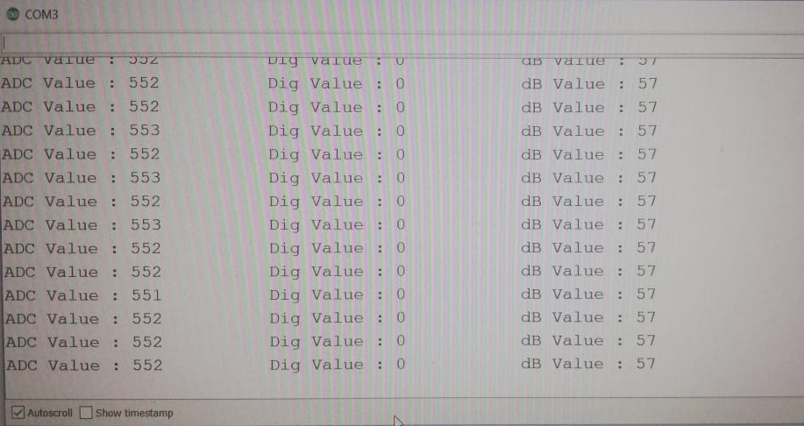
Actual PICS

Slide 13
Code Hooking Up the SOUND SENSOR
#define BAUDRATE 115200
#define MIC_PIN 0 /* the microphone amplifier output is connected to pin A0 */
#define INDICATOR_PIN 13
#define DIGITAL_OUT_PIN 10
/* General Threshold after which sound is annoying to ears (found using hit n trial at home) */
#define DECIBLE_THRESHOLD 57
#define DEBUG_ENABLE 1
#define LOOP_DELAY 2000 /* 2 secs */
int convertToDb( int AdcValue )
{
int dB = 0;
//Convert ADC value to dB using Regression values
dB = ( AdcValue + 83.2073 ) / 11.003;
return dB;
}
int calculateSoundLevel()
{
int adcVal = analogRead( MIC_PIN );
return convertToDb( adcVal );
}
void setup() {
Serial.begin( BAUDRATE ); //sets the baud rate on the Serial Monitor
pinMode( INDICATOR_PIN, OUTPUT );
pinMode( DIGITAL_OUT_PIN, OUTPUT );
}

Slide 14
Code Hooking Up the SOUND SENSOR
void loop()
{
int dBVal = 0;
int adcVal = 0;
int digVal = 0;
adcVal = analogRead( MIC_PIN ); //Read the ADC value from amplifer
#if DEBUG_ENABLE
// Print ADC Value
Serial.print("ADC Value : ");
Serial.print( adcVal );//Print ADC for initial calculation
#endif
/* Convert ADC value coming out of Sound Sensor */
dBVal = convertToDb( adcVal );
#if DEBUG_ENABLE
// Print Digital Value
digVal = digitalRead(DIGITAL_OUT_PIN); //Read the ADC value from amplifer
Serial.print("\t\t Dig Value : ");
Serial.print(digVal); //Print dB for initial calculation
// Print dB Value
Serial.print("\t\t dB Value : ");
Serial.println(dBVal); //Print dB for initial calculation
#endif
if ( dBVal > DECIBLE_THRESHOLD )
{
#if DEBUG_ENABLE
digitalWrite(INDICATOR_PIN, HIGH); // turn the LED on (HIGH is the voltage level)
delay(2000); // wait for a second
digitalWrite(INDICATOR_PIN, LOW);
#endif
/* We need to reduce volume till it matches DECIBLE_THRESHOLD */
while( calculateSoundLevel() == DECIBLE_THRESHOLD )
{
reduceVolume();
}
}
else if( dBVal < DECIBLE_THRESHOLD )
{
/* We need to increase volume till it matches DECIBLE_THRESHOLD */
while( calculateSoundLevel() == DECIBLE_THRESHOLD )
{
increaseVolume();
}
}
delay( LOOP_DELAY );
}

Slide 15

PINOUT

Slide 16
PINOUT

Slide 17
TROUBLESHOOT guide

Slide 18
TROUBLESHOOT guide
1. Sound sensor module gives same output irrespective of ambient noise??
Check if connections are done as per pinout. (But most probably this would be correctly done by you already).
Try adjusting Sensitivity of Sound Sensor using onboard Potentiometer (if any).
Use Android Phone App “Sound Meter” to calibrate your board’s potentiometer

Slide 19
CONCLUSION

Slide 20
Conclusion

