Slide 1
Timer in arduino
https://playground.arduino.cc/Code/Timer/

Slide 2
DELAY
The Arduino 'delay' function is both a blessing and a curse. Its great for showing beginners how to make an LED flash. But as soon as you get more complex and start slowing down your 'loop' function you will run into problems.
A classic example is turning LED on/off alternatively for 5secs.
The 'delay'-way looks like this:
int pin = 13;
void setup()
{
pinMode(13, OUTPUT);
}
void loop()
{
digitalWrite(pin, HIGH);
delay(5 * 1000);
digitalWrite(pin, LOW);
delay(5 * 1000);
}

Slide 3
TIMER
The disadvantage of the delay approach is that nothing else can go on while the 'delay' is happening. You cannot update a display, or check for key presses for example.
'Timer' library version looks like this -------------------------------------------→
The 'pulse' method takes arguments of a pin to change,
the period to change it for and its initial state.
The call to t.update() will take a matter of microseconds to run,
unless the appropriate period of time has passed.
#include "Timer.h"
Timer t;
int pin = 13;
void setup()
{
pinMode(pin, OUTPUT);
t.pulse(pin, 5 * 1000, HIGH); // 5 secs
}
void loop()
{
t.update();
}

Slide 4
TIMER – TWO EVENTS
Lets look at another example that uses two timer events. One to flash an LED and another that reads A0 and displays the result in the Serial Monitor.
#include "Timer.h"
Timer t;
int pin = 13;
void setup()
{
Serial.begin(115200);
pinMode(pin, OUTPUT);
t.oscillate(pin, 200, LOW);
t.every(1000, takeReading);
}
The first thing to notice is that we are using a callback function called 'takeReading'. We connect it to the Timer using the 'every' command, which in this case, will call the function every second.
We have also attached another event to the timer using the method 'oscillate'. This will cause the LED to toggle state every 200 milliseconds.
void loop()
{
t.update();
}
void takeReading(void * data)
{
Serial.println(analogRead(0));
}

Slide 5
TIMER – Stopping EVENTS
Each of the events has an integer ID associated with it, so that you can stop an event, as we do in this example below, which will write to the serial monitor every 2 seconds, flash the LED and after 5 seconds, stop the LED flashing fast, and flash it 5 times slowly.
#include "Timer.h"
Timer t;
int ledEvent;
void setup()
{
Serial.begin(115200);
int tickEvent = t.every(2000, doSomething, NULL);
Serial.print("2 second tick started id=");
Serial.println(tickEvent);
pinMode(13, OUTPUT);
ledEvent = t.oscillate(13, 50, HIGH);
Serial.print("LED event started id=");
Serial.println(ledEvent);
int afterEvent = t.after(10000, doAfter, NULL);
Serial.print("After event started id=");
Serial.println(afterEvent);
}
void loop()
{
t.update();
}
void doSomething()
{
Serial.print("2 second tick: millis()=");
Serial.println(millis());
}
void doAfter()
{
Serial.println("stop the led event");
t.stop(ledEvent);
t.oscillate(13, 500, HIGH, 5); // 5 means repeat FIVE times
}

Slide 6
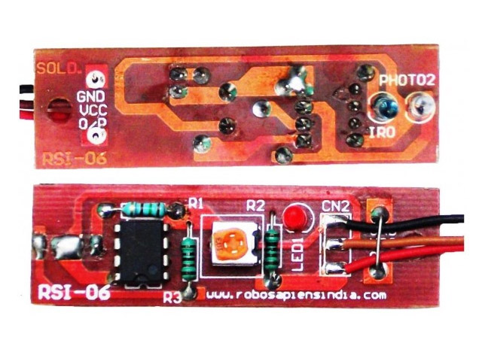
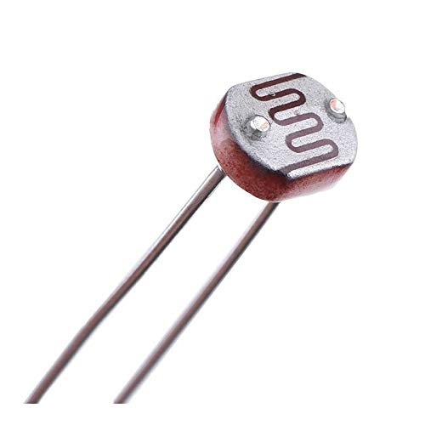
Hardware Required
Arduino or Genuino Board
LED (Or use LED associated with pin-13 on-board)
Any Analog output sensor (LDR or IrDA breakoutboard)
hook-up wires
breadboard
LDR
IrDA breakoutboard

Slide 7
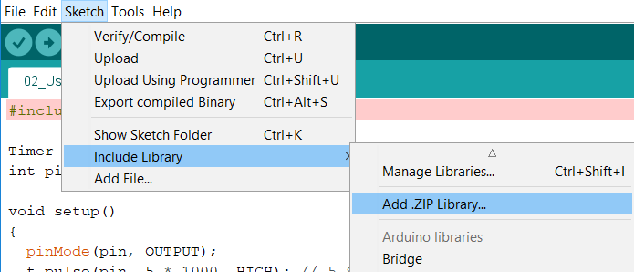
Library Installation
Library repository: https://github.com/JChristensen/Timer
Download https://github.com/JChristensen/Timer/archive/v2.1.zip
2. (In the Arduino IDE) Sketch > Include Library > Add .ZIP Library > select the downloaded file > 3. Open

Slide 8
Sketch file

