Slide 1
SD Card Interfacing
https://www.instructables.com/id/Micro-SD-Card-Tutorial/

Slide 2
SDCARD INTERFACING
Micro SD Card is used for transfering data to and from a standard sd card.
The pin out is directly compatible with Arduino and also can be used with other microcontrollers.
It allow us to add mass storage and data logging to our project.

Slide 3
Hardware Required
Arduino Board
USB Cable type A to B
Micro Sd Card Module
Female to male jumper wire
SD Card
Hook-up wire
SOFTWARE Required

Slide 4
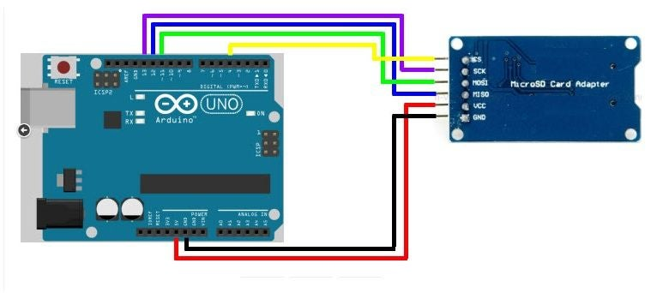
Circuit
Connect VCC with 5V in the Arduino.
Connect the GND of SD card to the ground of Arduino.
Connect CS to pin 14
Connect SCK to pin 13
MOSI connect to the pin 11
Lastly, connect MISO to pin 12
After completing the connection, connect the Arduino to power supply with USB cable.
This module uses the standard SPI interface for communication, which involve SPI buses, MISO, MOSI, SCK, and a CS signal pin. through programming, the data can easily be read and wrote into SD Card by using the Arduino or other microcontrollers.
CS (chip select)
SCK (serial clock)
MOSI (master out slave in)
VCC (3.3V or 5V)
GND (ground)

Slide 5
Code – MMC R/W
/*
SD card read/write
This example shows how to read and write data to and from an SD card file
The circuit:
* SD card attached to SPI bus as follows:
** MOSI - pin 11
** MISO - pin 12
** CLK - pin 13
** CS - pin 4 (for MKRZero SD: SDCARD_SS_PIN)
*/
#include <SPI.h>
#include <SD.h>
File myFile;
void setup() {
// Open serial communications and wait for port to open:
Serial.begin(115200);
while (!Serial) {
; // wait for serial port to connect. Needed for native USB port only
}
Serial.print("Initializing SD card...");
if (!SD.begin(4)) {
Serial.println("initialization failed!");
while (1);
}
Serial.println("initialization done.");
// open the file. note that only one file can be open at a time,
// so you have to close this one before opening another.
myFile = SD.open("test.txt", FILE_WRITE);

Slide 6
Code – MMC R/W
// if the file opened okay, write to it:
if (myFile) {
Serial.print("Writing to test.txt...");
myFile.println("testing 1, 2, 3.");
// close the file:
myFile.close();
Serial.println("done.");
} else {
// if the file didn't open, print an error:
Serial.println("error opening test.txt");
}
// re-open the file for reading:
myFile = SD.open("test.txt");
if (myFile) {
Serial.println("test.txt:");
// read from the file until there's nothing else in it:
while (myFile.available()) {
Serial.write(myFile.read());
}
// close the file:
myFile.close();
} else {
// if the file didn't open, print an error:
Serial.println("error opening test.txt");
}
}
void loop() {
// nothing happens after setup
}

Slide 7
Sketch file

