Slide 1
Temperature Reading

Slide 2
Temperature Reading
Temperature reading is using to read the ambience temperature around the device.
The pin out is directly compatible with Arduino and also can be used with other microcontrollers.
This project is developed using Dallas DS1820 temp reading IC

Slide 3
Hardware Required
Arduino Board
USB Cable type A to B
DS1820 Breakout board
Hook-up wire
SOFTWARE Required
One Wire Library
DallasTemperature Library

Slide 4
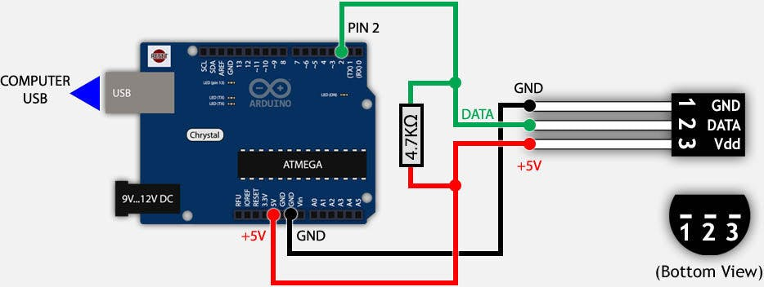
Circuit
Connect VDD with 5V in the Arduino.
Connect the GND of DS1820 to the ground of Arduino.
Connect DATA to pin 2
Caution : If you are using a breakout board, the one which contains a DS1820 IC and a pull up resistor, then the pins may be inter-changed. So ensure you are connecting right pin to right pin on Arduino else the temperature reported would be negative (generally -127deg).

Slide 5
Code – Temperature Sensor
// Code for testing Temperature Sensor over Serial Port
#include <OneWire.h>
#include <DallasTemperature.h>
// Data wire is plugged into pin 5 on Ardiuno
#define ONE_WIRE_BUS 5
// Setup a oneWire instance to communicate with any OneWire
// devices (not just lcMaxim/Dallas temperature ICs)
OneWire oneWire(ONE_WIRE_BUS);
// Pass our oneWire reference to Dallas Temperature.
DallasTemperature sensors(&oneWire);
void setup(void) {
// start serial port
Serial.begin(115200);
Serial.println("Dallas Temperature IC Control Library Demo");
// Start up the library
sensors.begin();
}
void loop(void) {
// call sensors.requestTemperatures() to issue a global temperature
// request to all devices on the bus
Serial.print(" Requesting temperatures...");
// Send the command to get temperatures
sensors.requestTemperatures();
Serial.println("DONE");
Serial.print("Temperature for Device 1 is: ");
Serial.print(sensors.getTempCByIndex(0));
// You can have more than one IC on the same bus.
// 0 refers to the first IC on the wire
delay(20000);
}

Slide 6
Sketch file

