Slide 1
RTC EEPROM Interfacing
DS1307 (RTC) + 24CXX (EEPROM)

Slide 2
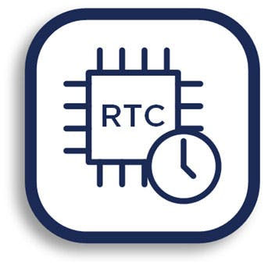
What is Real Time Clock?
Real Time Clock or RTC is a system that keeps track of the current time and can be used in any device which needs to keep accurate time.
RTCs have some important advantages.
Low power consumption
Releasing system time from time calculation (this feature is critical because in many cases CPU is operating some delicate tasks like receiving sensors data. and if you don’t use RTC, CPU also has to keep track of the time and it can disrupt processors main tasks.)
High accuracy
RTCs often have an alternate source of power, so that they can continue to keep time while the primary source of power is off or unavailable.
RTCs often use a 32.768 kHz crystal oscillator. But why 32,768?
32768 is equal to 215 and hence can generate 1 second easily.
Also, the crystal must be small with proper width and low power consumption, which can be satisfied with using 32876 Hz. Higher frequencies are larger and fragile crystals, and the lower frequencies have more power consumption that 32, 768KHz.

Slide 3
DS1307 Module Feature & Specifications
DS1307 module is one of the most affordable and common RTCs modules. It can accurately keep track of seconds, minutes, hours, days, months, and years.
Some of the DS1307 important features are:
Ability of Generating Programmable Square-Wave
Low Current Use; under 500nA in Battery Backup mode
The Ability to Set the Date Up to Year 2100
I2C Serial Interface
The DS1307 module has the capability to install a 3-volt CR2023 backup battery. there is also an embedded EEPROM 24c32 memory on this module that can save 32kb of data.

Slide 4
RTC EEPROM Interfacing

Slide 5

Hardware Required
Arduino board (Uno, Mega)
Jumper cables (as per breakout headers)
DS1307 (RTC) + 24Cxx (EEPROM)
USB connection cable
SOFTWARE Required
RTC_DS1307 – You need the RTClib library to use DS1307 with Arduino

Slide 6
PINOUT
PIN on DS1307 board | Operation | Pin on Arduino
Vcc | +5V | 5V
GND | GND | GND
SDA | RTC & EEPROM I2C Data Line | A4 (Analog Input Pin 4)
SCL | RTC & EEPROM I2C Clock Line | A5 (Analog Input Pin 5)

Slide 7
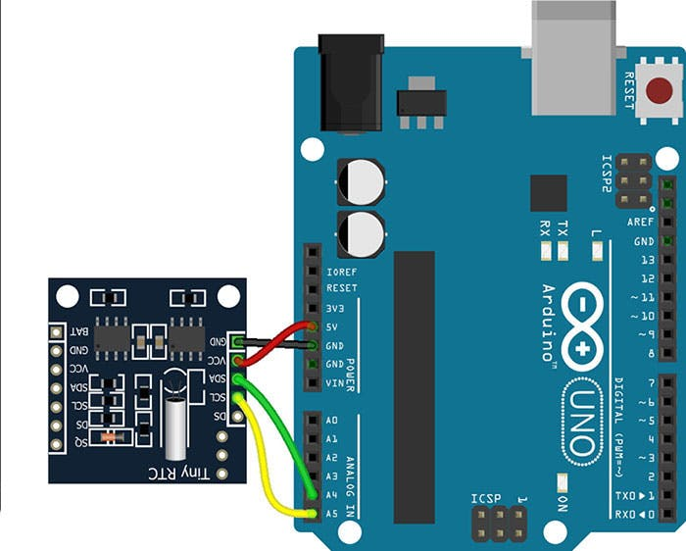
Circuit
RTC part communicates with the microcontroller using I2C protocol.

Slide 8
Code – Example1 ( Using RTC_DS1307 Lib )

Slide 9
Code – Explaination

Slide 10
Code – Explanation

Slide 11
Sketch file

