Slide 1
Ardiuno Meets FreeRTOS
https://www.udemy.com/course/arduino-freertos/

Slide 2
Ardiuno Meets FreeRTOS
This tutorial ports FreeRTOS to Ardiuno environment.
Use FreeRTOS’s thread functionality to blink 3 LEDs connected to digitial input pins. (Instead of using single thread environment of Ardiuno’s loop() function.

Slide 3
Hardware Required
Arduino Board
3 x 100ohm Resistors
3 x LEDs
hook-up wire
SOFTWARE Required
Free RTOS library – by Richard Barry

Slide 4
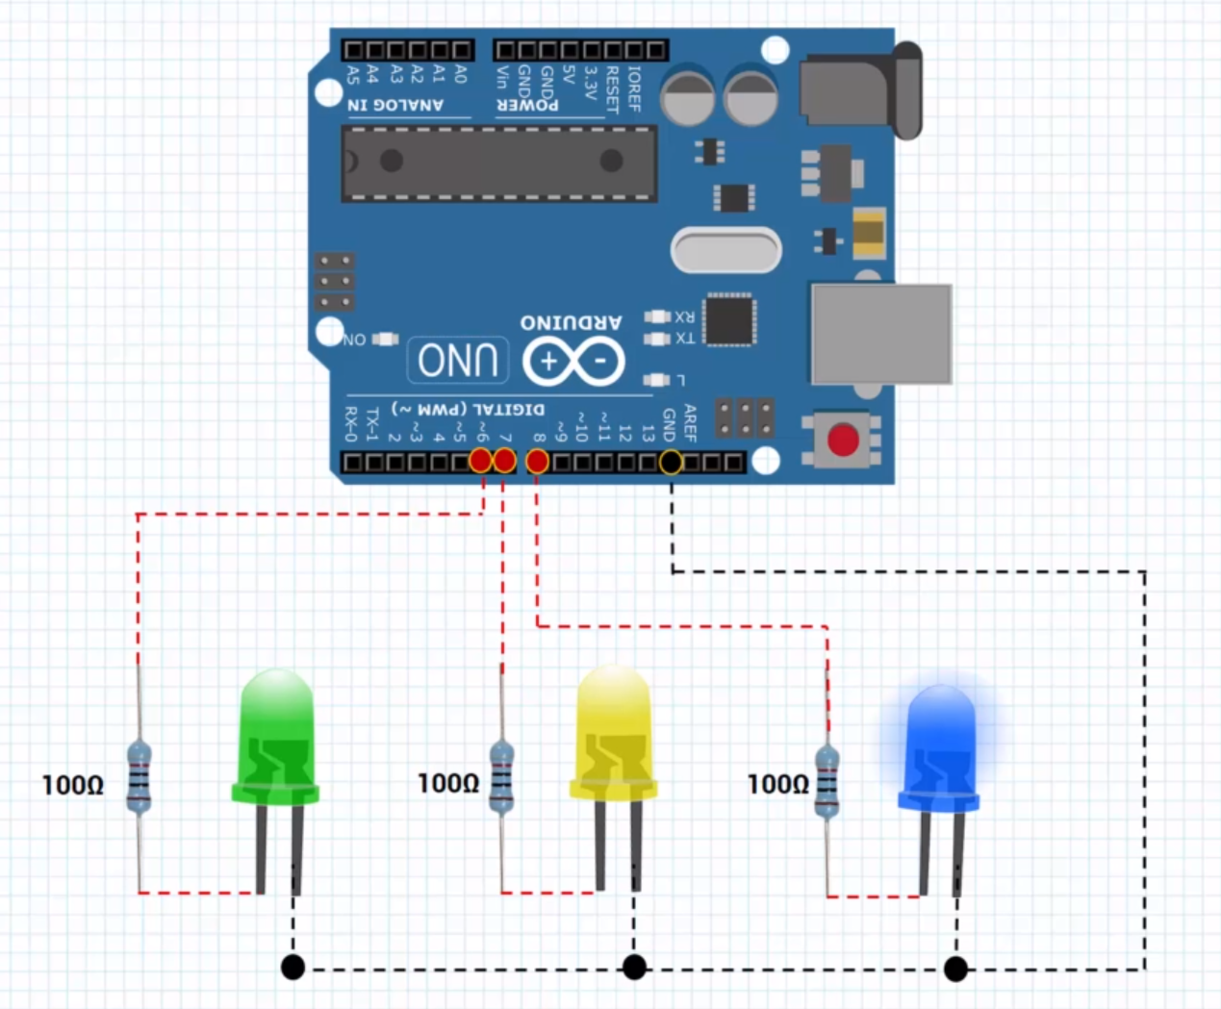
Circuit
TODO : Add circuit description here

Slide 5
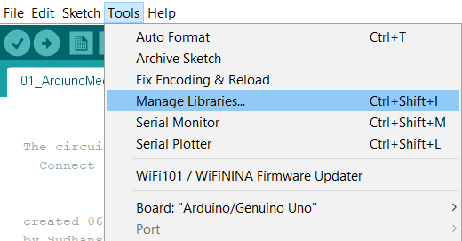
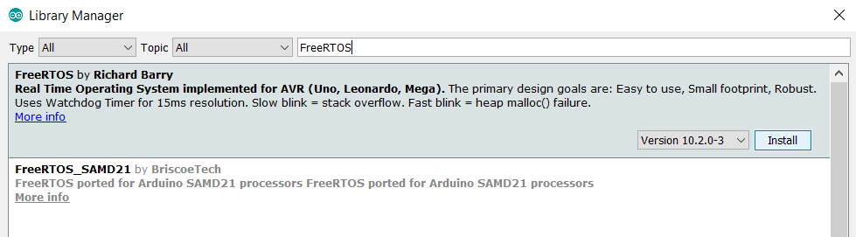
FREE-RTOS Library installation
Install the FreeRTOS library.
Go to Tools → Manage Libraries…
Search for “FreeRTOS” and install FreeRTOS library by Richard Barry (Latest Version).

Slide 6
Code – Blinking LEDs
/* Blinking LEDs Demo using digitialWrite() */
#define RED 6
#define BLUE 7
#define YELLOW 8
void setup() {
pinMode(RED, OUTPUT);
pinMode(BLUE, OUTPUT);
pinMode(YELLOW, OUTPUT);
}
void loop() {
digitalWrite(RED, digitalRead(RED)^1);
digitalWrite(BLUE, digitalRead(BLUE)^1);
digitalWrite(YELLOW, digitalRead(YELLOW)^1);
delay(500);
}

Slide 7
Code – Blinking LEDs RTOS way
void redLedControllerTask(void *pvParameters)
{
pinMode(RED, OUTPUT);
while(1)
{
// XOR toggles LED ON / OFF
digitalWrite(RED, digitalRead(RED)^1); delay(5000);
}
}
void blueLedControllerTask(void *pvParameters)
{
pinMode(BLUE, OUTPUT);
while(1)
{
// XOR toggles LED ON / OFF
digitalWrite(BLUE, digitalRead(BLUE)^1);
delay(5000);
}
}
void yellowLedControllerTask(void *pvParameters)
{
pinMode(YELLOW, OUTPUT);
while(1)
{
// XOR toggles LED ON / OFF
digitalWrite(YELLOW, digitalRead(YELLOW)^1);
delay(5000);
}
}
// Include Arduino FreeRTOS library
#include <Arduino_FreeRTOS.h>
#define RED 6
#define BLUE 7
#define YELLOW 8
void setup() {
// Create FreeRTOS threads
xTaskCreate(redLedControllerTask, "RED LED Task", 128, NULL, 1, NULL);
xTaskCreate(blueLedControllerTask, "BLUE LED Task", 128, NULL, 1, NULL);
xTaskCreate(yellowLedControllerTask, "YELLOW LED Task", 128, NULL, 1, NULL);
}
// Loop() is empty in case of FreeRTOS, we have our own threads now.
void loop() { }

Slide 8
Sketch file

