Slide 1
Great projects

Slide 2
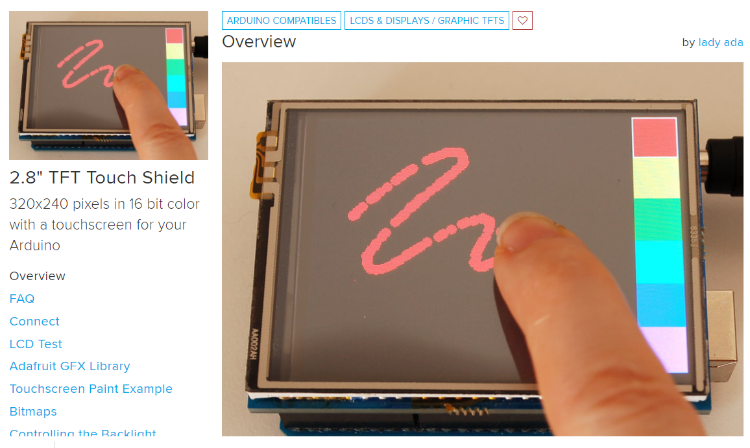
https://learn.adafruit.com/2-8-tft-touch-shield

Slide 3
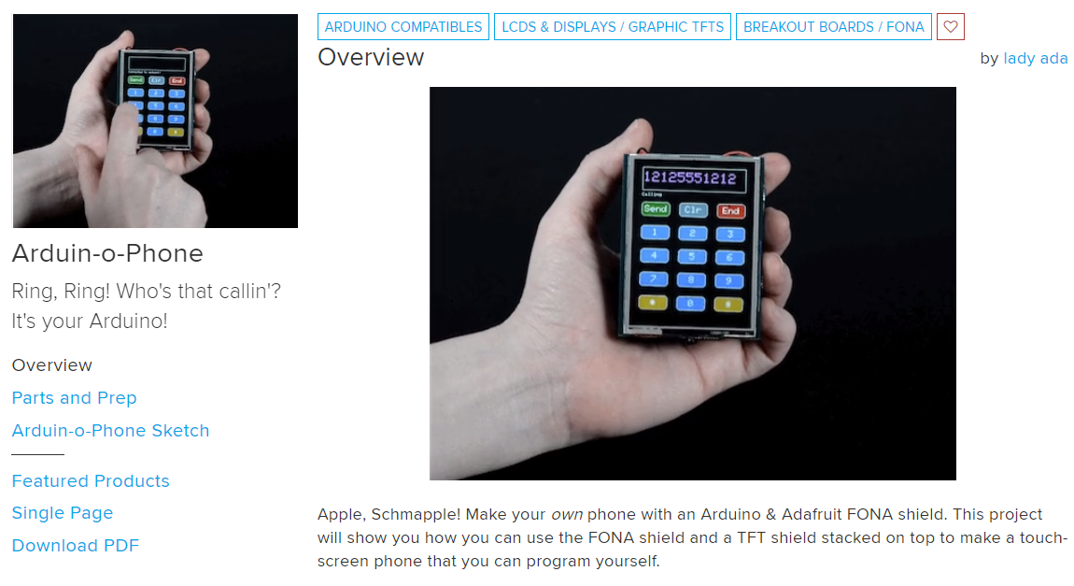
https://learn.adafruit.com/arduin-o-phone-arduino-powered-diy-cellphone

