Slide 1
Nomination for Game Of Threads D.O.G. Debug On the Go
Sudhanshu Gupta

Slide 2


Before We Begin …Answer few questions
Do you use your mobile to book your favorite meal?
Do you use your mobile to shop cloths / grocery ?
Do you use your mobile to update yourself to latest news ?

Slide 3

One Last Question…
Did you ever Debug your code on mobile???

Slide 4


Slide 5


What if this was possible??
D.O.G

Slide 6
Behold…..D.O.G aka Debug On the Go
D.O.G is an innovative “new” concept that will change the way developers debug their systems under test.
A light-weight , no frills Debug tool, which just suffices its purpose.
No more use of bulky software.
Provides an in-depth Health-card of your DUT.
Analyzes contents of special debug registers.

Slide 7
D.O.G Pros & Cons
Pros
Ease of use.
Readily available to everyone (Google Playstore)
Not-so-complex UI.
Auto App update. (No need to manually update software like in CodeWarrior)
Easy Expansion to new NPIs. (Single line code addition and Code compilation needed)
App Crashes (if any) will be automatically reported to developer console. (Days of “provide me reproduction steps” are gone).
Automatic Detection of NPI DB to be used from XML dump file generated from CW tool.
Plenty of “Free” Google Services that can monitor its health (Crashes/Hangs) and real time usage of the app worldwide.
Supports two types of dump file format (<regAddr, value> & <regName, value>)
Handles the corner case Registers, that are _NOT_ handled in CodeWarrior’s register Databases.
This APP can work even when Physical board has hanged or crashed.
Cons
Available only for Android devices as of now.
People don’t accept changes easily. Ie. Human nature not accustomed to working on Phone ;-)

Slide 8

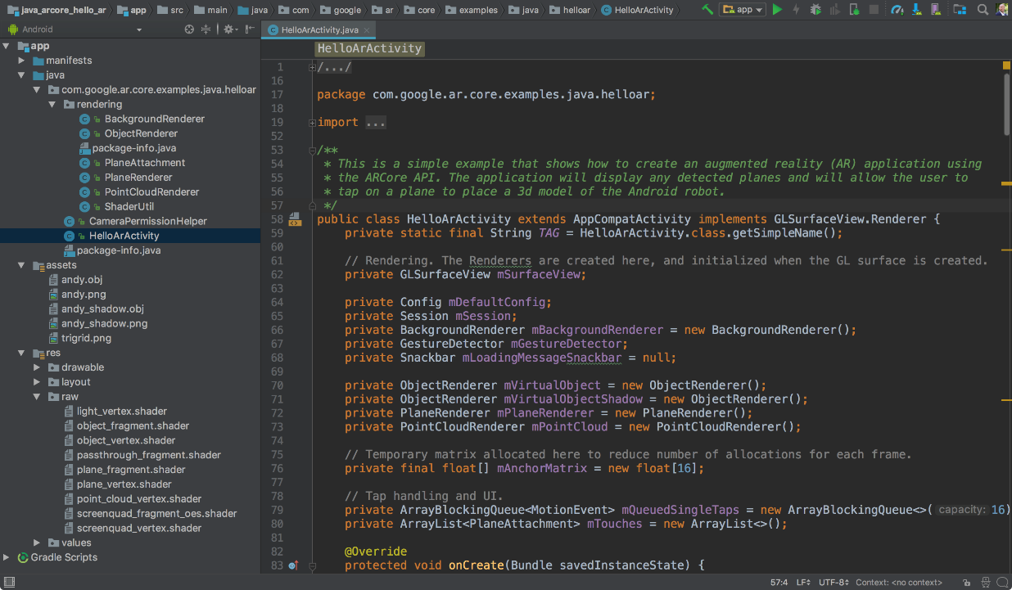


D.O.G Architecture
D.O.G.
CW NPI DBs
+
Debug Register
DB

Slide 9

D.O.G WorkFlow
1
2
3
4
Open DOG App
Select NPI DB
Choose Dump File
RegAdd,Value pair
Or
CW generated XML file
Dump File Analysis Report

Slide 10
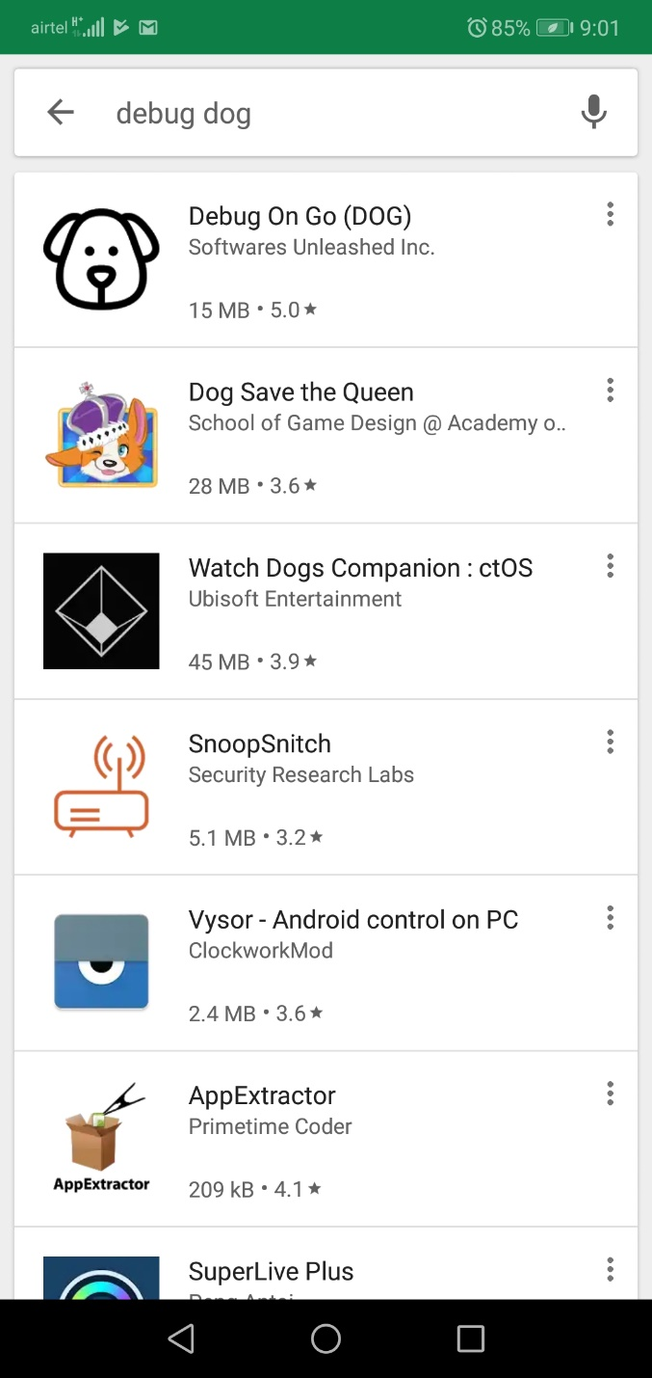
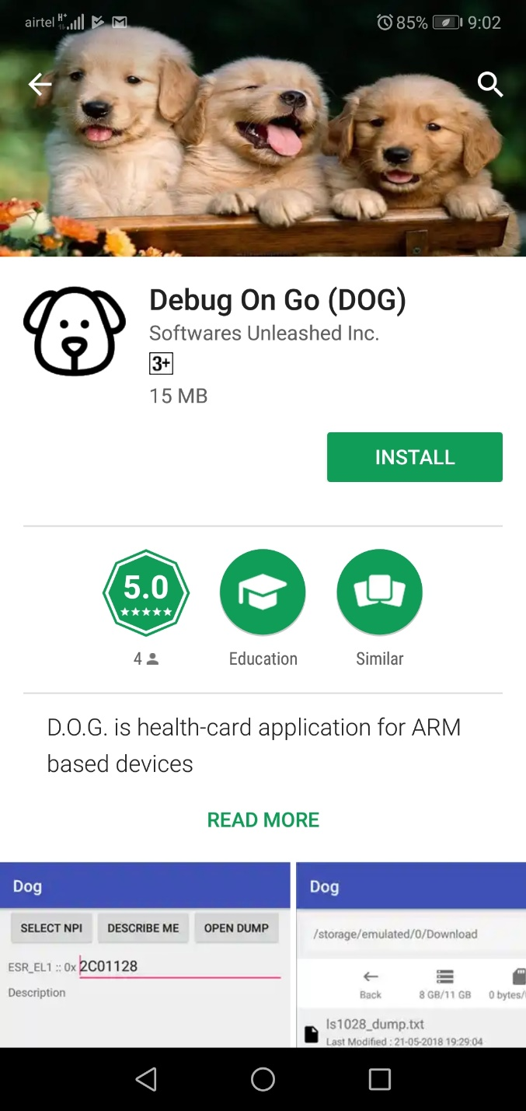
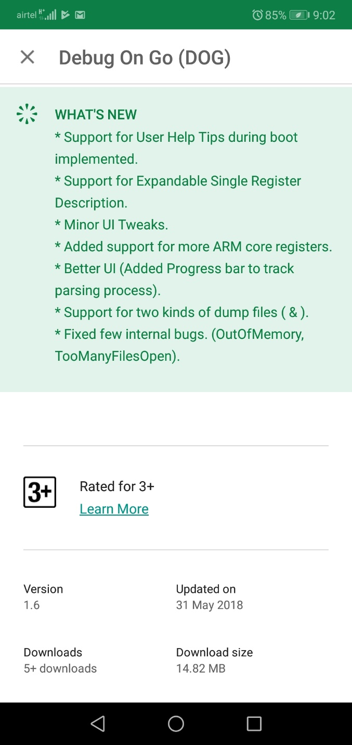
D.O.G. Peek Sneak

Slide 11
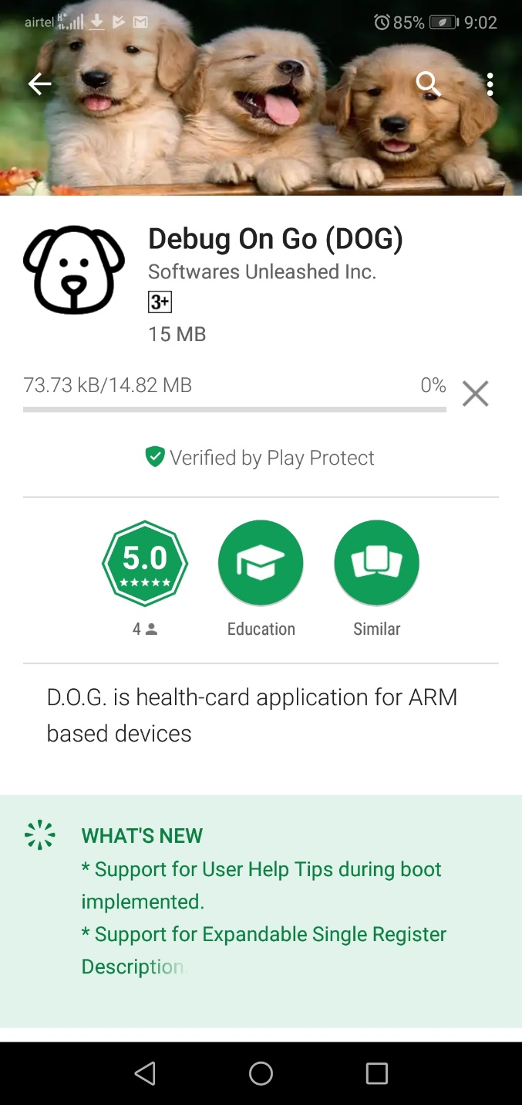

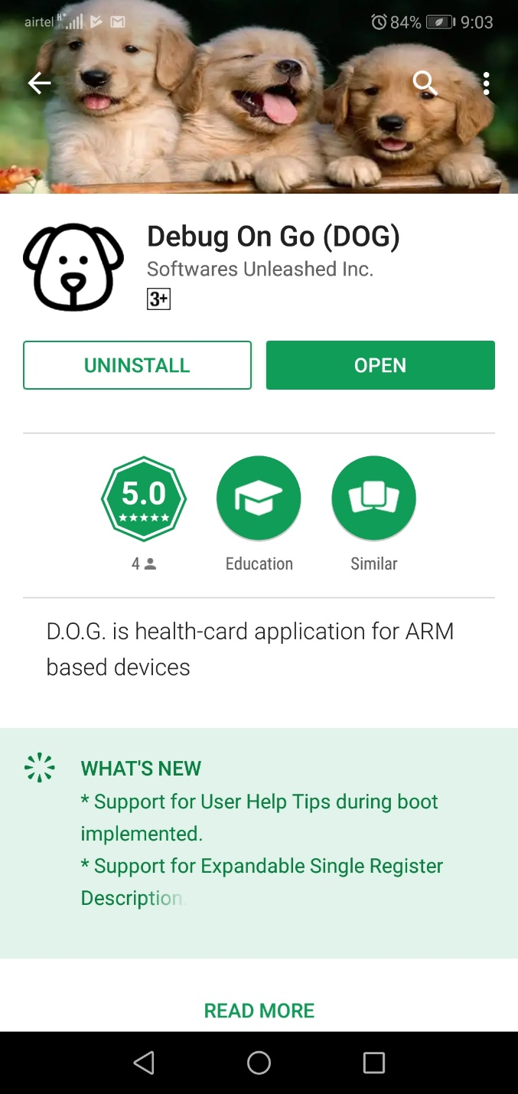
D.O.G. Peek Sneak

Slide 12
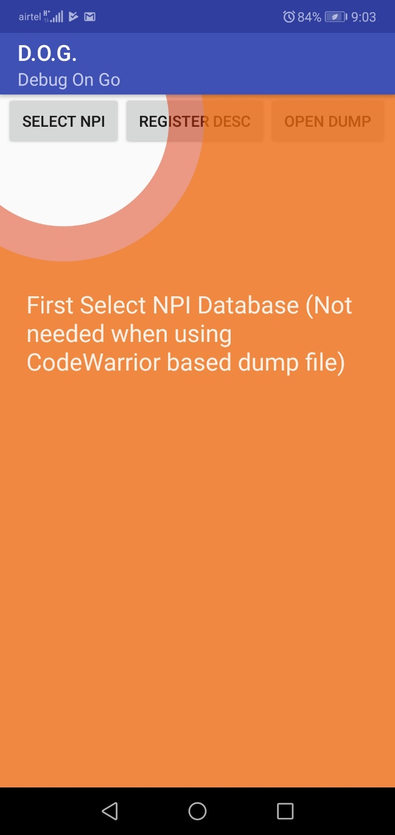
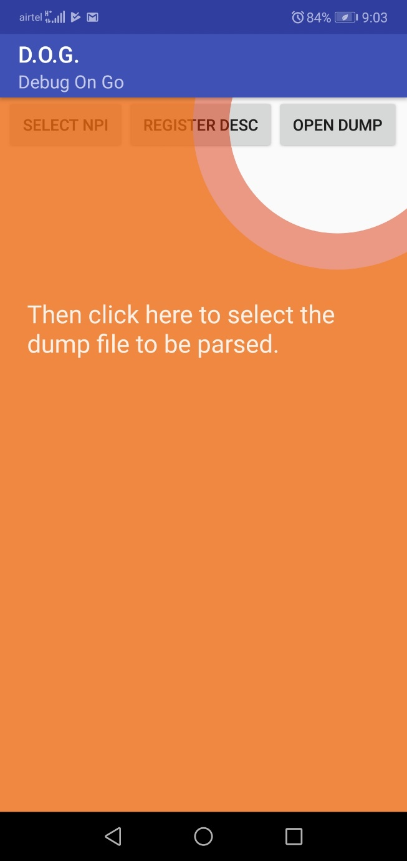
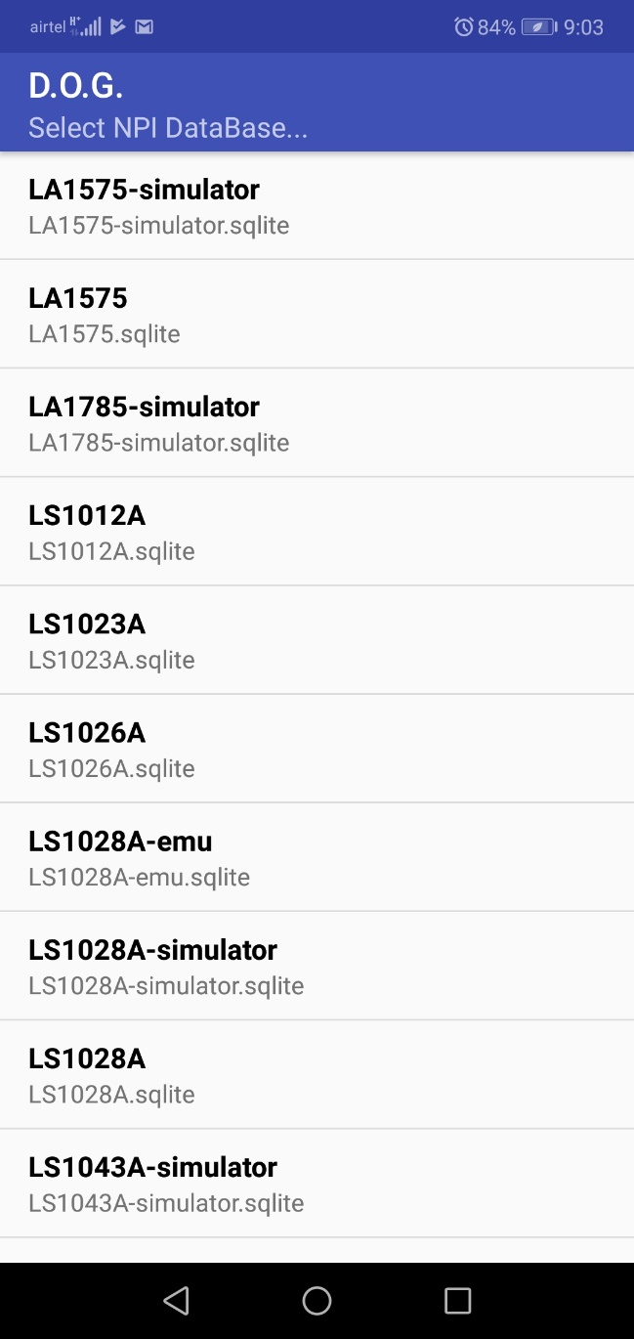
D.O.G. Peek Sneak

Slide 13
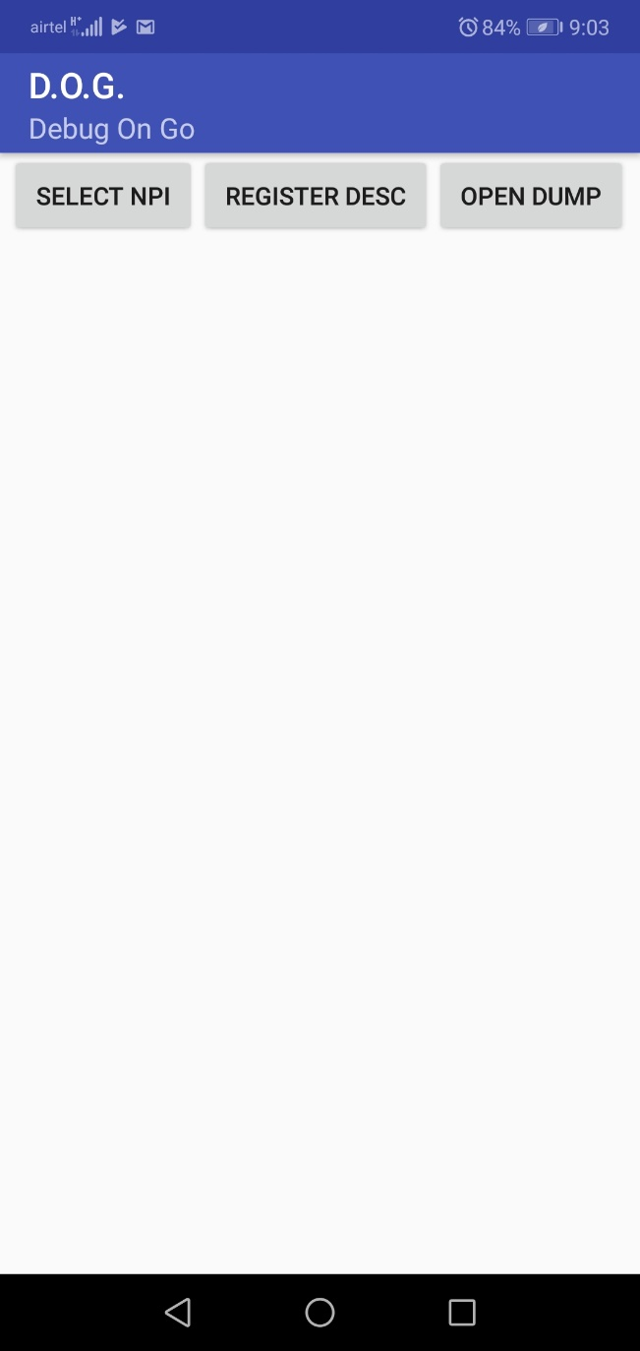
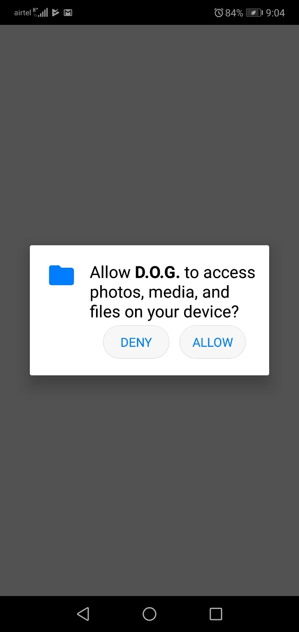
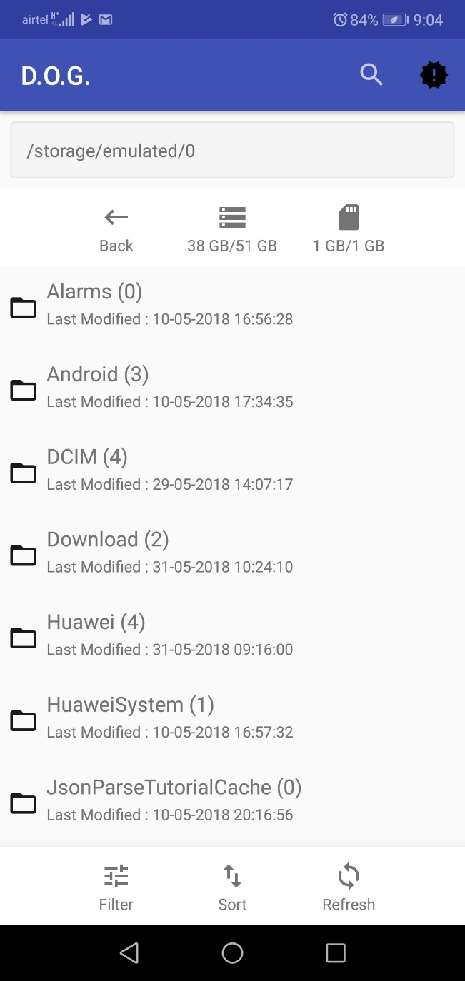
D.O.G. Peek Sneak

Slide 14
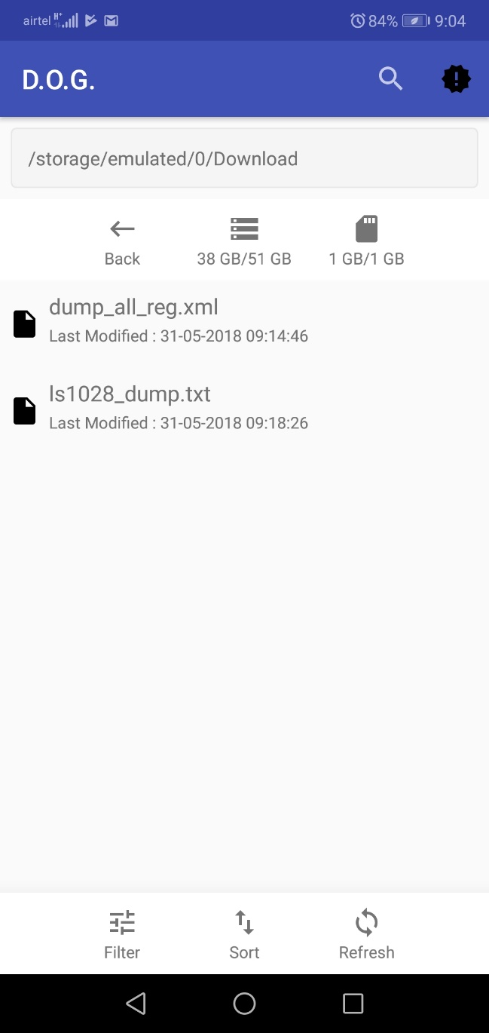
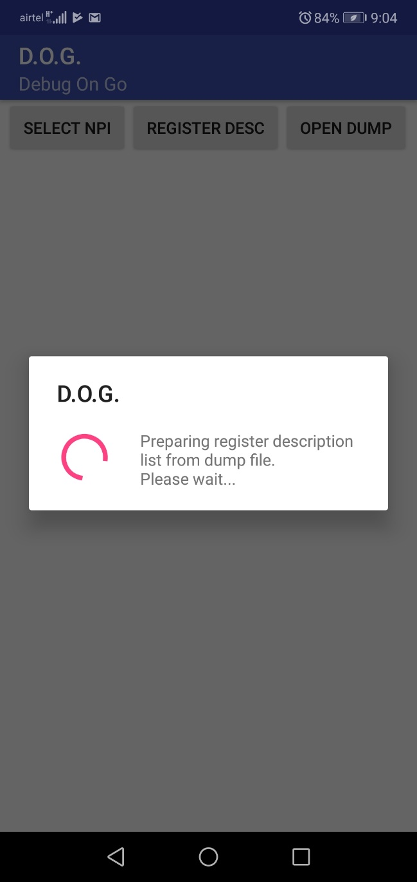
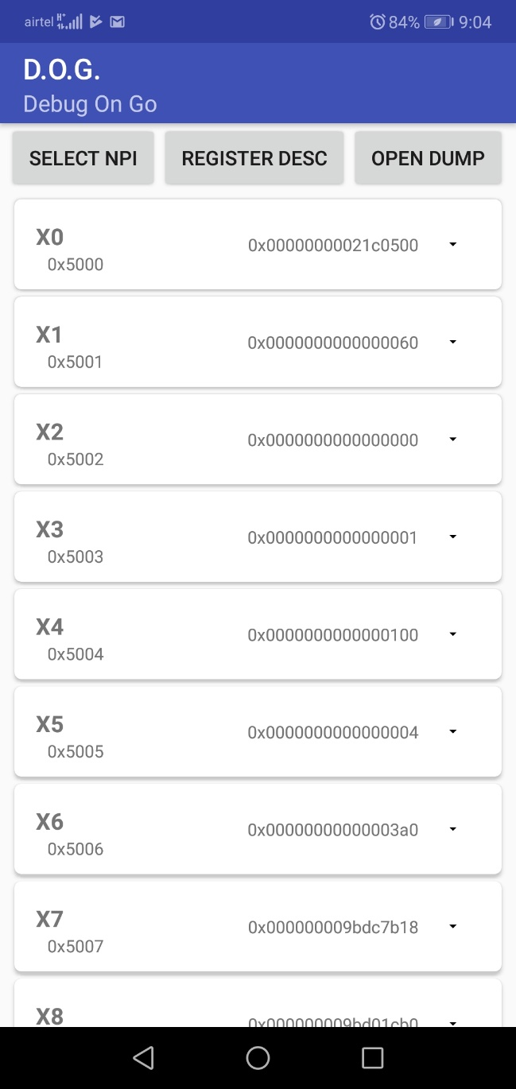
D.O.G. Peek Sneak

Slide 15
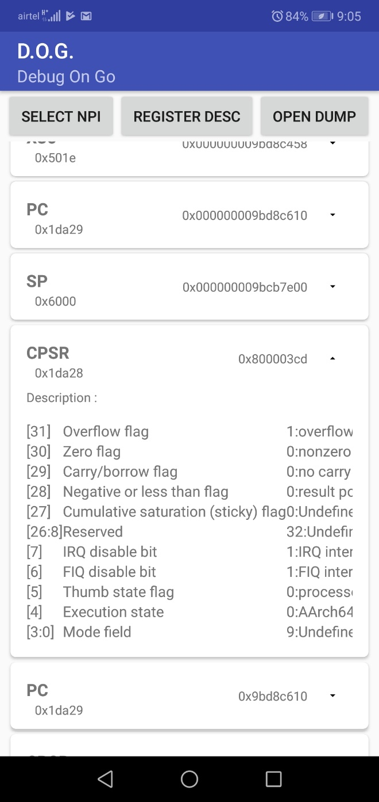
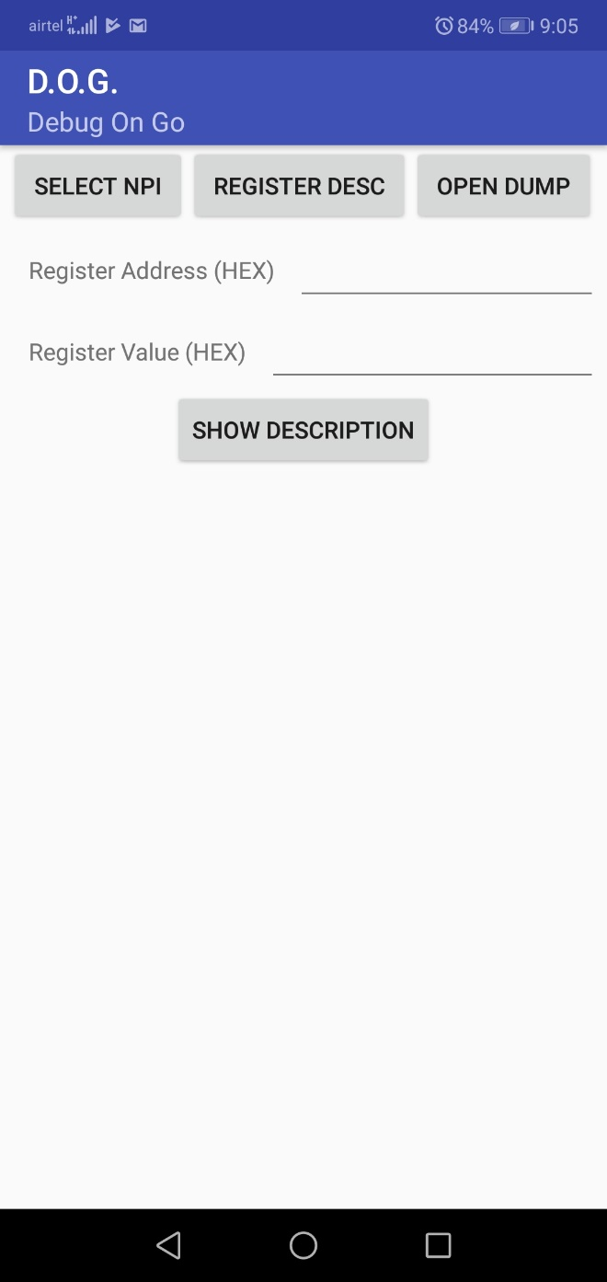
D.O.G. Peek Sneak

Slide 16
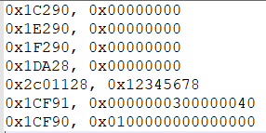
D.O.G - Dump File Format – Plain text file
<reg_address> , <reg_value> \n
…
…
<reg_address> , <reg_value> \n
Sample Dump File

Slide 17
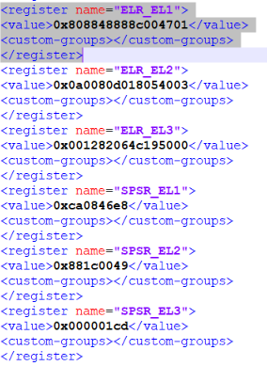
D.O.G - Dump File Format – XML Format (Code Warrior Format)
<register name=“ABCDEF">
<value>0xyyyyyyyyyyyy</value>
<custom-groups></custom-groups>
</register>
Sample Dump File
How to generate CW based XML Dump File ::
Execute following command in Debugger console of CW
Usage:
reg_export FILE <ALL | GROUP_NAME1,GROUP_NAME2...> [FORMAT=regs]
GROUP_NAME is the name of the register group (IP block).
To see a detailed description of each command, enter "help <cmd>" in the GDB console.
reg_export dump_all_reg all Exporting... All the register content would be dumped into dump_all_reg file located at C:\Freescale\CW4NET_v2018.01\CW_ARMv8\ARMv8 directory

Slide 18
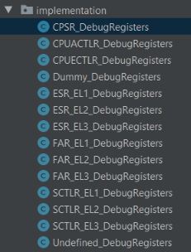
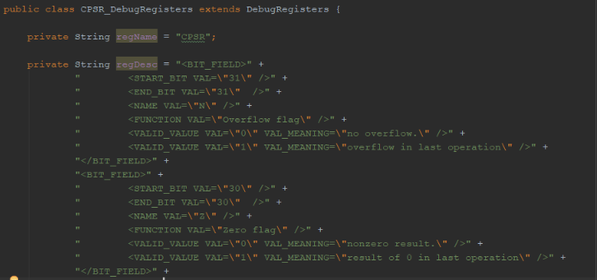
D.O.G - Adding Custom Registers Is Easy
Each custom register extends a base class → DebugRegisters
Populate the “regDesc” with an XML format string which contains bit field information.
Populate “regName” field for Register Name.

Slide 19
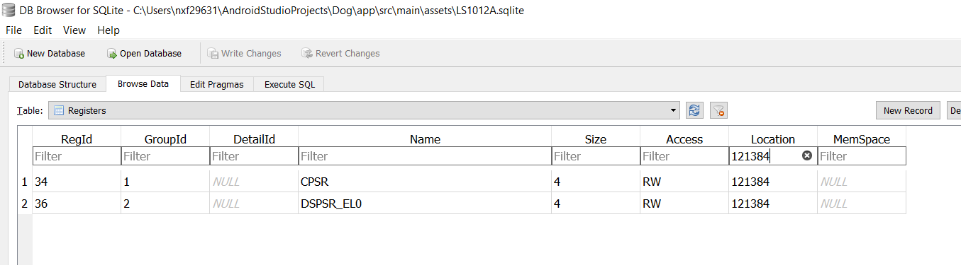
Known Issues
Register Endianess check not yet implemented. (Assumption : ARM & IP Registers are programmed - Little Endian)
Few Register addresses are duplicate in CodeWarrior DB. Due to which multiple entries are listed for same register addresses. (Possible Bug in CW DB …Need to check with CW team??)

Slide 20



D.O.G Presence
https://play.google.com/store/apps/details?id=com.softwaresunleashed.dog

Slide 21
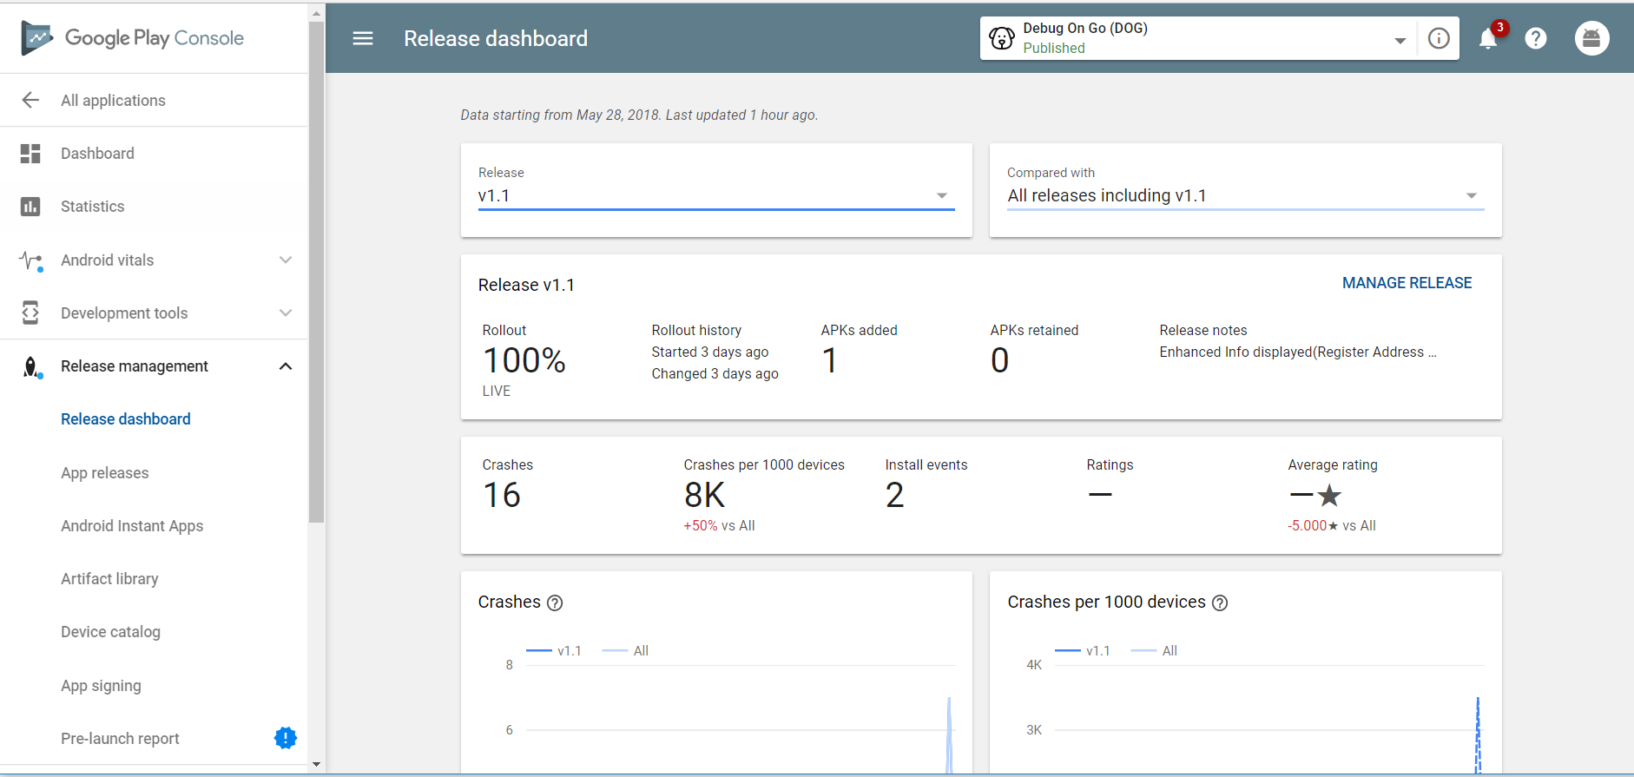
Google’s Free Analytical Services (Dashboard)

Slide 22

Demo
&
QnA

