Slide 1
ARMv8 Fundamentals & Architechture
Sudhanshu Gupta
BSP
DN-SW

Slide 2
Fundamentals of ARMv8 – Exception Levels
In ARMv8, execution occurs at one of four Exception levels…
EL0 - Normal user applications.
EL1 - Operating system kernel typically described as privileged.
EL2 - Hypervisor.
EL3 - Low-level firmware, including the Secure Monitor.
An application , Kernel of an operating system or a Hypervisor, each execute in their respective Exception level.
An exception to this rule is in-kernel hypervisors
such as KVM, which operate across both EL2 and EL1.

Slide 3
Fundamentals of ARMv8 – Security States
* ARMv8-A provides two security states:
* Secure and
* Non-secure (Normal World)
* This enables an Operating System (OS) to run in parallel with a trusted OS on the same hardware, and provides protection against certain software attacks and hardware attacks.
* ARM TrustZone technology enables the system to be partitioned between the Normal and Secure worlds.
* ARMv8-A also provides support for virtualization, though only in the Normal world.
This means that hypervisor, or Virtual Machine Manager (VMM) code can run on the system and
host multiple guest operating systems.
In ARMv7-A architecture, the Secure monitor acts as a gateway for moving between the Normal and Secure worlds.

Slide 4
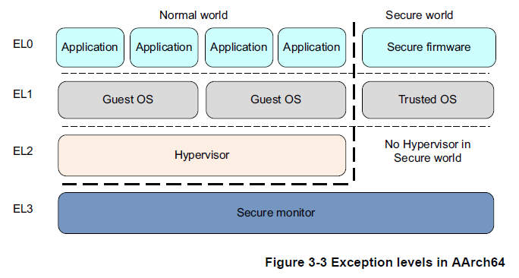
Legends :
GPR – General Purpose Registers
Fundamentals of ARMv8
Execution States in ARMv8
Aarch 64
[GPR 64bit]
Aarch 32
[GPR 32bit]
Privilege level is determined by Exception Level (EL 0,1,2,3).
Executes A64 instruction set.
Retains ARMv7 definitions of priviledge.
Executes either A32 (aka ARM) or T32 (Thumb) instruction sets.

Slide 5
Fundamentals of ARMv8 – Changing Exception Levels in ARMv7
In the ARMv7 architecture, the processor mode can change under privileged software control.
When an exception occurs, the core saves the current execution state and the return address, enters the required mode, and possibly disables hardware interrupts.
:: Sub-Systems and associated Privilege levels ::
Applications [PL0]
Unprivileged mode, lowest level of privilege.
Operating systems [PL1]
Hypervisor [PL2]
with the Virtualization extensions
Secure monitor [PL1]
Acts as a gateway for moving between the Secure and Non-secure (Normal) worlds)

Slide 6
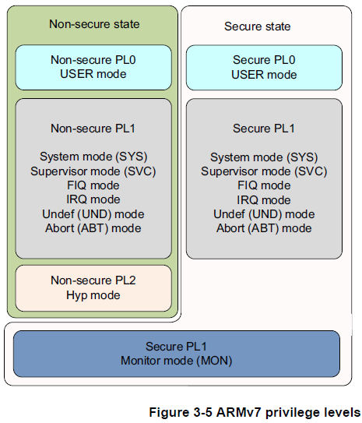
Fundamentals of ARMv8 – Exception Levels in ARMv7
Privilege Level Table in previous slide summarized as a block diagram below

Slide 7
Fundamentals of ARMv8 – Exception Levels in ARMv8
In AArch64, the processor modes are mapped onto the Exception levels as in Figure 3-6.
Like ARMv7 (AArch32) when an exception is taken, the processor changes to the Exception level (mode) that supports the handling of the exception.
Sources of Exception Level Hopping
— Memory system aborts.
— Interrupts such as IRQ and FIQ.
— Undefined instructions.
— System calls. These permit unprivileged software to make a system call to an operating system.
— Secure monitor or hypervisor traps.
Exception Level Hopping rule(s)
Moves to a higher Exception level, (say EL0 → EL1), indicate increased software execution privilege.
exception cannot be taken to a lower Exception level.
There is no exception handling at level EL0, exceptions must be handled at a higher Exception level.
Execution of an exception handler starts, at an Exception level higher than EL0, from a defined vector that relates to the exception taken.
Ending exception handling and returning to the previous Exception level is performed by executing the ERET instruction
Returning from an exception can stay at the same Exception level or enter a lower Exception level. (except when retuning from EL3 to a Non-secure state.)

Slide 8
Fundamentals of ARMv8 – Changing Execution State
Usecase :
There are times when you must change the execution state of your system.
Lets suppose, you are running a 64-bit operating system, and want to run a 32-bit application at EL0.
To do this, the system must change to AArch32. When the application has completed or execution returns to the OS, the system can switch back to AArch64.
Method :
To change between execution states at the same Exception level, you have to switch to a higher Exception level then return to the original Exception level.
For example, you might have 32-bit and 64-bit applications running under a 64-bit OS.
In this case, the 32-bit application can execute and generate a Supervisor Call (SVC) instruction, or receive an interrupt, causing a switch to EL1 and AArch64. The OS can then do a task switch and return to EL0 in AArch64.

Slide 9
Fundamentals of ARMv8

Slide 10
Fundamentals of ARMv8

Slide 11
Fundamentals of ARMv8

