Slide 1
TBGEN Introduction Time Based Generator
Presenter :
Sudhanshu Gupta
BSP SW Team

Slide 2
Agenda
1.1 Introduction to TBGEN
1.2 TBGEN Block Diagram
1.3 TBGEN Event Connectivity

Slide 3
01. Introduction to TBGEN
Timebase Generator (TBGEN) provides system timing services that allow signaling of events within the chip while maintaining the delay accuracy requirements.
TBGEN is capable of generating a 10 ms radio frame signal and various programmable frame signals which can be used for GSM, CDMA, WCDMA, UMTS and LTE with the option to synchronize to the 10 ms SYNC signal or with an offset with the start of the 64-bit Timebase Master Counter (RFG – not in current scope).
Modes of Operation TBGEN consists of several programmable timers which use a common architecture.
The timers can be programmed to run in
One-Shot mode or
Continuous mode
The period of the output events is programmable.

Slide 4
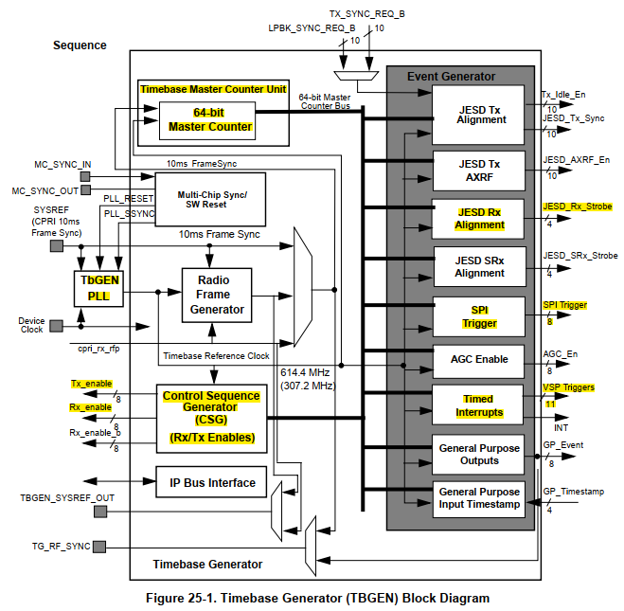
02. TBGEN Block Diagram
MPIC
VSPA
AXIQ_H
VSPA
Refer : TBGEN Block Guide

Slide 5
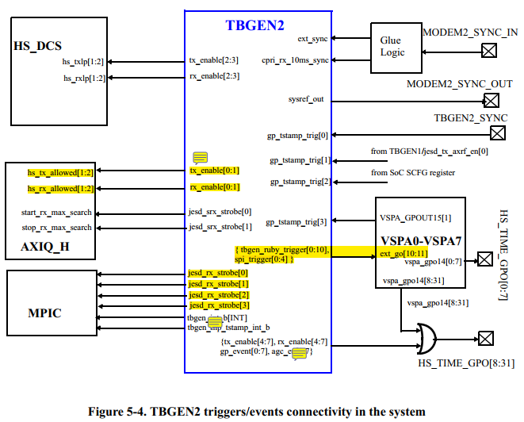
03. TBGEN Event Connectivity
Refer : Geul Arch Def v0.7

Slide 6
Q n A

Slide 7
Backup Slides

Slide 8
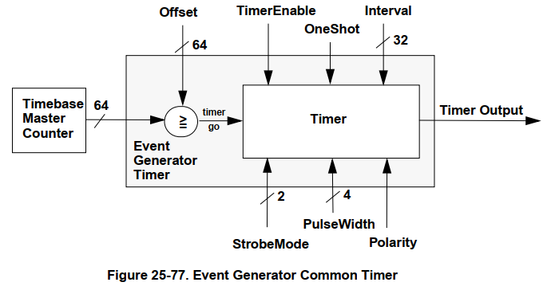
Functional Description
Timebase Event Generator
Timer generates its first event when the 64-bit timebase master counter value is greater than or equal to the offset value programmed for the timer.
The output event of the timer can occur once (one-shot mode), or repeat in a periodic fashion.
In one-shot mode, the timer fires once and goes to sleep.
In the repeating, periodic mode, the timer output event will fire repeatedly.
INTERVAL[31:0] : number of reference clock cycles between output events.
STRBMODE[1:0] : configure the type of output event. Output events can be configured to be a
Pulse (of programmable width)
In pulse mode, the width of the output pulse is configured with the PULSEWIDTH[3:0] bits and can be set to be between 1 and 16 reference clock cycles wide.
a simple toggle, or
an approximate 50% duty cycle pulse.

Slide 9
Functional Description
Timebase Master Counter Unit (TMCU)
Master Counter
Master Counter is a 64-bit counter which is used to keep track of the system timing.
It is fed by the Timebase Reference Clock and is initialized to zero out of system reset or cleared by software reset.
The Master Counter will be running as soon as the Timebase Reference Clock is available and will not rollover within 500 years if left running continuously.
Last 10ms Master Counter Register
Timebase Counter unit has a Last 10ms Master Counter (TS10MSHI and TS10MSLO) register which stores the value of the master counter of the last 10 ms frame.

Slide 10
Functional Description
Control Sequence Generator
Tx/Rx Switching Modes
TbGEN has the hardware mechanism to individually drive the Tx_enable and Rx_enable signals for up to 8 transceivers.
The TX and RX enables can be driven manually by software using the TDDx_CTRL(TXRXEN[1:0]) bits, or in a programmable sequential fashion.
TDD switching unit contains 8 timers to control up to 8 transceivers. Each timer can be programmed to output a sequence of up to 16 steps. Each of the 16 steps in the sequence have a programmable duration and a programmable TX/RX Enable output value.
Duration of each step is programmed by writing a value to the TDDx_DURATIONx(DURATIONx[31:0]) bits of the register associated with the timer and sequence step. TDDx_DURATIONx(DURATIONx[31:0]) bits represents the number of reference clock cycles for the given step in the sequence.
TDDx_MODE(MODEx[1:0]) bits determine the value of the TX/RX enable outputs for the associated step in the sequence. The length of the sequence can be configured to be between 1 and 16 steps. The sequence starts when the Timebase Master Counter value is greater than or equal to the programmed offset for the TDD Switching Unit timer.
If the TDD switching unit timer is configured for continuous sequencing, the timer will execute the number of sequence steps defined by the TDDx_CTRL(BUFLENGTH[3:0]) bits and then immediately repeat the sequence of steps, starting with step 0. Sequencing will continue until the TDD switching unit timer is disabled or until there is a reset.
When the master coutner value is less than the timer’s offset value, the TX/RX enable output value is determined by the TDDx_CTRL(TXRXEN[1:0]) bits. The TDDx_CTRL(TXRXEN[1:0]) bits also configure the TX/RX enable outputs when the TDD switching unit timer is disabled

Slide 11
Radio Frame Generator
Functional Description
– Not being used in Geul project
Generates the local 10ms Radio Frame depending on the incoming Timebase Reference clock frequency, configure the REFCLKS_PER_10MS register accordingly.

