Slide 1
FreeRTOS Coding Guidelines
Let’s Code FreeRTOS…
Presenter :
Sudhanshu Gupta
BSP SW Team

Slide 2
Agenda
1 Variables
2 Functions
Macros
Style Guide
Code Layout

Slide 3
Coding Standard FreeRTOS Variables
Variable Type (Standard) | Prefix | Remarks
unit32_t | ul | u – unsigned, l – long
unit16_t | us | u – unsigned, s – short
unit8_t | uc | u – unsigned, c – char
Variable Type (Non Standard) | Prefix | Remarks
BaseType_t TickType_t | x | portable layer defined typedefs for the natural or most efficient type for the architecture
UBaseType_t (unsigned BaseType_t) | ux | Unsigned variables of non stdint types have an additional prefix u
size_t | x
Enum | e
Pointers | p | pointer to a uint16_t will have prefix pus
size_t | x
char | c | unqualified standard char types are only permitted to hold ASCII characters
char * | pc | variables of type char * are only permitted to hold pointers to ASCII strings and are prefixed pc

Slide 4
Coding Standard FreeRTOS Variables
Variable Type (Non Standard) | Prefix | Remarks
Enum | e
Pointers | p | pointer to a uint16_t will have prefix pus
size_t | x
char | c | unqualified standard char types are only permitted to hold ASCII characters
char * | pc | variables of type char * are only permitted to hold pointers to ASCII strings and are prefixed pc

Slide 5
Coding Standard FreeRTOS Functions
Function Type | Prefix | Remarks
static function | prv | File scope static (private) functions
API function | return type | v – void c – char i – int u – unsigned p – pointer to …
* API function names start with the name of the file in which they are defined.
* For example vTaskDelete is defined in tasks.c, and has a void return type.

Slide 6
Coding Standard FreeRTOS Macros
MACRO Type
1) Macros are pre-fixed with the file in which they are defined.
2) The pre-fix is lower case.
3) Other than the pre-fix, macros are written in all upper case, and use an underscore to separate words.
For example: configUSE_PREEMPTION is defined in FreeRTOSConfig.h

Slide 7
Coding Standard FreeRTOS Style Guide
Style Guide
Indentation Tabs are used to indent. One tab equals 4 spaces.
Comments Comments never pass column 80 C++ style double slash (//) comments are not used.
Layout The FreeRTOS source code lay out is designed to be as easy to view and read as possible.
The code snippets on next slides show first the file layout, then the C code formatting.

Slide 8
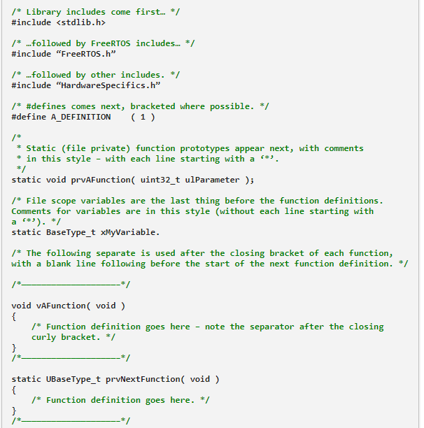
FreeRTOS Coding Standard / Layout
Library Header files at top
FreeRTOS Header files follow next
User Defined Header files at the end
#defines comes next, good to have in ( braces )
Private / static functions come after #defines
Private / file scope variables comes next
Prefix and Camel-case naming followed for functions and variables
Curly braces on separate lines

Slide 9
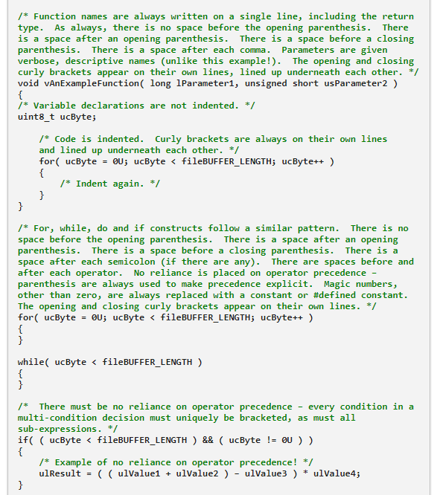
FreeRTOS Coding Standard / Layout
Functions :
No space b/w function name and opening brace.
Space needed b/w Function Parameters & Opening-Closing round braces.
Opening-Closing curly braces on their own lines.
For, While, Do, If :
Same rules as in case of function (above).
Space after each ; in “for” loop.
Operator precedence to be explicitly defined via braces.
No Magic Numbers …please!!!
Replace magic numbers with
enum constants
Variable constants
#defines
Operator precedence to be explicitly defined via braces.

Slide 10
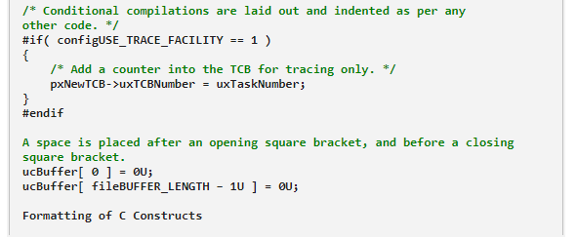
FreeRTOS Coding Standard / Layout
Conditional compilations to be indented as per code block it is defined.
Space is needed between square brackets (as depicted)

Slide 11
References
Link to FreeRTOS coding guidelines :
https://www.freertos.org/FreeRTOS-Coding-Standard-and-Style-Guide.html

Slide 12
Q n A

