Slide 1
Slots & Symbols Unleashed
Presenter :
Sudhanshu Gupta
BSP SW Team

Slide 2
Agenda
Numerology - Subcarrier Spacing
Numerology and Slot Length
Numerology and Supported Channels
OFDM Symbol Duration
Radio Frame Structure
Slot Format
Predefined Symbol Allocation of Slot(s)
Why we need so many different types of slot formats ?

Slide 3
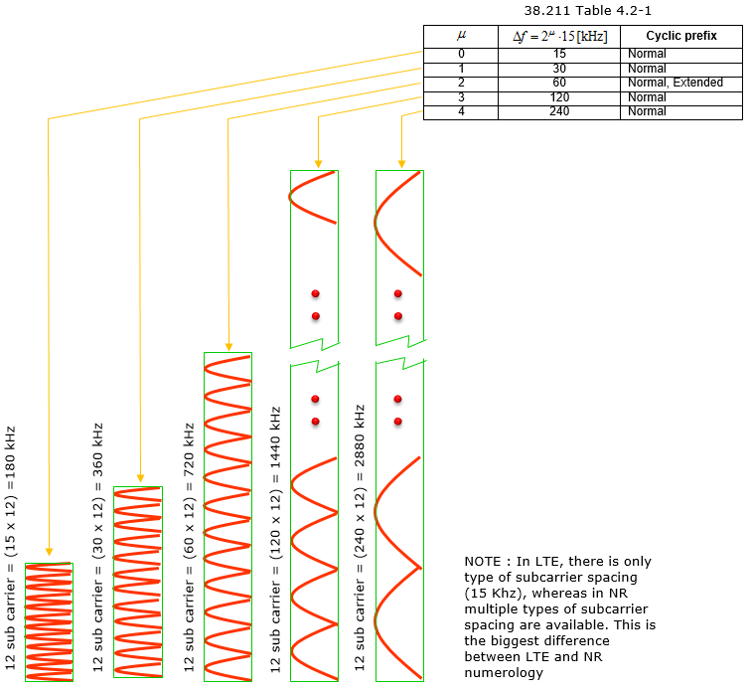
Numerology - Subcarrier Spacing
Comparing to LTE numberology (subcarrier spacing and symbol length), the most outstanding difference you can notice is that NR support multiple different types of subcarrier spacing (in LTE there is only one type of subcarrier spacing, 15 Khz).
Each numerology is labled as a parameter(u, mu in Greek). The numerology (u = 0) represents 15 kHz which is same as LTE. And as you see in the second column the subcarrier spacing of other u is derived from (u=0) by scaling up in the power of 2.

Slide 4
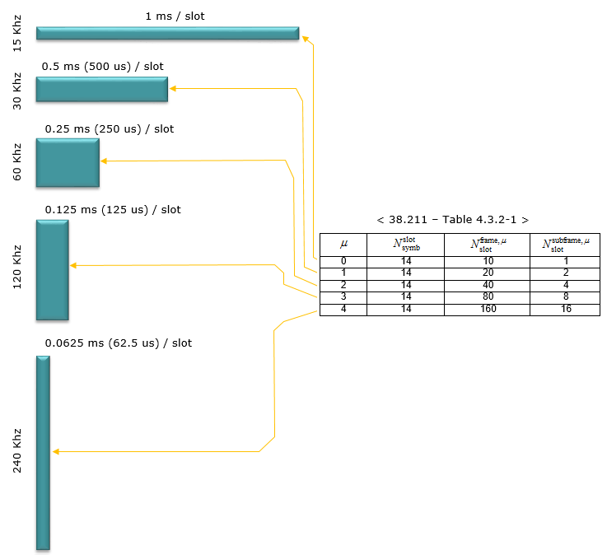
Numerology and Slot Length
Slot length gets different depending on numerology. The general tendancy is that slot length gets shorter as subcarrier spacing gets wider.

Slide 5
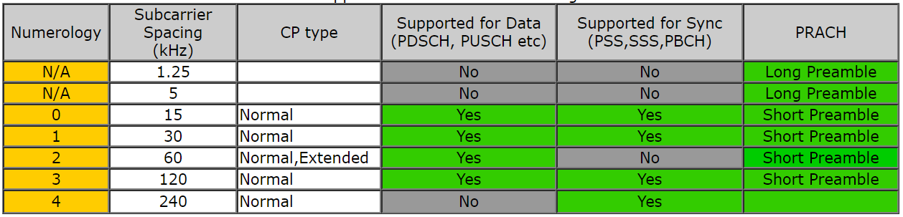
Numerology and Supported Channels
Not every numerology can be used for every physical channel and signals.
That is, there is a specific numerologies that are used only for a certain type of physical channels even though majority of the numerologies can be used any type of physical channels.

Slide 6
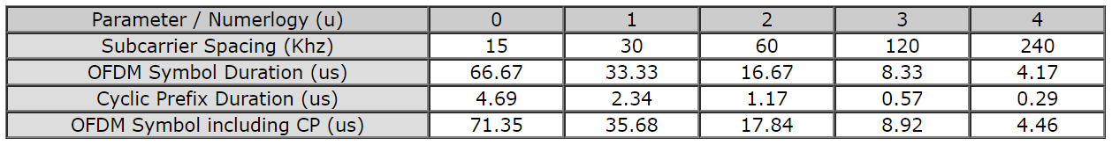
OFDM Symbol Duration

Slide 7
Radio Frame Structure
In 5G/NR multiple numerologies(waveform configuration like subframe spacing) are supported and the radio frame structure gets a little bit different depending on the type of the numerology.
However, regardless of numerology the length of one radio frame and the length of one subframe is same. The length of a Radio Frame is always 10 ms and the length of a subframe is always 1 ms.
Then what should get different to accommodate the physical property of the different numerology ?
The answer is to put different number of slots within one subframe. There is another varying parameter with numerology. It is the number of symbols within a slot.
However, the number of symbols within a slot does not change with the numerology, it only changes with slot configuration type.
For slot configuration 0, the number of symbols for a slot is always 14 and for slot configuration 1, the number of symbols for a slot is always 7.

Slide 8
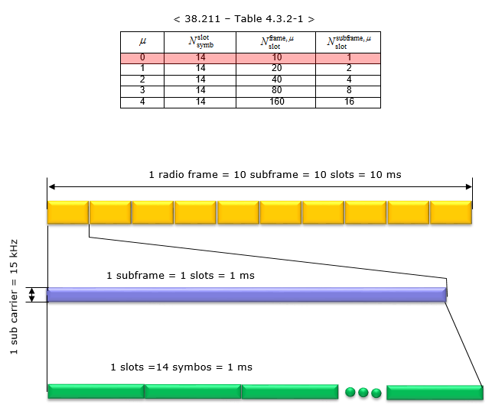
< Normal CP, Numerology = 0 >
In this configuration, a subframe has only one slot in it, it means a radio frame contains 10 slots in it. The number of OFDM symbols within a slot is 14.

Slide 9
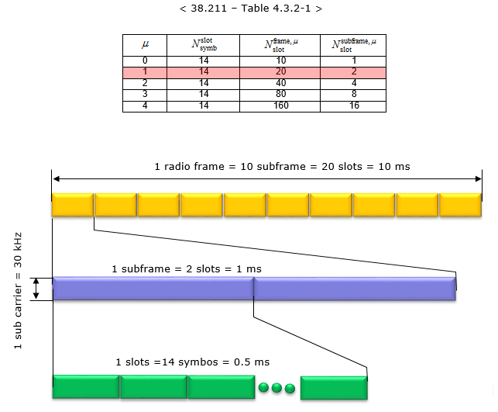
< Normal CP, Numerology = 1 >
In this configuration, a subframe has 2 slots in it, it means a radio frame contains 20 slots in it. The number of OFDM symbols within a slot is 14.

Slide 10
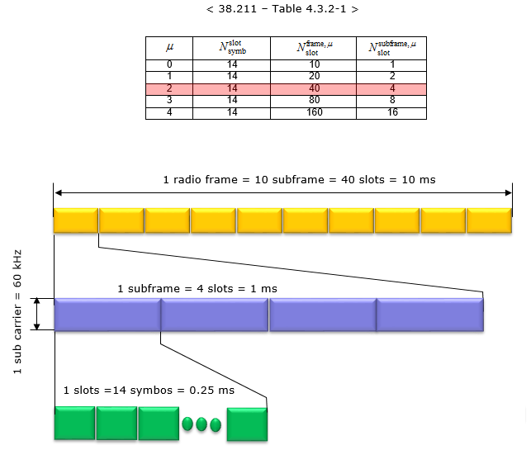
< Normal CP, Numerology = 2 >
In this configuration, a subframe has 4 slots in it, it means a radio frame contains 40 slots in it. The number of OFDM symbols within a slot is 14.

Slide 11
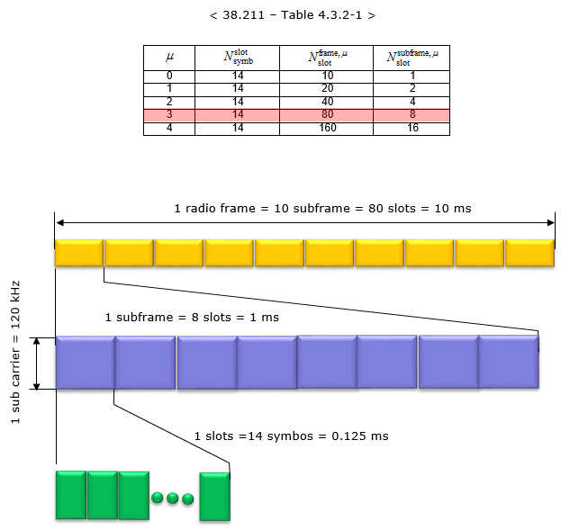
< Normal CP, Numerology = 3 >
In this configuration, a subframe has 8 slots in it, it means a radio frame contains 80 slots in it. The number of OFDM symbols within a slot is 14.

Slide 12
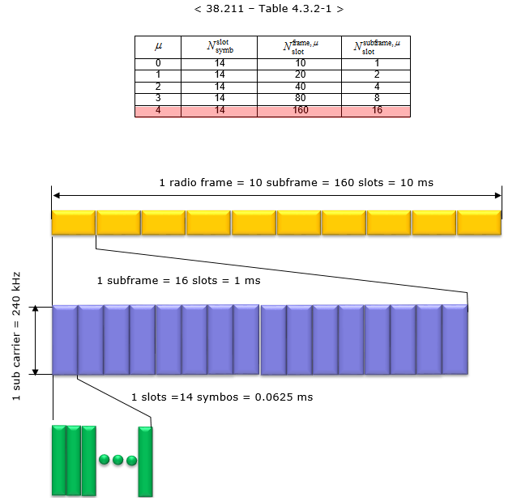
< Normal CP, Numerology = 4 >
In this configuration, a subframe has 16 slots in it, it means a radio frame contains 160 slots in it. The number of OFDM symbols within a slot is 14.

Slide 13
Slot Format
Slot Format indicates how each of symbols within a single slot is used. It defines which symbols are used for uplink and which symbols are used for downlink within a specific slot. In LTE TDD, if a subframe (equivalent to a Slot in NR) is configured for DL or UL, all of the symbols within the subframe should be used as DL or UL
But in NR, the symbols within a slot can be configured in various ways as follows.
We don't need to use every symbols within a slot (this can be a similar concept in LAA subframe where only a part of subframes can be used for data transmission).
Single slot can be devided into multiple segments of consecutive symbols that can be used for DL , UL or Flexible.
Theoretically we can think of almost infinite number of possible combinations of DL symbol, UL symbol, Flexible Symbol within a slot, but 3GPP allows only 61 predefined symbol combination within a slot as in following table.

Slide 14
These predefined symbol allocation of a slot called Slot Format.
D : Downlink, U : Uplink, F : Flexible
 | Symbol | Number | in a | slot
Format | 0 | 1 | 2 | 3 | 4 | 5 | 6 | 7 | 8 | 9 | 10 | 11 | 12 | 13
0 | D | D | D | D | D | D | D | D | D | D | D | D | D | D
1 | U | U | U | U | U | U | U | U | U | U | U | U | U | U
2 | F | F | F | F | F | F | F | F | F | F | F | F | F | F
3 | D | D | D | D | D | D | D | D | D | D | D | D | D | F
4 | D | D | D | D | D | D | D | D | D | D | D | D | F | F
5 | D | D | D | D | D | D | D | D | D | D | D | F | F | F
6 | D | D | D | D | D | D | D | D | D | D | F | F | F | F
7 | D | D | D | D | D | D | D | D | D | F | F | F | F | F
8 | F | F | F | F | F | F | F | F | F | F | F | F | F | U
9 | F | F | F | F | F | F | F | F | F | F | F | F | U | U
10 | F | U | U | U | U | U | U | U | U | U | U | U | U | U
11 | F | F | U | U | U | U | U | U | U | U | U | U | U | U
12 | F | F | F | U | U | U | U | U | U | U | U | U | U | U
13 | F | F | F | F | U | U | U | U | U | U | U | U | U | U
14 | F | F | F | F | F | U | U | U | U | U | U | U | U | U
15 | F | F | F | F | F | F | U | U | U | U | U | U | U | U
16 | D | F | F | F | F | F | F | F | F | F | F | F | F | F
17 | D | D | F | F | F | F | F | F | F | F | F | F | F | F
18 | D | D | D | F | F | F | F | F | F | F | F | F | F | F
19 | D | F | F | F | F | F | F | F | F | F | F | F | F | U
20 | D | D | F | F | F | F | F | F | F | F | F | F | F | U
21 | D | D | D | F | F | F | F | F | F | F | F | F | F | U
22 | D | F | F | F | F | F | F | F | F | F | F | F | U | U
23 | D | D | F | F | F | F | F | F | F | F | F | F | U | U
24 | D | D | D | F | F | F | F | F | F | F | F | F | U | U
25 | D | F | F | F | F | F | F | F | F | F | F | U | U | U
26 | D | D | F | F | F | F | F | F | F | F | F | U | U | U
27 | D | D | D | F | F | F | F | F | F | F | F | U | U | U
28 | D | D | D | D | D | D | D | D | D | D | D | D | F | U

Slide 15
29 | D | D | D | D | D | D | D | D | D | D | D | F | F | U
30 | D | D | D | D | D | D | D | D | D | D | F | F | F | U
31 | D | D | D | D | D | D | D | D | D | D | D | F | U | U
32 | D | D | D | D | D | D | D | D | D | D | F | F | U | U
33 | D | D | D | D | D | D | D | D | D | F | F | F | U | U
34 | D | F | U | U | U | U | U | U | U | U | U | U | U | U
35 | D | D | F | U | U | U | U | U | U | U | U | U | U | U
36 | D | D | D | F | U | U | U | U | U | U | U | U | U | U
37 | D | F | F | U | U | U | U | U | U | U | U | U | U | U
38 | D | D | F | F | U | U | U | U | U | U | U | U | U | U
39 | D | D | D | F | F | U | U | U | U | U | U | U | U | U
40 | D | F | F | F | U | U | U | U | U | U | U | U | U | U
41 | D | D | F | F | F | U | U | U | U | U | U | U | U | U
42 | D | D | D | F | F | F | U | U | U | U | U | U | U | U
43 | D | D | D | D | D | D | D | D | D | F | F | F | F | U
44 | D | D | D | D | D | D | F | F | F | F | F | F | U | U
45 | D | D | D | D | D | D | F | F | U | U | U | U | U | U
46 | D | D | D | D | D | D | F | D | D | D | D | D | D | F
47 | D | D | D | D | D | F | F | D | D | D | D | D | F | F
48 | D | D | F | F | F | F | F | D | D | F | F | F | F | F
49 | D | F | F | F | F | F | F | D | F | F | F | F | F | F
50 | F | U | U | U | U | U | U |  | U | U | U | U | U | U
51 | F | F | U | U | U | U | U | F | F | U | U | U | U | U
52 | F | F | F | U | U | U | U | F | F | F | U | U | U | U
53 | F | F | F | F | U | U | U | F | F | F | F | U | U | U
54 | D | D | D | D | D | F | U | D | D | D | D | D | F | U
55 | D | D | F | U | U | U | U | U | U | FU | U | U | U | U
56 | D | F | U | U | U | U | U | D | F | U | U | U | U | U
57 | D | D | D | D | F | F | U | D | D | D | D | F | F | U
58 | D | D | F | F | U | U | U | D | D | F | F | U | U | U
59 | D | F | U | U | U | U | U | D | F | U | U | U | U | U
60 | D | F | F | F | F | F | U | D | F | F | F | F | F | U
61 | D | D | F | F | F | F | U | D | D | F | F | F | F | U

Slide 16
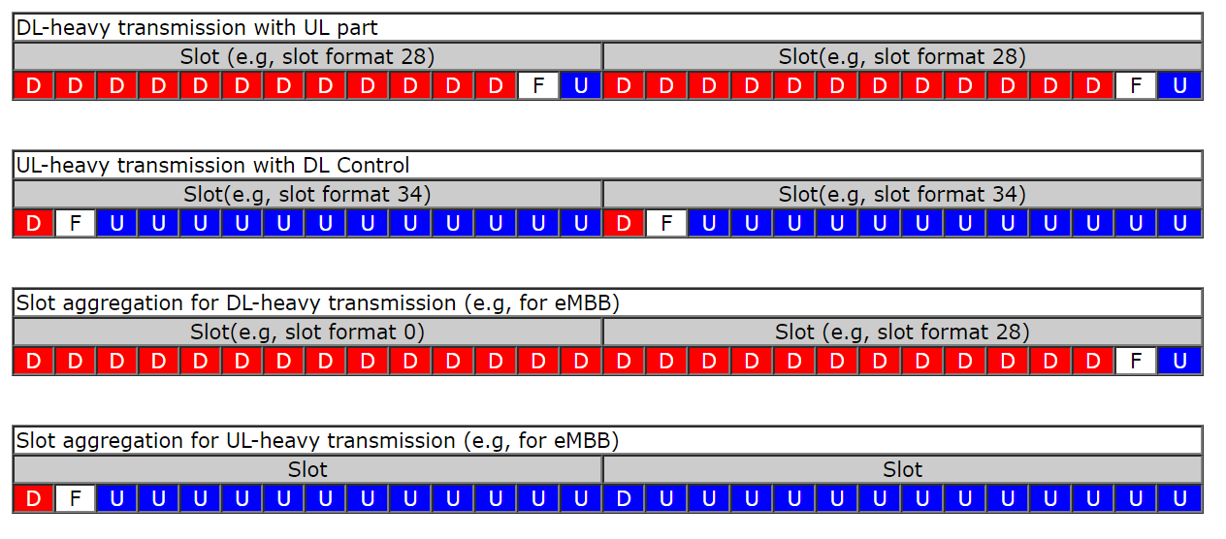
Why we need so many different types of slot formats ?
It is to make NR scheduling flexible especially for TDD operation.
By applying a slot format or combining different slot formats in sequence, we can implement various different types of scheduling as in the following example (these examples are based on 5G NEW RADIO : Designing For The Future (Ericsson Technology Review))

Slide 17
References
Link :
http://www.sharetechnote.com/html/5G/5G_FrameStructure.html

Slide 18
Q n A

Slide 19
Q.1. Minimum granularity of "symbol" (125us ?)
A.1.
Q.2. Which numerology needs to be supported (u = 1,2,3,4) ?
A.2. For the moment the numerology that we need to support is u=3 and u=4(mandatory for rach), But I’m not excluding queries to support also the rest of the numerology.
Q.3. Cyclic prefix - is it present in beginning / ending of each transition (Tx -> Rx vice versa)
A.3. Each OFDM (orthogonal frequency-division multiplexing) symbol has cyclic prefix.

Slide 20
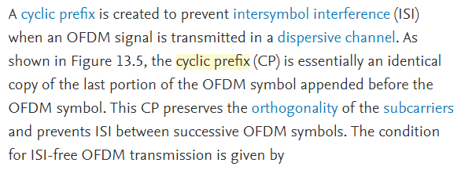


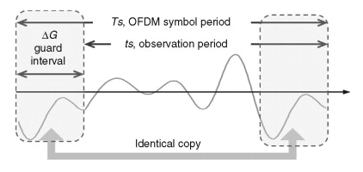
Cyclic Prefix
https://www.sciencedirect.com/topics/engineering/cyclic-prefix

