Slide 1
Introduction to TBGEN & AXIQ LB APIs
Presenter :
Sudhanshu Gupta
BSP SW Team

Slide 2
Agenda
1.1 Introduction to TBGEN
1.2 TBGEN Block Diagram
1.3 TBGEN Event Connectivity
1.4 TBGEN APIs Walkthrough
2.1 Introduction to AXIQ
2.2 AXIQ Block Diagram
2.3 AXIQ Connectivity
2.4 AXIQ Loopback APIs Walkthrough

Slide 3
Agenda
1.1 Introduction to TBGEN
1.2 TBGEN Block Diagram
1.3 TBGEN Event Connectivity
1.4 TBGEN APIs Walkthrough
2.1 Introduction to AXIQ
2.2 AXIQ Block Diagram
2.3 AXIQ Connectivity
2.4 AXIQ Loopback APIs Walkthrough

Slide 4
1.1. Introduction to TBGEN
Timebase Generator (TBGEN) provides system timing services that allow signaling of events within the chip while maintaining the delay accuracy requirements.
TBGEN is capable of generating a 10 ms radio frame signal and various programmable frame signals which can be used for GSM, CDMA, WCDMA, UMTS and LTE with the option to synchronize to the 10 ms SYNC signal or with an offset with the start of the 64-bit Timebase Master Counter (RFG – not in current scope).
Modes of Operation TBGEN consists of several programmable timers which use a common architecture.
The timers can be programmed to run in
One-Shot mode
Continuous mode
Duration - The period of the output events is programmable.
Intervals – Repetitions of patterns
Registering of Interrupt handlers (CSG , Timed Interrupts)

Slide 5
Agenda
1.1 Introduction to TBGEN
1.2 TBGEN Block Diagram
1.3 TBGEN Event Connectivity
1.4 TBGEN APIs Walkthrough
2.1 Introduction to AXIQ
2.2 AXIQ Block Diagram
2.3 AXIQ Connectivity
2.4 AXIQ Loopback APIs Walkthrough

Slide 6
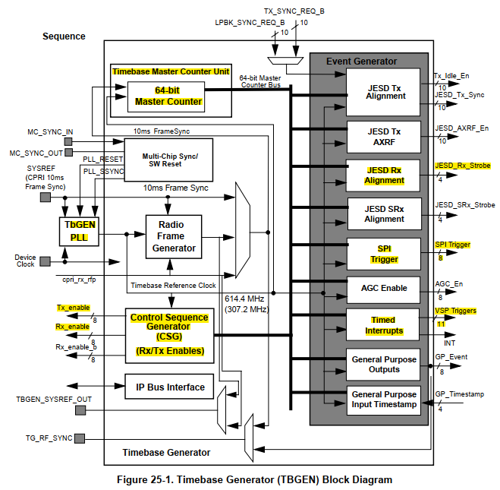
1.2. TBGEN Block Diagram
TBGEN1 – Connected to AXIQ_L
TBGEN2 – Connected to AXIQ_H
MPIC
VSPA
AXIQ_H
VSPA
Refer : TBGEN Block Guide

Slide 7
Agenda
1.1 Introduction to TBGEN
1.2 TBGEN Block Diagram
1.3 TBGEN Event Connectivity
1.4 TBGEN APIs Walkthrough
2.1 Introduction to AXIQ
2.2 AXIQ Block Diagram
2.3 AXIQ Connectivity
2.4 AXIQ Loopback APIs Walkthrough

Slide 8
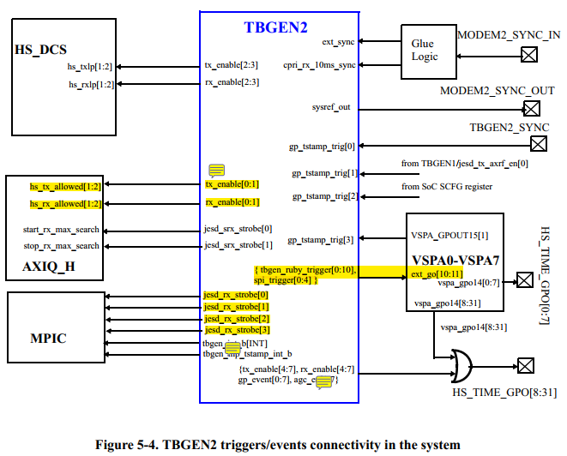
1.3. TBGEN Event Connectivity
Refer : Geul Arch Def v0.7

Slide 9
Agenda
1.1 Introduction to TBGEN
1.2 TBGEN Block Diagram
1.3 TBGEN Event Connectivity
1.4 TBGEN APIs Walkthrough
2.1 Introduction to AXIQ
2.2 AXIQ Block Diagram
2.3 AXIQ Connectivity
2.4 AXIQ Loopback APIs Walkthrough

Slide 10
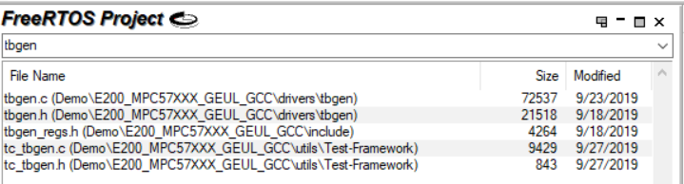
1.4. TBGEN Code Walkthrough
Folder / File
Structure

Slide 11
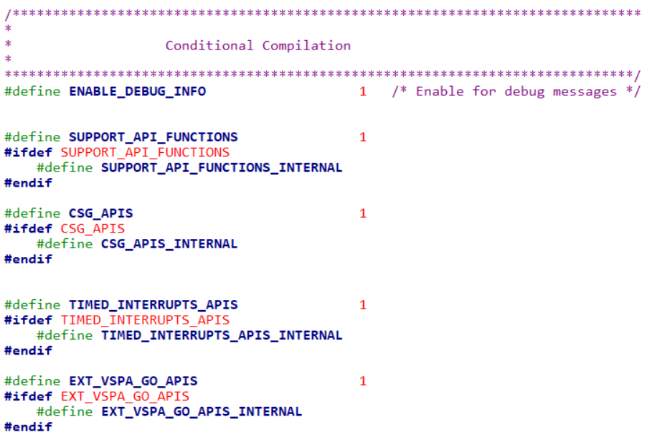

1.4. TBGEN Code Walkthrough
Totally Configurable

Slide 12
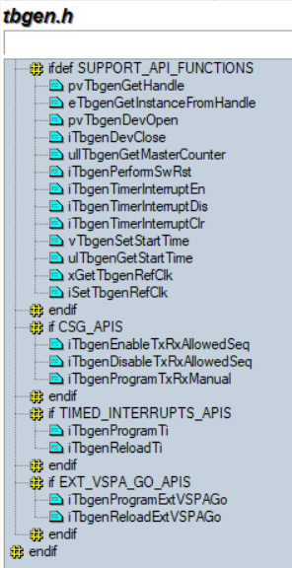
1.4. TBGEN Code Walkthrough – Interface APIs
Support APIs
TBGEN Handle
TBGENx Open / Close
Master Counter value
Software Reset
Timer Interrupts Enable / Disable (CSG, Timed Interrupts)
TBGENx Start Time (Get / Set)
TBGENx Reference Clock (Get / Set)
CSG – Control Sequence Generator APIs
CSG Manual Tx Rx switching
CSG Sequence Tx Rx Switching
Timed Interrupts APIs
Program TI timer
Reload TI timer
Ext VSPA Go APIs
Program Ext VSPA Go
Reload Ext VSPA Go

Slide 13
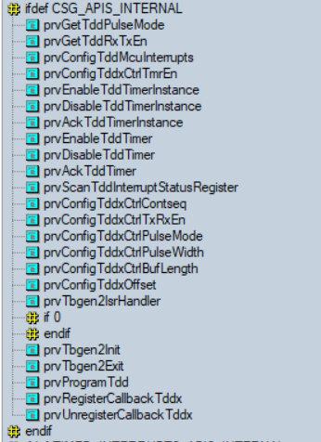
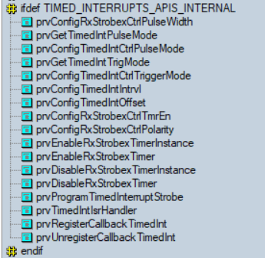



1.4. TBGEN Code Walkthrough – API Implementation
Timed Interrupts
Control Sequence Generator

Slide 14
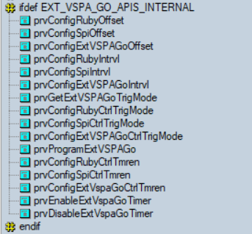
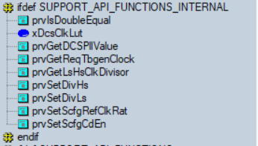
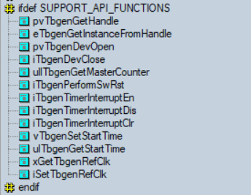

1.4. TBGEN Code Walkthrough – API Implementation
Ext VSPA Go APIs
Support APIs

Slide 15
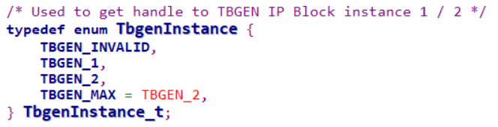
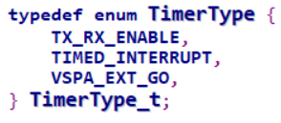
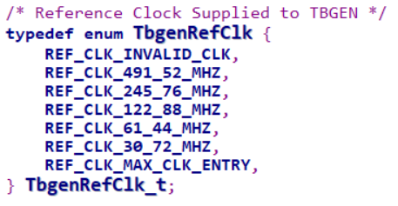
1.4. TBGEN Code Walkthrough – Data Structures – Support APIs
Support APIs

Slide 16
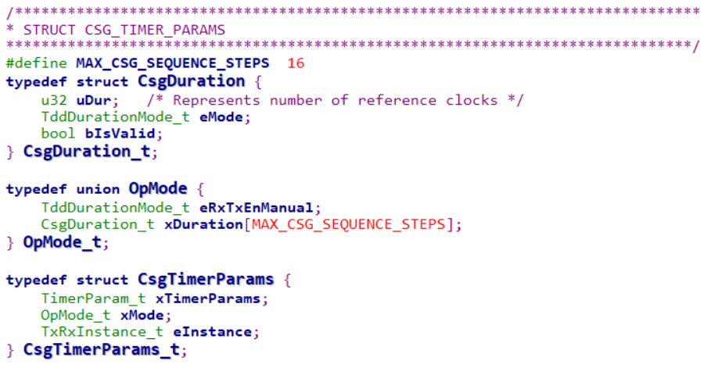
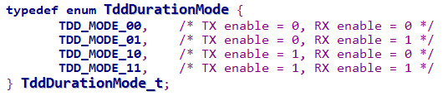
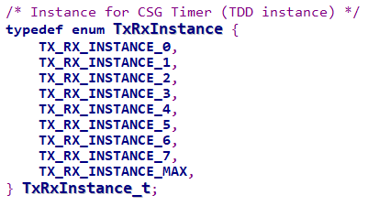
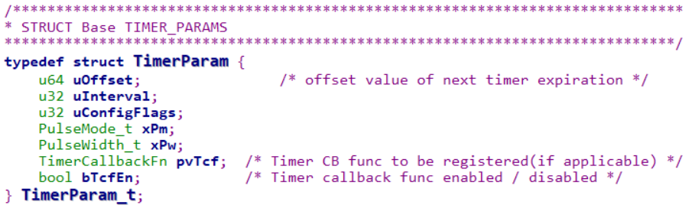

1.4. TBGEN Code Walkthrough – Data Structures - CSG
Control Sequence Generator

Slide 17
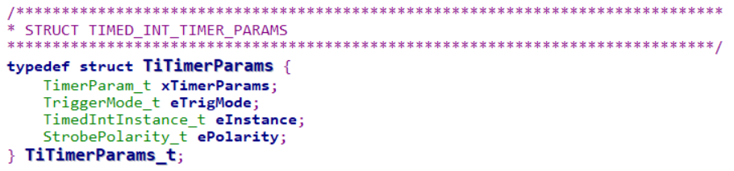

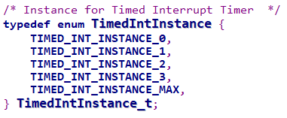
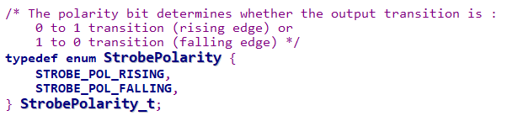
1.4. TBGEN Code Walkthrough – Data Structures – Timed Interrupts
Timed Interrupts

Slide 18
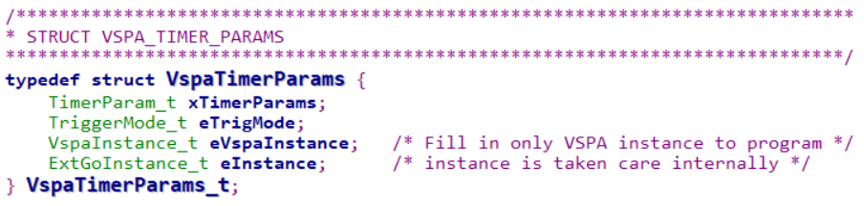
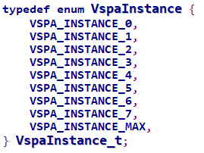
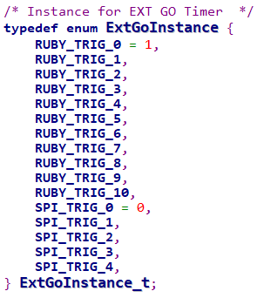
1.4. TBGEN Code Walkthrough – Data Structures – Ext VSPA Go
Ext VSPA Go APIs
No need to program
(Taken care internally in API)

Slide 19
Agenda
1.1 Introduction to TBGEN
1.2 TBGEN Block Diagram
1.3 TBGEN Event Connectivity
1.4 TBGEN APIs Walkthrough
2.1 Introduction to AXIQ
2.2 AXIQ Block Diagram
2.3 AXIQ Connectivity
2.4 AXIQ Loopback APIs Walkthrough

Slide 20
2.1. Introduction to AXIQ Loopback Capability
It may be desired to test Geul base system without RF Transceivers & AFE components.
This may be required for early software development
OR
for initial Silicon debugging
OR
for SoC verification on Emulator/RTL platforms.
To support this feature, a loopback capability is built around the AXIQ in the SoC that allows data from a Transmit channel to be fed into the corresponding Receive channel bypassing ADC/DACs.
There are 2 loopback modes : • Intra AXIQ loopback mode • Inter AXIQ loopback mode

Slide 21
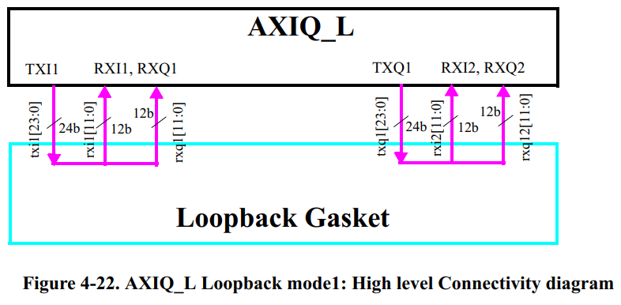
Intra AXIQ loopback mode – AXIQ_L0, AXIQ_L1
AXIQ_L loopback: TX-FIFO interface of AXIQ_L is 24-bit I/Q interface, while RX-FIFO interface is 12-bit interface. Due to this limitation, following loopback scheme is followed.
— txi1[23:0] (TX0 FIFO - I) → {rxi1[11:0], rxq1[11:0]} (RX0 FIFO- I+Q). — txq1[23:0] (TX0 FIFO - Q) → {rxi2[11:0], rxq2[11:0]} of (RX1 FIFO- I+Q).

Slide 22
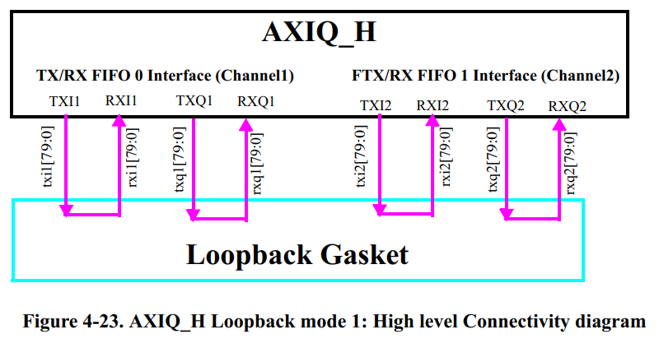
Intra AXIQ loopback mode – AXIQ_H
AXIQ_H loopback:
As both TX-FIFO interface & RX-FIFO interface of AXIQ_H is 80-bit I/Q interface, loopback scheme for AXIQ_H is simple.
txi1[79:0] -- rxi1[79:0], txq1[79:0] -- rxq1[79:0]
txi2[79:0] -- rxi2[79:0], txq2[79:0] -- rxq2[79:0]

Slide 23
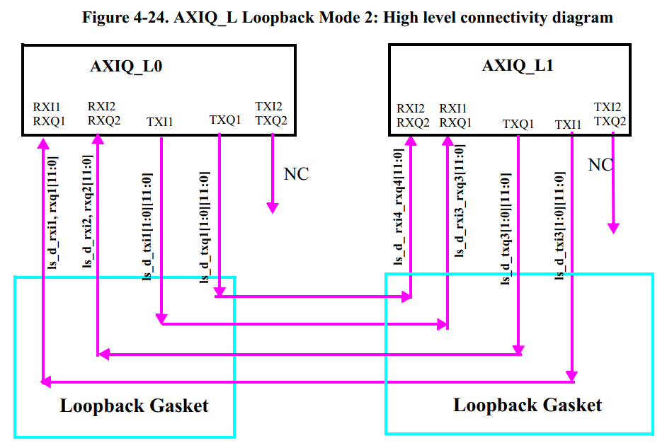
Inter AXIQ loopback mode – AXIQ_L0, AXIQ_L1
In this mode, loopback paths are enabled from
TX channel of AXIQ_L0 → RX channels of AXIQ_L1

Slide 24

Inter AXIQ loopback mode – AXIQ_H
As there is only one AXIQ_H instance, this loopback mode is not supported for AXIQ_H.

Slide 25
Agenda
1.1 Introduction to TBGEN
1.2 TBGEN Block Diagram
1.3 TBGEN Event Connectivity
1.4 TBGEN APIs Walkthrough
2.1 Introduction to AXIQ
2.2 AXIQ Block Diagram
2.3 AXIQ Connectivity
2.4 AXIQ Loopback APIs Walkthrough

Slide 26
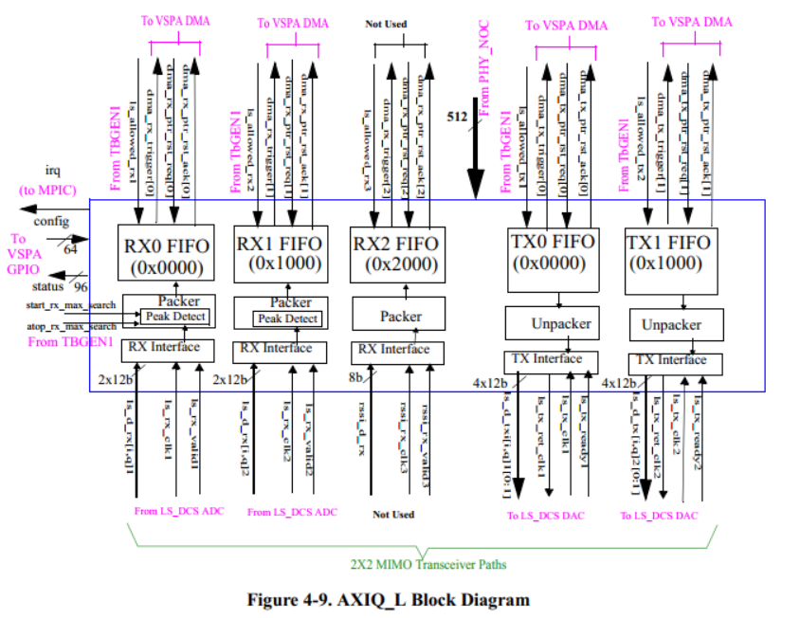

2.2. AXIQ Block Diagram – LS (Connected to TBGEN 1)
Geul AXIQ_L Features: • 512-bit AXI3 target interface
• 2 Receive FIFOs for DCS ADC data
• 2 Transmit FIFOs for data to be transmitted on the DCS DACs
• Controlled through 64 GPIO input and 96 GPIO output signals connected to the VSPAs.
• No configuration registers

Slide 27
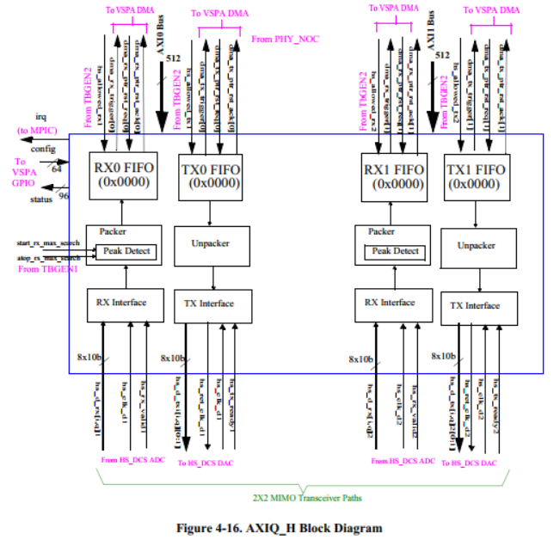
2.2. AXIQ Block Diagram – HS (Connected to TBGEN2)
Geul AXIQ Features: • Two 512-bit AXI3 target interface
• 2 Receive FIFOs for DCS ADC data
• 2 Transmit FIFOs for data to be transmitted on the DCS DACs
• Controlled through 64 GPIO input and 96 GPIO output signals connected to the VSPAs.
• No configuration registers

Slide 28
Agenda
1.1 Introduction to TBGEN
1.2 TBGEN Block Diagram
1.3 TBGEN Event Connectivity
1.4 TBGEN APIs Walkthrough
2.1 Introduction to AXIQ
2.2 AXIQ Block Diagram
2.3 AXIQ Connectivity
2.4 AXIQ Loopback APIs Walkthrough

Slide 29

2.3. AXIQ Connectivity

Slide 30
Agenda
1.1 Introduction to TBGEN
1.2 TBGEN Block Diagram
1.3 TBGEN Event Connectivity
1.4 TBGEN APIs Walkthrough
2.1 Introduction to AXIQ
2.2 AXIQ Block Diagram
2.3 AXIQ Connectivity
2.4 AXIQ Loopback APIs Walkthrough

Slide 31
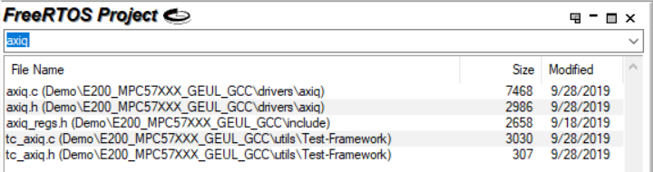
2.4. AXIQ Loopback APIs Walkthrough
Folder / File
Structure

Slide 32
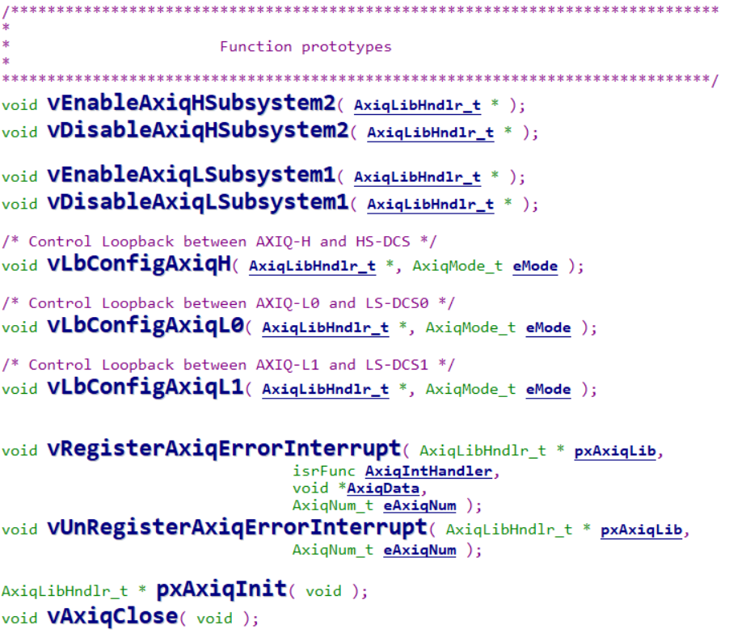
2.4. AXIQ LoopBack Code Walkthrough - APIs
Enable / Disable HS Subsystem
Enable / Disable LS Subsystem
Configure Loopback Mode
for L0, L1, H
Register / Un-register Over & UnderRun Interrupts
AXIQ Init Exit routines

Slide 33
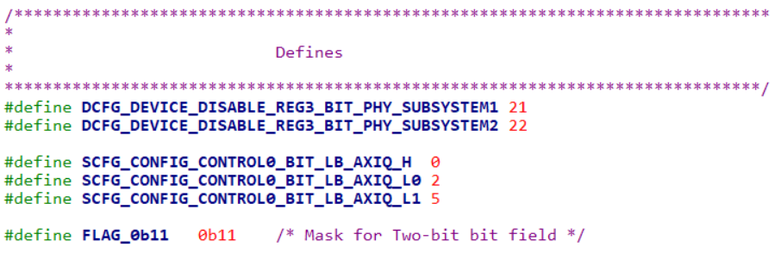
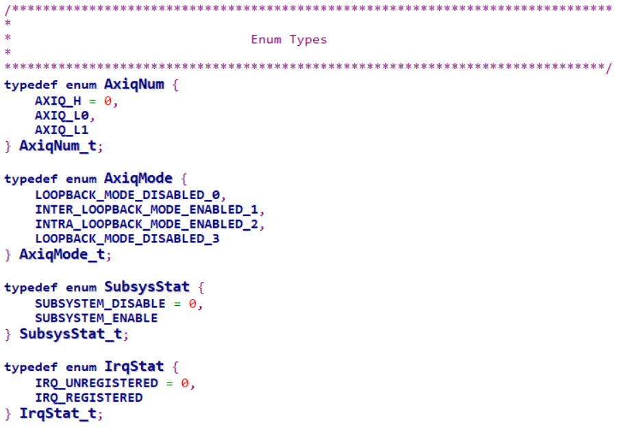
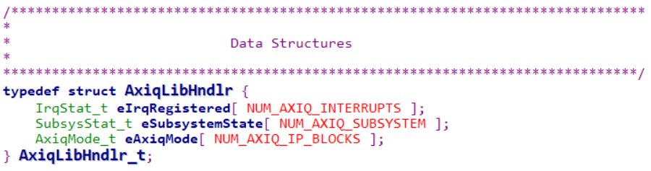
2.4. AXIQ LoopBack Code Walkthrough – Data Structures

Slide 34
Q n A

Slide 35
Backup Slides

