Slide 1
Geul Test Framework
Author : Sudhanshu Gupta

Slide 2
Agenda
Introduction – New Test Framework
Running Test Cases from console
Sample Commands
Adding a New Test Case

Slide 3
Agenda
Introduction – New Test Framework
Running Test Cases from console
Sample Commands
Adding a New Test Case

Slide 4
Introduction
Test framework allows developer to execute their test / demo functions from FreeRTOS console.
No more compile time flags to enable/disable test functions.
Test framework is OFF for “Release” build variants
Build command to enable Test-Framework ( -b debug has been added to build command)
./build.sh -t simu -l all -b debug

Slide 5
Agenda
Introduction – New Test Framework
Running Test Cases from console
Sample Commands
Adding a New Test Case

Slide 6
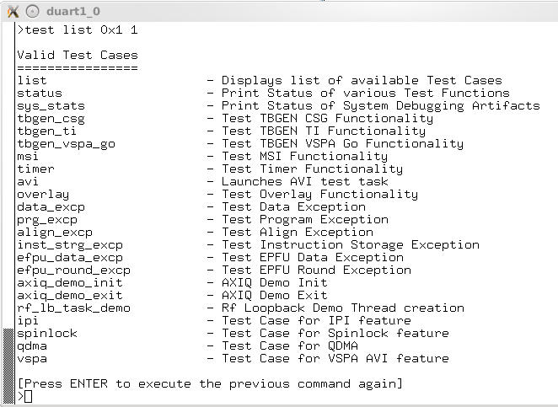
Running Test Cases
On FreeRTOS console enter command to execute test cases.
Syntax :
test <cmd_name> <core_mask> <iterations>
Example Valid core mask values :
0x1 – Core 0 only
0x3 – Core 0 & 1 only
0x7 – Core 0, 1, 2 only
0xf – All cores
Etc. (All other possible combos)
Sample Commands :
> test list 0x1 1 → displays the available list of test functions on core 0 console
> test list 0x2 1 → displays the available list of test functions on core 1 console
Core_mask
Core 3 | Core 2 | Core 1 | Core 0

Slide 7
Agenda
Introduction – New Test Framework
Running Test Cases from console
Sample Commands
Adding a New Test Case

Slide 8
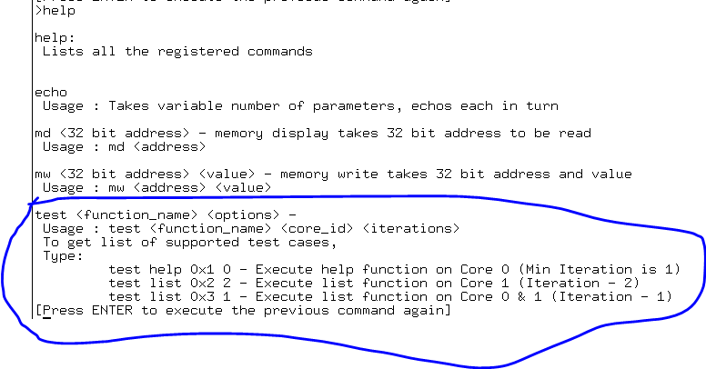
Sample Commands - HELP
> help → displays the available CLI commands. Refer to “test” cmd

Slide 9
Sample Commands - LIST
> test list 0x1 1 → displays the list of test functions available in binary

Slide 10
Agenda
Introduction – New Test Framework
Running Test Cases from console
Sample Commands
Adding a New Test Case

Slide 11
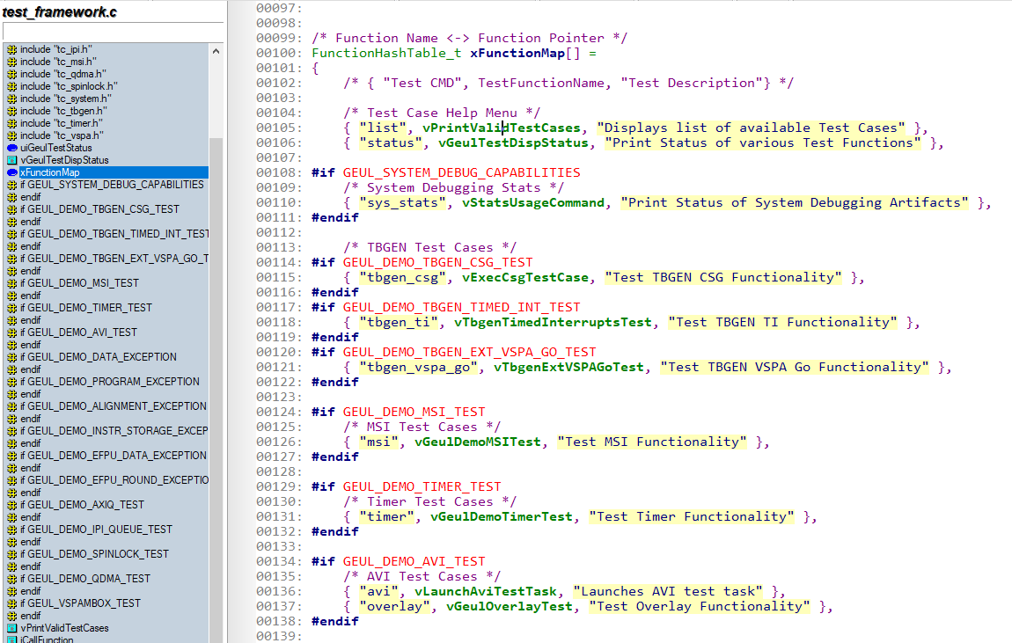

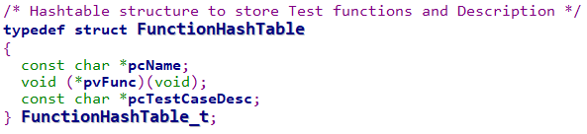
Adding a New Test Case
Add an entry in xFunctionMap[ ] <test_framework.c>
Try to add entry in the designated blocks (e.g. TBGEN, SYSTEM_DEBUG, TIMER, MSI, AVI etc). If unsure, please contact author.

Slide 12
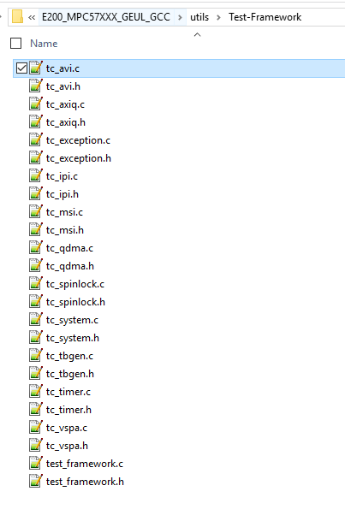
Adding a New Test Case File Locations
Contents of geul_demo.c file has been relocated to :
\\geul_freertos_la12xx_devel\FreeRTOS\Demo\E200_MPC57XXX_GEUL_GCC\utils\Test-Framework
Each module / sub-system gets its own tc_****.h & tc_****.c files. (**** represents module name).
Add your test code in one of these files (tc_****.h & tc_****.c ), and the interface function in .h file. The interface function is the one that goes in xFunctionMap Table.
DO NOT add new test functions in test_framework.c / .h directly

Slide 13
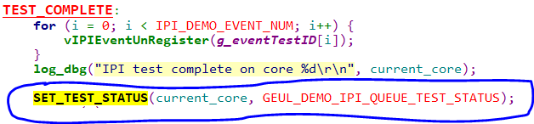
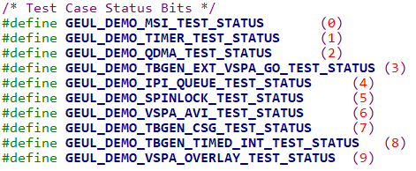

Adding a New Test Case SETTING TEST STATUS
After Test Case has reached to completion, Set the status bit to Success using following macro (Use the BIT assigned for your sub-system only)
Success
case
Use Sub-Module specific MACRO bit to set status
Failure
case

