Slide 1
Industrial Revolution 4.0
Presenter | Sudhanshu Gupta

Slide 2
Title and Content Layout with List
Add your first bullet point here
Add your second bullet point here
Add your third bullet point here

Slide 3
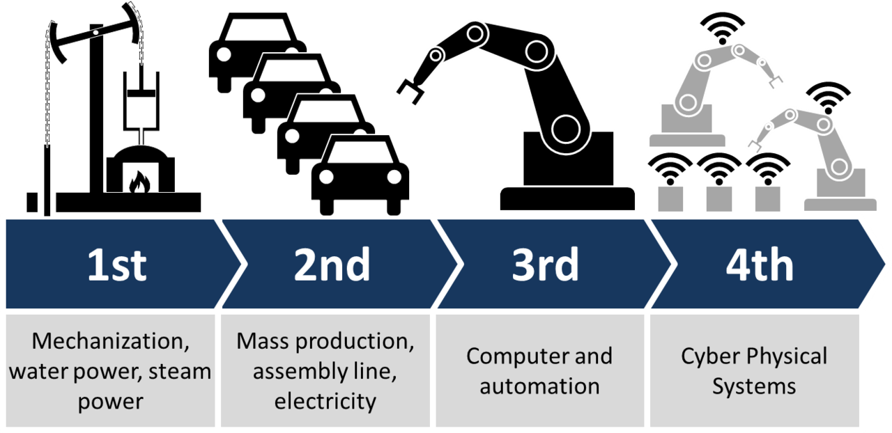
Industrial Revolution The Journey So Far…

Slide 4
Industry 4.0 (Fourth Industrial Revolution)
Name given to the current trend of automation and data exchange in manufacturing technologies.
It broadly includes
Cyber-Physical Systems
Internet of Things
Cloud computing
Cognitive computing

Slide 5
Industry 4.0 (Fourth Industrial Revolution)
Industry 4.0 introduces the concept of “Smart Factory”
Within the Smart-Factories, “Cyber-Physical” Systems monitor the Physical world activities.
Cyber Physical Systems (CPS) create a virtual copy of the physical world and make decentralized decisions.
Over IoT, these CPS communicate with each other and also with humans in real-time.
These communications happen internally or across organization

Slide 6
Industry 4.0 | I4.0 | I4 | (Fourth Industrial Revolution)
Originates from a project in the high-tech strategy of the German government, which promotes the computerization of manufacturing.
Term "Industry 4.0" was revived in 2011 at the Hannover Fair.
In October 2012 the Working Group on Industry 4.0 presented a set of Industry 4.0 implementation recommendations to the German federal government.
On 8 April 2013 at the Hannover Fair, the final report of the Working Group Industry 4.0 was presented.
As Industry 4.0 principles have been applied by companies they have sometimes been re-branded, for example the aerospace parts manufacturer Meggitt PLC has branded its own Industry 4.0 research project M4.

Slide 7
Industry 4.0 Design Principles
Following principles support implementing Industry 4.0 scenarios
Interoperability
The ability of machines, devices, sensors, and people to connect and communicate with each other via the Internet of Things (IoT) or the Internet of People (IoP)
Information transparency
The ability of information systems to create a virtual copy of the physical world by enriching digital plant models with sensor data. This requires the aggregation of raw sensor data to higher-value context information.
Technical assistance
Ability of assistance systems to support humans by aggregating and visualizing information comprehensively for making informed decisions and solving urgent problems on short notice.
Ability of CPS to physically support humans by conducting a range of tasks that are unpleasant, too exhausting, or unsafe for their human co-workers.
Decentralized decisions
The ability of cyber physical systems to make decisions on their own and to perform their tasks as autonomously as possible. Only in the case of exceptions, interferences, or conflicting goals, are tasks delegated to a higher level.

Slide 8
Industry 4.0 Principles
The basic principle of Industry 4.0 is that by connecting machines, work pieces and systems, businesses are creating intelligent networks along the entire value chain that can control each other autonomously.
Some examples for Industry 4.0 are machines which can predict failures and trigger maintenance processes autonomously or self-organized logistics which react to unexpected changes in production.
Networks and processes have so far been limited to one factory. But in an Industry 4.0 scenario, these boundaries of individual factories will most likely no longer exist. Instead, they will be lifted in order to interconnect multiple factories or even geographical regions.

Slide 9
Industry 4.0 Differences Traditional Factory -vs- Industry 4.0 Factory
Providing high-end quality service or product with the least cost.
Industrial factories are trying to achieve as much performance as possible to increase their profit as well as their reputation.
Various data sources are available to provide worthwhile information about different aspects of the factory.
The utilization of data for understanding current operating conditions and detecting faults and failures is an important topic to research.
e.g. in production, there are various commercial tools available to provide overall equipment effectiveness (OEE) information to factory management in order to highlight the root causes of problems and possible faults in the system
In addition to condition monitoring and fault diagnosis, components and systems are able to gain self-awareness and self-predictiveness, which will provide management with more insight on the status of the factory.
Furthermore, peer-to-peer comparison and fusion of health information from various components provides a precise health prediction in component and system levels and force factory management to trigger required maintenance at the best possible time to reach just-in-time maintenance and gain near-zero downtime.

Slide 10
Industry 4.0 Challenges
IT security issues
Reliability and stability needed for critical machine-to-machine communication (M2M), including very short and stable latency times
Need to maintain the integrity of production processes
Need to avoid any IT snags, as those would cause expensive production outages
Lack of adequate skill-sets to expedite the march towards fourth industrial revolution
Loss of many jobs to automatic processes and IT-controlled processes, especially for lower educated parts of society
Unclear legal issues and data security
Unclear economic benefits/ Excessive investment
Lack of regulation, standard and forms of certifications
Insufficient qualification of employees

Slide 11
Industry 4.0 Impact
Services and business models
Reliability and continuous productivity
IT security
Companies like Symantec, Cisco, and Penta Security have already begun to address the issue of IoT security
Machine safety
Product lifecycles
Workers' education and skills
:: Note ::
Industry Demonstration: To help industry understand the impact of Industry 4.0, Cincinnati Mayor John Cranley, signed a proclamation to state "Cincinnati to be Industry 4.0 Demonstration City".^{[Link]}
An article published in February 2016 suggests that Industry 4.0 may have a beneficial effects for emerging economies such as India.^{[Link]}
The aerospace industry has sometimes been characterized as "too low volume for extensive automation" however Industry 4.0 principles have been investigated by several aerospace companies, technologies have been developed to improve productivity where the upfront cost of automation cannot be justified, one example of this is the aerospace parts manufacturer Meggitt PLC's project, M4. ^{[Link]}
The discussion of how the shift to Industry 4.0, especially digitalization, will affect the labour market is being discussed in Germany under the topic of Work 4.0.^{[Link]}

Slide 12
Questions & Answers

Slide 13
Backup Slides

Slide 14
Cyber-Physical System https://en.wikipedia.org/wiki/Cyber-physical_system
A cyber-physical system (CPS) is a mechanism that is controlled or monitored by computer-based algorithms, tightly integrated with the Internet and its users.
In cyber-physical systems, physical and software components are deeply intertwined, each operating on different spatial and temporal scales, exhibiting multiple and distinct behavioral modalities, and interacting with each other in a lot of ways that change with context.
CPS is typically designed as a network of interacting elements with physical input and output instead of as standalone devices
Examples :
Smart grid
Autonomous automobile systems
Medical monitoring
Process control systems
Robotics systems
Automatic pilot avionics

Slide 15
Cyber-Physical System - Scope
Ongoing advances in science and engineering will improve the link between computational and physical elements by means of intelligent mechanisms, dramatically increasing the adaptability, autonomy, efficiency, functionality, reliability, safety, and usability of cyber-physical systems.
This will broaden the potential of cyber-physical systems in several dimensions, including:
Intervention (e.g., collision avoidance)
Precision (e.g., robotic surgery and nano-level manufacturing)
Operation in dangerous or inaccessible environments (e.g., search and rescue, firefighting, and deep-sea exploration
Coordination (e.g., air traffic control, war fighting)
Efficiency (e.g., zero-net energy buildings)
Augmentation of human capabilities (e.g., healthcare monitoring and delivery).

Slide 16
Mobile cyber-physical systems
Subcategory of Cyber-Physical Systems.
Mobile-CPS with inherent mobility.
Examples:
Mobile robotics
Electronics transported by humans or animals.
Applications to track and analyze CO₂ emissions
Detect traffic accidents
Measure traffic
Monitor cardiac patients.^{[17]}
Smartphones has increased interest in the area of Mobile CPS for a number of reasons, including:
Significant computational resources
Processing capability, local storage
Multiple sensory input/output devices
Touch screens, cameras, GPS chips, speakers, microphone, light sensors, proximity sensors
Multiple communication mechanisms
WiFi, 3G, EDGE, Bluetooth
High-level programming languages that enable rapid development of mobile CPS node software
Java, Objective C, Swift
Readily-available application distribution mechanisms
Play Store and Apple App Store
End-user maintenance and upkeep, including frequent re-charging of the battery

Slide 17
Mobile cyber-physical systems Real World Examples
A real-world example : “Distributed Robot Garden” at MIT
A team of robots tend a garden of tomato plants.
This system combines distributed sensing (each plant is equipped with a sensor node monitoring its status), navigation, manipulation and wireless networking.
Another example : MIT's ongoing “CarTel” project
A fleet of taxis work by collecting real-time traffic information in the Boston area.
Together with historical data, this information is then used for calculating fastest routes for a given time of the day.
Cyber-physical models for future manufacturing (Industry Revolution 4.0)
"coupled-model" approach was developed.
“Coupled Model” is a digital twin of the real machine
Operates in the cloud platform and simulates the health condition with an integrated knowledge from both data driven analytical algorithms as well as other available physical knowledge.
The coupled model first constructs a digital image from the early design stage.
Based on which a simulation model is built as a reference for future analysis. The simulation model can be considered as a mirrored image of the real machine, which is able to continuously record and track machine condition during the later utilization stage.
With Ubiquitous connectivity / Cloud computing, the coupled model provides better accessibility of machine to factory managers in cases where physical access to actual equipment or machine data is limited.

Slide 18
Mobile cyber-physical systems Design Based on the 5C architecture
Connection
Devices can be designed to self-connect and self-sensing for its behavior.
Conversion
Data from self-connected devices and sensors are measuring the features of critical issues with self-aware capabilities, machines can use the self-aware information to self-predict its potential issues.
Cyber
Each machine is creating its own "twin" by using these instrumented features and further characterize the machine health pattern based on a "Time-Machine" methodology.
The established "twin" in the cyber space can perform self-compare for peer-to-peer performance for further synthesis.
Cognition
Outcomes of self-assessment and self-evaluation will be presented to users based on an "infographic" meaning to show the content and context of the potential issues
Configuration
Machine or production system can be reconfigured based on the priority and risk criteria to achieve resilient performance.

Slide 19
Internet of Things https://en.wikipedia.org/wiki/Internet_of_things
Network of :
Physical devices,
Vehicles,
Home appliances,
Other nodes embedded with
electronics,
software,
sensors,
actuators,
connectivity
Enables these nodes to connect and exchange data
Creating opportunities for more direct integration of the physical world into computer-based systems,
Resulting in efficiency improvements, economic benefits, and reduced human exertions.
Estimated coverage by 2020 : 30 Billion Devices worldwide.

Slide 20
Internet of Things - Applications https://en.wikipedia.org/wiki/Internet_of_things
IoT Applications
Consumer
Application
Commercial
Application
Industrial
Application
Infrastructure
Application
E.g.
Connected Vehicles (IoV)
Wearable Tech.
Smart Home
Elder Care
E.g.
Medical & Health-Care
Transportation
Building & Home automation
E.g.
Manufacturing (Bandsaw)
Agriculture (Fish Farming Tools)
E.g.
Monitor & Control operations of
Bridges
Railway tracks
Wind Farms

Slide 21
Cloud Computing https://en.wikipedia.org/wiki/Cloud_computing

Slide 22
Cognitive Computing https://en.wikipedia.org/wiki/Cognitive_computing

Slide 23
Use Case 1 - Faulty Product detection
Camera attached to assembly line, sends images of product on assembly line to central image processing system, which analyses the image data to detect faulty products. Then via Automation systems (Robotic arms) removes the faulty products off the assembly line.

Slide 24
Use Case 2 - Remote Machine Repair
M/c is in a broken state at a remote location. And access to repair it is given to troubleshoot it remotely from a remote location.

Slide 25
Use Case 3 - Home Automation (With IoT & ML)
Office goer with LS1028 based IoT Gateway (IoTG) installed at home, leaves for home. His GPS enabled Phone with ML, detects this movement (leaving for home), and sends a MQTT to IoTG. IoTG using ML algos, predicts that user will switch on AC / Heater (depending on the weather of the year) once he reaches home.
So IoTG instructs IoT enabled AC / Heater to switch on and maintain the user preferred temperature (again collected by IoT enabled sensors installed at home). IoT sensors in different rooms collect and share Temperature preference with timestamp with IoTG.

Slide 26
Reference(s)
YouTube
https://www.youtube.com/watch?v=qhLvhYFLoWE
Web
https://en.wikipedia.org/wiki/Industry_4.0
https://en.wikipedia.org/wiki/Cyber-physical_system
https://en.wikipedia.org/wiki/Internet_of_things
https://en.wikipedia.org/wiki/Cloud_computing
https://en.wikipedia.org/wiki/Cognitive_computing

Slide 27
Title and Content Layout with List
Add your first bullet point here
Add your second bullet point here
Add your third bullet point here

Slide 28
Title and Content Layout with Chart

Slide 29
Two Content Layout with Table
First bullet point here
Second bullet point here
Third bullet point here
Class | Group 1 | Group 2
Class 1 | 82 | 95
Class 2 | 76 | 88
Class 3 | 84 | 90

Slide 30
Title and Content Layout with SmartArt
Step 1 Title
Task description
Task description
Step 2 Title
Task description
Step 3 Title
Task description
Task description
Task description

Slide 31
Add a Slide Title - 1

Slide 32
Add a Slide Title - 2

Slide 33
Add a Slide Title - 3

Slide 35
Add a Slide Title - 4

Slide 36
Add a Slide Title - 5

