Slide 1
ARMv8 Core Architecture
Presenter :
Sudhanshu Gupta

Slide 2
ARM Architecture History v1 ~~ v7
ARM architecture dates back to 1985
ARM Version | Features
ARMv4 and earlier | Used only the ARM 32-bit instruction set
ARMv4T | Added Thumb 16-bit instruction (e.g. ARM7TDMI® , ARM9TDMI® processors)
ARMv5TE | Added improvements for DSP-type operations, saturated arithmetic, and for ARM and Thumb interworking. (e.g. ARM926EJ-S®)
ARMv6 | Support for unaligned memory accesses Significant changes to the memory architecture Multi-processor support. (e.g. ARM1136JF-S®) Support for SIMD operations. Some optional extensions, notably Thumb-2 and Security Extensions (TrustZone®). Thumb-2 extends Thumb to be a mixed length 16-bit and 32-bit instruction set.
ARMv7-A | ARMv7-A makes Thumb-2 extensions mandatory Adds the Advanced SIMD extensions (NEON). ARM introduced a set of architecture profiles: ARMv7-A provides all the features necessary to support a platform Operating System such as Linux. ARMv7-R provides predictable real-time high-performance. ARMv7-M is targeted at deeply-embedded microcontrollers.

Slide 3
ARM Architecture History – ARMv8
ARM Version | Features
ARMv8-A | Includes both 32-bit execution and 64-bit execution. It introduces the ability to perform execution with 64-bit wide registers, while preserving backwards compatibility with existing ARMv7 software.
ARMv8-A architecture introduces a number of changes ::
Large physical address
64-bit virtual addressing
Automatic event signaling
Larger register files (31 * 64-bit general purpose registers) – increased performance and reduced stack use.
Large PC-relative addressing range.
Additional 16KB and 64KB translation granules - reduces Translation Lookaside Buffer (TLB) miss rates and depth of page walks.
New exception model
Efficient cache management
Hardware-accelerated cryptography - Provides 3× to 10× better software encryption performance
Load-Acquire, Store-Release instructions
NEON double-precision floating-point advanced SIMD.

Slide 4
ARMv8-A Processor properties

Slide 5
ARMv8-A Processor properties …contd.

Slide 6
ARMv8 Compatible Processors
Cortex-A53 processor
Cortex-A57 processor
Cortex-A72 processor

Slide 7
ARMv8 Processors
Cortex-A53 processor
Mid-range, low-power processor.
Extremely power efficient processor.
One and four cores in a single cluster.
Each core with an L1 cache subsystem.
Optional integrated GICv3/4 interface.
Optional L2 cache controller.
Capable of supporting 32-bit and 64-bit code.
Capable of deployment as a standalone applications processor

Slide 8
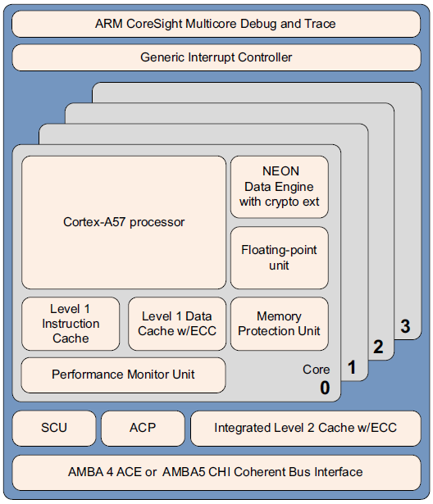
ARMv8 Processors
Cortex-A57 processor
Targeted at mobile and enterprise computing applications including compute intensive 64-bit applications such as high end computer, tablet, and server products.
Features cache coherent interoperability with other processors, including the ARM Mali™ family of Graphics Processing Units (GPUs) for GPU compute
Inclusion of cryptography extensions improves performance on cryptography algorithms by 10 times over the previous generation of processors.
Multi-core operation with one to four cores multi-processing within a single cluster.
Multiple coherent SMP clusters are possible, through AMBA5 CHI or AMBA 4 ACE technology.
Debug and trace are available through CoreSight technology
Out-of-order, 15+ stage pipeline
Power-saving features include way-prediction, tag-reduction, and cache-lookup suppression.
Increased peak instruction throughput through duplication of execution resources.
Power-optimized instruction decode with localized decoding, 3-wide decode bandwidth.
Performance optimized L2 cache design enables more than one core in the cluster to access the L2 at the same time.

Slide 9
ARMv8 Processors
Cortex-A72 processor (LS1028)
High-performance, low-power processor that implements the ARMv8-A architecture
Has one to four cores in a single processor device with L1 and L2 cache subsystems
Support for both AArch32 and AArch64 Execution states.
Support for all Exception levels, EL0, EL1, EL2, and EL3, in each Execution state.
A32 instruction set, previously called the ARM instruction set.
T32 instruction set, previously called the Thumb instruction set.
A64 instruction set.
Advanced Single Instruction Multiple Data (SIMD) operations
Cortex-A72 processor does not support the T32EE (ThumbEE) instruction set.
The Thumb Execution Environment (ThumbEE) extension is a variant of the Thumb instruction set that is designed as a target for dynamically generated code.

