Slide 1
Lockup / Hang encountered during uBoot + Linux (Multicore) binary bringup on LS1028 simulator
Problem :
During the very initial uboot + linux code bringup on simulator , the code was stuck at initial phases. We couldn’t attach any debugger.
How we debugged this issue / Solution :
We exploited Instruction Trace feature of simulator, using the following command in boot.py script.
top.cluster0.cpu0.exts.setInstrTrace(0, True)
On analyzing the instruction execution pumped out by simulator, we saw that the last executed instruction was “WFE” (Wait For Event).

Slide 2
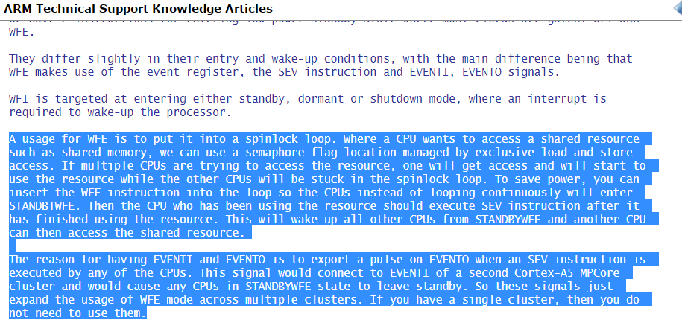
According to ARM v8 reference manual, WFE stands for

Slide 3
So we again back tracked the instructions being executed before we hit WFE. The last few instructions are shown below :
RED addresses map to Uboot code
BLACK addresses map to GPP + BootROM code (Combined binary)
121810 clk IT 20100040 54000160 0 0 0 : b .EQ 11
121811 clk IT 2010006c d51cc000 0 0 0 : MSR VBAR_EL2,X0
121812 clk IT 20100070 d2867fe0 0 0 0 : movz X0,#33ff,LSL #0
121813 clk IT 20100074 d51c1140 0 0 0 : MSR CPTR_EL2,X0
121814 clk IT 20100078 14000004 0 0 0 : b 4
121815 clk IT 20100088 d539f220 0 0 0 : MRS X0,CPUECTLR_EL1
121816 clk IT 2010008c b27a0000 0 0 0 : orr X0,X0,#0x0
121817 clk IT 20100090 d519f220 0 0 0 : MSR CPUECTLR_EL1,X0
121818 clk IT 2c00 140000e2 0 0 0 : b 226
121819 clk IT 2f88 a9bf07e0 0 0 0 : stp X0,X1,[SP,#-0X10]!
121820 clk IT 2f8c a9bf0fe2 0 0 0 : stp X2,X3,[SP,#-0X10]!
121821 clk IT 2f90 d5033f9f 0 0 0 : dsb
121822 clk IT 2f94 d5033fdf 0 0 0 : isb
121823 clk IT 2f98 d53e5201 0 0 0 : MRS X1,ESR_EL3
121824 clk IT 2f9c aa1f03e2 0 0 0 : orr X2,XZR,XZR,LSL 0
121825 clk IT 2fa0 331a7c22 0 0 0 : bfm W2,W1,#26,#1f
121826 clk IT 2fa4 71005c5f 0 0 0 : subs WZR,W2,#17,LSL
121827 clk IS 2fa8 54000080 0 0 0 : b .EQ 4
121828 clk IT 2fac 71004c5f 0 0 0 : subs WZR,W2,#13,LSL
121829 clk IS 2fb0 54000240 0 0 0 : b .EQ 18
121830 clk IT 2fb4 1400002a 0 0 0 : b 42
121831 clk IT 305c d503205f 0 0 0 : WFE

Slide 4
The code flow (Visually)
GPPBootRom +
PPA
uBoot
_cln_inv_all_dcache()
0x20100000 _start()
Monitor_exit_EL3()
0x20100028 reset()
0x2010001ac save_boot_params()
Synch_handler()
0x2010002c save_boot_params_ret()
Synch_handler()
Exception happens here
WFE

Slide 5
sudhanshu@sudhanshu-ubuntu:~/sources/02_ls1028/ls1028a-uboot $ vim arch/arm/cpu/armv8/start.S
save_boot_params_re:t( )
#ifdef CONFIG_SYS_RESET_SCTRL
bl reset_sctrl
#endif
/*
* Could be EL3/EL2/EL1, Initial State:
* Little Endian, MMU Disabled, i/dCache Disabled
*/
adr x0, vectors
switch_el x1, 3f, 2f, 1f
3: msr vbar_el3, x0
mrs x0, scr_el3
orr x0, x0, #0xf /* SCR_EL3.NS|IRQ|FIQ|EA */
msr scr_el3, x0
msr cptr_el3, xzr /* Enable FP/SIMD */
#ifdef COUNTER_FREQUENCY
ldr x0, =COUNTER_FREQUENCY
msr cntfrq_el0, x0 /* Initialize CNTFRQ */
#endif
b 0f
2: msr vbar_el2, x0
mov x0, #0x33ff
msr cptr_el2, x0 /* Enable FP/SIMD */
b 0f
1: msr vbar_el1, x0
mov x0, #3 << 20
msr cpacr_el1, x0 /* Enable FP/SIMD */
0:
/*
* Enalbe SMPEN bit for coherency.
* This register is not architectural but at the moment
* this bit should be set for A53/A57/A72.
*/
#ifdef CONFIG_ARMV8_SET_SMPEN
mrs x0, S3_1_c15_c2_1 /* cpuactlr_el1 */
orr x0, x0, #0x40
msr S3_1_c15_c2_1, x0
#endif
Crash Happens while accessing this register in EL2 ,which should ideally be accessed in EL3 (Execution Logic 3)

Slide 6
Meanwhile we got a new binary from GPP + PPA binary owner.

Slide 7
Boot Sequence Explained
1
0x20100000 | Uboot
Reset
0x00000000 | GPP BootRom
 | PPA
2
ppa_init()
Linux Kernel Image
3
4
RAM
FlexSPI
5

Slide 12
Big Thanks to the Contributors to Debugging Process :
Sriram Dash
Abhimanyu Saini

