Slide 1
LS1028A-cfp Training / usage
Sw TEAM
07 May 2018

Slide 2
Authored By
Sudhanshu Gupta
Blessed By
“Almighty”
Aka CFP
Disclaimer : Although the steps documented in following slides have been tried multiple times, there are times when CFP behaves abnormally. **

Slide 3
TRAC Page Link for Model Announcements
Model Release Link :
http://trac.nxp.com/cfp/wiki
Model 1B
http://trac.nxp.com/cfp/wiki/ls1028_model1b
Model 1C
http://trac.nxp.com/cfp/wiki/ls1028_model1c
Model 2a1
http://trac.nxp.com/cfp/wiki/ls1028_model2a1
Model 2a2
http://trac.nxp.com/cfp/wiki/ls1028_model2a2

Slide 4
Group Permissions 1/2
Request for following Group permissions :
soc_ip , tmt (formerly atx_tmt), ecglo_eval14nm
Link
https://rnditapps.freescale.net/unix-group-man/
soc_ip -> need to be part of this group to access folder /proj/lsas_soc_emu_verif
tmt -> need to be part of this group to access folder /proj/lsas_emulation (Owner : Ed Brosz , Amol Bhinge)

Slide 5
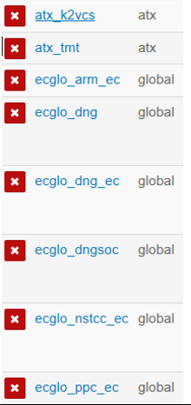
Group Permissions 2/2
To run CFP in PHX environment:
Needed this 'ecglo_dng_ec' group to access the model.
https://rnditapps.freescale.net/unix-group-man/#/member

Slide 6
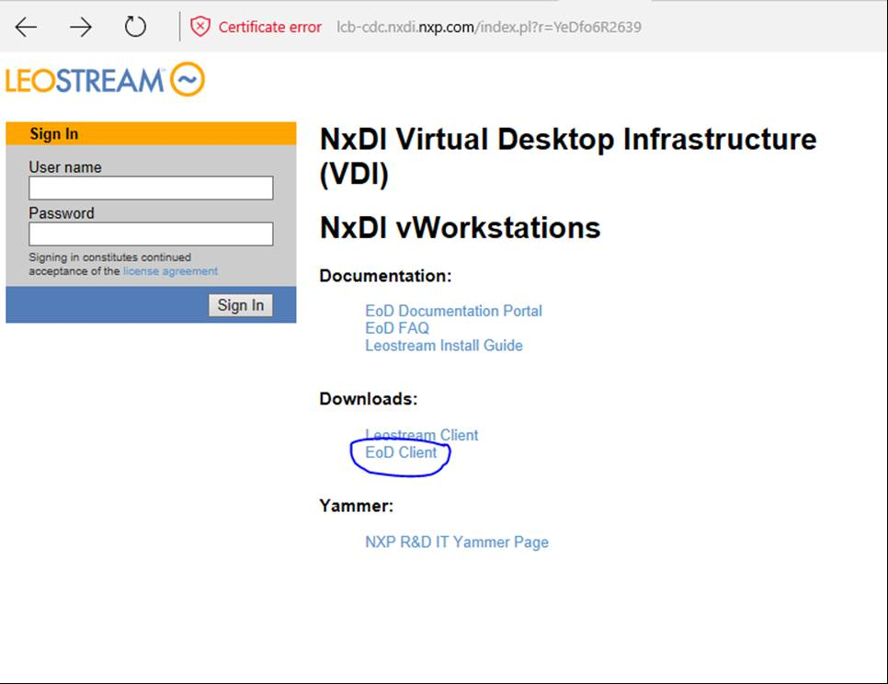
PHX Server Login 1/4
Below are steps to be followed before using PHX VDIs.
Go to the website – https://lcb-cdc.nxdi.nxp.com
Click on the link – EoD Client (To download the Latest version of EoD as PHX VDIs need latest version of EOD to work )

Slide 7
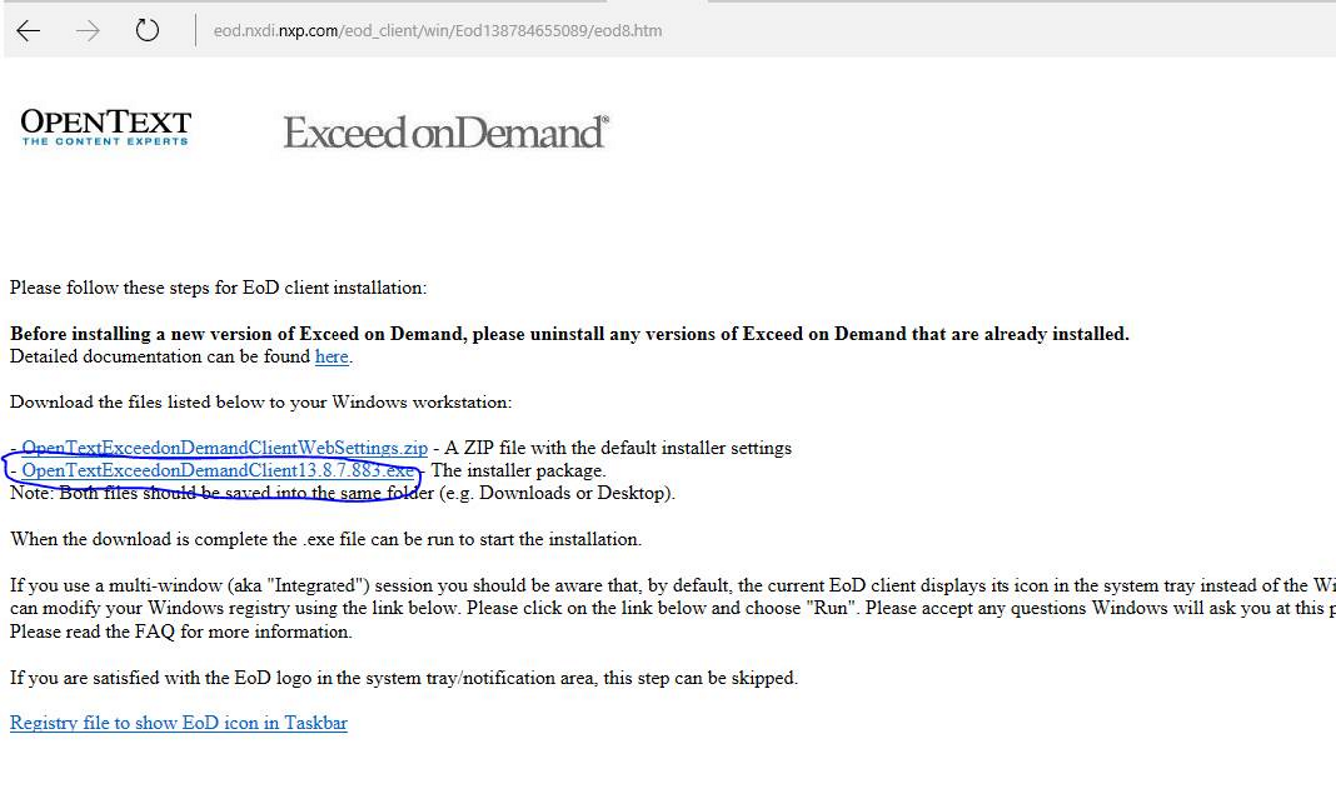
PHX Server Login 2/4
3. Download and install– OpenText EoD Client as shown below

Slide 8
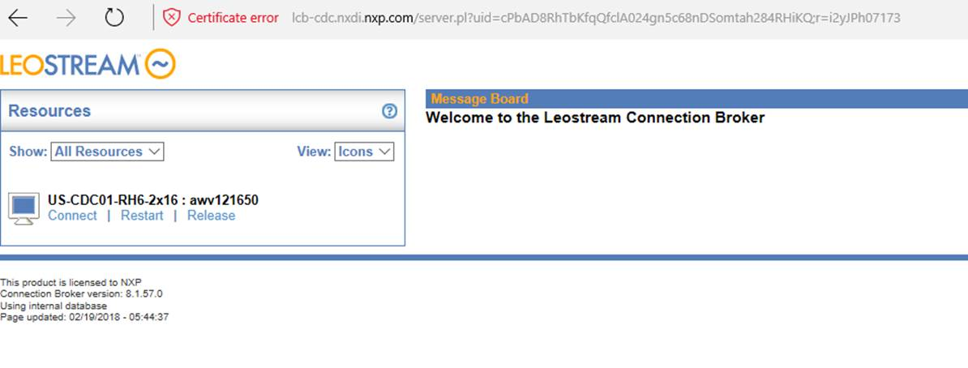
PHX Server Login 3/4
4. Now login to https://lcb-cdc.nxdi.nxp.com with your NXF ID
5. You should be able to see a machine allocated to you as shown below.

Slide 9
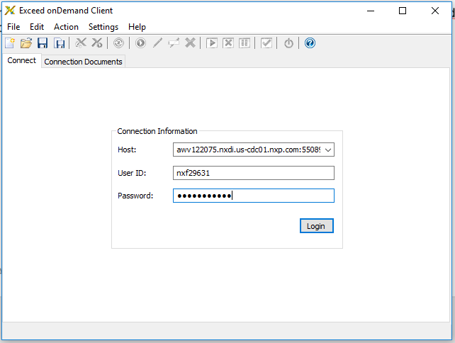
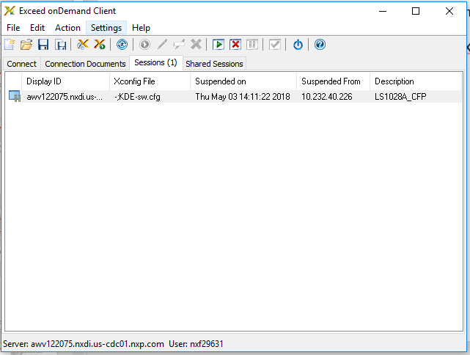
PHX Server Login 4/4
6. Now click on Connect, it will download leostream.eod file.
7. Then open it with the EOD Client (Latest version – This is mandatory. PHX VDIs will not work with older version of EoD)
8. In the EoD Connect Dialog box, for Xconfig select ‘Default Xconfig’ and for Xstart select ‘KDE-TR-desktop.xs’ (very important to select KDE-TR-desktop.xs xstart). Click Run. [Applicable only for the first time].

Slide 10
CFP Board Allocation for LS1028 Project
Following CFPs are allocated to LS1028 project
CFP1
CFP2
CFP CW TAP Addresses
CFP1: config cc cwtap:10.81.48.3
CFP2: config cc cwtap:10.81.48.22

Slide 11
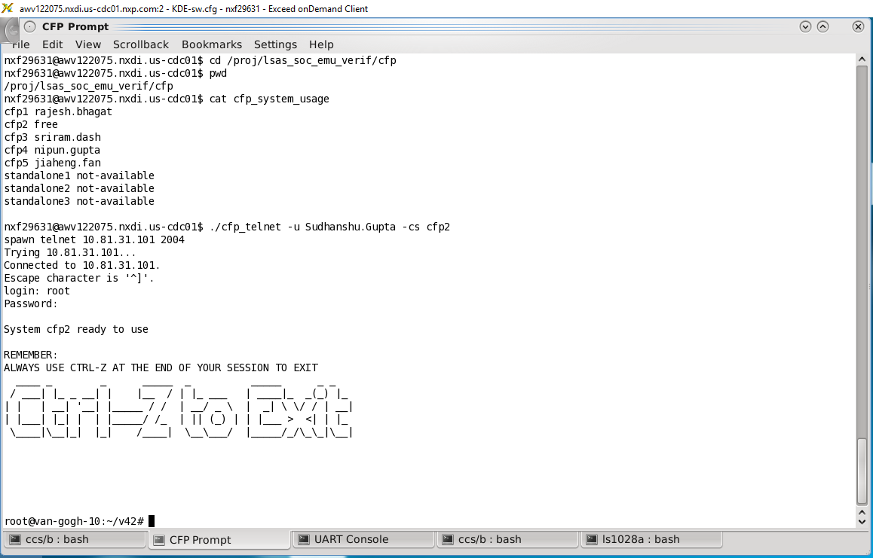
Login To CFP 1 or CFP 2
[To Login to CFP] –
Execute on PHX server shell
$ cd /proj/lsas_soc_emu_verif/cfp
$ cat cfp_system_usage
$ ./cfp_telnet -u Sudhanshu.Gupta -cs cfp2 --> Use your name.surname combination to login

Slide 12
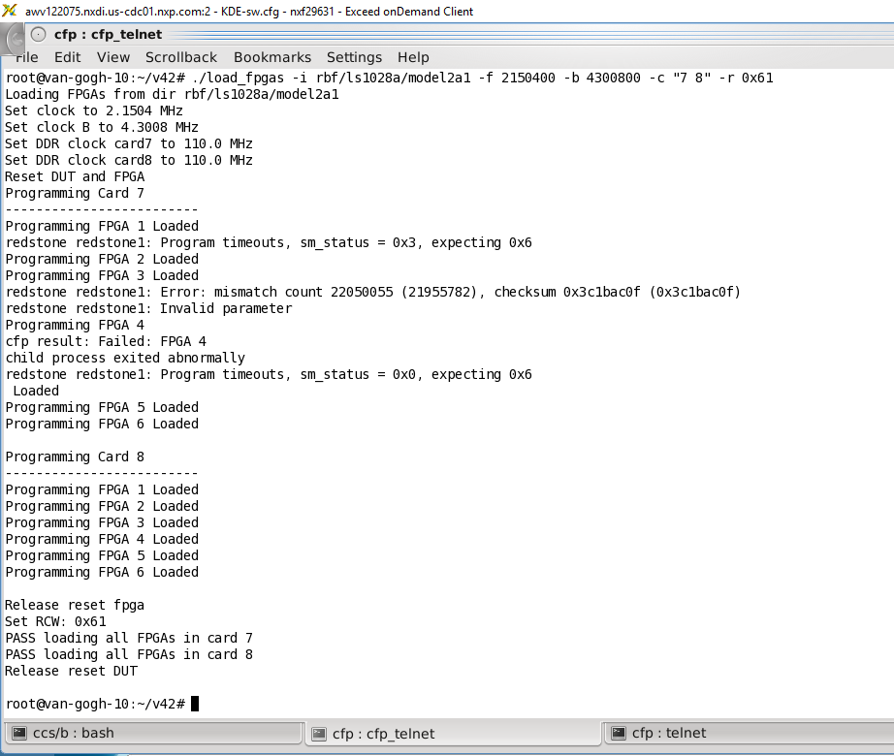
Load Model Command
[CFP Shell] # ./load_fpgas -i rbf/ls1028a/model1c -f 2150400 -b 4300800 -c "7" -r 0x61
[CFP Shell] # ./load_fpgas -i rbf/ls1028a/model2a1 -f 2150400 -b 4300800 -c "7 8" -r 0x61

Slide 13
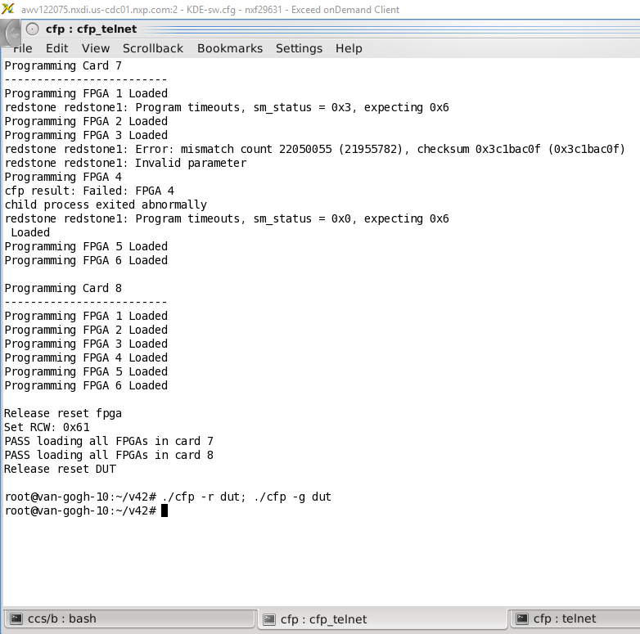
Reset / Init Model Command
[To reset the DUT - if needed]
[CFP Shell] # ./cfp -r dut - to reset board
[CFP Shell] # ./cfp -g dut - to come out of reset

Slide 14
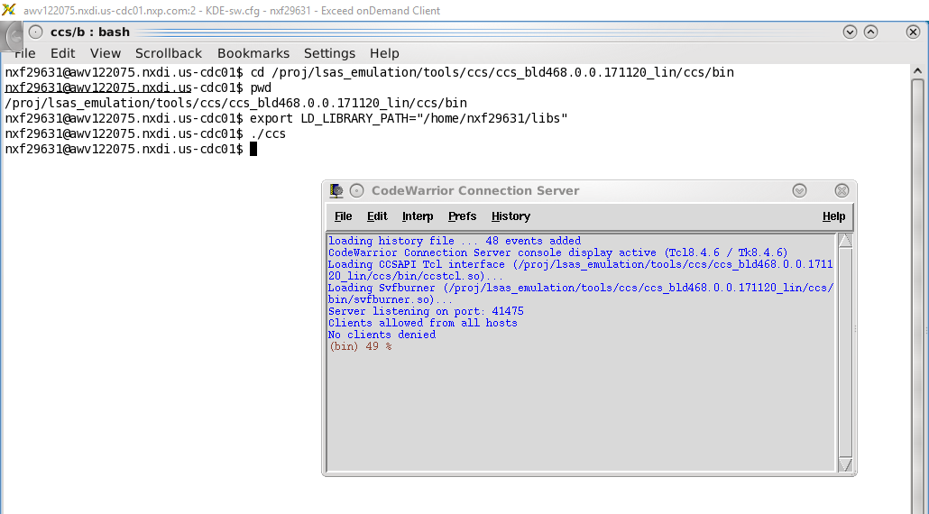
Open CCS (CodeWarrior Connection Server) Window
[PHX Server - New Tab]
$ cd /proj/lsas_emulation/tools/ccs/ccs_bld468.0.0.171120_lin/ccs/bin
$ export LD_LIBRARY_PATH="/home/nxf29631/libs"
$ ./ccs

Slide 15
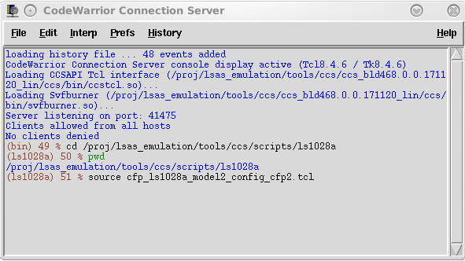
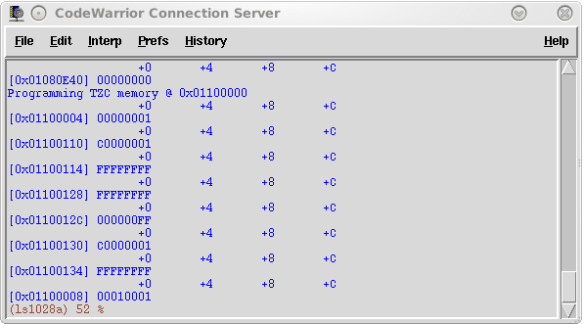
Configure CFP – Initialization Script
Script Initializes the following :
UART
DDR
TZC
Script is model & CFP board dependendant, so refer to Trac page for details on which one to use.
[CCS Shell] - Please use the file in the Release mail
% cd /proj/lsas_emulation/tools/ccs/scripts/ls1028a
% ls –lrt cfp_ls1028a_model*
% source cfp_ls1028a_model1c_config_cfp2.tcl ( CFP2 )
% source cfp_ls1028a_model2_config_cfp2.tcl

Slide 16
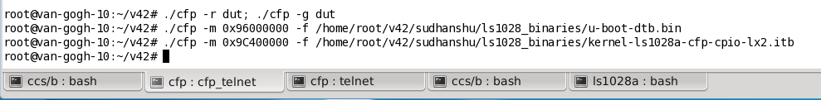
Load Uboot & Linux Images
Load Uboot & Linux Images (only after config script is executed successfully)
Prerequisite : Images needs to be copied to CFP 1 / 2
[Preload Binary to DDR] : All binaries should be 32-bit padded.
[Phoenix - CFP Shell]
[CFP Shell] # ./cfp -m 0x96000000 -f /home/root/v42/sudhanshu/ls1028_binaries/u-boot-dtb.bin
[CFP Shell] # ./cfp -m 0x9C400000 -f /home/root/v42/sudhanshu/ls1028_binaries/kernel-ls1028a-cfp-cpio-lx2.itb

Slide 17
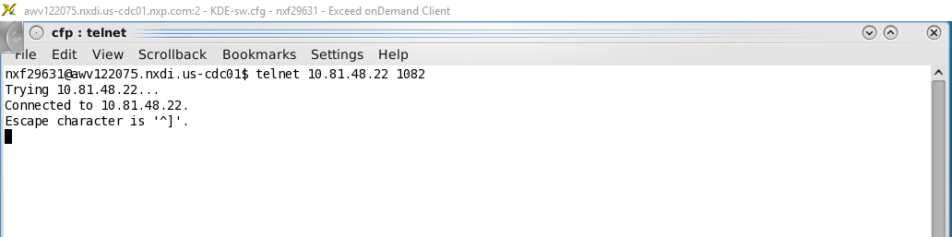
Open A UART Console
Open a UART console to dump uboot / linux prints before executing the image.
UART console IP is same as CWTAP IP for your CFP board.
[Open a UART Console]
In new shell, open a connection to UART console
$ telnet 10.81.48.3 1082 -- cfp1 uart console
$ telnet 10.81.48.22 1082 -- cfp2 uart console

Slide 18
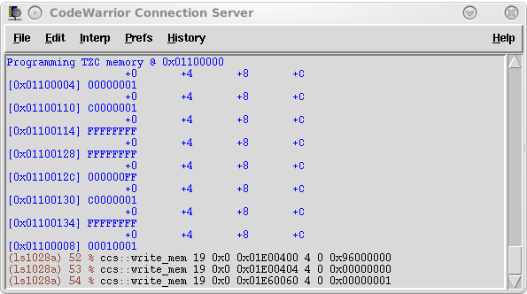
Execute Images
[Set and Verify Boot Location Pointer to 0x96000000]
% ccs::write_mem 19 0x0 0x01E00400 4 0 0x96000000
% ccs::write_mem 19 0x0 0x01E00404 4 0 0x00000000
[Finally Boot System]
% ccs::write_mem 19 0x0 0x01E60060 4 0 0x00000001 (Core 0 only)
% ccs::write_mem 19 0x0 0x01E60060 4 0 0x00000003 (SMP)

Slide 19
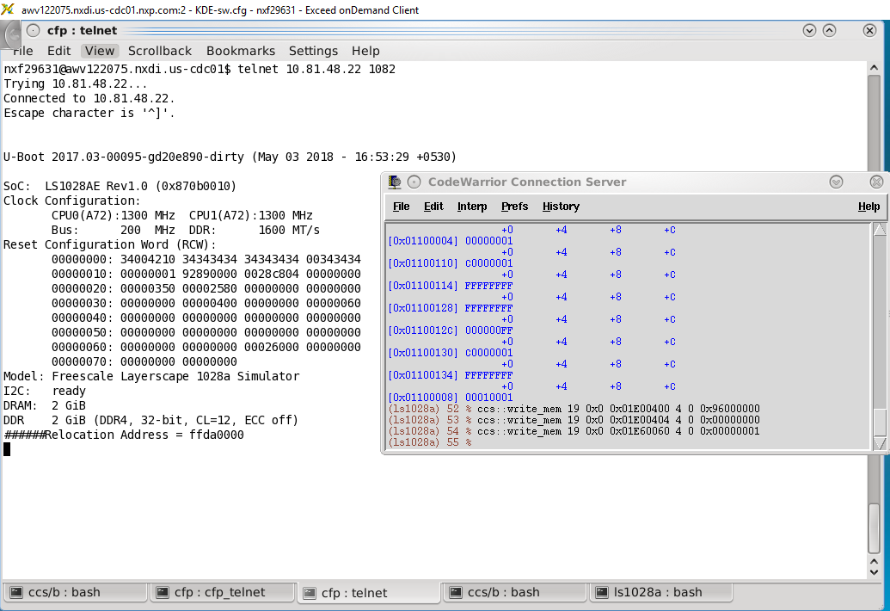
Uboot Run Output

Slide 20
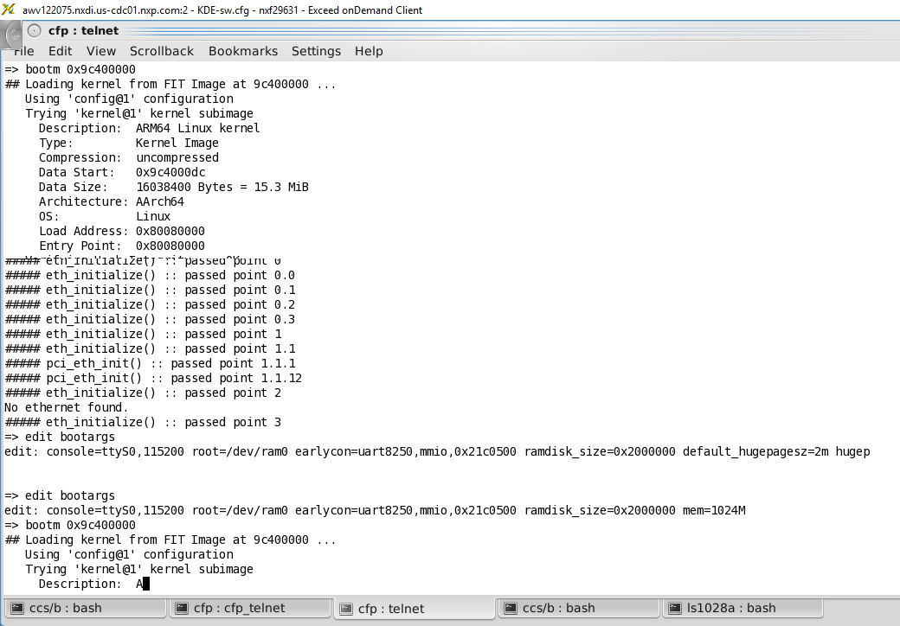
Booting Linux
[Uboot Command Shell]
=> edit bootargs
edit: console=ttyS0,115200 root=/dev/ram0 earlycon=uart8250,mmio,0x21c0500 ramdisk_size=0x2000000 mem=1024M
=> bootm 0x9c400000

Slide 21
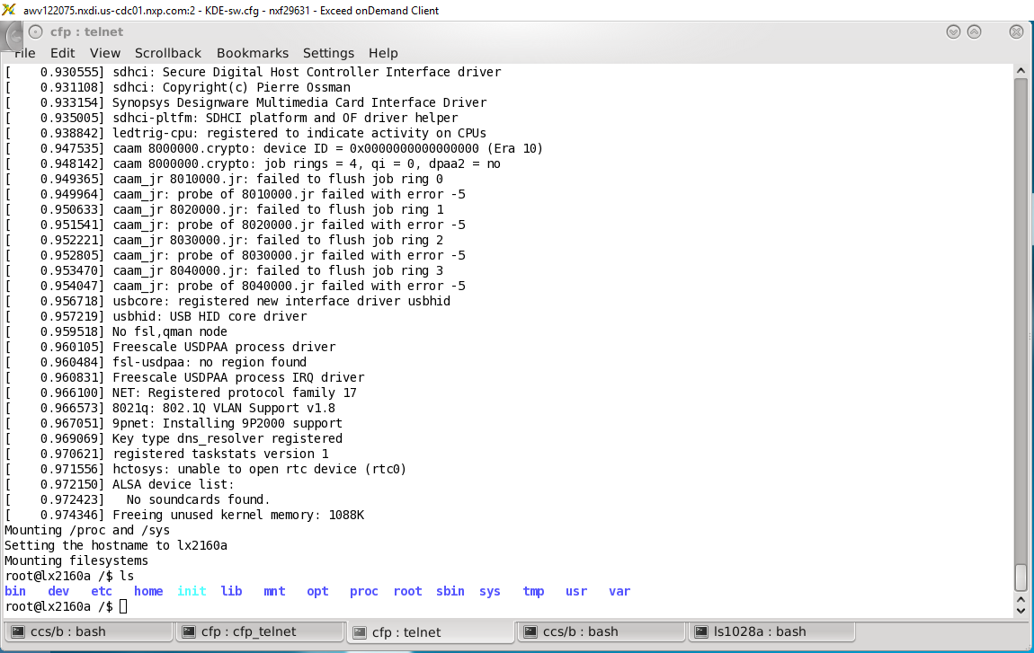
Linux Prompt reached !!! (Takes around 5-10 mins with Tiny RFS)

Slide 22
Troubleshoot Guide

Slide 23
Fixing Library init issue while trying to start CCS from PHX server
Download the lib from this path https://nxp1.sharepoint.com/sites/dnghwdesign/NPI/Forms/AllItems.aspx?FolderCTID=0x0120000D91B7456C83DA4D8F10B6AA7E9DE6E7&id=/sites/dnghwdesign/NPI/Emulation/Planning/LX2
<<libusb-0.1.so.4>>
Copy it to a local folder on PHX machine via Samba server
\\smb.nxdi.us-cdc01.nxp.com\nxf29631
Move the lib file copied to suitable path
$ mkdir libs
$ cp /home/nxf29631/Desktop/libusb-0.1.so.4 /home/nxf29631/libs/
Now add the path to this library to a local path on PHX VDI machine
export LD_LIBRARY_PATH="/home/nxf29631/libs"

Slide 24
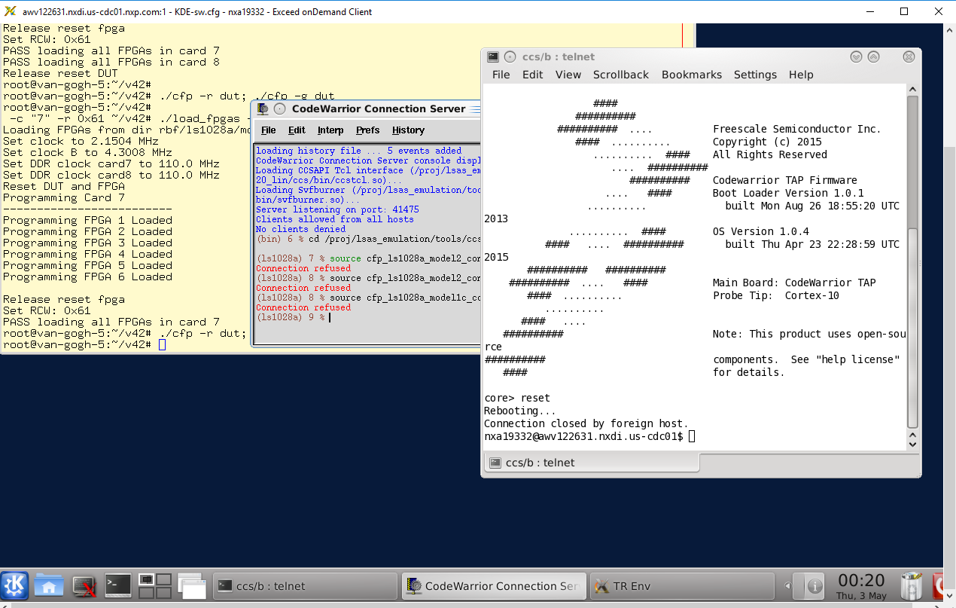
Connection Refused Error
Open a telnet to CWTAP IP , and issue reset command.
Core> reset
Try executing the initialization script again after 1~2 mins.

Slide 25
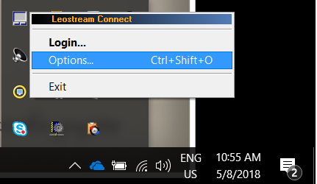
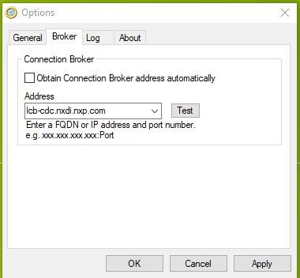
Unable to connect to PHX server via EoD client
Right click on “Leostream Connect 3.0” icon in system tray, and click on “Options…”
Change the Connection Broker in LeoStream Connect as below:
lcb-cdc.nxdi.nxp.com

