Slide 1
SW HW Breakpoints – Demystified
Sudhanshu Gupta
23 May 2018

Slide 2
Breakpoints
Literally , “Break” at a “Point”
Breakpoints are most commonly used to interrupt a running program immediately before the execution of a programmer-specified instruction. This is often referred to as an instruction breakpoint.
Other kinds of conditions can also be used, such as the reading, writing, or modification of a specific location in an area of memory. This is often referred to as a conditional breakpoint, a data breakpoint, or a watchpoint.

Slide 3
SW Breakpoints
SW (Software) breakpoints are implemented by temporarily replacing the instruction opcode at the breakpoint location with a special "breakpoint" instruction immediately prior to stepping or executing your code.
When the core executes the breakpoint instruction, it will be forced into debug state (Execution to Debug state).
SW breakpoints can only be placed in RAM because they rely on modifying target memory.
Usage : Uboot code.

Slide 4
HW Breakpoints
HW (Hardware) breakpoint is set by programming a watchpoint unit to monitor the core busses for an instruction fetch from a specific memory location.
HW breakpoints can be set on any location in RAM or ROM.
When debugging code where instructions are copied (Scatterloading), modified or the processor MMU remaps areas of memory, HW breakpoints should be used. In these scenarios SW breakpoints are unreliable as they may be either lost or overwritten.
Usage : Uboot / Linux code.

Slide 5
What Fits Where ??
When to choose HW / SW Breakpoints
Which is good ? Both are good ….

Slide 6
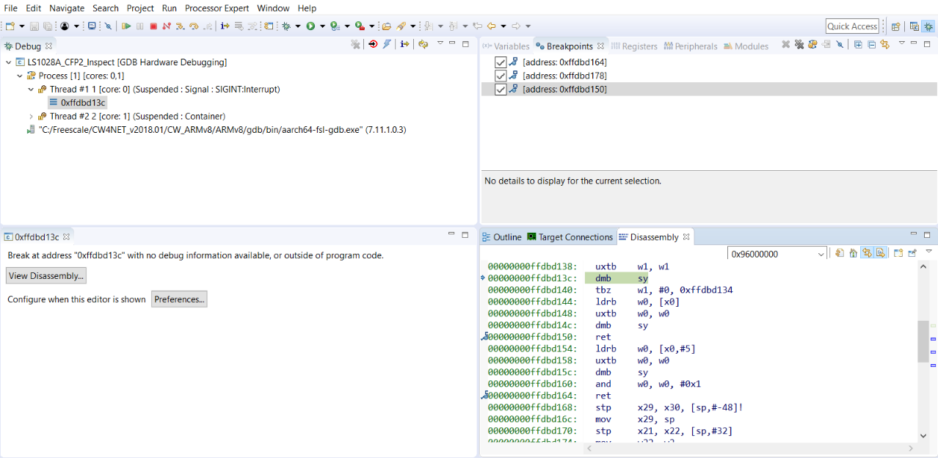
Software Breakpoints can be applied
by just clicking next to instruction

Slide 7
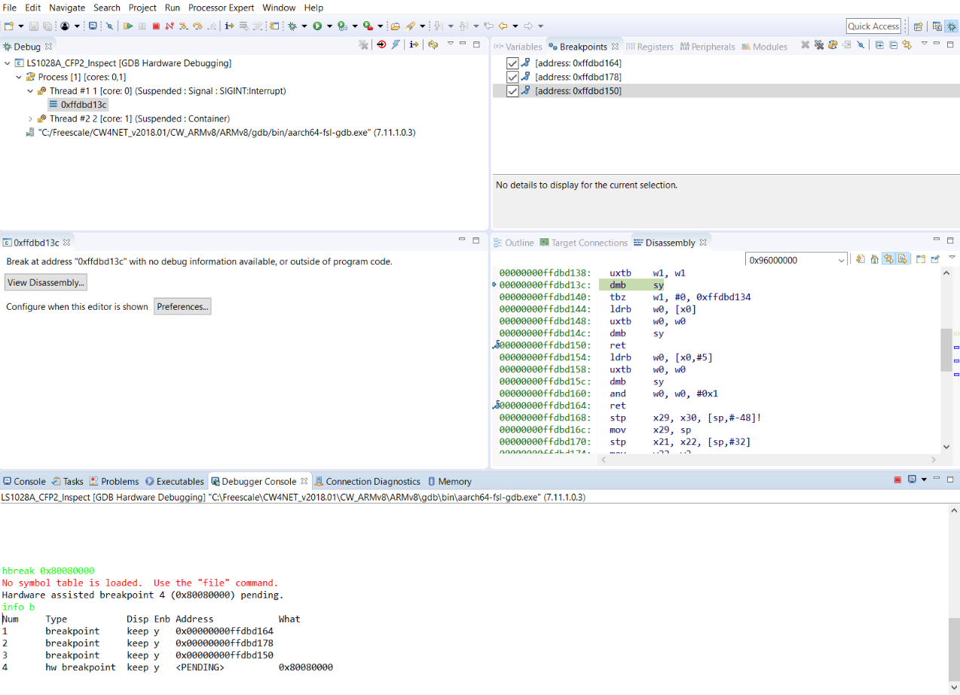
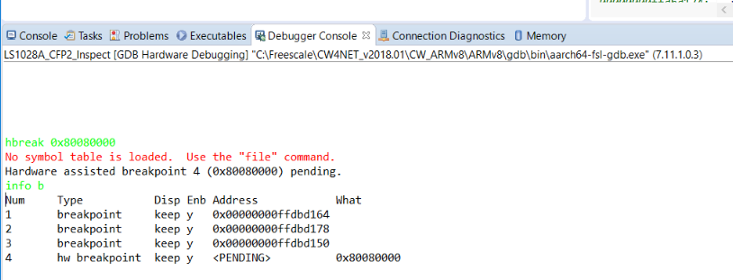

Slide 8
How to apply SW / HW breakpoints in CW
SW BP are possible in uboot (Since pagetables are not RO)
HW BP to be used in case of Linux (Since pagetables are marked RO)
Demo (Optional)

Slide 9
Q n A

Slide 10
Backup Slides

Slide 11
Breakpoints
Breakpoints are most commonly used to interrupt a running program immediately before the execution of a programmer-specified instruction. This is often referred to as an instruction breakpoint.
Other kinds of conditions can also be used, such as the reading, writing, or modification of a specific location in an area of memory. This is often referred to as a conditional breakpoint, a data breakpoint, or a watchpoint.
Software
Without hardware support (and in multitasking environments), debuggers have to implement breakpoints in software.
For instruction breakpoints, this is a comparatively simple task of replacing the instruction at the location of the breakpoint by either:
an instruction that calls the debugger directly (e.g. a system call) or
an invalid instruction that causes a deliberate program interrupt (that is then intercepted/handled by the debugger)
This technique may be more difficult to implement in multitasking systems using shared program storage (the interrupt may occur on a different thread, requiring resurrection of the original instruction for that thread). Also, if the program resides in protected memory, overwriting of instructions may be prevented.
Hardware
Many processors include hardware support for breakpoints (typically instruction and data breakpoints).

