Slide 1
Structured Planning Under Uncertainty:
A Decision Graph Approach to AI-Assisted Software Development
Naman Sogani · Ashvin Sehgal · Mari Garey · Elena Motonishi · Sreemae Konduru · Omkar Khade
CS 639 — Deep Learning for NLP · UW–Madison · Spring 2026

Slide 2
Problem & Motivation
The Gap
Why It Matters
AI coding tools optimise for the immediate task — they have no memory of past decisions, system-wide constraints, or architectural intent
Past decisions and coding standards are silently ignored
Cross-module dependencies are routinely missed
Errors surface later in unrelated parts of the codebase
As projects grow, inconsistency compounds — a single misaligned decision can invalidate downstream components
No existing tool surfaces the planning graph implicit in developer–AI conversations
We propose extracting that graph and using it to keep AI grounded in project-wide context

Slide 3
Related Work
▸ Graph Chain-of-Thought (Jin et al., 2024)
→ Graph-structured reasoning over multi-step dependencies via nodes & edges — but no persistent or evolving system context.
▸ Search-R1 (Jin et al., 2025)
→ RL-trained LLM that decides when to search for external info — improves reasoning via adaptive retrieval, but works on unstructured data only.
▸ GNN-RAG (Mavromatis & Karypis, 2025)
→ GNNs retrieve relevant subgraphs for multi-hop LLM reasoning — but relies on static, pre-built graphs and non-adaptive retrieval.

Slide 4
Our Approach: Decision Graph Extraction
7 Node Types
8 Edge Types
Objective — what the system aims to achieve
Requirement — hard constraints and must-haves
Assumption — implicit beliefs about the environment
Decision — explicit architectural choices + rationale
Component — modules, services, libraries
Interface — APIs, protocols, schemas
Risk — concerns, tradeoffs, failure modes
motivated_by — decision ← objective
assumes — decision → assumption
implements — component → requirement
depends_on — component → component
conflicts_with — risk ↔ decision
invalidates — risk → assumption
exposes — component → interface
consumes — component → interface
Extracted from developer–AI conversation logs via LLM; stored as a typed directed graph (NetworkX).

Slide 5
Data Collection & EDA Methodology
Corpus (166 documents, 5,702 sentences)
4-Phase EDA
GitHub Issues — 116 issues across 8 design-heavy repos fetched via Search API (keyword: design OR architecture OR rfc OR proposal OR decision OR tradeoff in title)
rust-lang/rfcs, denoland/deno, astral-sh/uv, tokio-rs/tokio, gleam-lang/gleam, ghostty-org/ghostty, BurntSushi/ripgrep, microsoft/typescript
Stack Overflow — 30 [software-design] questions + top 3 voted answers per question
Post-mortems — danluu/post-mortems curated list (8k words of incident descriptions)
Hedge detection — epistemic modals & conditionals as Assumption node signal
Node-type keyword density — hits per 1k words across 7 node types × 3 tiers
Dependency verb patterns — surface signals for edge extraction
Uncategorized sampling — manual review to surface schema gaps

Slide 6
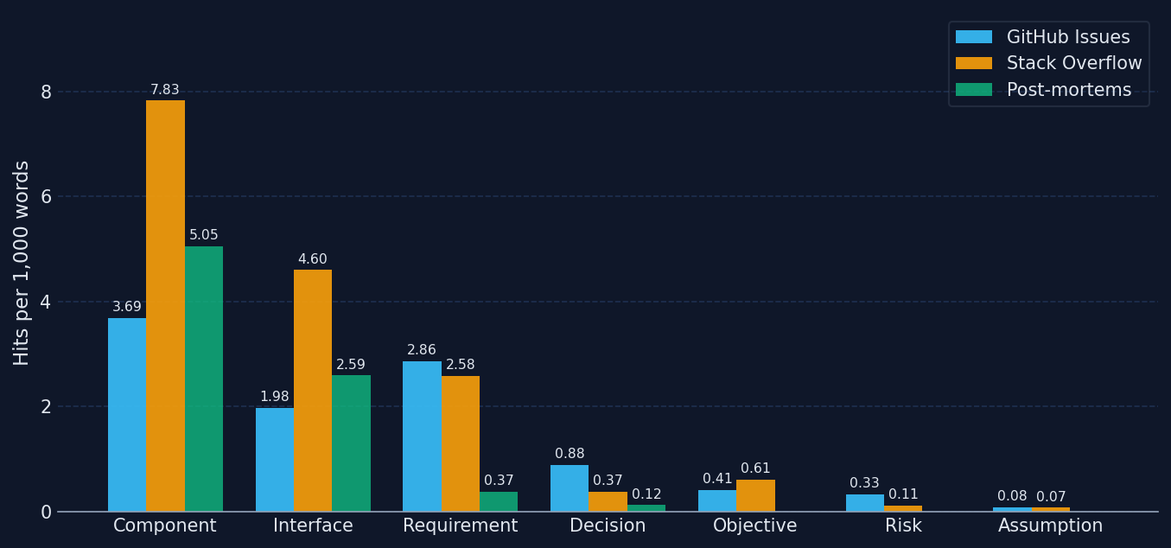
EDA Findings: Node-Type Keyword Density
Assumption is rarest across all tiers (mean 0.049/1k). GitHub Issues are the only reliable source of Risk & Decision signal.

Slide 7
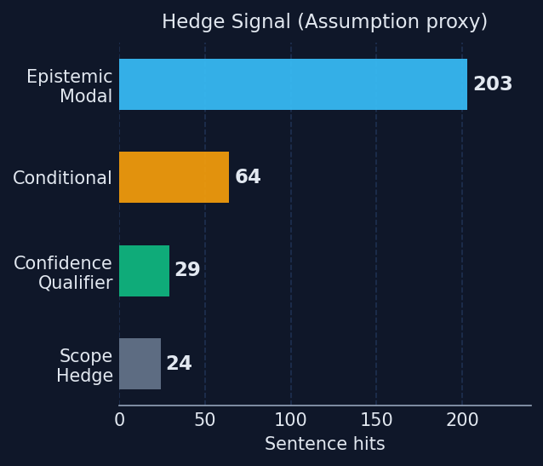
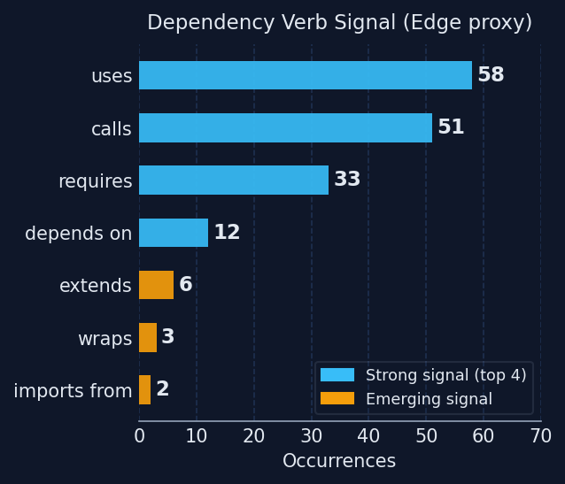
EDA Findings: Hedge & Edge Signal
320 hedge hits across 5,702 sentences. 11/14 dependency verb patterns found; 'consumes', 'feeds_into', 'delegates_to' absent from corpus.

Slide 8
Prefix Tuning: Repo-Aware LLM Specialisation
What It Does
Why It Fits
Trains separate PEFT prefix adapters (20 virtual tokens) per repo domain — e.g. finance_python, backend_sql
JSON metadata router selects the right adapter at inference time based on frameworks, directive, and file-path constraints
Soft-biases LLM output style without storing repo data in weights — retrieval handles knowledge, prefix handles behaviour
GitHub Issues (Decision/Risk-heavy) and Stack Overflow (Component/Interface-heavy) have near-disjoint node profiles → natural adapter split
Modular: new domains added as small adapters, not new models
Next: build train_examples.json and run first adapter training loop

Slide 9
Evaluation Plan
Metrics
Experiment Design
Node Recall — fraction of ground-truth nodes recovered from a conversation
Edge Precision — fraction of extracted edges that are correct
Failure Point Recall — fraction of post-mortem failure points mapped to Risk or Assumption nodes
6 planning projects spanning diverse complexity (job pipeline, OAuth2/SSO, ETL, monolith migration, ML feature, dev CLI)
Condition A: standard Claude Code session — prompt in, plan out
Condition B: graph-augmented — extraction after each exchange, graph fed back as planning context
Each project scored against a pre-defined objectives rubric (functional + structural)
Baseline: RAG-augmented planning to isolate graph contribution from retrieval alone
Dataset
Open-sourced codebases with documented design decisions (sourced from our EDA corpus); manually annotated decision graphs as ground truth.

Slide 10
Case Study: Job Copilot Pipeline
 | Condition A | Condition B
Functional (7) | 5.5 / 7 | 6 / 7
Structural (3) | 1 / 3 | 3 / 3
Runtime | Python — implicit ✗ | Python — documented + alternatives ✓
Assumptions | None enumerated | 8 nodes, confidence-rated
Risks | 6 items, informal prose | 9 nodes, severity-rated
Graph | — | 57 nodes · 64 edges
Key Findings
Structural coverage dominated even with a broken feedback loop — B surfaced 8 explicit assumption nodes + 9 risk nodes; A produced zero enumerable ones
Both chose Python for Playwright (wrong); B's graph logged the decision with alternatives_considered — the mistake is auditable and challengeable
Core result: the graph forces explicit enumeration of assumptions and risks regardless of whether the planner makes correct decisions

Slide 11
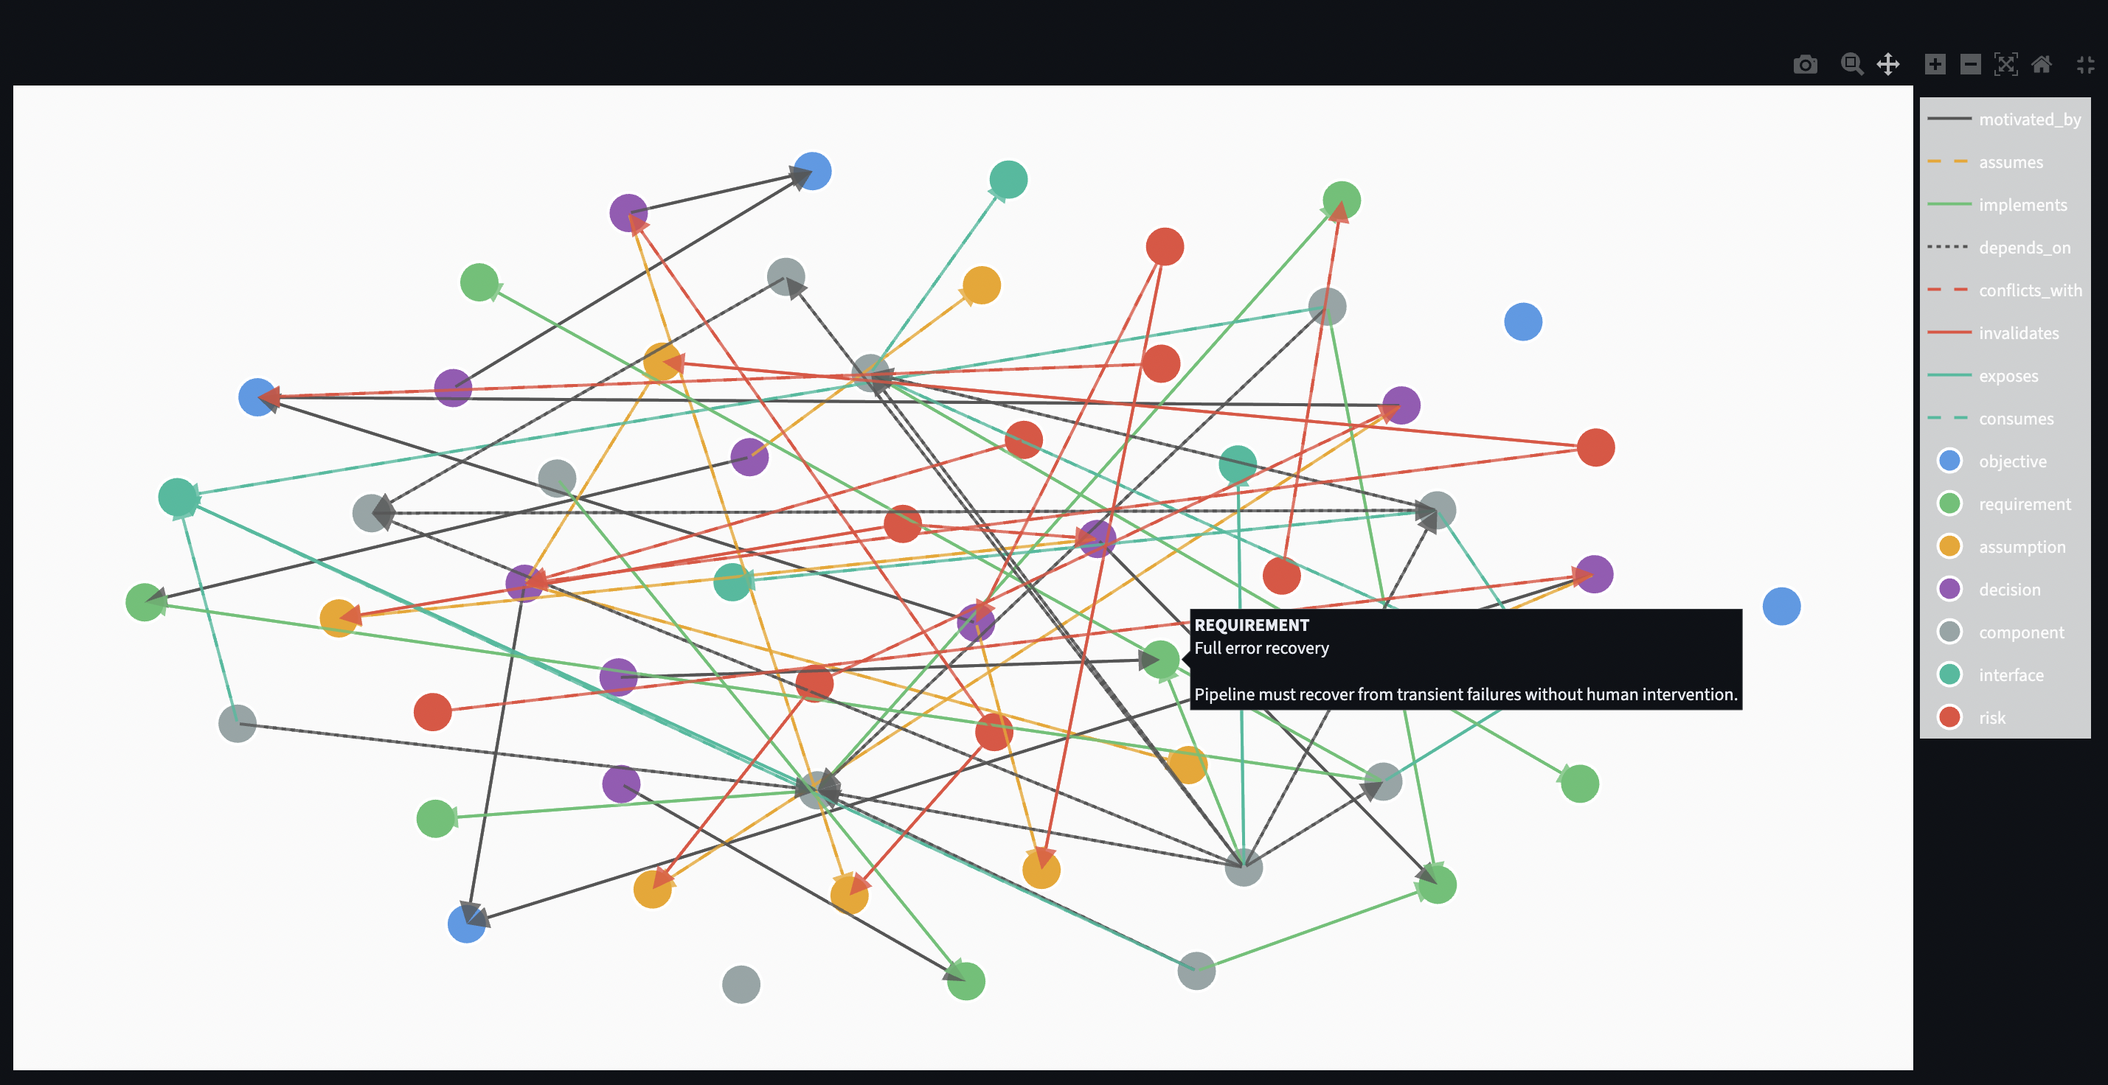
Decision Graph: Job Copilot Pipeline (Condition B)
57 nodes · 64 edges · extracted from 2 planning exchanges. Colours: blue = objective, orange = requirement, green = decision, teal = component, purple = interface, yellow = assumption, red = risk.

Slide 12
Next Steps
Immediate Priorities
Run comparative evaluation on 5 remaining projects — vary domain (OAuth2/SSO, ETL pipeline, monolith migration, ML feature, dev CLI) to test graph generalization
Test true iterative feedback loop: two-window workflow where graph is re-injected after each decision cluster — isolate whether iteration improves planning vs. single-shot extraction
Experiment with stronger Condition B prompting mechanisms: 'reference graph before each decision', structured decision templates, explicit assumption-surfacing prompts
Compare planning agents: Claude Code vs Cursor vs raw API — do different agents respond differently to graph context?
Annotate ground truth graphs + train prefix-tuning adapters for domain-specific assumption and risk extraction

