Slide 1
Client Side
Server Side
Client’s Browser
Internet
Web App
Database
REST API Controller

Slide 2
Client Side App (Angular Project)
Server Side App
Banner
Action Toolbar
Data Grid
Navigation Tree Component
Controller
Database
REST API Controller
Details Tab Component
Details
User Feedback Components
Add/Edit Form Components

Slide 3
Client’s Browser
Data Access Class Library (c# DataAccess Project)
Angular
Web App
Request/Response Formatter
Data Access Abstract Class
REST API Controller (c# NgArbi Project)
Data Provider Classes
Command Parameter Generators
OleDb
Requests Formatter
OracleDB
Database
Table Configuration JSON Files
MS SQL
Client App Dataset Service and Table Models
TypeScript (*.ts) Generator
AppSettings / Connection String
Other

Slide 4
Client Side App (Angular Project v2)
Server Side App
Banner
Action Toolbar
Data Grid
Navigation Tree Component
Database
Controller
REST API Controller
Details Tab Component
Details
User Feedback Components
Add/Edit Form Components

Slide 5
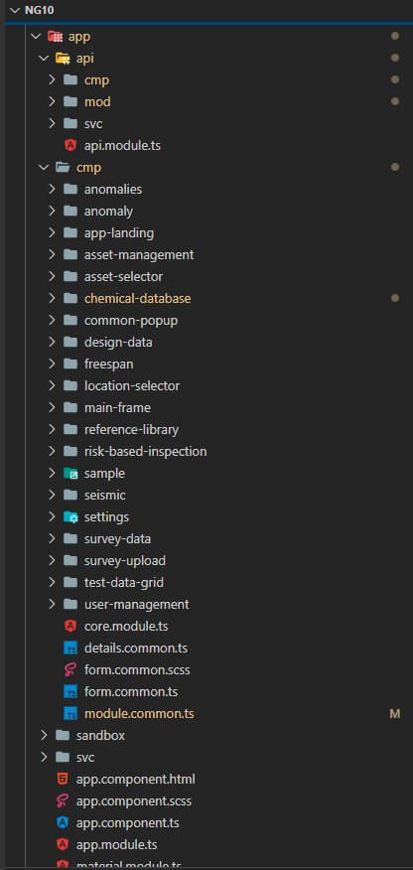
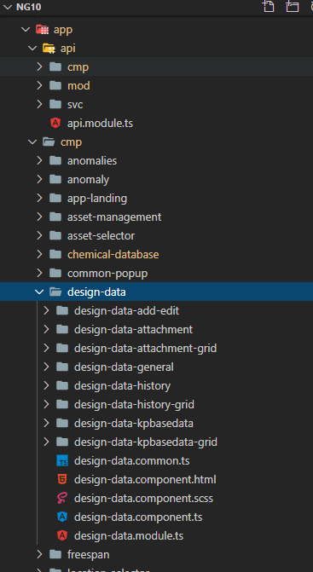
Project Common Components, Models, Classes and Services
Application-Specific Components, Models and Classes
Sample application folder structure
“Scratchpad”
Injectable Services

Slide 6
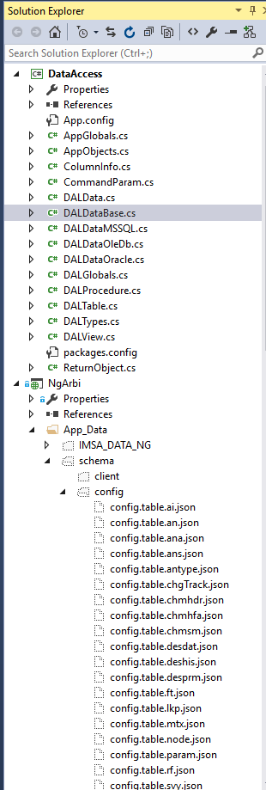
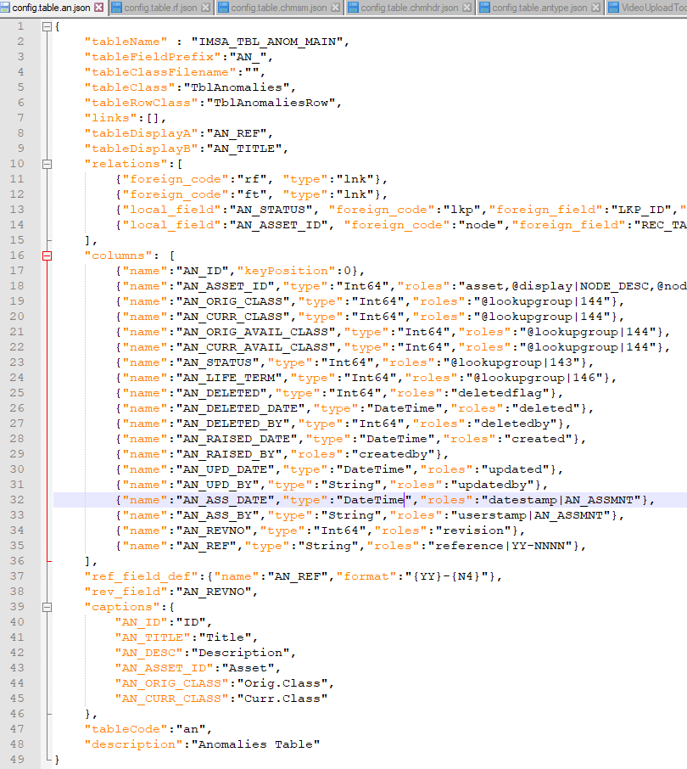
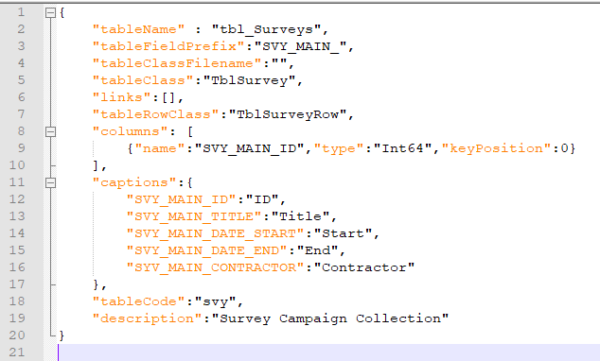
Data Provider Classes
Data Table Configuration Files

Slide 7
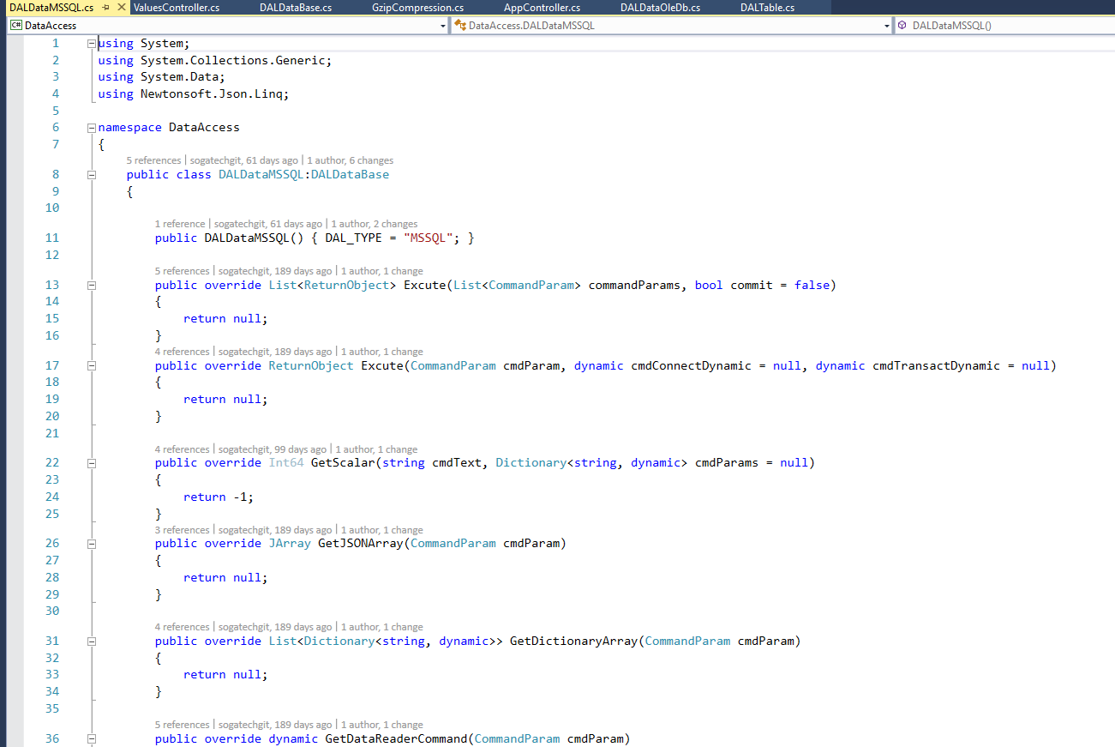

Slide 8
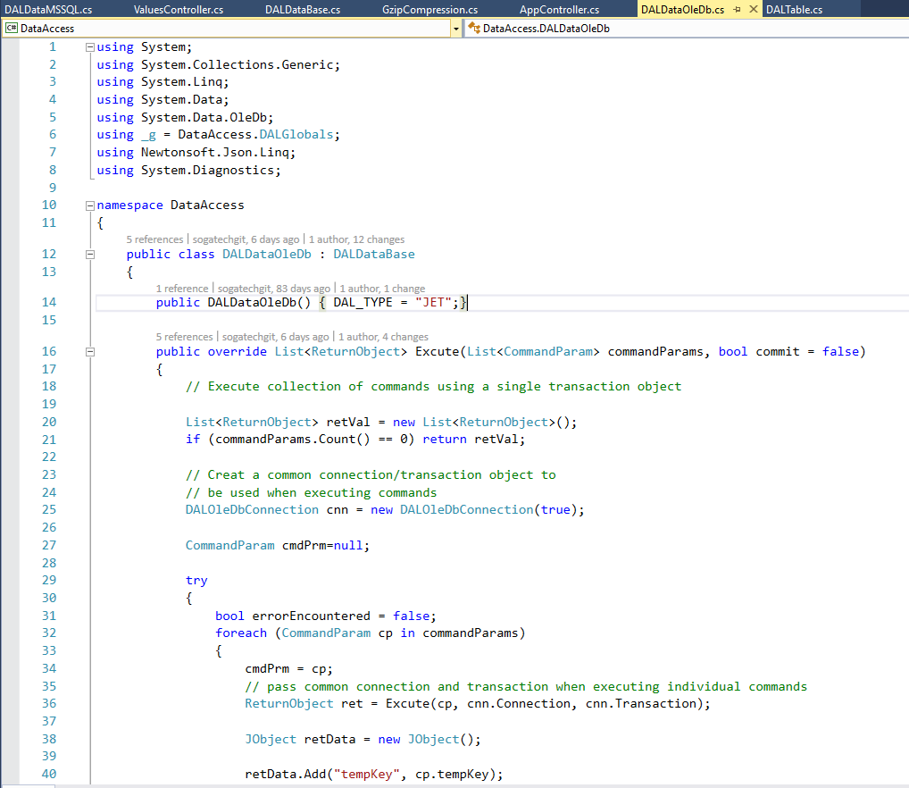

Slide 9
DataGridB Implementation

