Slide 1
Api And you, An Uber example
By Angello Pozo

Slide 2
What is An API
API → Application Program Interface
Can be a server that response to requests based on an interface
Can be a Library
Can be and SDK

Slide 3


Slide 4
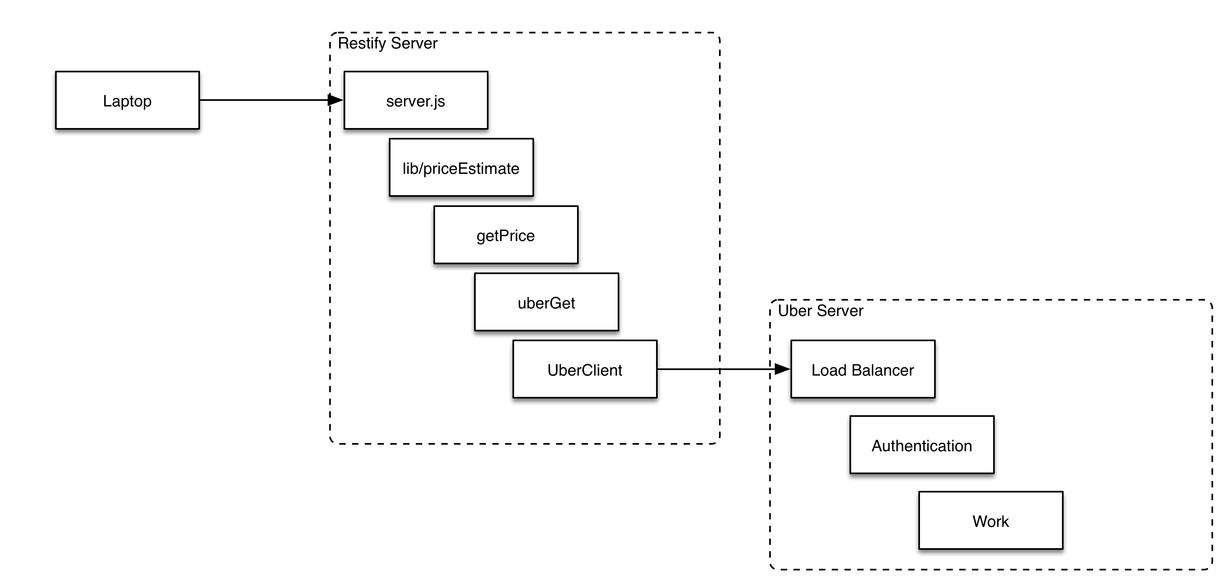
Some Details

Slide 5
Questions?
Go to github for code
https://github.com/sogoiii/restify-example

