Slide 1
Job Change Prediction
ML Classification Project
Academic Year 2025/2026

Slide 2
Problem Overview
• Task: Predict if a person is willing to change job
• Dataset: 12,427 training / 3,308 test samples
• 14 features: demographics, education, work, company
• Target: willing_to_change_job (0/1)
• Metric: Balanced Accuracy

Slide 3
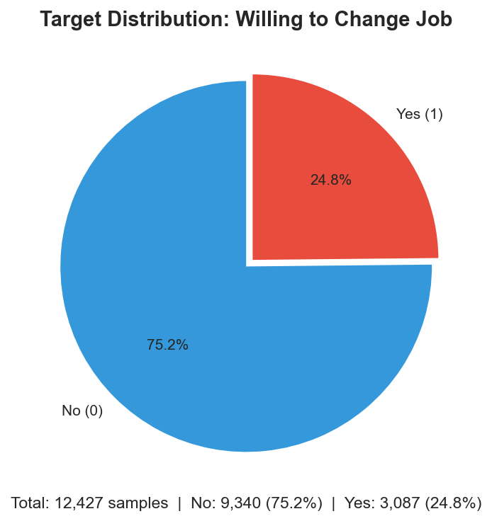
Target Distribution

Slide 4
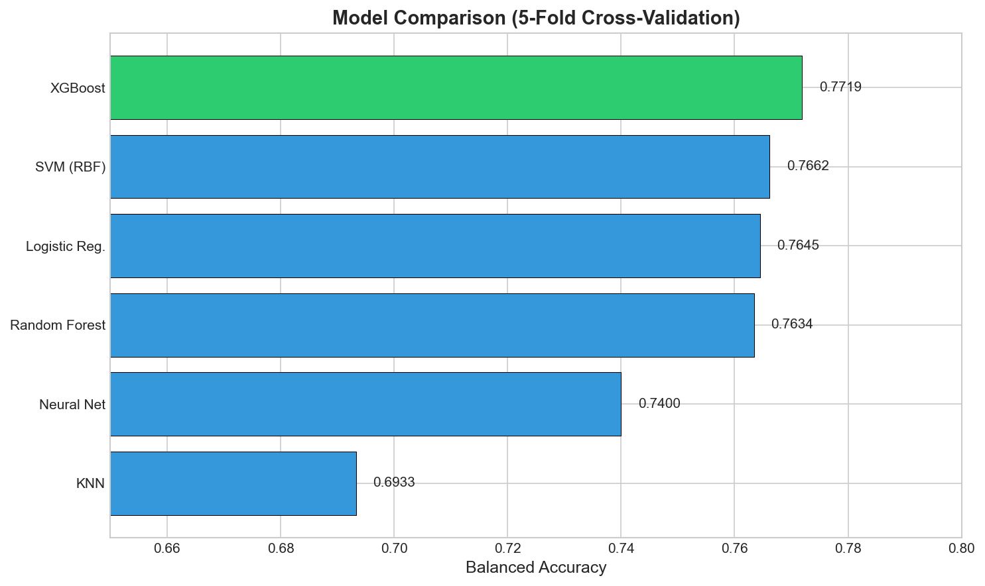
Model Comparison (5-Fold CV)

Slide 5
Best Model: XGBoost
• Balanced Accuracy: 0.7719
• GridSearchCV tuning (432 combinations)
• Parameters: n_estimators=100, max_depth=5
• learning_rate=0.05, scale_pos_weight=3
• subsample=0.8, colsample_bytree=0.8

Slide 6
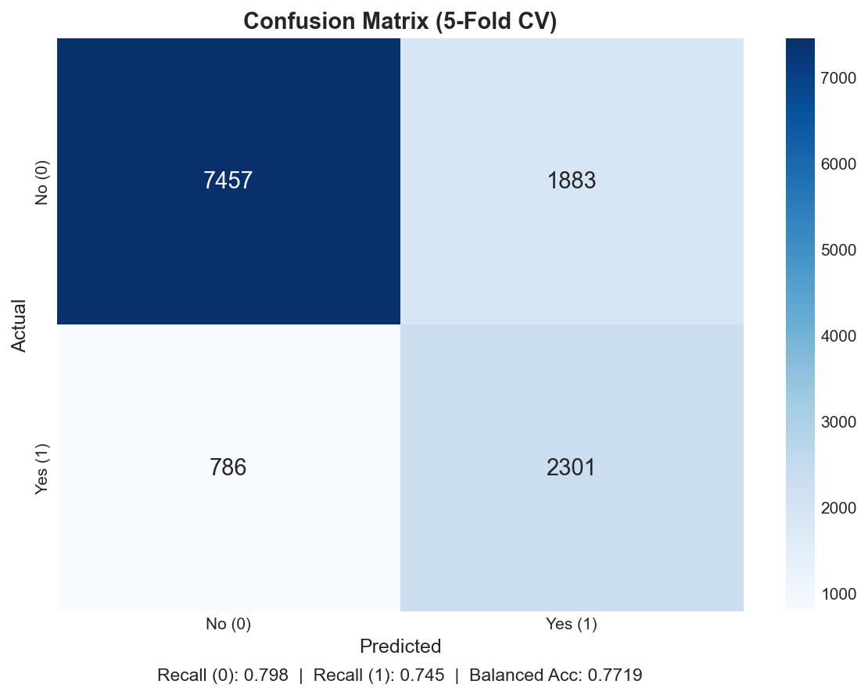
Confusion Matrix

Slide 7
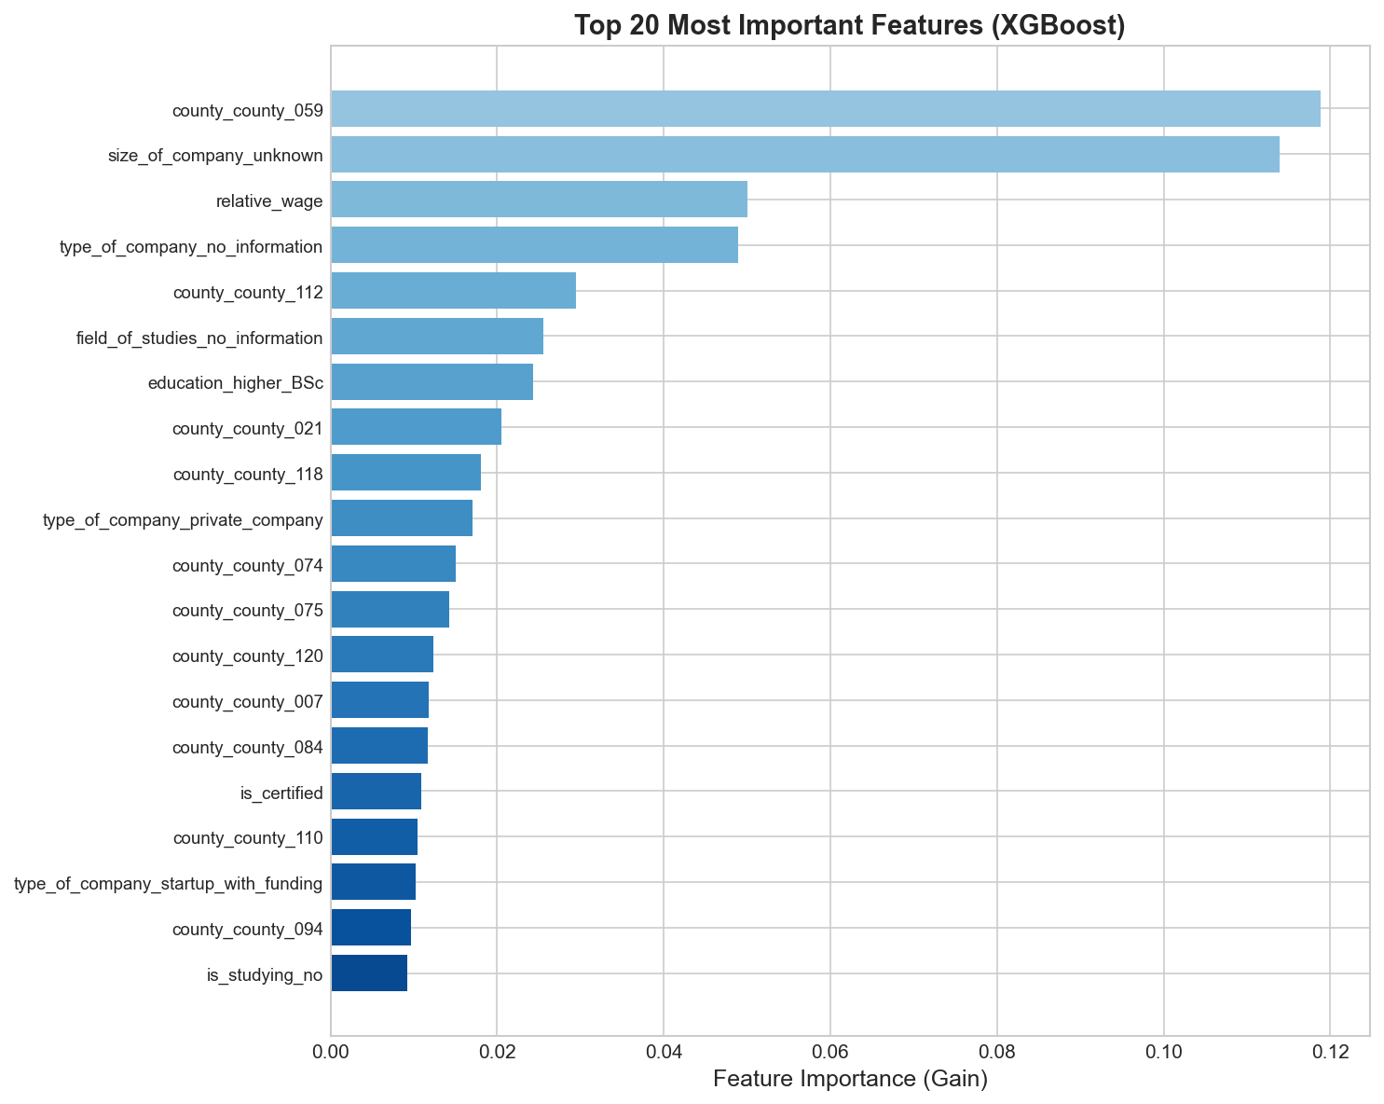
Top 20 Feature Importance

Slide 8
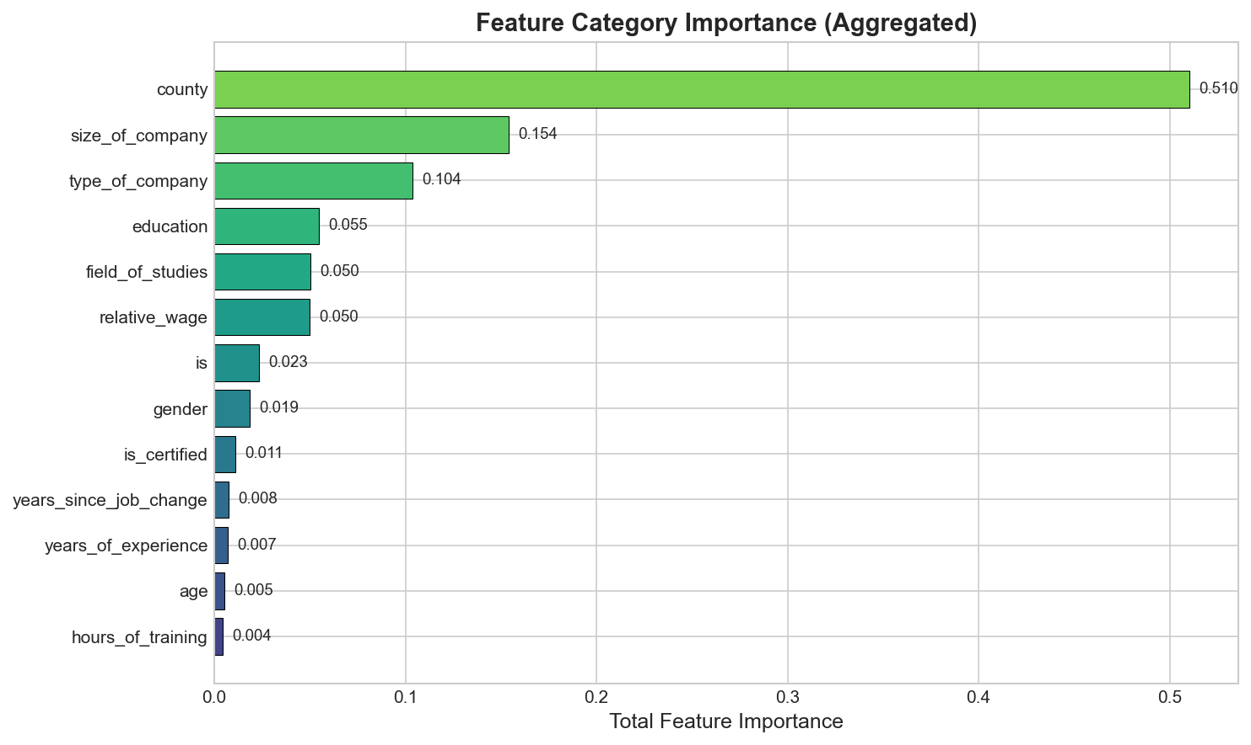
Feature Category Importance

Slide 9
Key Insights
• County (location) is strongest predictor (51%)
• Company size and type are significant
• Missing info flags are highly predictive
• Relative wage is top numeric feature
• Demographics have low predictive power

Slide 10
Summary
• Compared 6 ML algorithms with 5-fold CV
• XGBoost selected (Balanced Acc: 0.7719)
• Hyperparameters optimized via GridSearchCV
• 3,308 test predictions generated

Slide 11
GitHub Repository
[INSERT GITHUB LINK]
Thank you!

