Slide 1
Overview
Background
Methodology
Results
User profiles [or personas]
[Perhaps next steps]

Slide 2
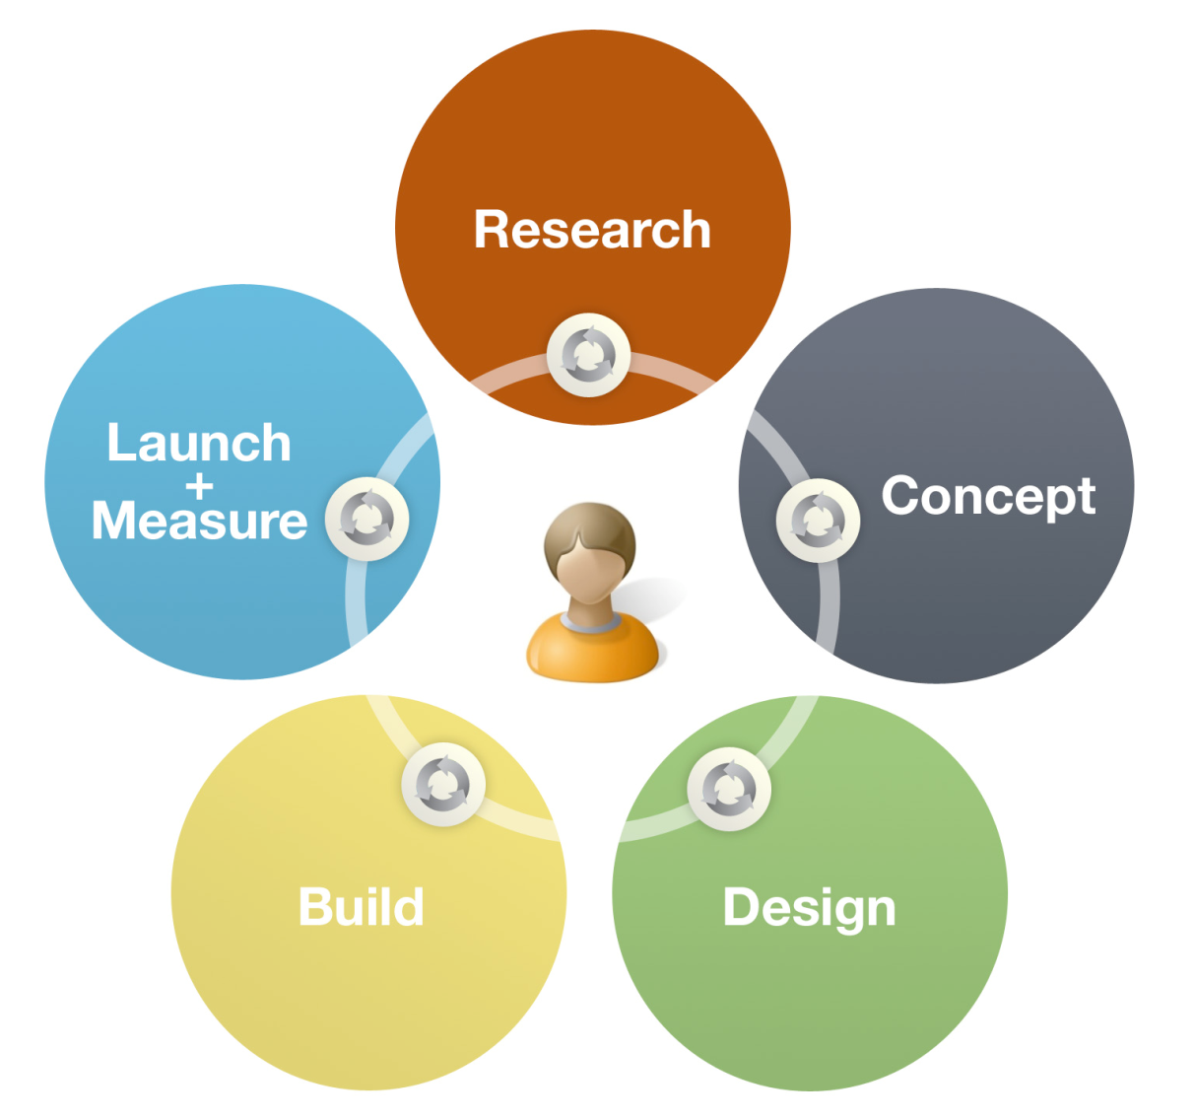
UCD helps create products that are relevant to users and easy to use by focusing on user needs at every stage of development.
Background
Credit: Anthro-Tech I http://www.anthro-tech.com/
Notes:
[Overview of the user-centered design process and the user research phase, in particular]

Slide 3


[Review the data sources you examined to complete your user research]
Background
Click analytics
Interviews
Site usage statistics
Survey

Slide 4
Methodology
[Go over specifics for each particular method you used – if you did a survey, for example, report on the timeframe, response rate, method for advertising the survey, and possible influences on the data.]

Slide 5
Results: Who is using the XX site?
[Consider structuring your results section by the question you wanted to answer with your user research. Then show the relevant data from each data source to answer the question.
Some questions you’ll want to address might include:
Who is using the site now (role, gender, age, education, location)?
How frequently do they use the site?
What platforms/browsers do they use to access the site?
When do they use the site?
What are their main reasons for visiting the site?
What are their specific tasks?
Can they complete their tasks? How long does it take?
How do they interact with the site?
How satisfied are they with the site?]

Slide 6
Results: Innovators
[Next, report on the results by specific audience segment; focus on reporting findings that are unique or interesting about each audience.]

Slide 7
Customer Profiles
[Boil down the user research into profiles or personas of your primary audiences.
Consider starting with the existing EERE personas and fleshing them out with information specific to your topic and audiences.
The EERE personas can be found on the Communication Standard site: http://www.eere.energy.gov/communicationstandards/index.html]

Slide 8

[Questions and discussion]

