Slide 1
AquaGuard AI
Water-quality analysis and preliminary screening in a single HTML file
IBM academic project | UN SDG 6: Clean Water and Sanitation
Sohan Manoj | St. Claret College, Bengaluru
Educational screening tool. All demo data is synthetic. Not endorsed by IBM, the UN or any government agency.
Notes:
Welcome. AquaGuard AI is a standalone, browser-based water-quality analysis and preliminary screening application, built for an IBM academic evaluation and aligned to UN SDG 6. It opens by double-clicking index.html: no installation, no server. State up front that it never certifies water as safe and that the demo data is synthetic.

Slide 2
OVERVIEW
Executive summary
Problem
Solution
Evidence
People have water-quality readings but no easy way to interpret them, see trends, or decide when further testing is needed.
A standalone HTML app: preloaded synthetic demo, validation, transparent screening, charts, outlier detection, CSV and HTML-report export.
75 unit checks and 46 real-browser checks passed; no console errors; works offline from file://.
Honest limits: screening only (never "safe" or "unsafe"); thresholds are marked UNVERIFIED until checked against the sources;
tested in Chromium only; no field pilot has been run.
AquaGuard AI | IBM academic project | UN SDG 6 | Educational screening tool - not a safety certification. Not endorsed by IBM, the UN or any agency.
2
Notes:
Summarise in three beats: the problem, what was built, and the evidence. The evidence is real: unit tests and browser tests were executed, and screenshots in this deck are captures of the running app. Be equally direct about what was not verified: Safari and Firefox, a live print dialog, and the reference thresholds against live sources.

Slide 3
CONTEXT
Introduction to SDG 6: Clean Water and Sanitation
Target 6.1
Target 6.3
Universal and equitable access to safe and affordable drinking water. AquaGuard helps people notice readings that warrant further testing.
Improve water quality by reducing pollution. Trend and location views help surface sites whose readings drift.
What this project does NOT claim
No improvement in any community's water has been achieved or measured. The tool supports interpretation and learning. Official source: https://sdgs.un.org/goals/goal6
AquaGuard AI | IBM academic project | UN SDG 6 | Educational screening tool - not a safety certification. Not endorsed by IBM, the UN or any agency.
3
Notes:
SDG 6 aims to ensure availability and sustainable management of water and sanitation for all. This project touches two targets. Be precise: the app supports understanding and prioritisation of follow-up; it does not itself improve water quality.

Slide 4
PROBLEM
Problem statement
Readings exist (handheld meters, school labs, community monitors) but are hard to interpret.
Users lack a clear overview of abnormal readings, trends over time, and sensible next steps.
Two risks: missing a real concern, or over-trusting a few in-range numbers.
pH, turbidity and TDS alone can never establish that water is safe to drink.
AquaGuard AI | IBM academic project | UN SDG 6 | Educational screening tool - not a safety certification. Not endorsed by IBM, the UN or any agency.
4
Notes:
Frame it as an interpretation gap. Instruments are cheap and common; knowing what the numbers mean is the hard part. The over-trust risk matters: three in-range numbers do not make water safe, so the tool must never imply that.

Slide 5
EVIDENCE
Background research and supporting evidence
Source (URL in references) | What it supports | Status
UN SDG 6 (sdgs.un.org/goals/goal6) | Goal and targets 6.1, 6.3 | Official goal page; not re-opened during build
WHO Guidelines for drinking-water quality, 2022 ed. | No health-based value for pH, TDS, turbidity; operational indicators | From author knowledge: verify
BIS IS 10500 (India) | Acceptable / permissible limits for pH, turbidity, TDS | Edition to be confirmed: verify
CPCB designated best use classes | Surface-water indicators (class A) | URL page unconfirmed: verify
WHO/UNICEF JMP (washdata.org) | Global access statistics | Re-check latest figure before quoting
All reference thresholds in the app carry the label UNVERIFIED (entered offline). No claim of official validation is made.
AquaGuard AI | IBM academic project | UN SDG 6 | Educational screening tool - not a safety certification. Not endorsed by IBM, the UN or any agency.
5
Notes:
Be transparent about provenance. The build environment had no internet, so these points come from the author's knowledge of the cited documents and are marked for verification in REFERENCES.md. Do not quote a global statistic without checking the latest WHO/UNICEF JMP report.

Slide 6
USERS
Target users and their challenges
Students and teachers
NGO monitors
Small monitoring teams
Evaluators
Need a safe, hands-on way to learn water-quality data handling.
Need to log samples, spot unusual sites and share a report.
Need repeatable checks, trends by location and exports.
Need visible assumptions and transparent rules they can audit.
Common challenge: not knowing whether a reading is unusual, what to do next, or how to present the data.
AquaGuard AI | IBM academic project | UN SDG 6 | Educational screening tool - not a safety certification. Not endorsed by IBM, the UN or any agency.
6
Notes:
Each persona wants transparency, not a black-box score: they want to know why something was flagged. That drives the explanation and provenance features.

Slide 7
GAP
Existing approaches and the gap
Approach | Strength | Limitation
Spreadsheets | Flexible | No validation; silent unit and typing errors
Lab reports (PDF) | Authoritative | Slow, per-sample, hard to trend
Commercial dashboards | Polished | Often paid and cloud-based; opaque scoring
Paper logs | Simple | No analysis, no export
AquaGuard AI | Free, offline, transparent rules, validation | Screening only; few parameters; thresholds to be verified
AquaGuard AI | IBM academic project | UN SDG 6 | Educational screening tool - not a safety certification. Not endorsed by IBM, the UN or any agency.
7
Notes:
Position AquaGuard as complementary to laboratory testing. The gap is a free, offline, transparent tool that validates data and refuses to overclaim.

Slide 8
SOLUTION
Proposed solution
Preloaded demo
Validated input
Transparent screening
120 synthetic records load on first open
Manual form and CSV; reasons for every rejection
Rules against a selectable, documented profile
Charts and filters
Outlier detection
Reports
Date, location, search and parameter filters
Robust statistics, clearly not machine learning
HTML report, CSV exports, print to PDF
AquaGuard AI | IBM academic project | UN SDG 6 | Educational screening tool - not a safety certification. Not endorsed by IBM, the UN or any agency.
8
Notes:
Walk through the capabilities at a high level and point out that everything works from a double-click.

Slide 9
GOALS
Project objectives
Objective | Measure | Status
Opens by double-click, no installs | Browser test via file:// | Verified (Chromium)
Correct validation with clear errors | Unit + browser tests | Verified
Transparent screening, never safe/unsafe | Wording tests; no safe badge | Verified
Dashboard figures from actual records | KPIs cross-checked independently | Verified
Works offline | Zero network requests recorded | Verified
Real-world value for users | Needs a user pilot | NOT measured
AquaGuard AI | IBM academic project | UN SDG 6 | Educational screening tool - not a safety certification. Not endorsed by IBM, the UN or any agency.
9
Notes:
Be honest about status: five objectives are verified by automated tests; the real-world value objective has not been measured and needs a pilot.

Slide 10
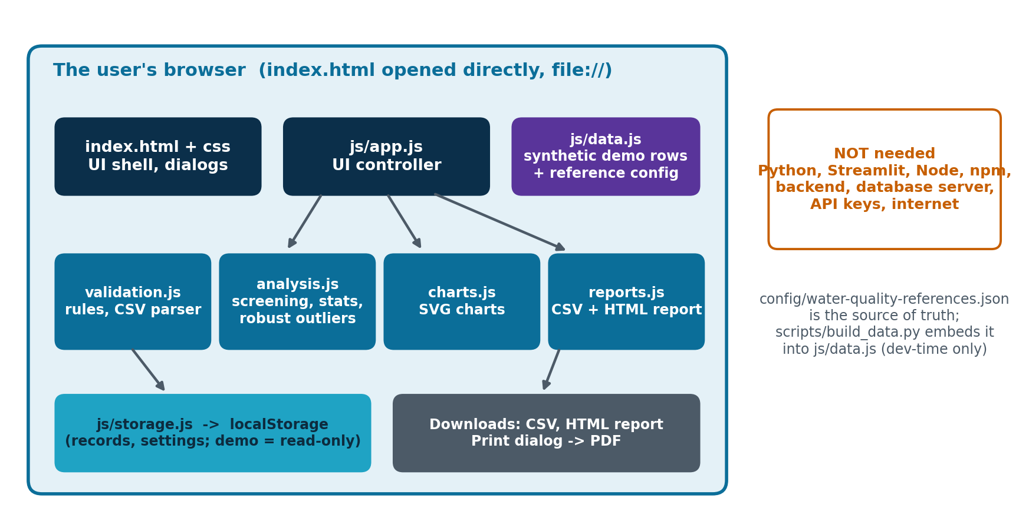
DESIGN
System architecture
AquaGuard AI | IBM academic project | UN SDG 6 | Educational screening tool - not a safety certification. Not endorsed by IBM, the UN or any agency.
10
Notes:
Everything runs in the browser. Plain scripts, not ES modules, so file:// works. The reference configuration lives in JSON and is embedded into data.js at build time by a small dev-only script, so the app can read it without a server.

Slide 11
DESIGN
Technology stack and rationale
Choice | Why
HTML5 + CSS3 + vanilla JavaScript | Runs by double-click; no build step, no frameworks
Plain <script> files (no ES modules) | Modules are blocked on file:// in some browsers
Custom SVG charts (js/charts.js) | Offline; also used inside exported reports; accessible titles
localStorage | Persistence without a server; per-browser and private
Embedded data.js | fetch() of local JSON is blocked on file://; data.js loads as a normal script
Node / Playwright (dev only) | Test runner and screenshots; NOT needed by users
AquaGuard AI | IBM academic project | UN SDG 6 | Educational screening tool - not a safety certification. Not endorsed by IBM, the UN or any agency.
11
Notes:
Vanilla technologies keep the app dependency-free and file://-friendly. Chart.js could not be downloaded in the build environment, so a small SVG chart library was written; the same functions render on-screen charts and charts embedded in the HTML report.

Slide 12
DESIGN
Application folder structure
AquaGuard-AI/
|-- index.html <- double-click this
|-- css/styles.css
|-- js/
| |-- app.js UI controller
| |-- data.js demo rows + references (generated)
| |-- validation.js rules + CSV parser
| |-- analysis.js screening, stats, outliers
| |-- charts.js SVG charts
| |-- storage.js localStorage
| `-- reports.js CSV + HTML report
|-- data/demo-water-quality.csv
|-- config/water-quality-references.json
|-- assets/ (logo, diagrams) screenshots/
|-- tests/ (unit + browser) scripts/ (dev tools)
|-- presentation/ (this deck + source)
`-- README.md, PROJECT_REPORT.md, ... LICENSE
What users need
index.html
css/ and js/
data/ and config/ (reference copies)
Everything else is documentation and developer tooling.
AquaGuard AI | IBM academic project | UN SDG 6 | Educational screening tool - not a safety certification. Not endorsed by IBM, the UN or any agency.
12
Notes:
Each module has one job. Users only need index.html and its folders; scripts, tests and presentation are for developers.

Slide 13
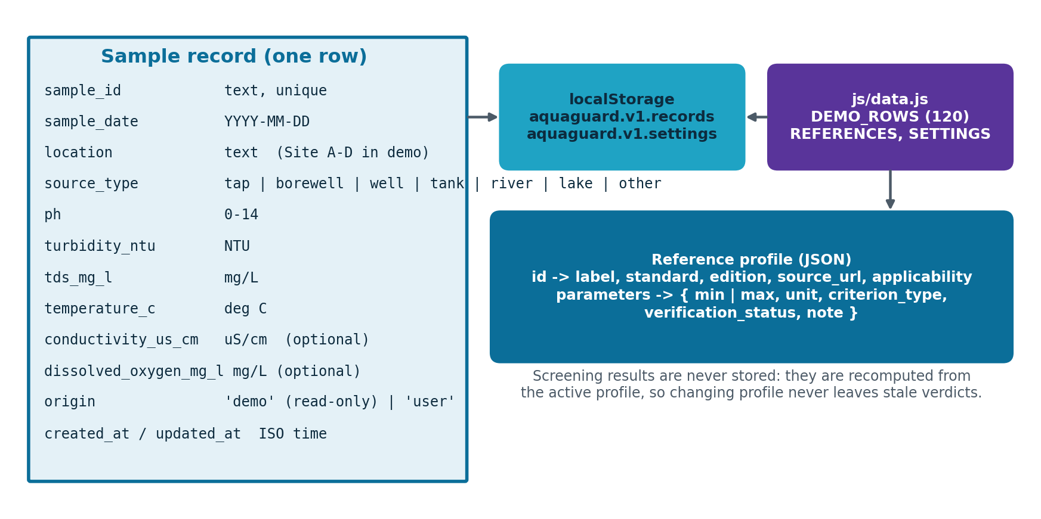
DATA
Data model and sample dataset
Demo dataset (synthetic)
120 records, 4 fictional sites (Site A-D)
2026-08-01 to 2026-10-10
32 flagged, 4 insufficient (BIS acceptable)
5 statistically unusual samples
Missing: conductivity 20.8%, dissolved oxygen 55.8%
AquaGuard AI | IBM academic project | UN SDG 6 | Educational screening tool - not a safety certification. Not endorsed by IBM, the UN or any agency.
13
Notes:
One flat record type. The demo dataset is synthetic: 120 records, four fictional sites, 2026-08-01 to 2026-10-10, with ordinary values, missing measurements, exceedances and deliberate anomalies. It is generated by a script with a fixed seed.

Slide 14
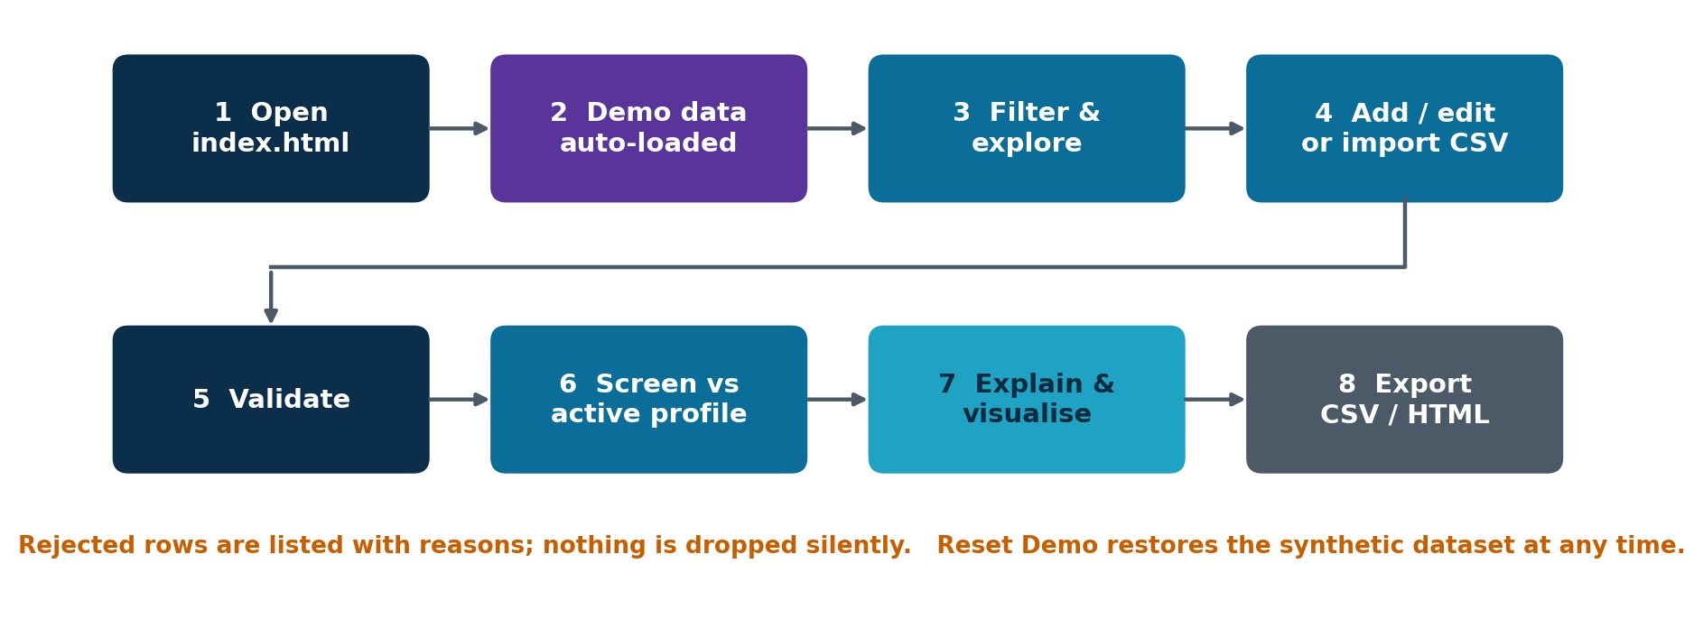
DESIGN
Application workflow: from input to result
Every figure and chart is recalculated from the stored records and the active filters.
AquaGuard AI | IBM academic project | UN SDG 6 | Educational screening tool - not a safety certification. Not endorsed by IBM, the UN or any agency.
14
Notes:
Tell the story of one record. It arrives through the form or a CSV, passes validation, is stored, is screened against the active profile, and then appears in charts, tables, explanations and exports. Reset Demo restores the original dataset at any time.

Slide 15
SCIENCE
Water-quality parameters explained
Parameter | Unit | In plain words | Input range
pH | pH units | How acidic or alkaline the water is | 0 to 14
Turbidity | NTU | How cloudy the water is (suspended particles) | 0 to 1000
TDS | mg/L | Dissolved minerals and salts (taste/acceptability) | 0 to 50000
Temperature | deg C | Water temperature at sampling | 0 to 60
Conductivity (optional) | uS/cm | How well water conducts current; tracks dissolved ions | 0 to 100000
Dissolved oxygen (optional) | mg/L | Oxygen available to aquatic life (surface water) | 0 to 25
None of these detects bacteria, viruses, arsenic, nitrate, pesticides or heavy metals.
AquaGuard AI | IBM academic project | UN SDG 6 | Educational screening tool - not a safety certification. Not endorsed by IBM, the UN or any agency.
15
Notes:
Explain each parameter simply, and say what it can and cannot tell you. Accepted input ranges are plausibility limits for data entry, not water-quality thresholds.

Slide 16
SCIENCE
Reference thresholds and scientific limitations
Profile | pH | Turbidity | TDS
BIS acceptable | 6.5-8.5 | <= 1 NTU | <= 500 mg/L
BIS permissible | 6.5-8.5 | <= 5 NTU | <= 2000 mg/L
WHO operational | 6.5-8.5 | <= 1 NTU | <= 600 mg/L
CPCB class A (surface) | 6.5-8.5 | (DO >= 6 mg/L) | <= 500 mg/L
Scientific limitations
Screening cannot establish potability
Microbial and toxic hazards are invisible
Sampling and instrument errors are not detected
Thresholds depend on use and jurisdiction
All values: UNVERIFIED (entered offline).
Criterion types: health-based, aesthetic/operational, environmental indicator.
Limits are inclusive; the active profile is always visible.
AquaGuard AI | IBM academic project | UN SDG 6 | Educational screening tool - not a safety certification. Not endorsed by IBM, the UN or any agency.
16
Notes:
Four profiles are configurable. Each threshold records standard, edition, unit, applicability, criterion type and source URL. They are all marked unverified. Distinguish drinking-water, operational and surface-water indicators.

Slide 17
METHOD
Screening algorithm, step by step
1 Validate
2 Select
3 Compare
4 Count
5 Explain
Bad or incomplete data -> Invalid record
Use parameters in the active profile that the sample has
Inclusive limits: a value on the limit is within range
Fewer than 2 profile parameters -> Insufficient data
Value, unit, range, source, status, reason, next step
▶
▶
▶
▶
Four outcomes: Within configured range | Flagged for review | Insufficient data | Invalid record.
Fixed wording: "No configured threshold exceedances detected" and "This result does not establish drinking-water safety."
There is no green "safe to drink" badge anywhere in the app.
AquaGuard AI | IBM academic project | UN SDG 6 | Educational screening tool - not a safety certification. Not endorsed by IBM, the UN or any agency.
17
Notes:
Walk the five steps. Stress that the same function screens manual and imported records (a test proves it), that limits are inclusive, and that the wording is fixed so the tool cannot say 'safe'.

Slide 18
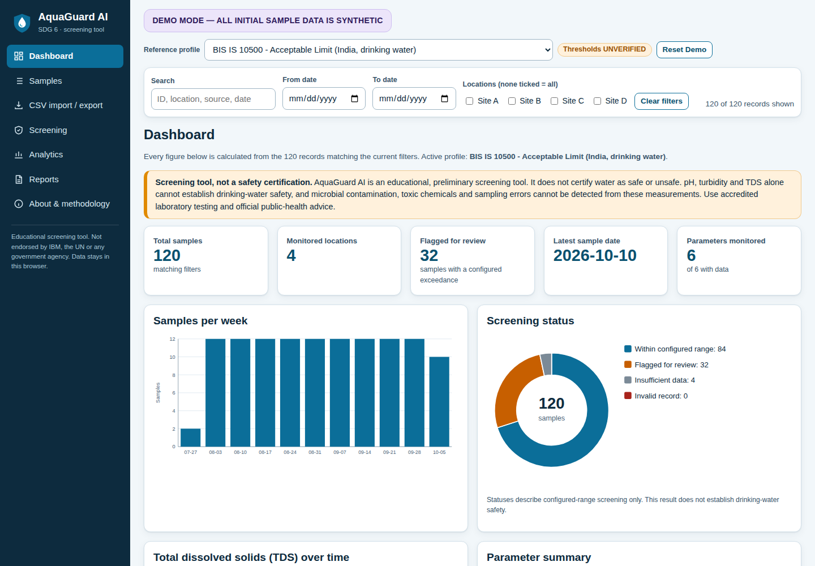
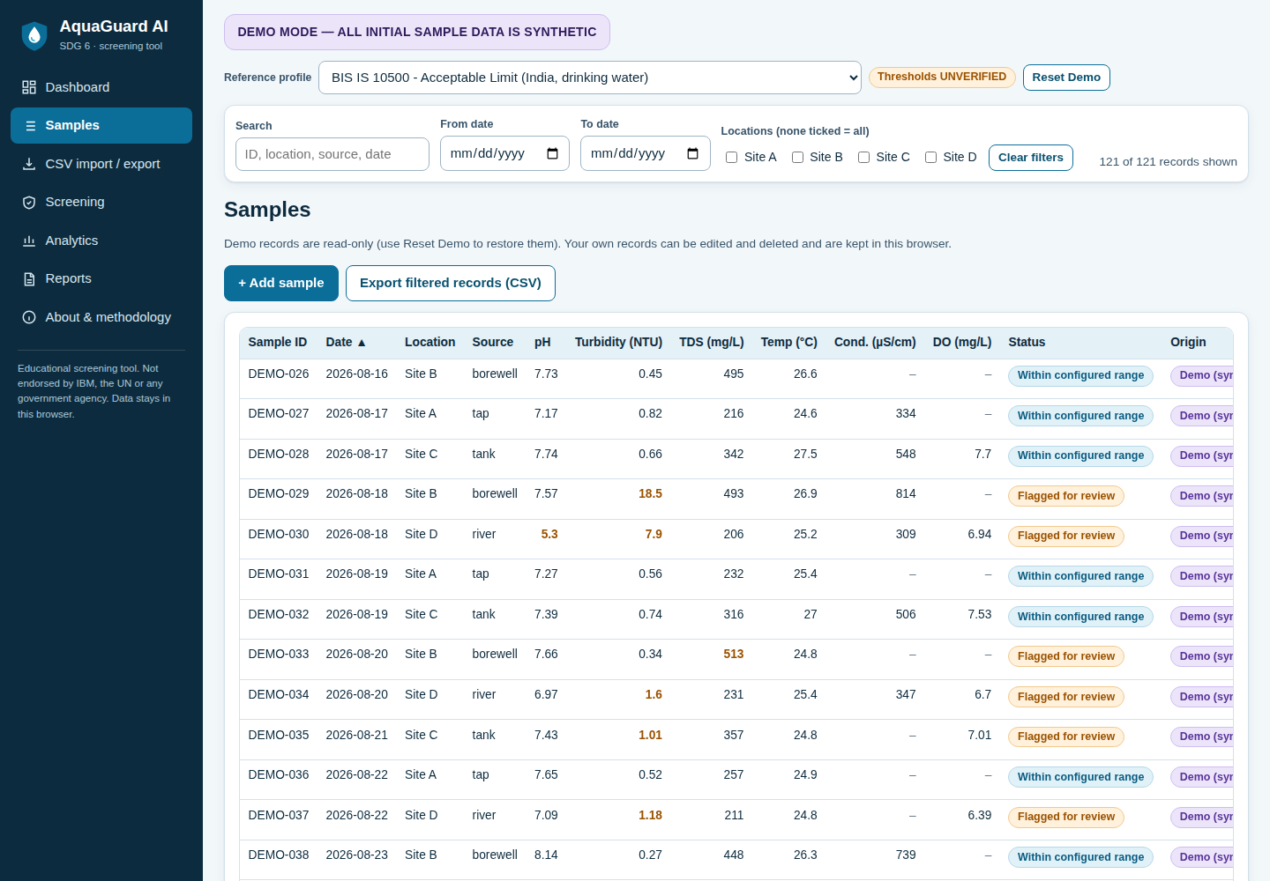
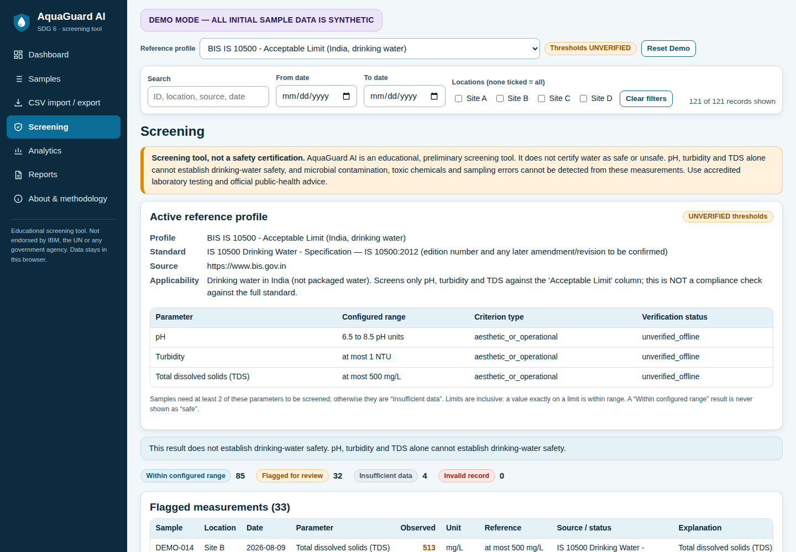
PRODUCT
Dashboard and application screenshots
Real screenshots of the running app (Chromium, file://). Synthetic demo data.
AquaGuard AI | IBM academic project | UN SDG 6 | Educational screening tool - not a safety certification. Not endorsed by IBM, the UN or any agency.
18
Notes:
These are real screenshots captured from the running application opened from file:// in headless Chromium during the automated test run. The dashboard shows figures computed from the loaded records. The demo-mode label is always visible.

Slide 19
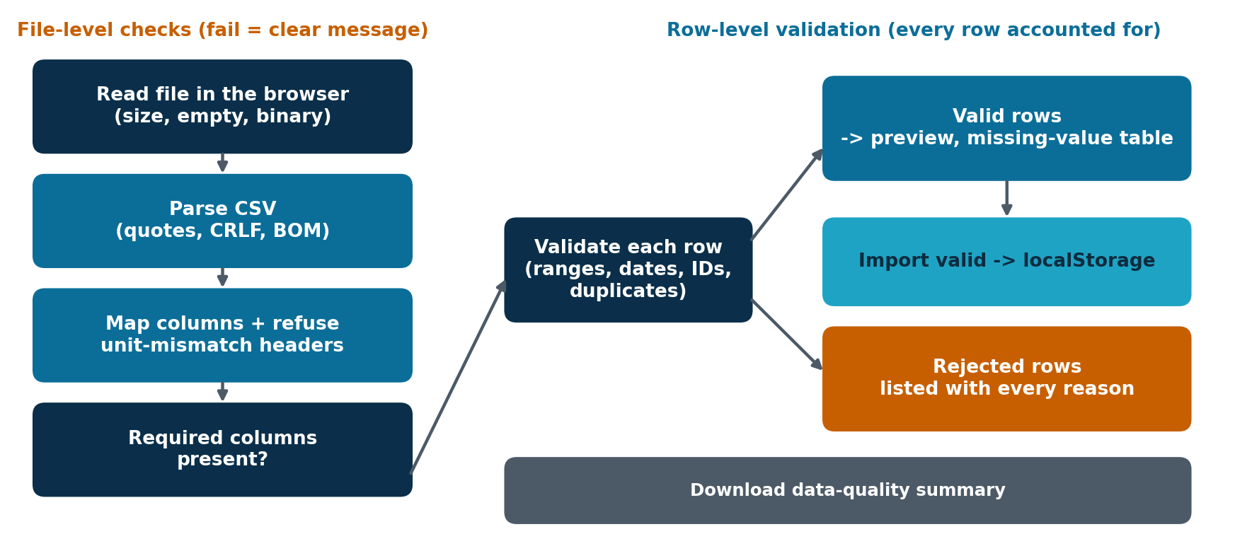
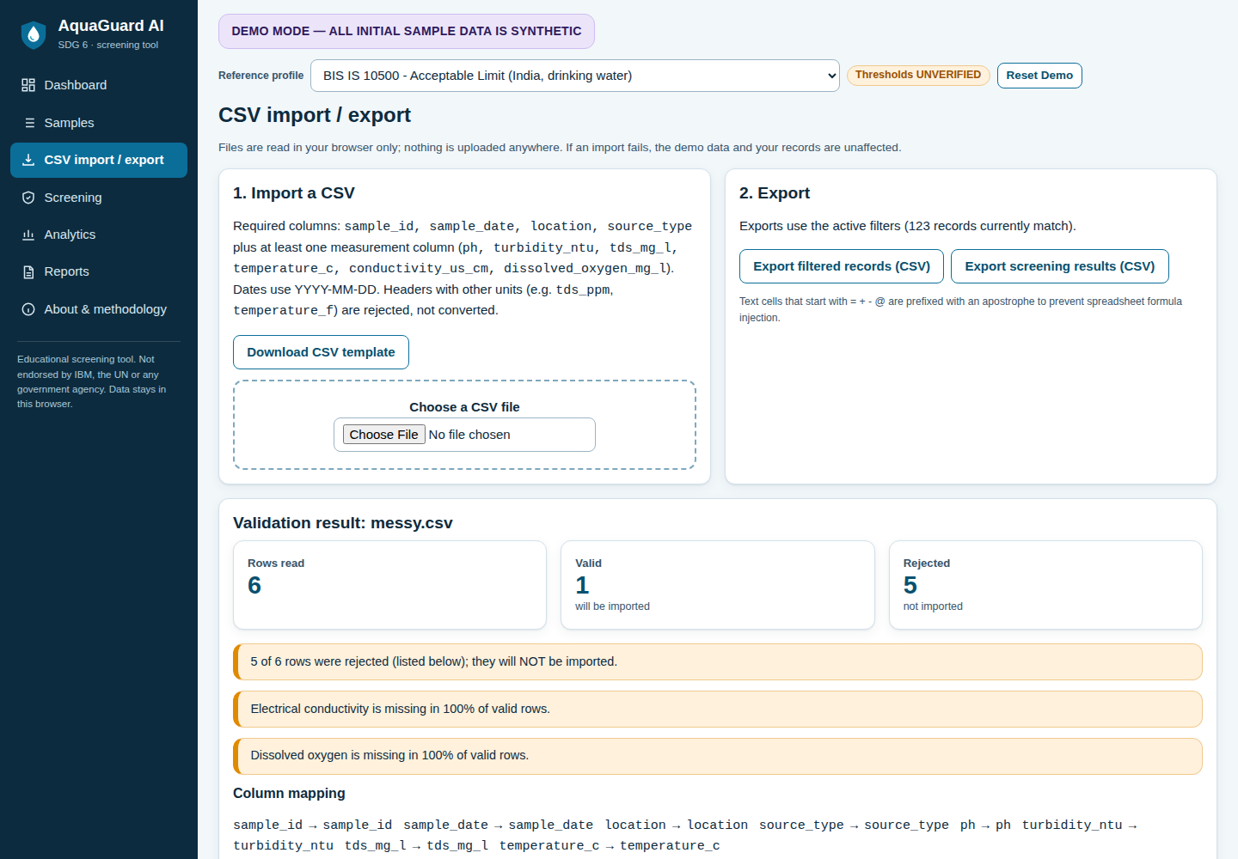
PRODUCT
CSV upload and validation workflow
Rejected rows are listed with every reason.
Headers like tds_ppm or temperature_f are refused, not converted.
Template download; data-quality summary download.
AquaGuard AI | IBM academic project | UN SDG 6 | Educational screening tool - not a safety certification. Not endorsed by IBM, the UN or any agency.
19
Notes:
Explain each safeguard. Fatal problems stop the import with a clear message; row-level problems are listed with reasons and never silently dropped; units are never converted. The demo data keeps working whatever happens to an upload.

Slide 20
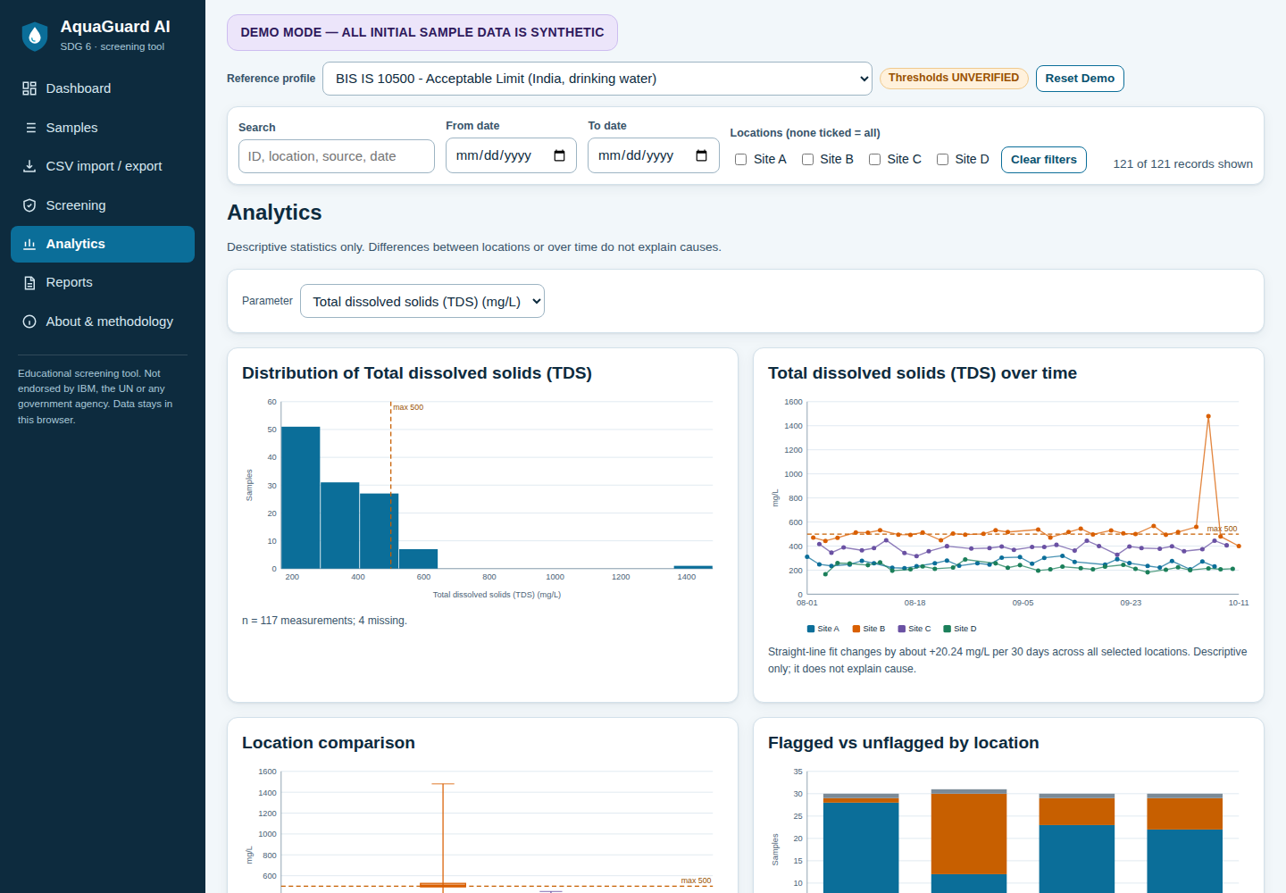
ANALYTICS
Analytics and outlier detection
Robust z-score (not ML)
z = 0.6745 x (value - median) / MAD
Flag when |z| >= 3.5 (adjustable), optionally within each location
Median/MAD are not distorted by the outliers they seek
Demo data: 5 unusual samples across all sites
Unusual does not mean contaminated or unsafe
Charts: distribution, trend, location box plot, status by site, missing data
AquaGuard AI | IBM academic project | UN SDG 6 | Educational screening tool - not a safety certification. Not endorsed by IBM, the UN or any agency.
20
Notes:
Charts update with the filters. Outlier detection uses a robust z-score from the median and MAD; the demo data yields 5 unusual samples at the default threshold. It is deliberately called a statistical outlier detector, not AI or machine learning, and an unusual value is not necessarily contaminated.

Slide 21
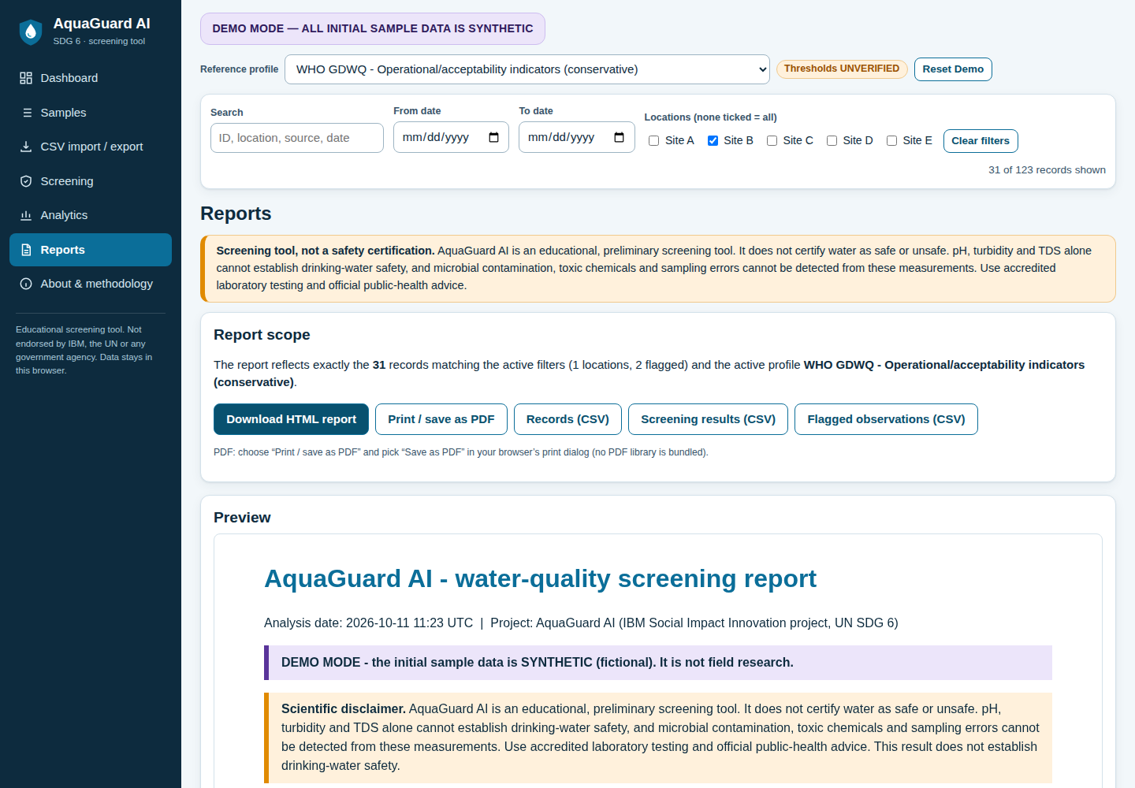
OUTPUT
Reporting and export
Exports
HTML report: sample details, profile, data quality, units, flags, charts, limitations, disclaimer
Print / save as PDF via the browser
CSV: filtered records, screening results, flagged observations
Data-quality summary (text)
Text cells are formula-injection safe
AquaGuard AI | IBM academic project | UN SDG 6 | Educational screening tool - not a safety certification. Not endorsed by IBM, the UN or any agency.
21
Notes:
Reports are generated in the browser from exactly the filtered records and the active profile. PDF is produced via the browser's print dialog because no PDF library could be bundled locally. The print dialog itself cannot be verified headlessly.

Slide 22
QUALITY
Testing strategy and actual results
75
46
0
unit checks passed
(validation, screening, storage, reports)
browser checks passed
(real Chromium, file://)
failures and 0 console errors
during the browser session
Verified
NOT verified
Add / edit / delete, persistence, reset
CSV valid, messy, empty, unit, binary files
Filters, search, sorting, charts, outliers
Reports and exports; offline (0 requests)
Mobile layout at 390 px; keyboard and labels
Safari and Firefox
Live print dialog / PDF output
Real phones; screen-reader audit
Thresholds against live standards
Any real-world pilot
AquaGuard AI | IBM academic project | UN SDG 6 | Educational screening tool - not a safety certification. Not endorsed by IBM, the UN or any agency.
22
Notes:
All numbers come from tests/results.json written by the test runners. Unit tests (75 checks) run the logic modules in Node; the browser suite (46 checks) drives index.html via file:// in headless Chromium. Not verified: Safari, Firefox, the live print dialog, real mobile devices, accessibility audit with a screen reader, and thresholds against live sources.

Slide 23
VALUE
Advantages, disadvantages and practical use cases
Advantages
Disadvantages
Use cases
Opens by double-click
Private: no data leaves the browser
Validation before analysis
Transparent, auditable rules
Six parameters only
Browser-local storage (per browser)
Thresholds unverified
No sharing or multi-user mode
Teaching data literacy
Community monitoring logs
Preparing a lab-test request
Demonstrating screening logic
Compared with manual interpretation: consistent rules, early data-quality checks, trends and exports. Not compared: accuracy of conclusions, because none was measured.
AquaGuard AI | IBM academic project | UN SDG 6 | Educational screening tool - not a safety certification. Not endorsed by IBM, the UN or any agency.
23
Notes:
Give a balanced view. The advantages are real but small in scope; the disadvantages are important for an honest evaluation.

Slide 24
RESPONSIBILITY
Privacy, security, ethics and limitations
Privacy
Security
No accounts, no personal data, no network calls; data stays in this browser's localStorage.
Files parsed as text only; size limits; all output HTML-escaped; CSV formula injection neutralised.
Ethics
Limitations
Never labels water safe/unsafe; synthetic data always labelled; no endorsement claimed.
Few parameters; no microbiology or toxic chemicals; unverified thresholds; tested in Chromium only.
AquaGuard AI | IBM academic project | UN SDG 6 | Educational screening tool - not a safety certification. Not endorsed by IBM, the UN or any agency.
24
Notes:
Cover each quadrant. The key ethical point is that the app must not be mistaken for a safety certificate, so it uses fixed wording, prominent disclaimers and no green badge.

Slide 25
FUTURE
SDG impact pathway and future scope
Clearer interpretation
Better follow-up
Earlier attention
Possible SDG 6 benefit
Readings are validated and explained
Users know when lab testing is warranted
Drifting sites are noticed sooner
Requires action by water managers; not claimed
▶
▶
▶
Realistic next steps
Evaluation plan (not yet done)
Verify every threshold against the sources
Test in Safari and Firefox; accessibility audit
Add parameters with documented criteria
Bundled PDF export
Pilot with 2-3 school/community monitors, with consent
Measure time to interpret, errors caught, comprehension
Compare with a spreadsheet baseline
AquaGuard AI | IBM academic project | UN SDG 6 | Educational screening tool - not a safety certification. Not endorsed by IBM, the UN or any agency.
25
Notes:
The pathway is a hypothesis, not a result. Make clear that no pilot has been run and none is claimed. Future work starts with verifying thresholds and testing in more browsers.

Slide 26
WRAP-UP
Conclusion and references
Conclusion
References (URLs not re-opened during build; verify):
UN SDG 6: https://sdgs.un.org/goals/goal6
WHO Guidelines for drinking-water quality, 4th ed. + addenda (2022): https://www.who.int/publications/i/item/9789240045064
WHO/UNICEF JMP: https://washdata.org
BIS IS 10500: https://www.bis.gov.in
CPCB: https://cpcb.nic.in
UN-Water SDG 6 Synthesis Report 2018: https://www.unwater.org/publications/highlights-sdg-6-synthesis-report-2018-water-and-sanitation
AquaGuard AI is a working, tested, double-click web app for transparent water-quality screening.
It validates data, explains flags and refuses to overclaim.
Its value for real users still has to be evaluated.
AquaGuard AI | IBM academic project | UN SDG 6 | Educational screening tool - not a safety certification. Not endorsed by IBM, the UN or any agency.
26
Notes:
Close by restating the contribution and the honest limits. All reference URLs were not re-opened during the build because the environment had no internet: verify them before presenting.

