Slide 1

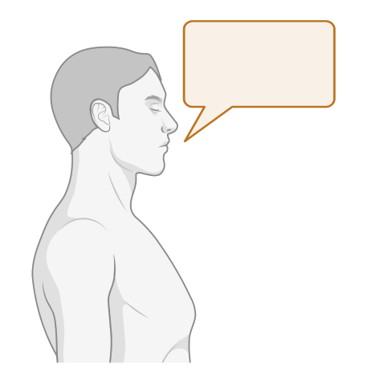
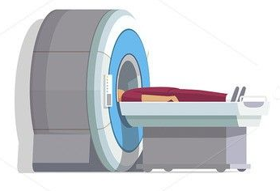
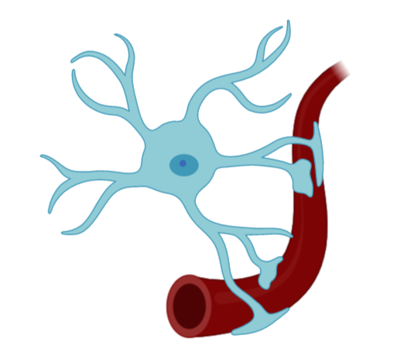
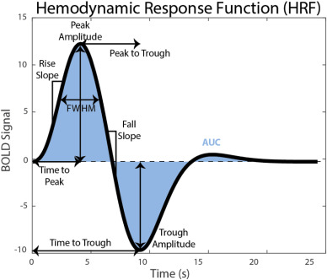
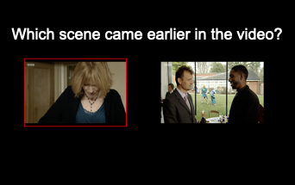

Protocol: Cognitive tasks
Neurovascular health
In the scanner
Haemodynamic response during cognitive task
We can use tasks to stimulate different brain regions and compare responses
Posterior Cingulate Cortex (PCC) during a memory task
Visual Cortex during visual checkerboard
Notes:
In the scanner, we will be using a memory task based on the video the participants watched at the start of the visit
We are using this particular test as it has been shown to specifically activate the posterior cingulate cortex
We will also use a visual stimulation task to compare responses in the posterior cingulate cortex to responses in the visual cortex
This allows us to get our measure of neurovascular coupling, as we can directly activate those brain regions and measure the blood flow response to neural activity in those regions
So we can investigate how the specific dynamics of the neurovascular response are affected, and relate these to differences we observe in physiology and cognitive performance

Slide 2
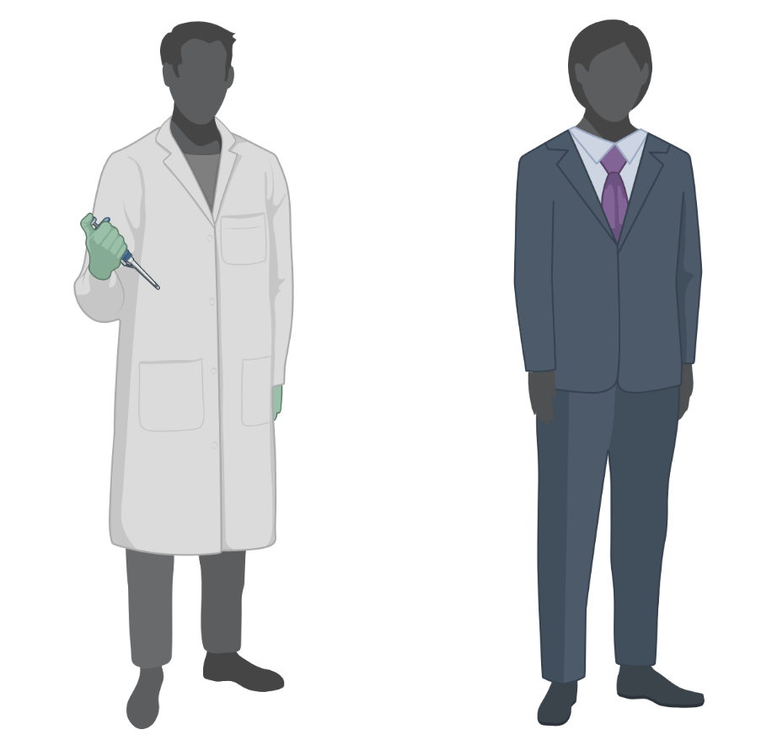

This is just the beginning… (we hope)
HOW do vascular factors affect the brain?
HOW do vascular factors affect the brain?
Can we spot it early?
And what can we do about it?
2021
Future
Notes:
So that summarises the HAVEN study that we’re embarking on now
But the hope is that this will open up continued collaborative schemes of work, and grant capture in the future
Which may allow us to ask and potentially answer the really important questions
If we know HOW vascular factors affect the brain, can we spot individuals at risk early, and can we target interventions to prevent decline

